Slide 1
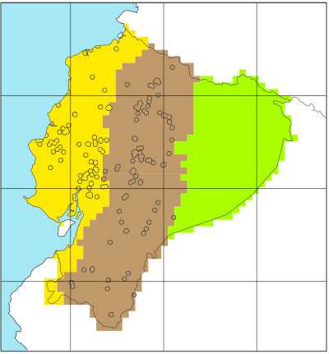
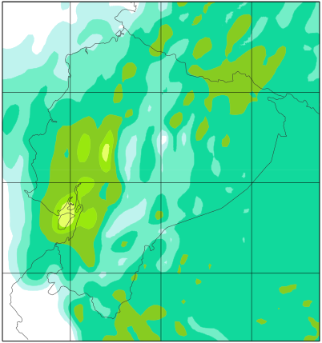
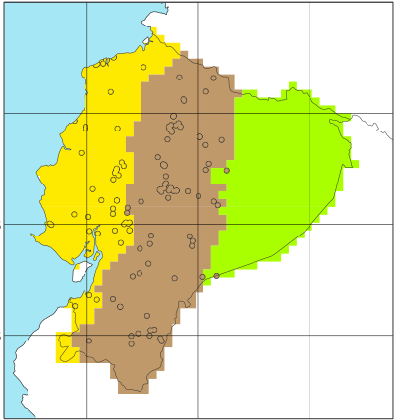
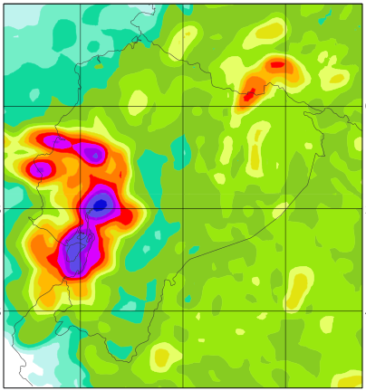
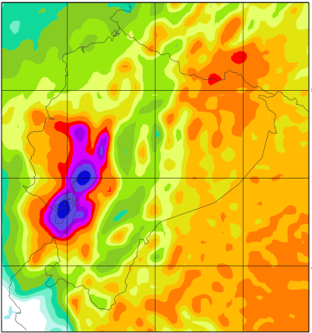
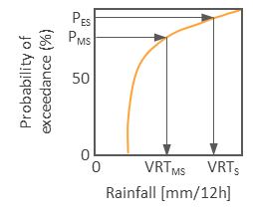
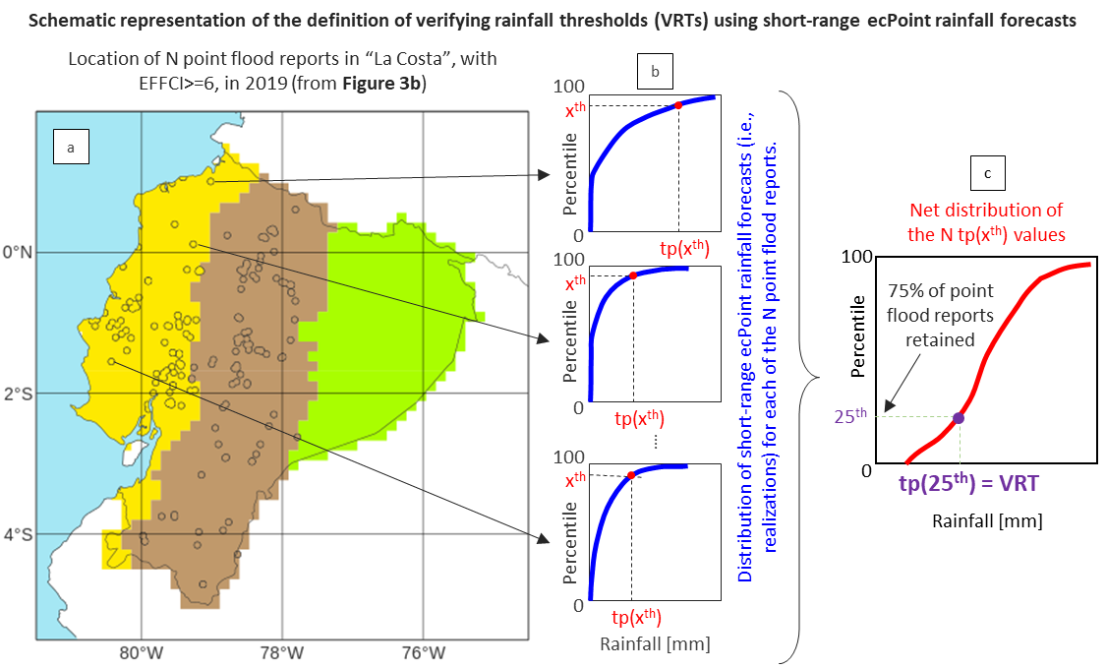
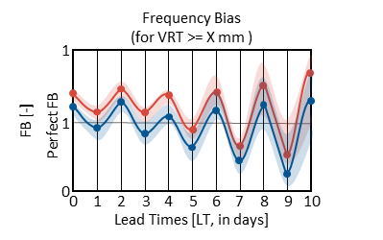
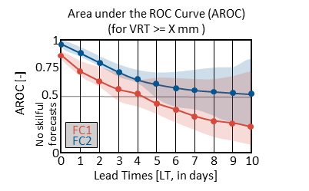
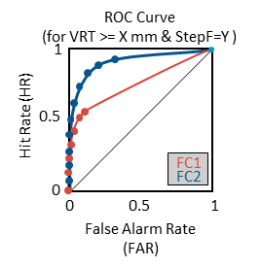
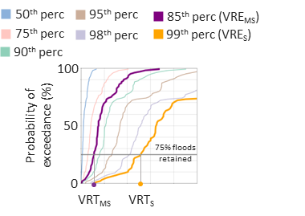
Definition of Verifying Rainfall Thresholds (VRTs)
START: analyse performance of rainfall forecasts (FC) in identifying areas at risk of flash floods.
Objective verification analysis
STOP
NO
Have point flash flood reports (FFR) for year X?
NO
Are VRTs known?
YES
Read VREs
STOP
YES
NO
Have FFR for year Y?
Read point FFRs for year X
Figure 2a & 2b
Figure 2c & 2d
Figure 3b
YES
FC1
FC2
Have point-rainfall observations (tp obs) associated with FFRs?
Read tp obs
Read flash flood reports
Read FC1 and FC2.
YES
Figure 3e
Create distribution of tp obs associated with FFR and select percentiles P_{MS} and P_{S} defining VRTs associated with moderately-severe (VRT_{MS}) and severe (VRT_{S}) flash floods.
NO
Create observational fields, for different VREs and accumulation periods, up to medium-range leads.
Create forecasts fields, for different VREs and accumulation periods, up to medium-range leads.
Read short-range ecPoint rainfall forecasts
Define VRTs using short-range ecPoint-Rainfall forecasts.
Figure 2c & 2d
Calculation of forecast reliability Compute Frequency Bias for different VRTs.
Calculation of forecast discrimination ability
Compute ROC curves for different VRTs and accumulation periods, and Areas under the ROC curve (AROC) for different VRTs.
Section 4.2.1
Section 4.2.2
Section 4.1 & Figure 6
Section 5.2.1 & Figure 7
Section 5.2.2 & Figure 9
Section 5.2.2 & Figure 10
Section 5.1 & Figure 7
END

Slide 2
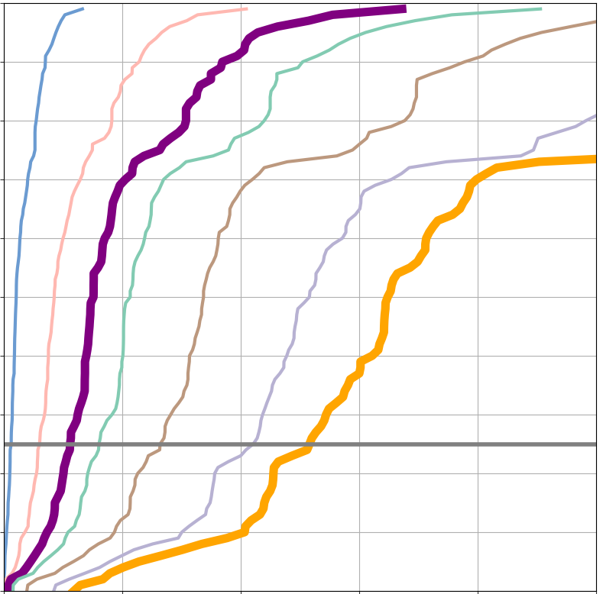
50th perc
95th perc
85th perc (VRE_{MS})
75th perc
99th perc (VRE_{S})
90th perc
98th perc
100
Probability of exceedance (%)
100
Probability of exceedance (%)
P_{ES}
P_{MS}
50
50
_{75% floods retained}
0
0
0
VRT_{MS}
VRT_{S}
VRT_{MS}
VRT_{S}
Rainfall [mm/12h]
ROC Curve
(for VRT >= X mm & StepF=Y )
Area under the ROC Curve (AROC)
(for VRT >= X mm )
Frequency Bias
(for VRT >= X mm )
Hit Rate (HR)
1
1
FB [-]
1
AROC [-]
0.75
0.5
1
0.5
Perfect FB
FC1
No skilful forecasts
FC2
FC1
0
0
FC2
0
1
2
3
4
5
6
7
8
9
10
0
0.5
1
0
0
1
2
3
4
5
6
7
8
9
10
Lead Times [LT, in days]
False Alarm Rate (FAR)
Lead Times [LT, in days]

