Slide 1
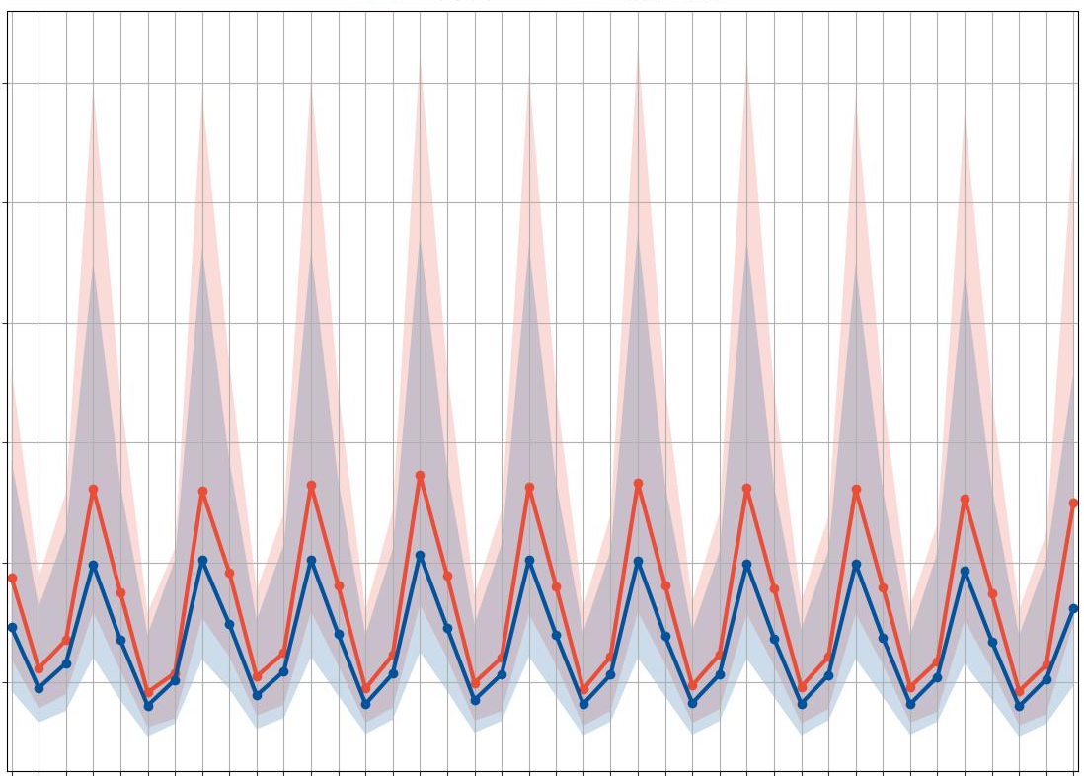
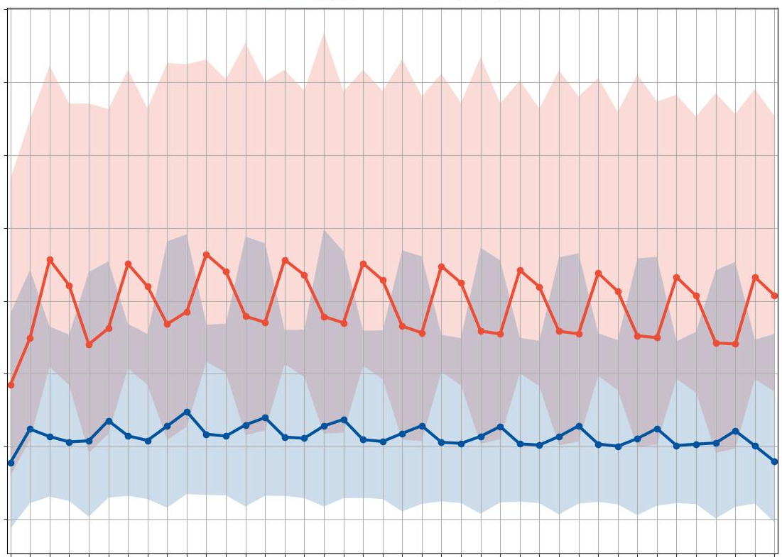
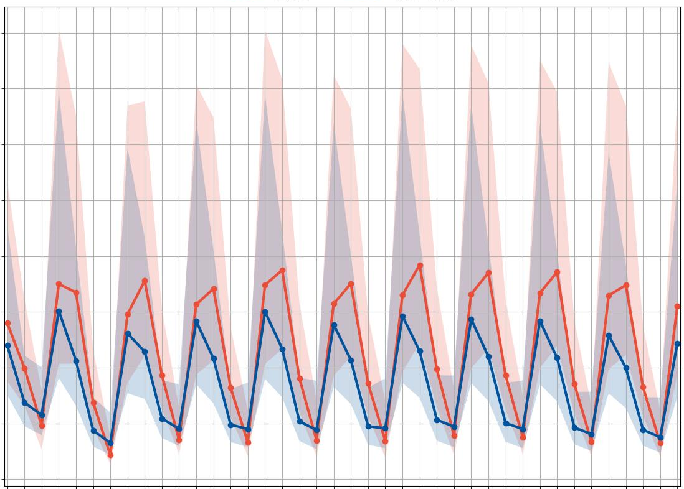
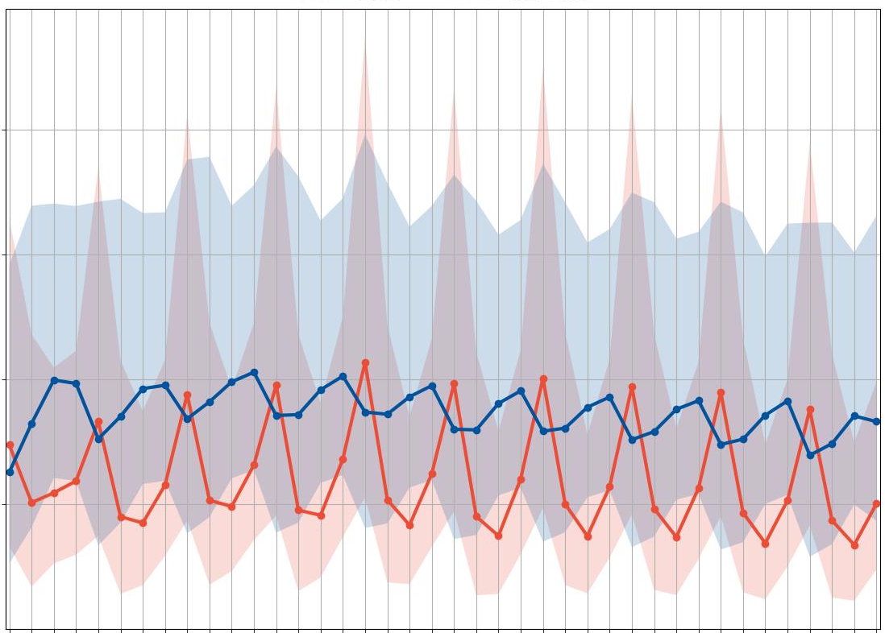
Frequency Bias (FB)
FB
95% CI
12-hourly accumulation periods
ENS
Nighttime
Daytime
ecPoint
0000 – 1200 UTC (1800 – 0600 LT)
1200 – 0000 UTC (0600 – 1800 LT)
0600 – 1800 UTC (0000 – 1200 LT)
1800 – 0600 UTC (1200 – 0000 LT)
La Costa
La Sierra
1200
a
VRT_{MS} = 10 mm/12h
2000
c
VRT_{MS} = 6 mm/12h
1000
1750
800
1500
Better score
FB [-]
1250
600
tp >= VRT_{MS}
1000
400
Over-forecast
750
200
500
FB=1, Perfect FB
12
24
36
48
60
72
84
96
108
120
132
144
156
168
180
192
204
216
228
12
240
24
36
48
60
72
84
96
108
120
132
144
156
168
180
192
204
216
228
240
18
30
42
54
66
78
90
102
114
126
138
150
162
174
186
198
210
222
234
18
246
30
42
54
66
78
90
102
114
126
138
150
162
174
186
198
210
222
234
246
80
b
VRT_{S} = 50 mm/12h
d
VRT_{S} = 26 mm/12h
70
1250
60
50
200
Better score
FB [-]
40
tp >= VRT_{S}
150
30
Over-forecast
20
100
10
FB=1, Perfect FB
0
12
24
36
48
60
72
84
96
108
120
132
144
156
168
180
192
204
216
228
12
240
24
36
48
60
72
84
96
108
120
132
144
156
168
180
192
204
216
228
240
18
30
42
54
66
78
90
102
114
126
138
150
162
174
186
198
210
222
234
18
246
30
42
54
66
78
90
102
114
126
138
150
162
174
186
198
210
222
234
246
Lead time steps for the 00 UTC run and at the end of the
12-hourly accumulation periods [in hours]
Lead time steps for the 00 UTC run and at the end of the
12-hourly accumulation periods [in hours]
D1
D2
D3
D4
D5
D6
D7
D8
D9
D1
D10
D2
D3
D4
D5
D6
D7
D8
D9
D10
Lead times (in days)
Lead times (in days)

