Slide 1
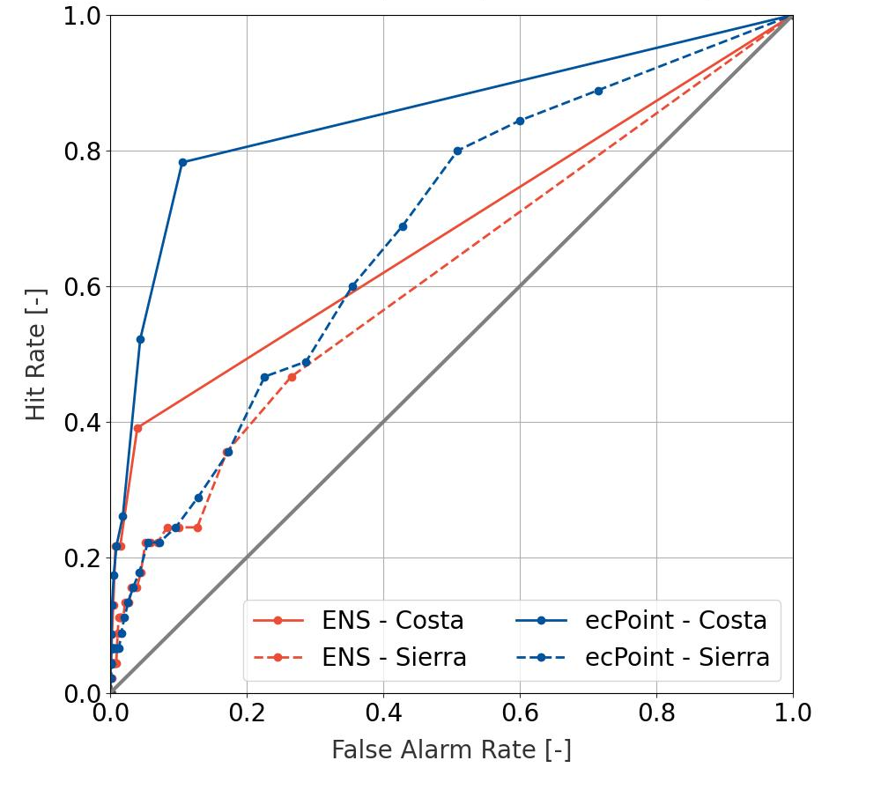
ROC curves for (t+60,t+72)
EFFCI>=6, tp>=VRT_{S}
Costa: VRT_{S} = 50 mm/12h
Sierra: VRT_{S} = 26 mm/12h

