Slide 1
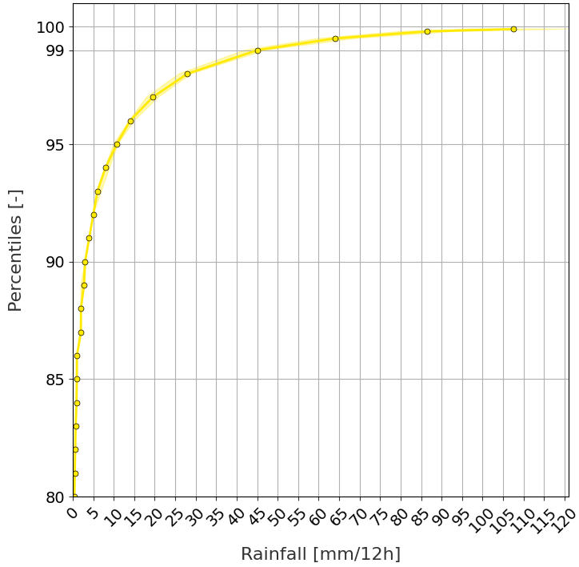
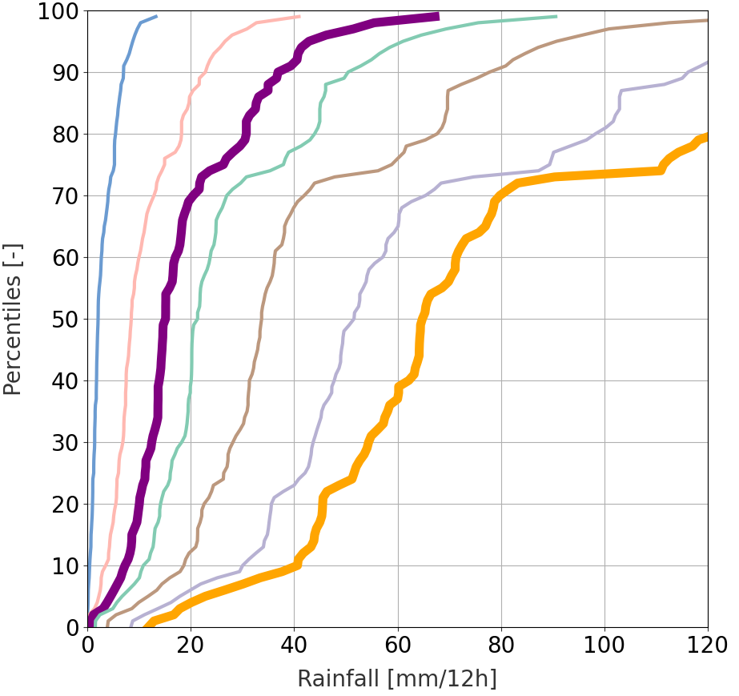
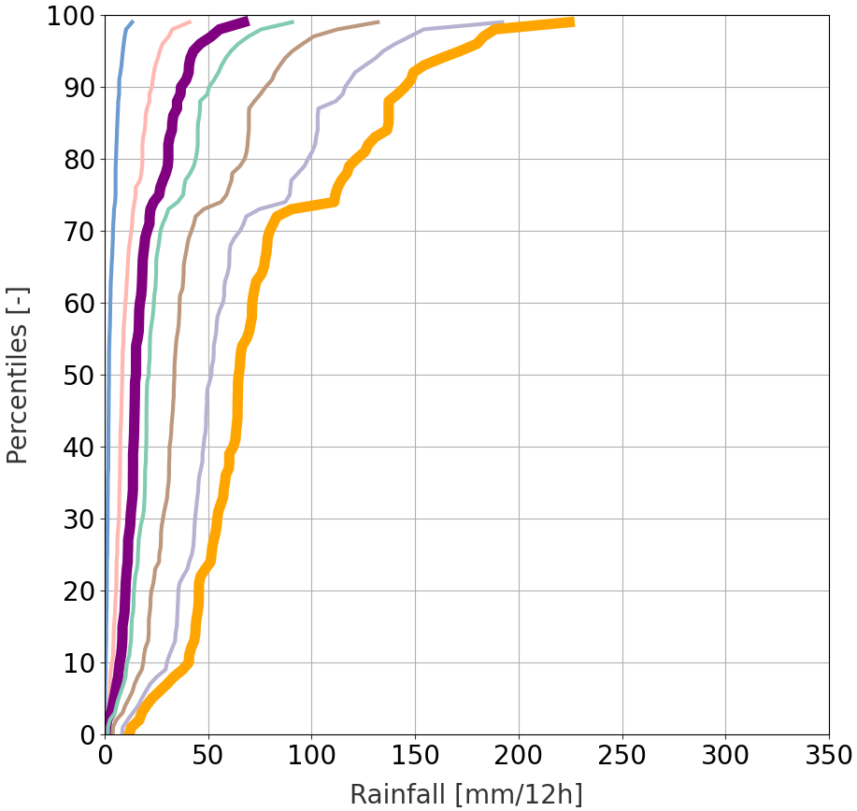
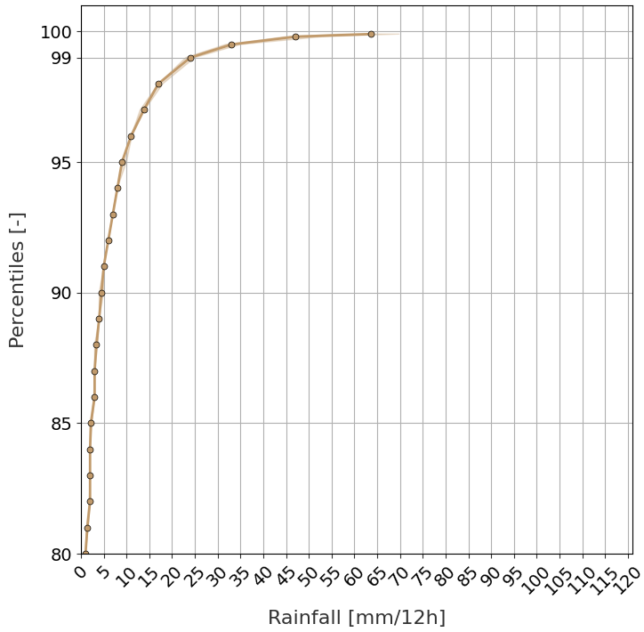
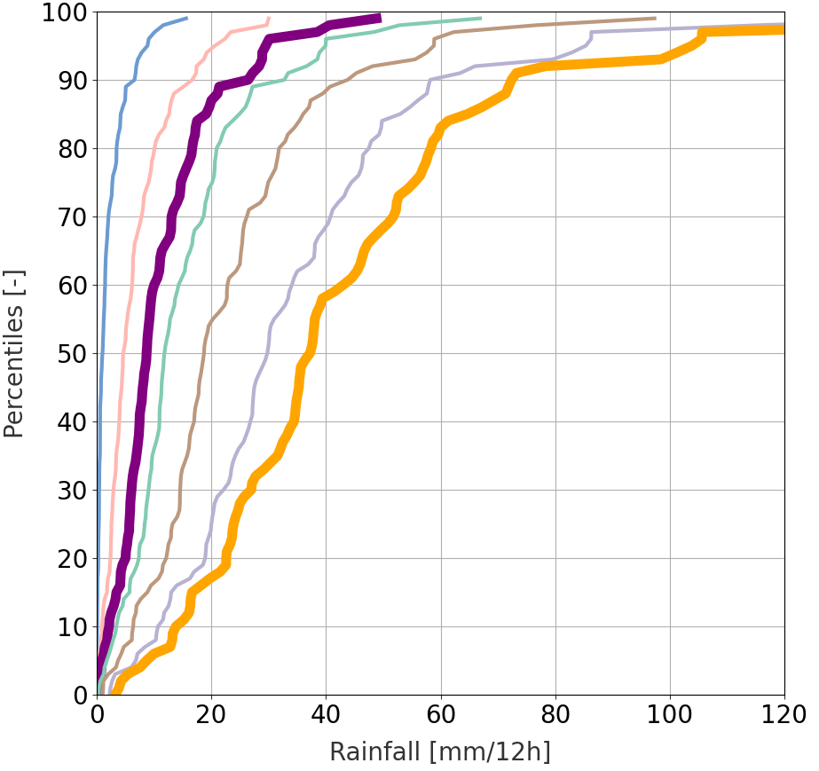
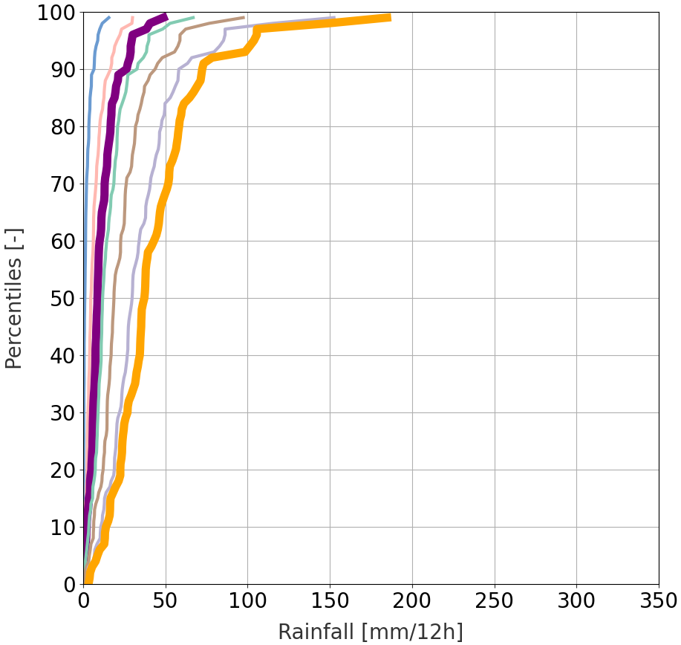
Observational rainfall climatology
from 2010-01-01 to 2019-12-31
Verifying Rainfall Thresholds (VRT)
95% CI
Net distributions of tp(x^{th} perc) values from short-range ecPoint rainfall forecasts
Climatology
La Costa
50th perc
75th perc
85th perc
VRT_{MS}
La Sierra
90th perc
95th perc
98th perc
VRT_{S}
Moderately severe rainfall events
99th perc
Severe rainfall events
a
c
b
La Costa
Top ¾ flood events
d
f
e
La Sierra
Top ¾ flood events

