Slide 1
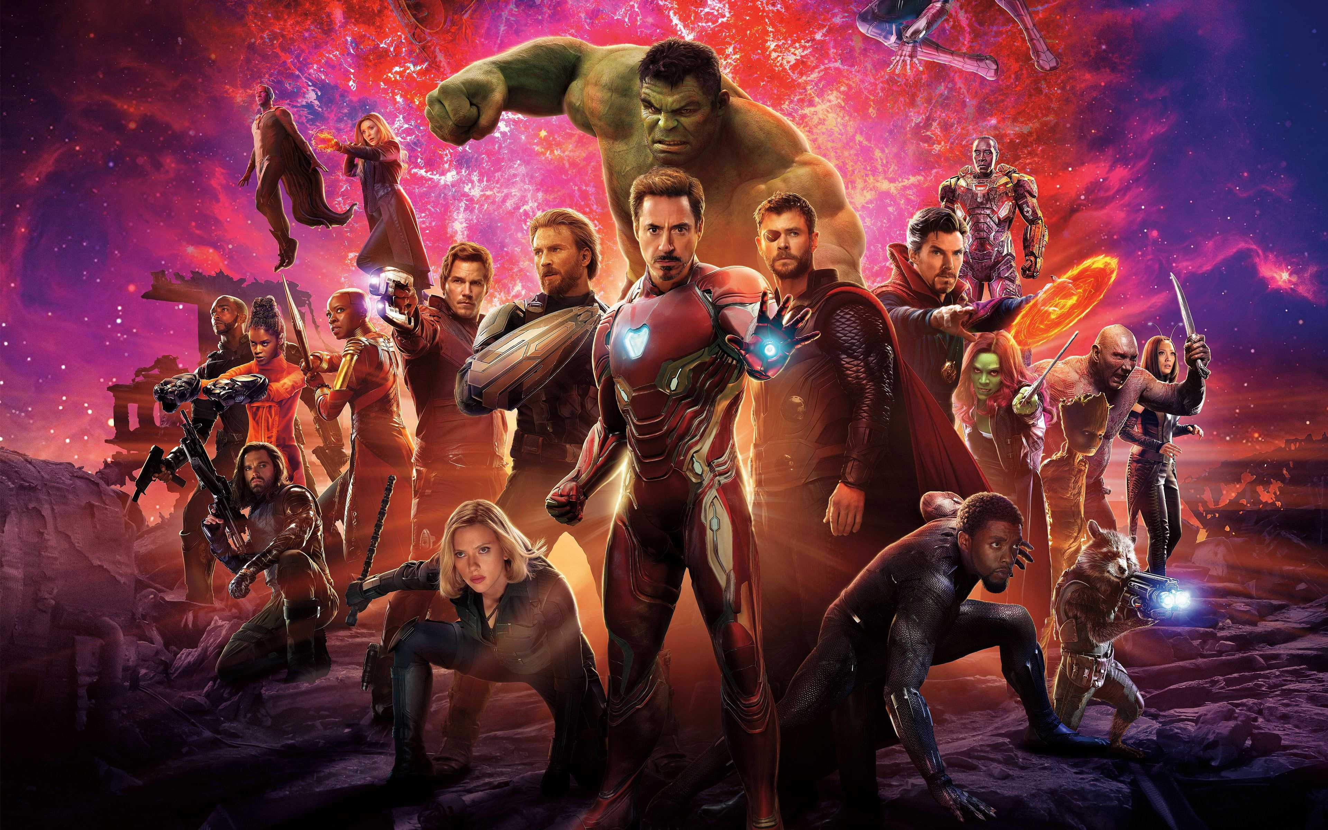
Shang-Chi: Advertisement Strategy Recommendations
Exploratory Data Analysis for MTA turnstile data and Marvel Universe

Slide 2
introduction

Slide 3






Methodology
Tools:
Data Sources:
Marvel Cinematic Universe movies Dataset
MTA Turnstile Data

Slide 4
Data cleaning and preprocessing
Marvel dataset:
Formatting and types
Dropped unwanted features
outliers
MTA dataset:
Formatting and types
Dropped recovered data
Dropped duplicates
Delt with negative values
Outliers

Slide 5
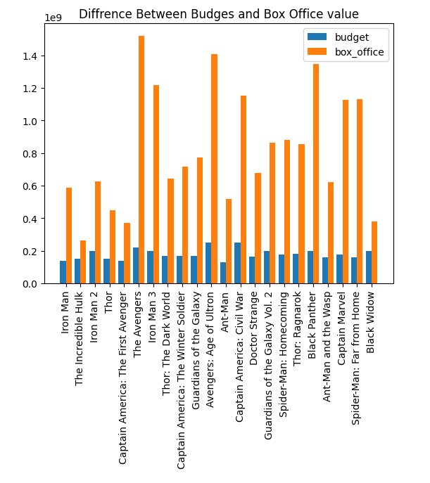
Marvel Dataset results

Slide 6
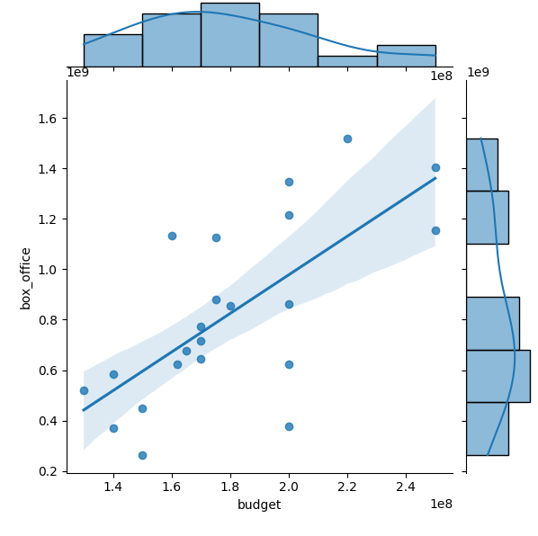
Marvel Dataset results

Slide 7
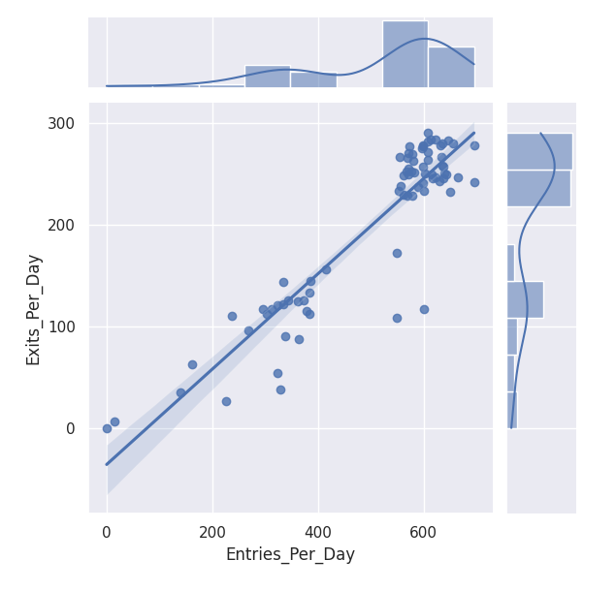
MTA Dataset results

Slide 8
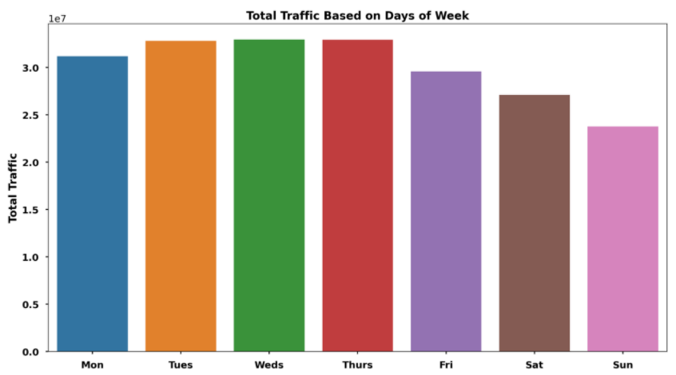
MTA Dataset results

Slide 9
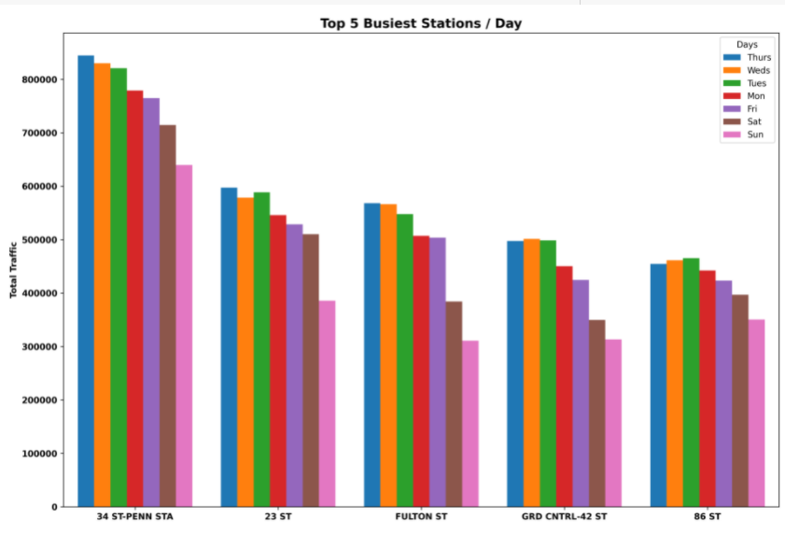
MTA Dataset results

Slide 10
Conclusion and recommendations

Slide 11
References
Wikipedia and IMDB
http://web.mta.info/developers/turnstile.html
https://www.kaggle.com/prashantk93/marvel-cinematic-universe-movies-dataset/version/5
https://clutch.co/agencies/resources/how-consumers-view-advertising-survey-2017
https://www.indoormedia.com/blog/how-many-times-do-customers-have-to-see-an-ad
https://medium.com/stronger-content/how-long-does-a-digital-ad-really-need-to-be-visible-on-screen-to-get-counted-as-a-one-second-3382aae0ec9b

Slide 12

Thank you

