Slide 1












Cabinet Médical App
Simplifying Healthcare Management

Slide 2
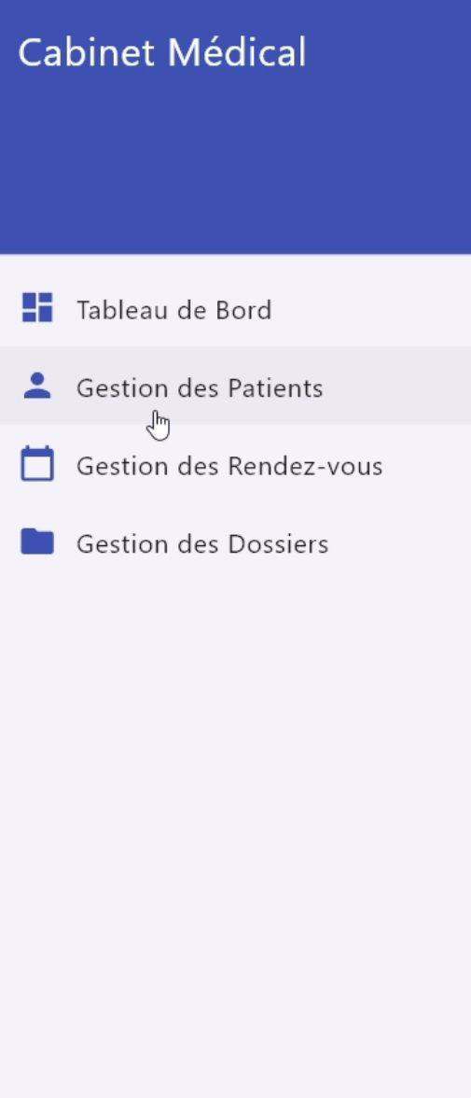


Introduction
What is Cabinet Médical App?
A Flutter-based application designed to manage patient records, appointments, and files.
Offers a user-friendly interface for healthcare professionals.

Slide 3
Key Features
02
Patient Management
01
Dashboard
Appointment Scheduling
File Management
03
04

Slide 4
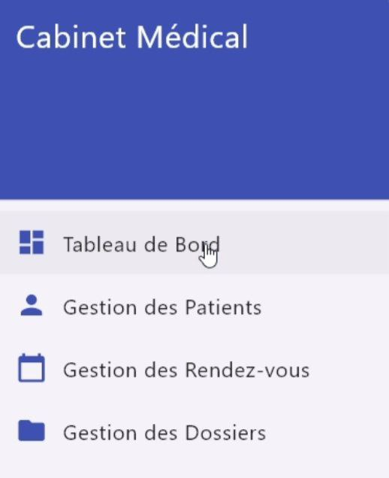


Dashboard
01

Slide 5
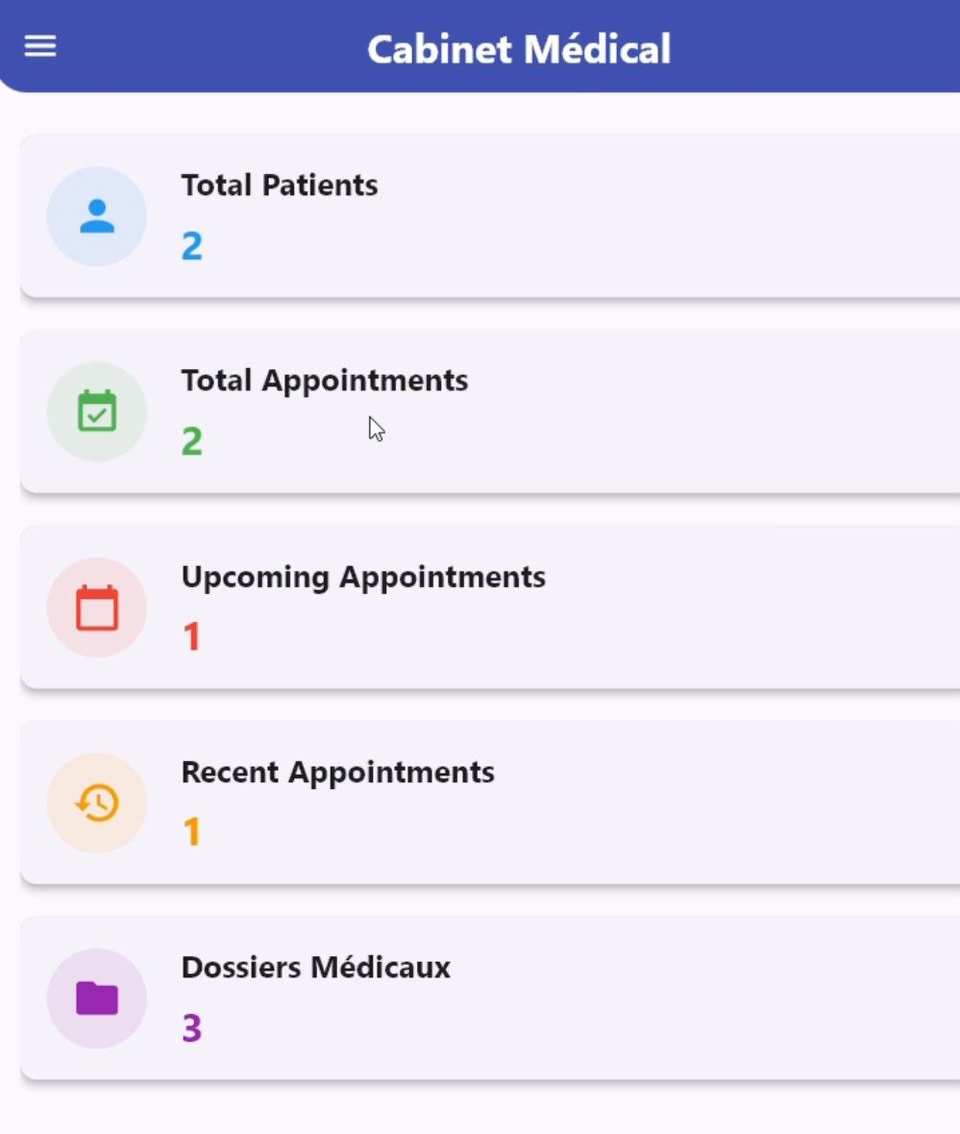
Real-Time Insights
View key statistics at a glance:
• Number of patients
• Scheduled appointments
• Recent file updates

Slide 6
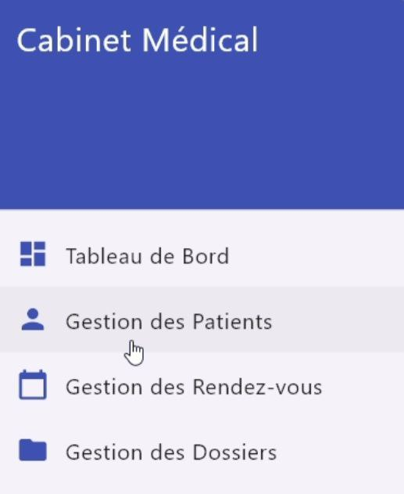
Patient Management
02

Slide 7
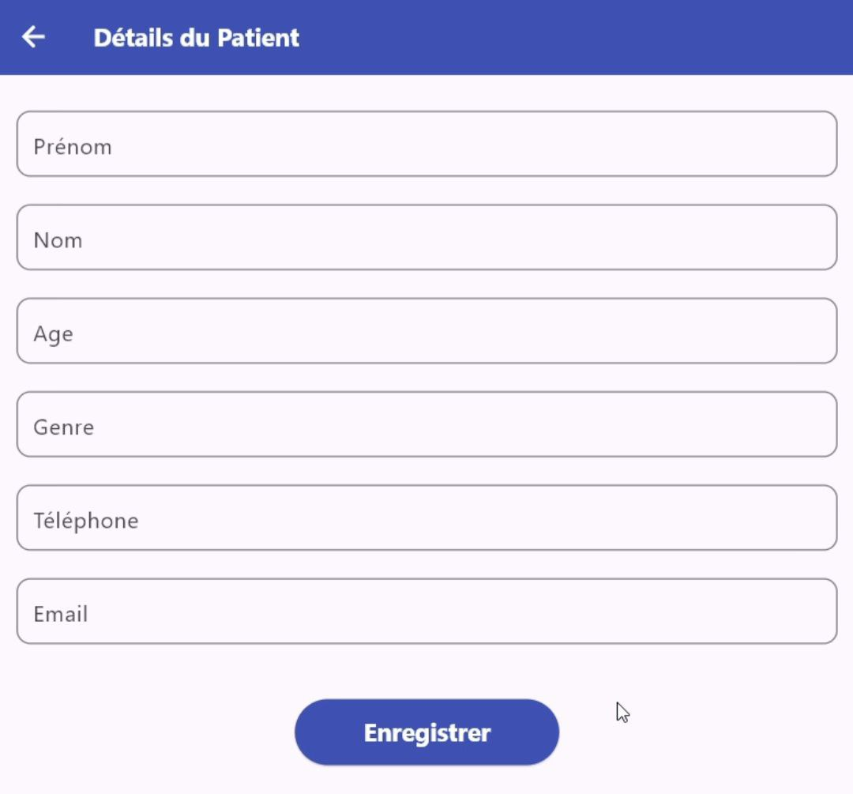
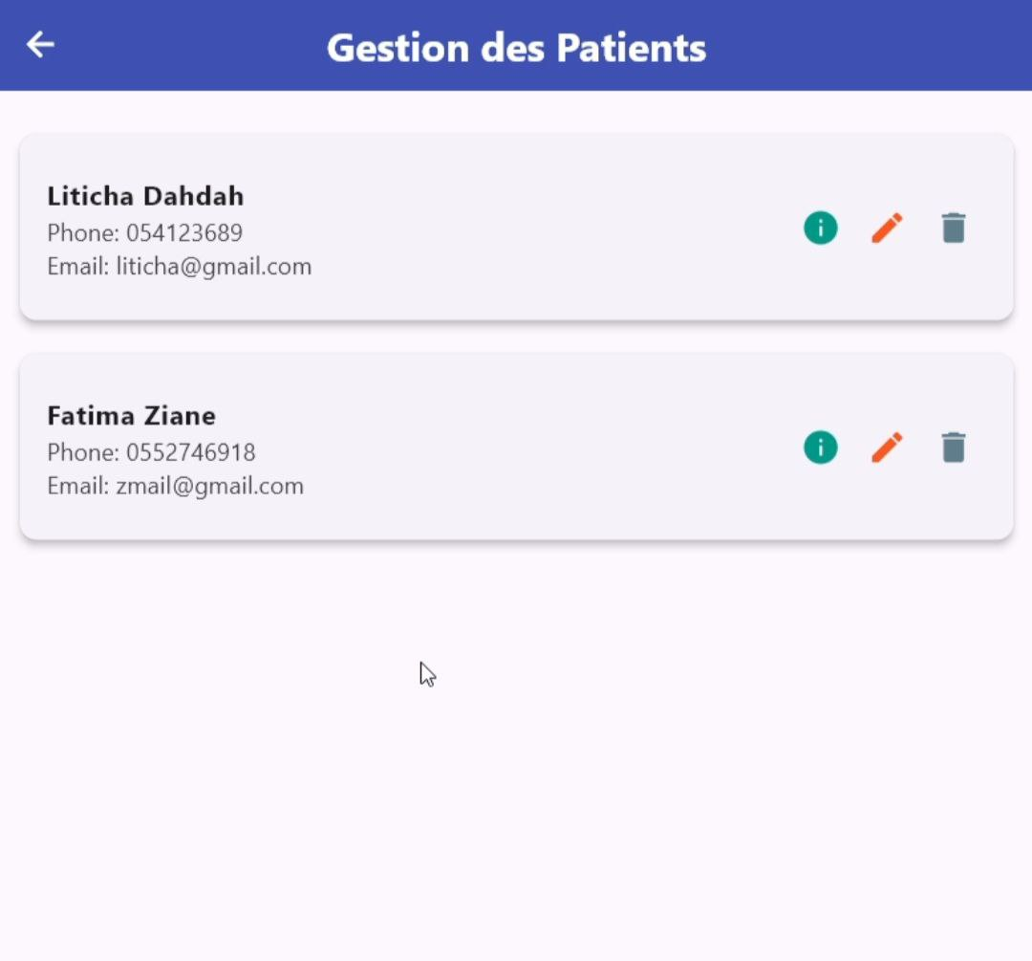
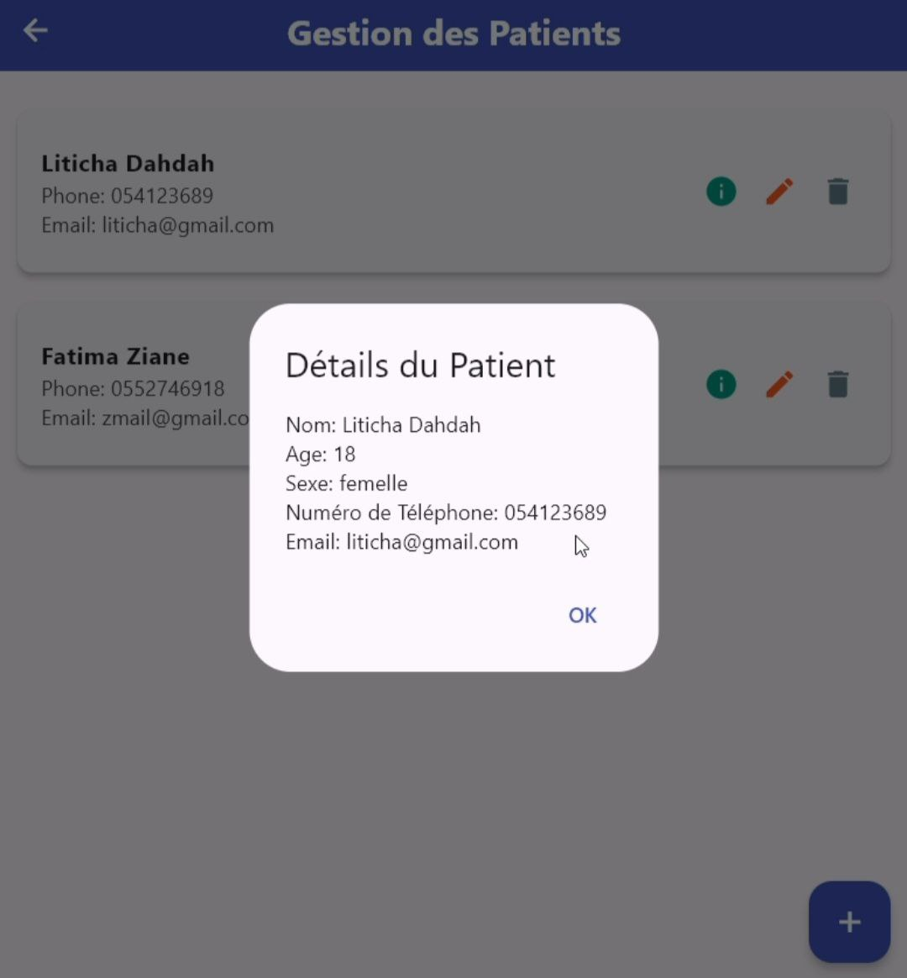
Manage Patients Seamlessly
Add, edit, or delete patient records.
See all the patients organized in a list
Details window for patient's important details

Slide 8
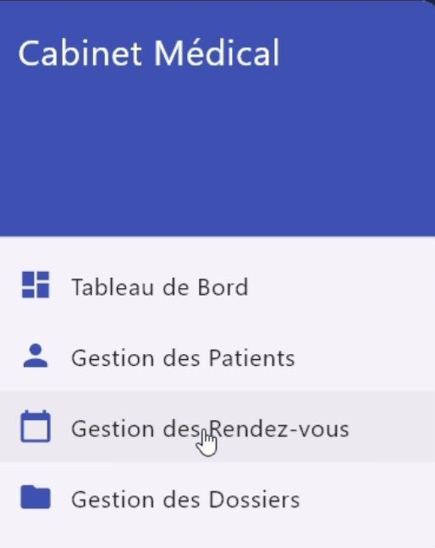
Appointment Scheduling
03

Slide 9
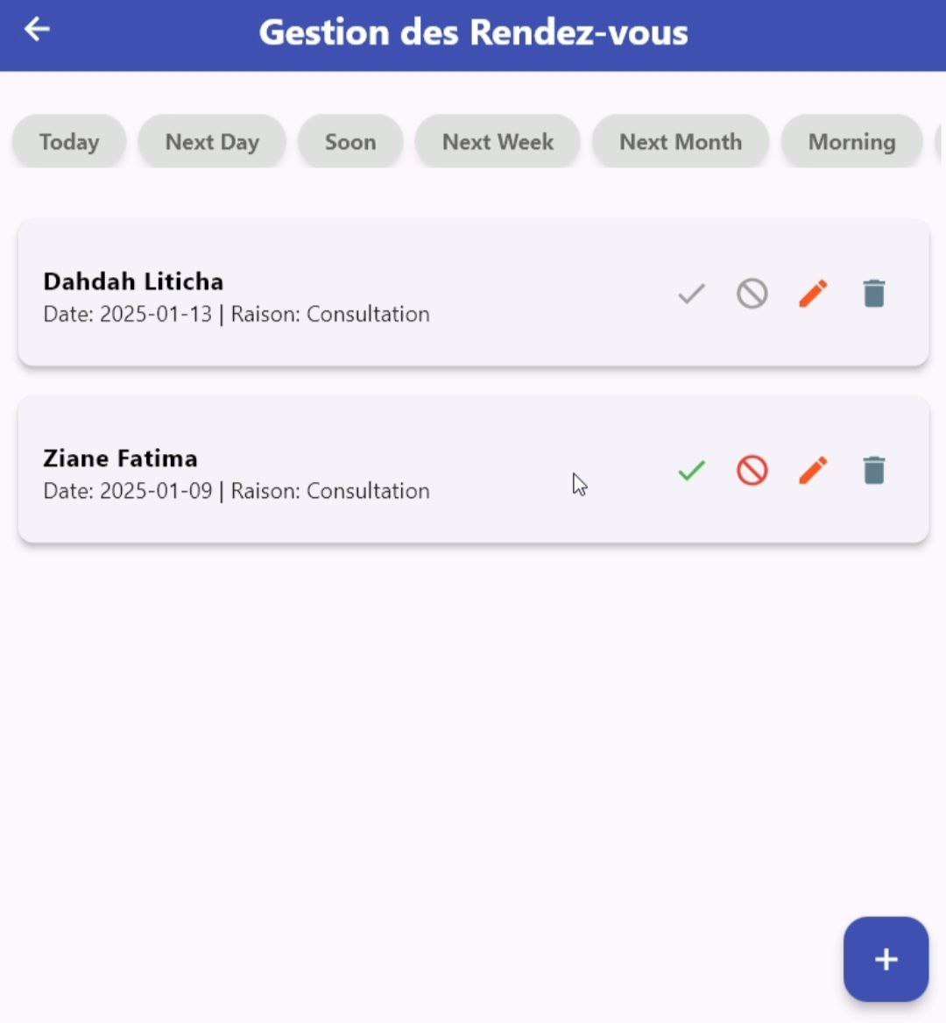
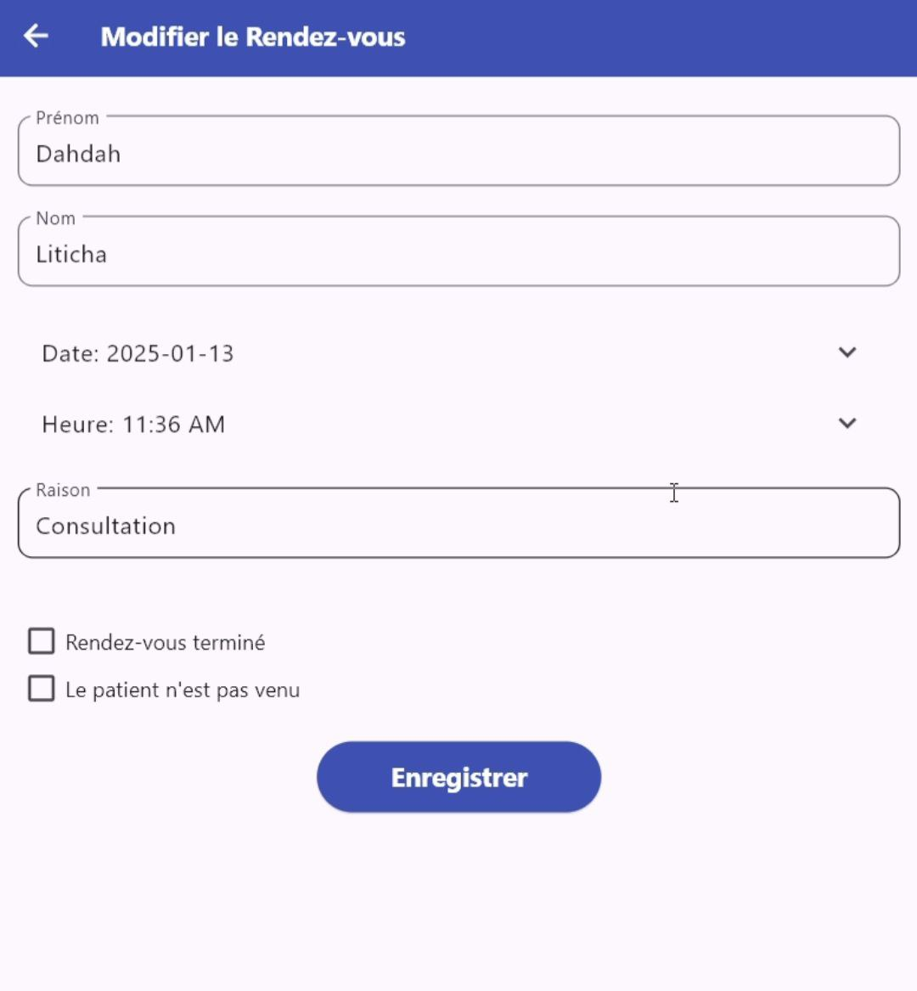
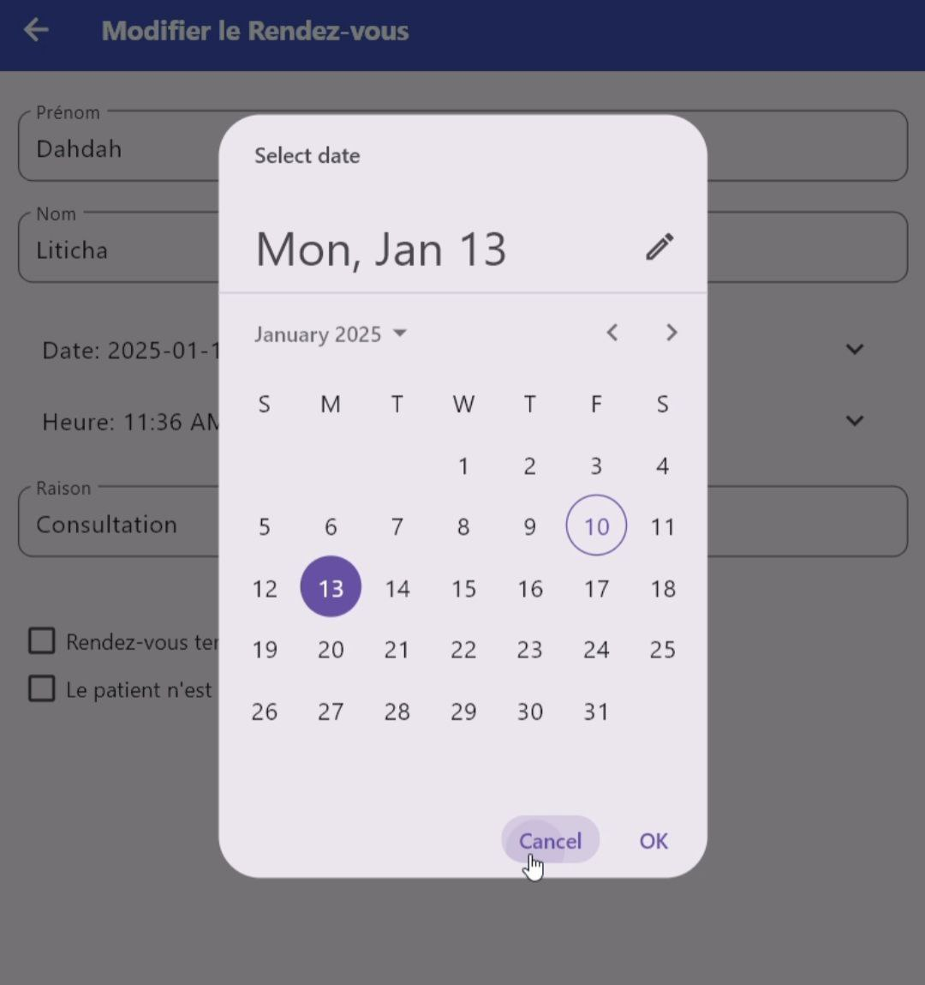
Stay on Top of Appointments
See all the appointments organized in a list with a filter for more structured searching
Schedule, track, and manage appointments.
Simple, calendar-based interface

Slide 10
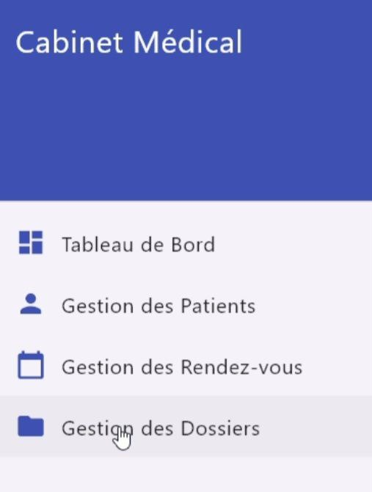
File Management
04

Slide 11
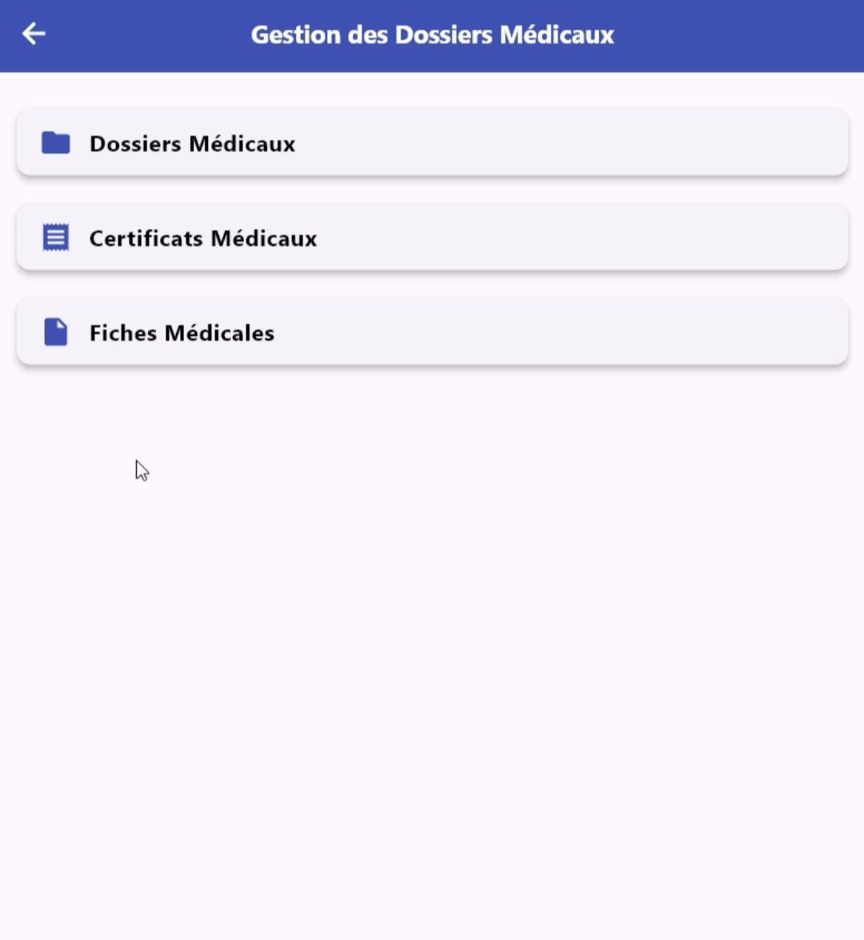
Secure Patient File Management
• Medical folders
• Medical certificates
• Medical files

Slide 12
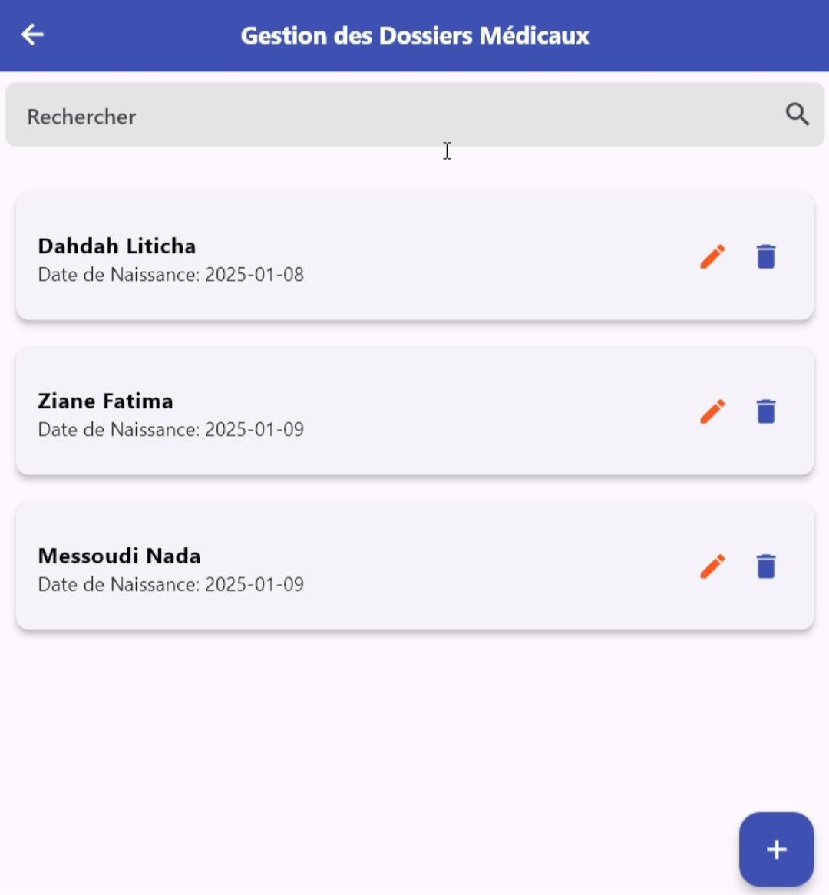
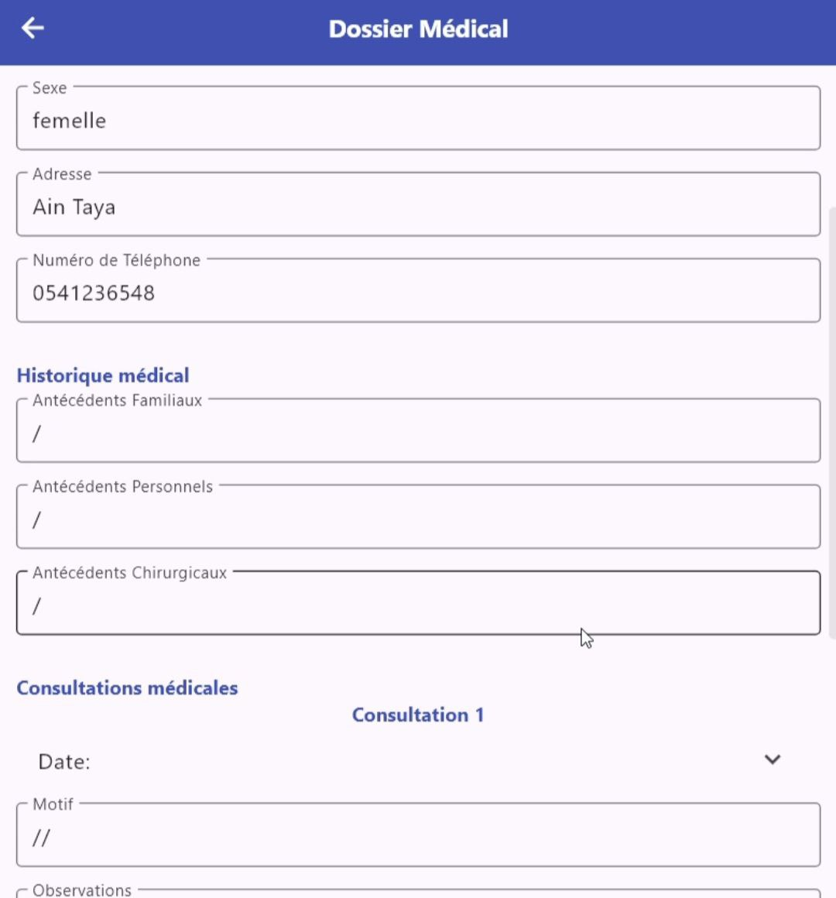
EXAMPLE : Medical folders Management
See all the folders organized in a list with a filter for more structured searching
Upload, organize, and access files efficiently.

Slide 13


Why Flutter?
• Cross-platform functionality: Android, iOS, and Web.
• High performance and seamless UI/UX.
• Easy to maintain and update.

Slide 14
Team Contributions
ZIANE FATIMA ZOHRA
DAHDAH LETICIA
232337422719
232331425902
LOUAIL WISSAM
MOUSSAOUI MERIEM NADA
232331500218
232331432803

Slide 15
Thank you !

