Slide 1


Medical Cost Prediction
Fatima Ahmed (509635) · Maryam Asif (507587)
Statistical analysis of patient factors and annual healthcare expenditure (N = 5,000)
Notes:
1

Slide 2

Problem & Objectives
Goal
Data
Explain drivers of annual medical cost; predict high‑cost profiles
5,000 patients, 20 variables (demographic, clinical, lifestyle, financial)
Key Objectives
Distribution fitting; ANOVA; Multiple regression on log-cost; Nonparametric validation
Notes:
2

Slide 3

Dataset & Quality
Highlights
  5,000 records; 20 features; no missing values, no duplicates
  Target: annual_medical_cost (USD)
  Key categorical: smoker, insurance_type, physical_activity_level, city_type
  Log-transform applied to cost (right-skewed)
Notes:
3

Slide 4

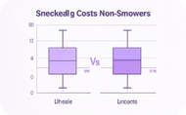
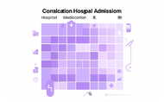
Exploratory Findings
Distribution
Smokers
Correlations
Cost highly right-skewed; wide variance (mean ≈ $8,048.89, SD ≈ $7,071.02)
Higher median and IQR for smokers (visual + Mann-Whitney result)
Hospital admissions, medication count, previous year cost ↑ strongest positive correlations
Notes:
4

Slide 5
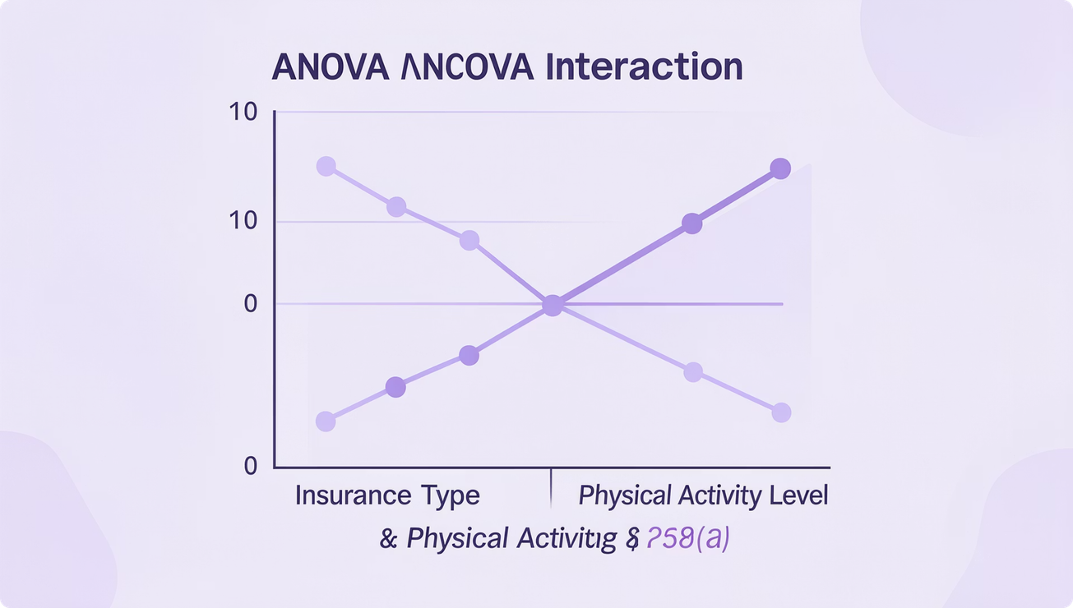
ANOVA Group Differences
One‑Way
Insurance type → significant differences in mean cost (ANOVA F, p < 0.05)
Two‑Way
Insurance × Physical Activity interaction significant (p < 0.001)
Notes:
5

Slide 6
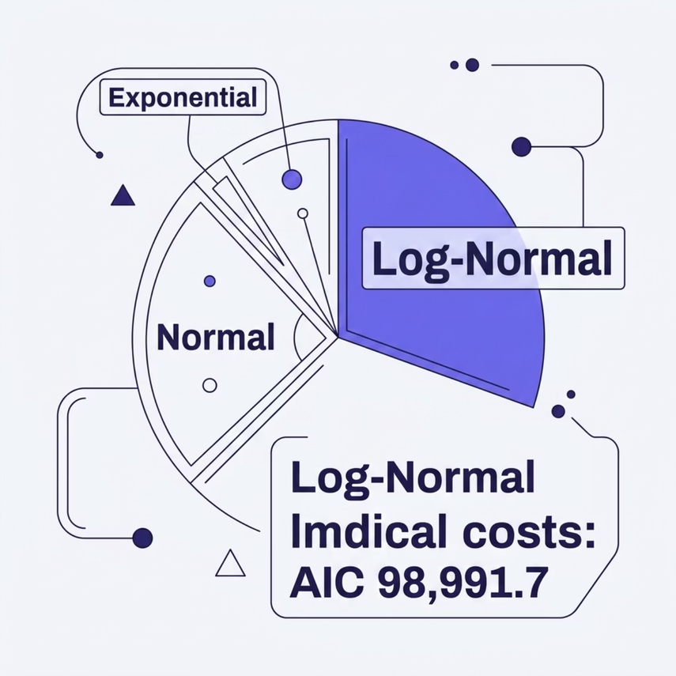

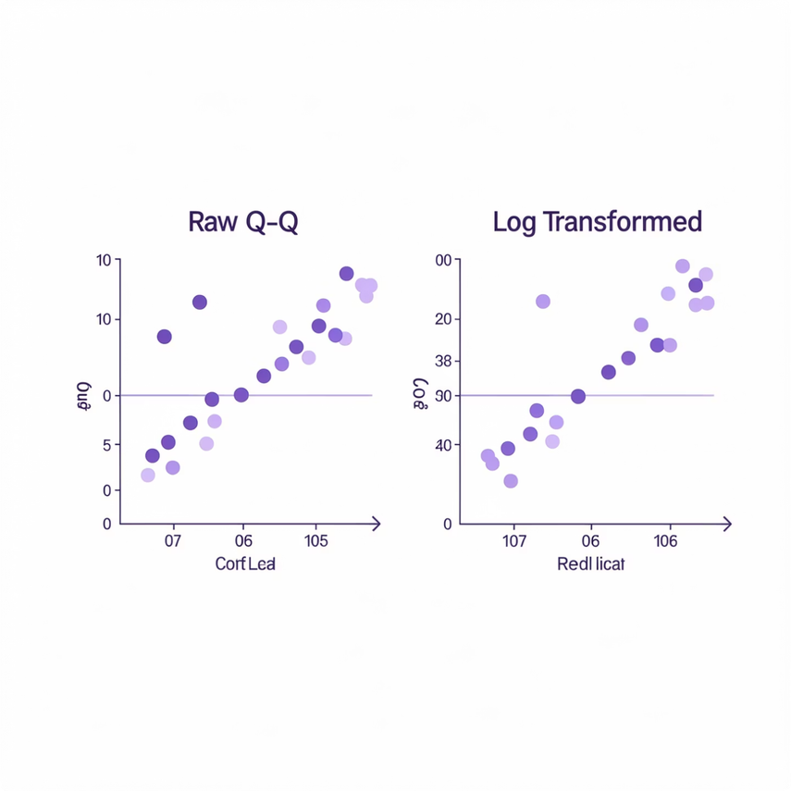
Distribution Fitting
Key Result
Log‑Normal best fit by AIC (AIC = 98,991.7). Implication: multiplicative cost process → use log-scale actuarial assumptions.
Notes:
6

Slide 7

Multiple Regression (log-cost)
Model
17 predictors on log(1 + annual_medical_cost)
Performance
R² ≈ 0.8925; Adjusted R² reported (strong explanatory power)
Top Predictors
Hospital admissions (β large), Medication count, Smoker, Previous year cost, highly significant
Assumptions
Heteroscedasticity detected → robust SEs advised; Durbin‑Watson ≈ 1.95; low VIFs
Notes:
7

Slide 8

Nonparametric Validation
Findings
  Mann‑Whitney: Smokers > Non‑smokers (significant)
  Kruskal‑Wallis: Costs differ across insurance types (significant)
  Spearman: Hospital admissions (ρ≈0.368) and medication count strong monotonic predictors
  Chi‑Square: Smoking × Insurance independent (fail to reject H₀)
Notes:
8

Slide 9





Interpretation & Policy Implications
Target Smoking
High‑impact: smoking cessation programs to reduce costs
Prevent Admissions
Reduce avoidable hospitalizations; largest cost driver
Promote Activity
Physical activity linked to lower mean costs; prevention programs
Actuarial Recommendation
Adopt log‑normal assumptions for pricing and risk models
Notes:
9

Slide 10

Limitations, Next Steps & Conclusion
Limitations
Cross‑sectional data; self‑reported lifestyle measures; heteroscedastic residuals
Conclusion
Insurance type, smoking, hospital admissions, medication count, and prior cost are primary determinants. Findings guide targeted interventions and pricing assumptions.
Next Steps
Stratified regressions, clustering to identify patient profiles.
Notes:
10

