Slide 1
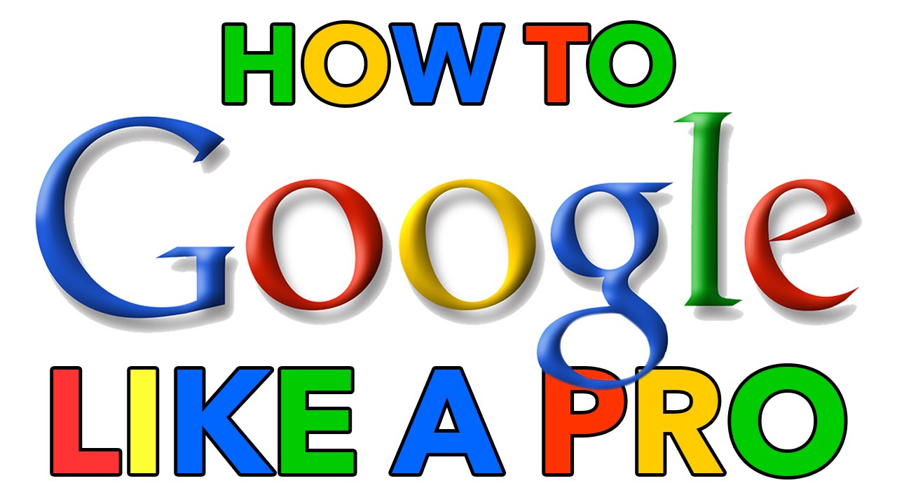

Slide 2


Slide 3
Use The Right Term
know what are you searching for
javascript >> javascript Strings
Start with the basics
closest airport Amman
Choose words carefully
instead of my head herts >> headache

Slide 4
Use Some KeyWords:
Weather:
To find weather for a certain place.
>> weather Amman
Dictionary:
Put define in front of any word to see its definition.
>> define programming
Calculations:
Enter a math equation
>> 3*9123
Unit conversions:
like 3 dollars in euros.

Slide 5
Either this or that
Simply put in a few potential variations of what you’re looking for
separate them by typing:
the “|“ symbol.
OR

Slide 6
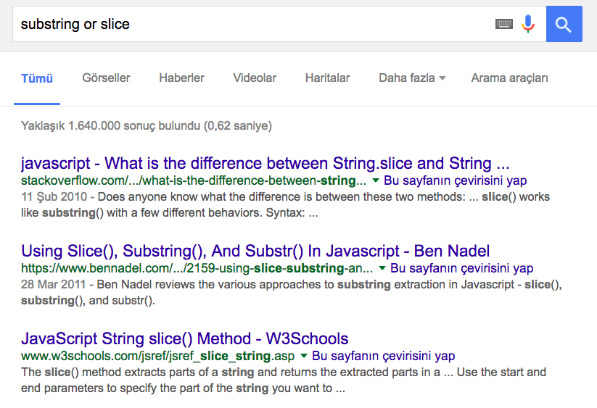

Slide 7
Searching using synonyms
If you need to find websites on a given subject rather than those that include a specific phrase
Add the "~" symbol to your search.

Slide 8
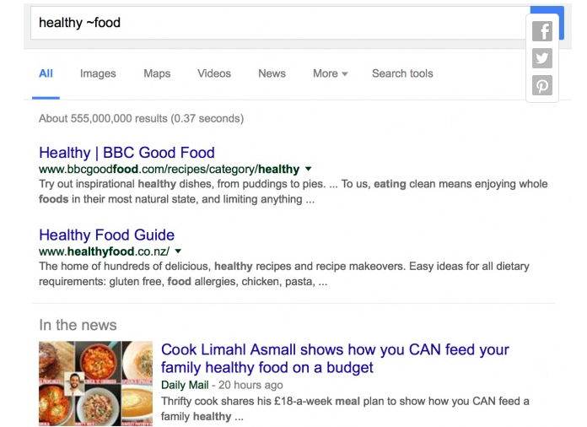

Slide 9
Searching within websites
The easiest way to find the desired piece of information again is to search within the website.
Type the address of the site, then a key word or entire phrase from the article.

Slide 10
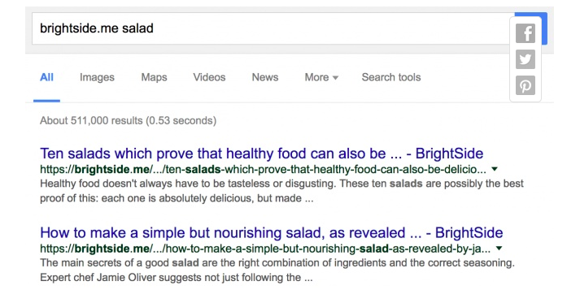

Slide 11
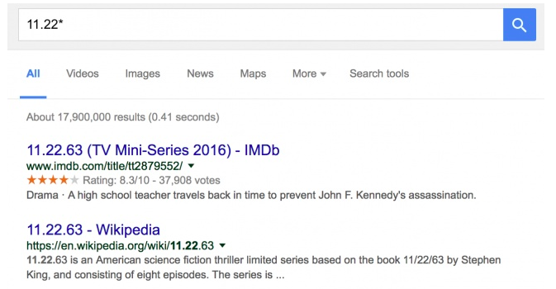
The power of the asterisk
Just use this * in the place of the word/phrase you can’t remember in your search.

Slide 12
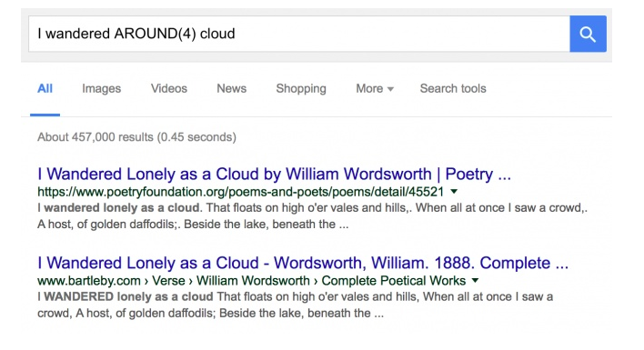
lots of words are missing
Write first and last words and put “AROUND + (the approximate number of missing words)“ between them.

Slide 13
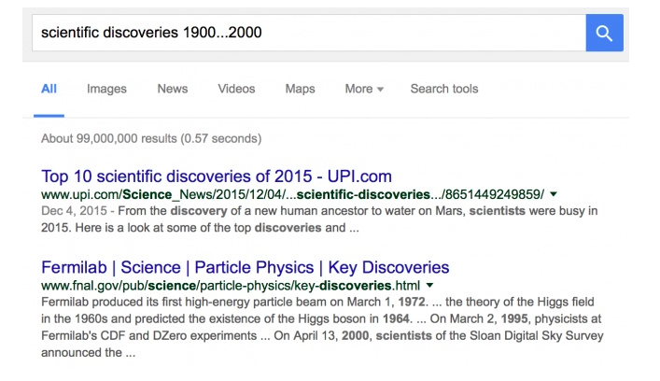
Using a time frame
A certain period of time events.
Add a time frame to your search query with the help of three dots.

Slide 14
Whole phrases
To find something specific and in the exact order you typed it in.
Use Quotation marks before and after the phrase.
This is a great way to find the lyrics to a song when you only know one line from it.

Slide 15
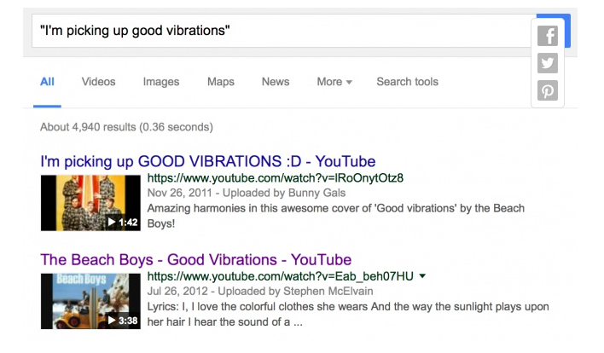

Slide 16
Unimportant search words
If you want to find a site about interesting books, but you aren’t looking to buy them
simply write a minus symbol before each one.

Slide 17
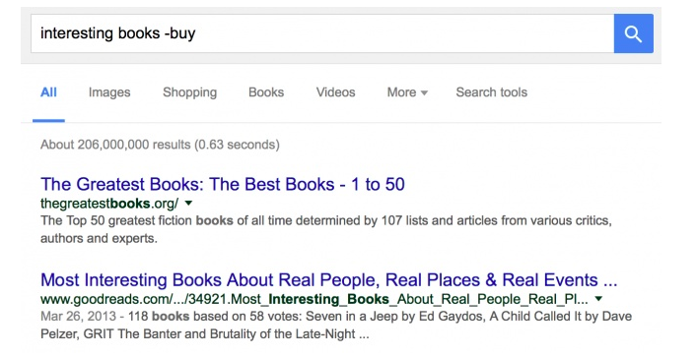

Slide 18
That’s All!

Slide 19
“If you have any question, just Google it!”
–Fatema Himmami

