Slide 1

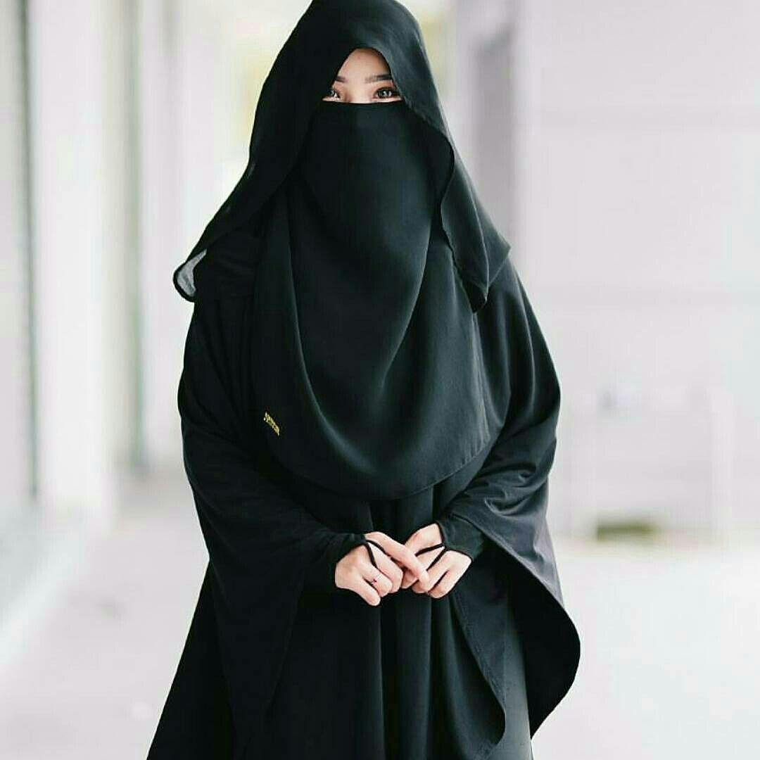

SELF-PRESENTATION
Fatima Attaullah CIT Student | Aspiring Technologist
About Me
- Passionate about Technology 💻 and Creativity 💡
- Always eager to learn and explore new ideas
- Believe in 'learning by doing'

Slide 2

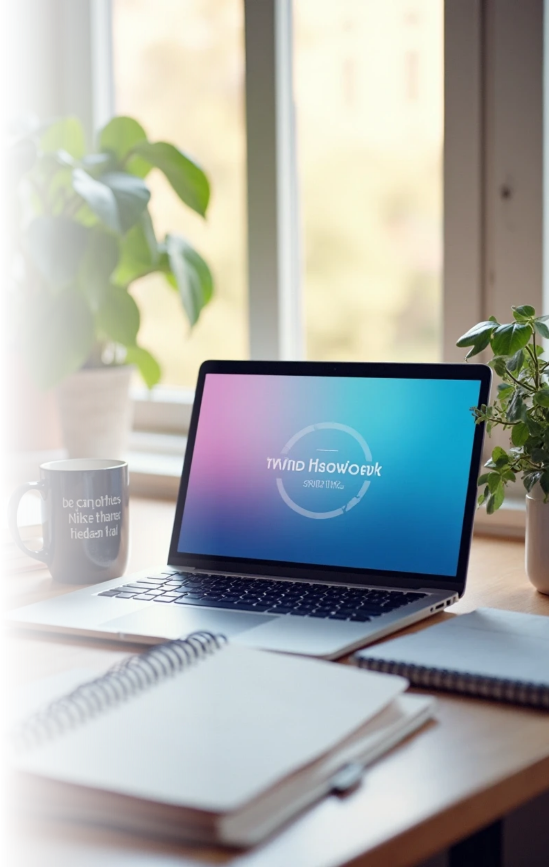


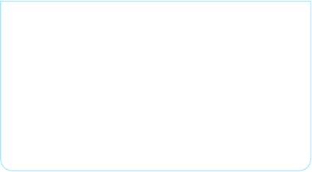
About Me & my Personality
1
2
📌 Introduction
🔄 Adaptable
Hi, my name is Fatima Attaullah. I am an active and lively person who loves to learn new things. I enjoy sharing ideas and always bring positive energy.
I can adjust easily to new situations and challenges. Whether working in a team or handling unexpected changes, I stay calm and find solutions quickly.
3
4
🕊️ Kind-hearted
🌟 Confident
I believe in my abilities and approach challenges with a positive mindset. Confidence helps me speak up, take risks, and achieve my goals effectively.”
By the grace of Almighty Allah, I try to treat people with empathy, respect, and care.

Slide 3




Hobbies and Interests
🌍 Traveling
💻 Technology
Love exploring new places, meeting people & learning cultures.
Excited about new tools & digital skills
1
2
🌱 Personal Development
✨Meditation & Reflection
Always working on new skills & growth.
Practice mindfulness for focus & balance.
4
3
Favorite Topic: 📊MS Excel
Reason: Excel helps me organize, analyze, and present data in a simple and clear way.

Slide 4

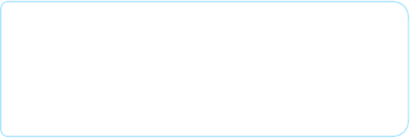
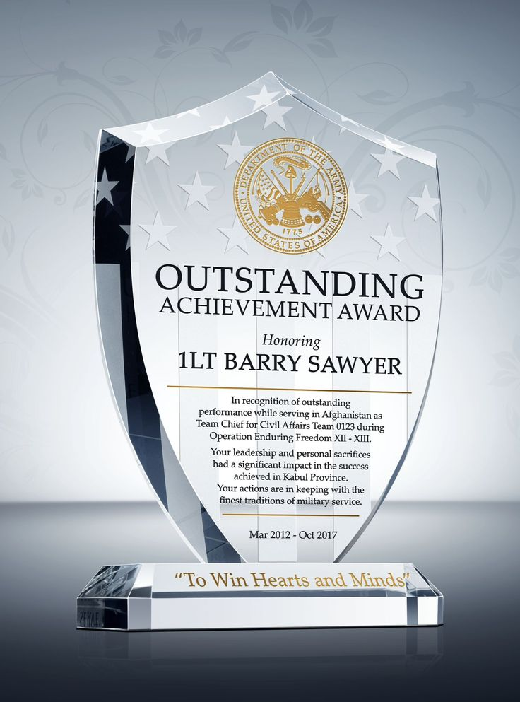

Achievements & Skills
🏆 Academic Achievements
✨ Soft skills
Communication – Clear & effective expression
Problem-Solving – Practical solutions
Teamwork – Working well with others
Time Management – Meeting deadlines
Confidence – Self-assured presence
A+ in Matric (Excellence Model School)
Best Performance Award in Academics
Highest Marks in Intermediate (College Topper)
📂 Projects
💻 Technical skills
Excel: Expense Tracker (automated)
Word: Certificates & CV
PowerPoint: Education System Presentation
GitHub: Professional Profile Setup
MS Office (Word, Excel, PowerPoint)
Python (Basics)
Networking (IP, Ports, Protocols)
Git & GitHub (Version Control & Collaboration)

Slide 5

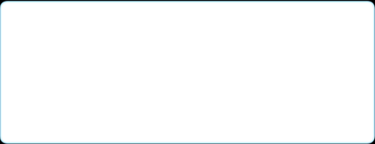
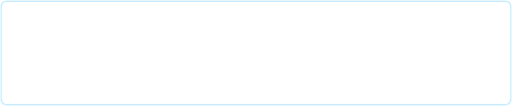
✨ Strengths
💡 Problem-Solver
🔍 Detail-Oriented
🤝 Team Player
I collaborate well with others, valuing different perspectives in achieving common goals.
I can analyze situations and come up with effective solutions quickly.
I pay attention to details, ensuring accuracy in my work.
⚡ Quick Learner
💬 Communication Skills
Grasp new skills and tools efficiently.
I express ideas clearly and actively listen to others.
🔄weakness
🌱 I prefer not to talk about my weaknesses; instead, I keep working on improving them.

Slide 6



🎯 Future Goals & Role Model
Long-Term Goals
Pursue continuous learning and growth to become a respected professional in the tech field.
Inspiration
Short-Term Goals
Enhance technical skills through certifications and internships within the next year.
My inspiration comes from people who are curious about technology and always improving themselves.
2
1
3

Slide 7
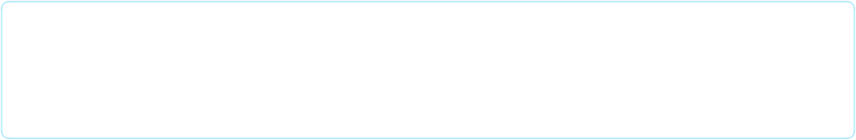
Closing / Fun Fact
Thank You for listening 🤝
I appreciate your time in listening about me, and I look forward to any questions you may have.
Excited to continue learning and growing 🚀
Fun Fact 🎉
I can spend hours making a presentation in PowerPoint, while AI can create one in just a minute😅

