Slide 1

SalesSpectrum – Retail Sales Analysis using SQL
Presented By: Shaikh Fatima Bee

Slide 2
NEXT SLIDE
Introduction
SalesSpectrum – Retail Sales Analysis using SQL
SalesSpectrum is a SQL-based project focused on analyzing retail sales data.
The dataset includes product details, monthly demand, pricing, and total sales value
The project uses SQL queries to extract meaningful insights from structured data
It helps in understanding product performance and revenue trends
01

Slide 3
NEXT SLIDE
Objective
To analyze product-level sales performance
To identify top and low-performing products
To evaluate category-wise revenue distribution
To analyze monthly demand trends
To apply SQL concepts like aggregation, sorting, subqueries, and grouping
02

Slide 4
NEXT SLIDE
Problem Statements
Businesses face difficulty in:
Identifying high-revenue products
Tracking monthly demand patterns
Understanding category performance
Making data-driven decisions
Raw data does not provide insights directly
03

Slide 5
Solutions
NEXT SLIDE
1. Product Performance Analysis
Identified Top 5 revenue-generating products → Key revenue drivers
Identified Bottom 5 low-performing products → Require improvement or removal
2. Pricing vs Sales Analysis
Found highest priced product → Evaluated impact of price on sales performance
Calculated average price per category → Compared pricing across categories
3. Category-Level Insights
Calculated category-wise total revenue → Identified top contributing categories
Compared product performance within categories → Determined most profitable segments
4. Advanced Analysis
Identified products with above-average sales → Strong performers
Analyzed monthly demand (Jan–Dec) → Observed trends and seasonality
04

Slide 6
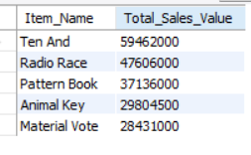
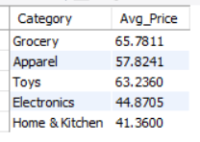
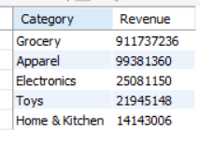
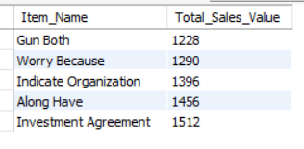
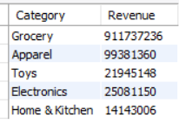

Outputs
Top 5 Revenue Generating Products
5. Average Price per Category
3. Category-wise Revenue
2. Bottom 5 Products (Low Performance)
6. Create View for Category Summary
4. Highest Priced Product
05

Slide 7
Insights
NEXT SLIDE
Identified Top 5 revenue-generating products
Detected Bottom 5 low-performing products
Found category-wise revenue contribution
Calculated average price per category
Identified highest priced product
Found products with above-average sales performance
Observed monthly demand patterns across the year
These insights help businesses improve strategy and decision-making
06

Slide 8
NEXT SLIDE
Future Scope
Integrate SQL results with Power BI for visualization
Add real-time sales data for live analysis
Perform predictive analysis using machine learning
Expand dataset with customer and regional data
Build dashboards for business reporting
07

Slide 9
NEXT SLIDE
Conclusion
Successfully built a SQL-based retail analysis system
Converted raw data into actionable insights
Demonstrated strong SQL skills (aggregation, grouping, subqueries)
Enabled better understanding of product and revenue performance
SalesSpectrum provides a complete overview of sales and demand trends
07

Slide 10
Thank You

