Slide 1

Lebanese International University Spam Email Classification using Machine Learning
Course: CSCI441 – Machine Learning
Instructor: Rida Shbeeb
Student: Fatima Hussien Dahwi
ID:42230649

Slide 2

Introduction:
Spam email detection is an important real-world problem.
Goal: classify emails as Ham or Spam using machine learning.
Compare three classification models (KNN , Naïve Bayes and Logistic Regression).
Study the impact of model choice and dataset balance.

Slide 3
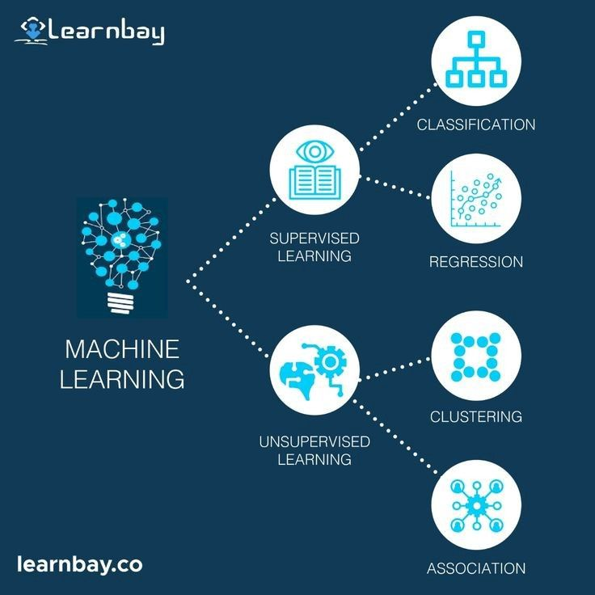
Machine Learning Type:
Machine Learning Type: Classification
Predicting discrete labels: Ham / Spam
Supervised learning (labeled dataset)

Slide 4
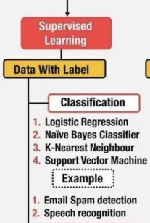
Models Used:
Naive Bayes
Probabilistic model, fast, effective for text.
K-Nearest Neighbors (KNN)
Instance-based, distance dependent.
Logistic Regression
Linear classifier, outputs probabilities, performs
well on balanced data.

Slide 5
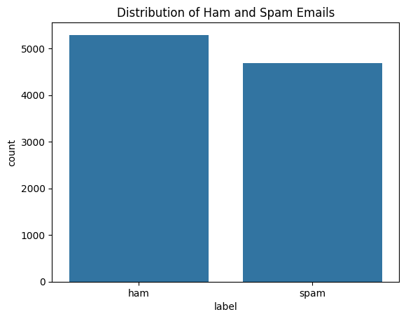
Dataset Description:
Total emails: 9,989
Classes:
Ham: 5,294
Spam: 4,695
Dataset is fairly balanced.
Features:
text (email content)
label (Ham / Spam)

Slide 6
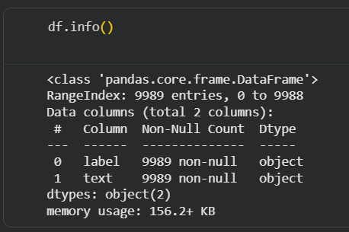
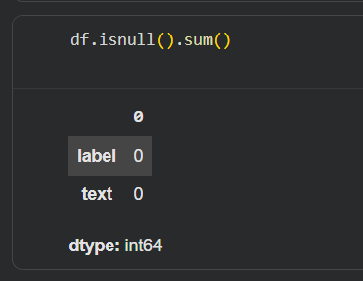

Data Preprocessing:
Removed missing values.
Removed stop words.
Converted text to numerical features using TF-IDF.
Split data into 80% training / 20% testing.

Slide 7
Algorithm Explanation:
Naive Bayes
Assumes feature independence.
Uses word probabilities.
KNN
Classifies based on nearest neighbors.
Logistic Regression
Uses sigmoid function for probability estimation.

Slide 8
Training & Evaluation:
Same preprocessing for all models.
Same train/test split.
Evaluation metrics:
Accuracy
Precision
Recall
F1-score
Confusion matrices used for deeper analysis.

Slide 9
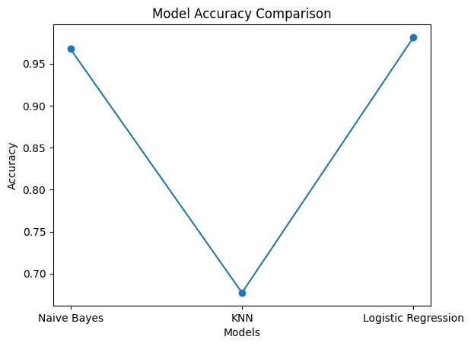
Accuracy Comparison:
Logistic Regression achieved the highest accuracy.
Naive Bayes performed slightly lower but still strong.
KNN showed poor performance.

Slide 10
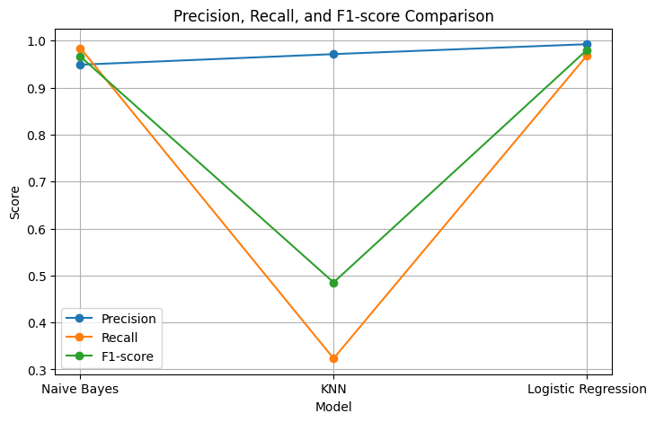
Precision, Recall, F1-score (Spam Class):
Logistic Regression and Naive Bayes show balanced metrics.
KNN has low recall for spam, meaning many spam emails were missed.

Slide 11
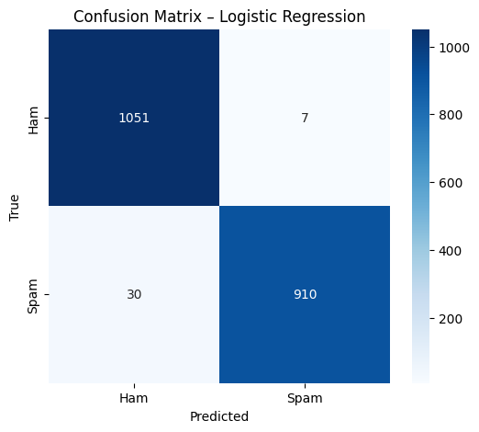
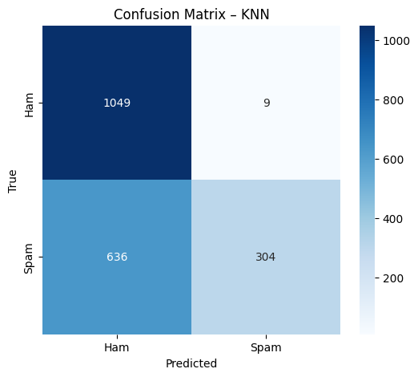

Confusion Metrices:
Naive Bayes: good balance between classes.
Logistic Regression: lowest misclassification.
KNN: many spam emails classified as ham

Slide 12
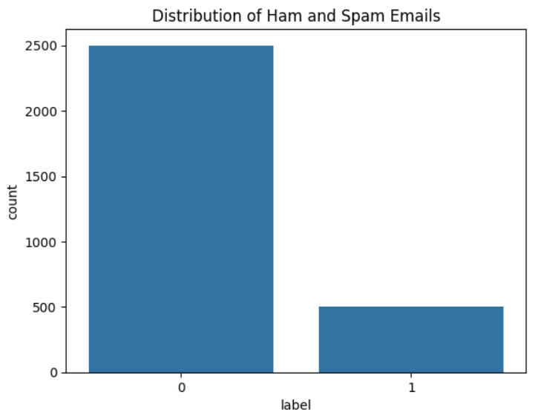
Impact of Dataset Balance:
Balanced dataset improves fairness and reliability.
Prevents bias toward majority class.
Helps models detect spam more accurately.

Slide 13
Recommendations:
Use Logistic Regression for production.
Naive Bayes is suitable for fast and simple systems.
KNN is not recommended for this dataset.
Future work:
Advanced models (SVM, ensembles)
Feature engineering (n-grams, bigrams)
Hyperparameter tuning

Slide 14

Real-World Applications:
Email spam filtering (Gmail, Outlook).
SMS spam detection.
Phishing and cybersecurity systems.

Slide 15
Self-Learning Outcomes:
Text preprocessing and TF-IDF vectorization.
Implemented multiple classification models.
Learned evaluation beyond accuracy.
Understood dataset imbalance effects.
Visualized results effectively.

Slide 16
Conclusion:
Model choice and dataset balance strongly affect performance.
Logistic Regression achieved the best overall results.
Balanced datasets lead to reliable spam detection.
Future improvements possible with advanced techniques.

Slide 17
Thank You !

