Slide 1
EXPLORATORY ANALYSIS ON PARCH & POSEY DATASET

Slide 2
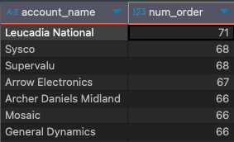
Name of accounts with orders more than 65 - Leucadia National placed the highest order.

Slide 3
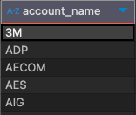
Accounts that placed an order in 2016 but not in 2017 - Top 5 accounts that didn’t place an order in 2017.

Slide 4

Account with the most order amount - EOG Resources has the highest order amount.

Slide 5
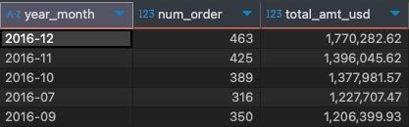
Month of the year with the highest total amount in USD. - Top 5 Months with highest total amount usd

Slide 6

Accounts with sales reps from ‘Northeast’ - Total number of accounts that have a sales rep from the Northeast region.

