Slide 1
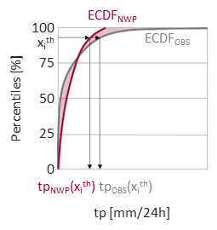
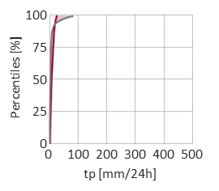
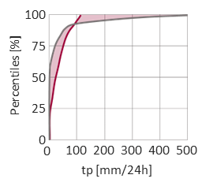
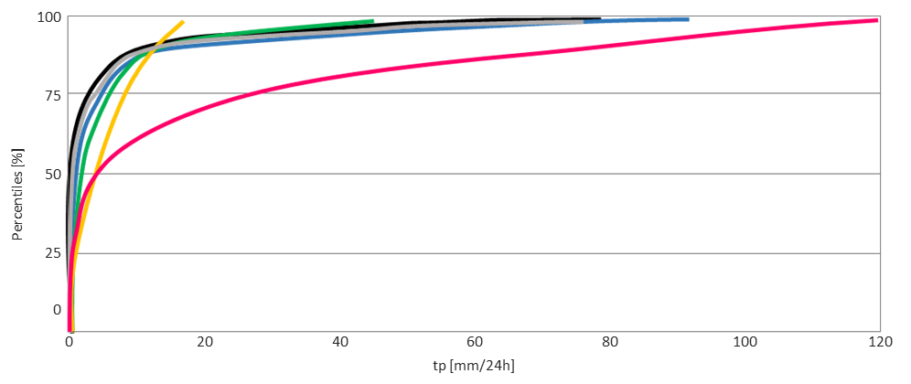
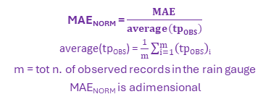
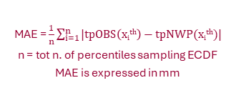
Normalized Mean Absolute Error (MAE_{NORM}) for 24-hourly total precipitation (tp)
Schematic on how to interpret MAE_{NORM}
(a) Schematic representation and computation of MAE and MAE_{NORM} at a specific rain gauge
(b) Example of MAE and MAE_{NORM} in drier climates
(c) Example of MAE and MAE_{NORM} in wetter climates
MAE = 5.28 mm
average(tp_{OBS}) =
5.55 mm
MAE_{NORM} = 0.953
MAE = 29.29 mm
average(tp_{OBS}) = 30.75 mm
MAE_{NORM} = 0.953
MAE_{NORM} = $\frac{MAE}{average(tpOBS)}$
average(tp_{OBS}) = $\frac{1}{m}\sum_{i=1}^{m}{\left(tpOBS\right)i}$
m = tot n. of observed records in the rain gauge
MAE_{NORM} is adimensional
MAE = $\frac{1}{n}\sum_{i=1}^{n}{|tpOBS\left(xith\right)−tpNWP(xith)|}$
n = tot n. of percentiles sampling ECDF
MAE is expressed in mm
(d) Examples of MAE_{NORM} values for different degrees of similarity between ECDFs
(SUBJECTIVE) CATEGORIES OF SIMILARITY DEGREES BETWEEN ECFDs
MAE_{NORM} = 0.097 -> Good ( < 0.1 )
MAE_{NORM} = 0.114 -> Acceptable ( between 0.1 and 0.3 )
MAE_{NORM} = 0.466 -> Intermediate ( between 0.3 and 0.5 )
MAE_{NORM} = 0.953 -> Poor ( between 0.5 and 1 )
MAE_{NORM} = 2.091 -> Very poor ( > 1 )

Slide 2

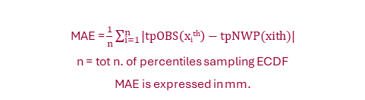
Normalized Mean Absolute Error (MAE_{NORM}) for 24-hourly total precipitation (tp)
Schematic on how to interpret MAE_{NORM}
(a) Schematic representation and computation of MAE and MAE_{NORM} at a specific rain gauge
100
ECDF_{NWP}
x_{i}^{th}
ECDF_{OBS}
MAE = $\frac{1}{n}\sum_{i=1}^{n}{|tpOBS\left(xith\right)−tpNWP(xith)|}$
n = tot n. of percentiles sampling ECDF
MAE is expressed in mm.
75
50
MAE_{NORM} = $\frac{MAE}{average(tpOBS)}$
average(tp_{OBS}) = $\frac{1}{m}\sum_{i=1}^{m}{\left(tpOBS\right)i}$
m = tot n. of observed records in the rain gauge
MAE_{NORM} is adimensional.
Percentiles [%]
25
0
tp_{NWP}(x_{i}^{th})
tp_{OBS}(x_{i}^{th})
tp [mm/24h]
(b) Example of MAE and MAE_{NORM} in drier climates
(c) Example of MAE and MAE_{NORM} in wetter climates
100
100
75
75
50
50
Percentiles [%]
Percentiles [%]
MAE = 5.28 mm
average(tp_{OBS}) = 5.55 mm
MAE_{NORM} = 0.952
MAE = 29.29 mm
average(tp_{OBS}) = 30.75 mm
MAE_{NORM} = 0.952
25
25
0
100
200
300
400
500
0
0
0
100
200
300
400
500
tp [mm/24h]
tp [mm/24h]
(d) Examples of MAE_{NORM} values for different degrees of similarity between ECDFs
100
75
(SUBJECTIVE) CATEGORIES OF SIMILARITY DEGREES BETWEEN ECFDs
MAE_{NORM} = 0.097 -> Good ( < 0.1 )
MAE_{NORM} = 0.114 -> Acceptable ( between 0.1 and 0.3 )
MAE_{NORM} = 0.466 -> Intermediate ( between 0.3 and 0.5 )
MAE_{NORM} = 0.953 -> Poor ( between 0.5 and 1 )
MAE_{NORM} = 2.091 -> Very poor ( > 1 )
50
Percentiles [%]
25
0
0
20
40
60
80
100
120
tp [mm/24h]

Slide 3
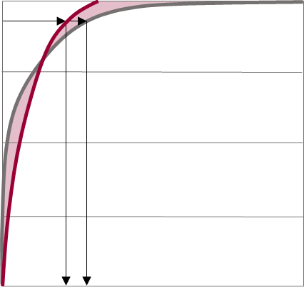
100
ECDF_{NWP}
x_{i}^{th}
ECDF_{OBS}
75
50
Percentiles [%]
25
0
tp_{NWP}(x_{i}^{th})
tp_{OBS}(x_{i}^{th})
tp [mm/24h]

Slide 4
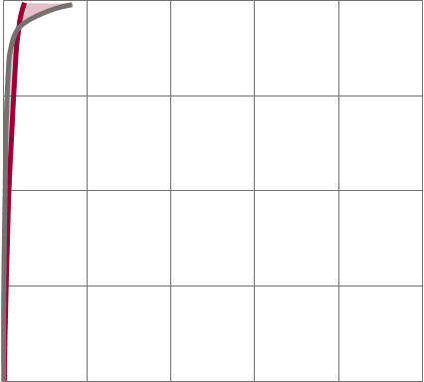
100
75
Percentiles [%]
50
25
0
100
200
300
400
500
0
tp [mm/24h]

Slide 5
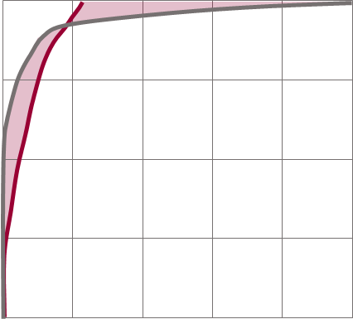
100
75
Percentiles [%]
50
25
0
100
200
300
400
500
0
tp [mm/24h]

Slide 6
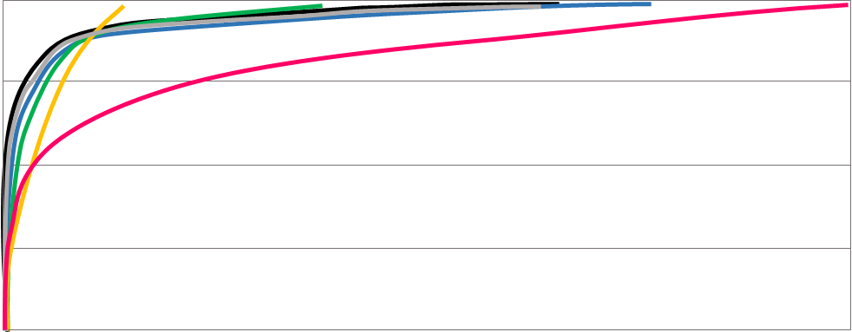
100
75
50
Percentiles [%]
25
0
0
20
40
60
80
100
120
tp [mm/24h]

