Slide 1
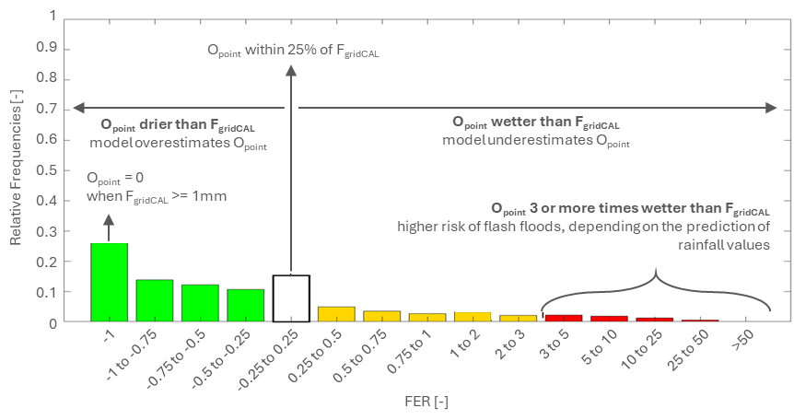
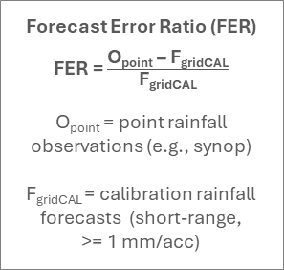
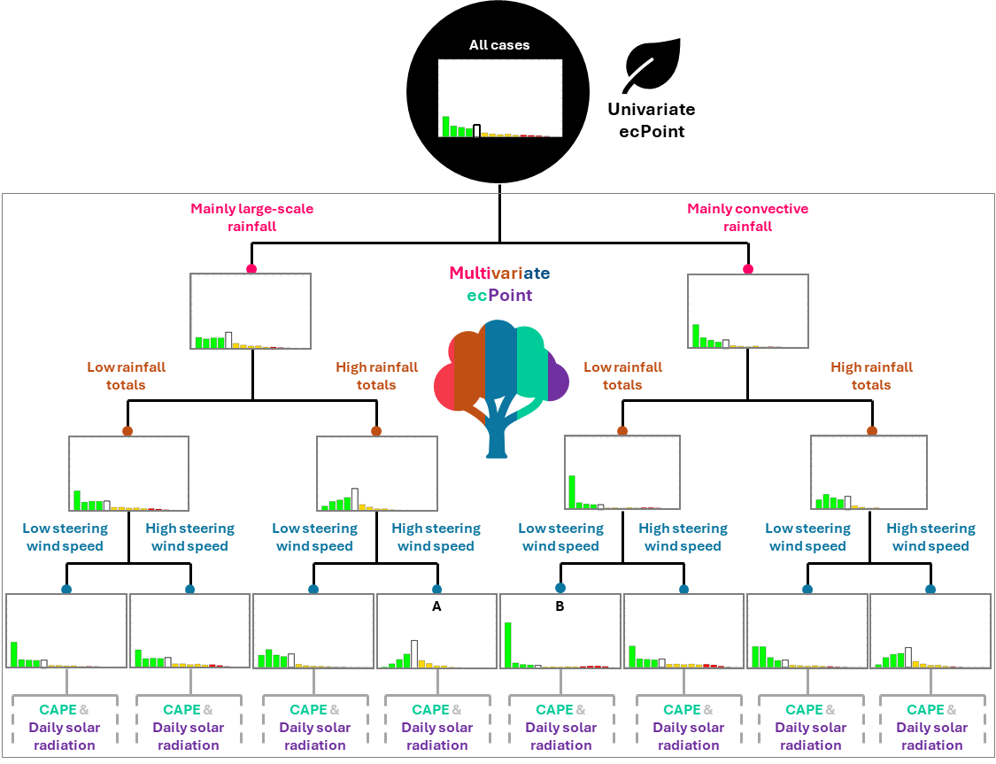
Graphical representation of the ecPoint post-processing technique
Mapping function and decision tree
(a) Error formulation for accumulated variables (Forecast Error Ratio, FER), and errors’ distribution for all cases in the training dataset (Mapping Function, MF)
(b) Univariate and multivariate ecPoint represented, respectively, as a “single-leaf” and “multiple-leaf” decision tree (DT)

Slide 2
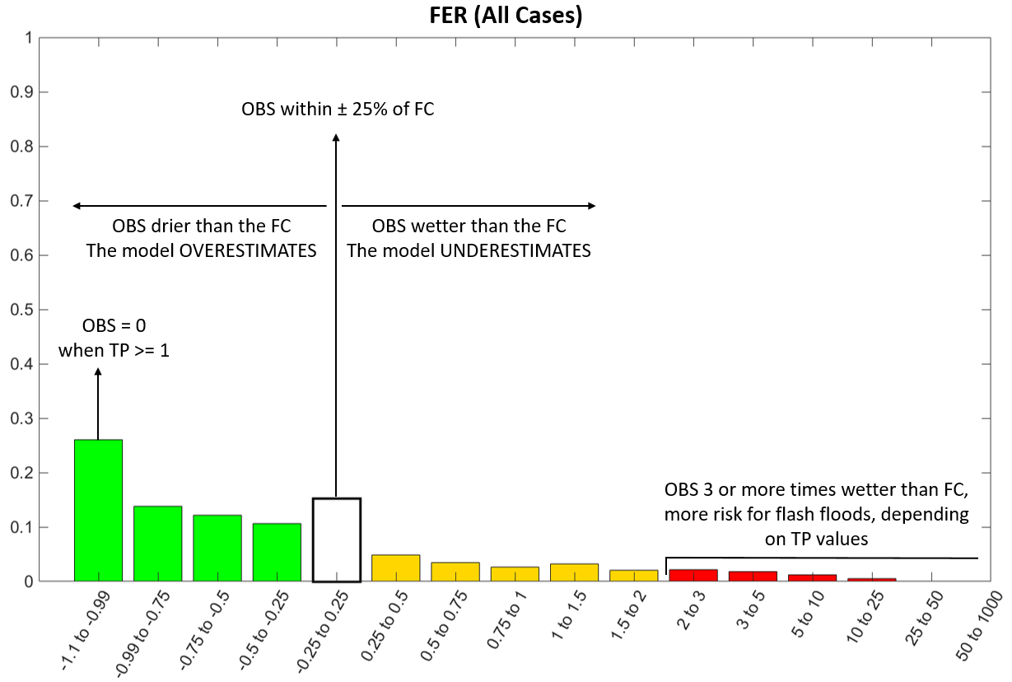

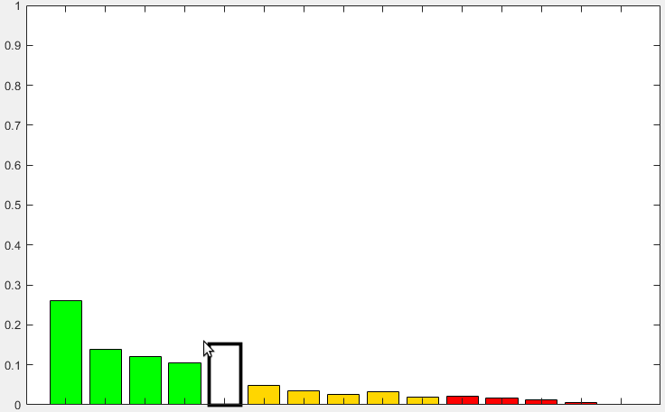
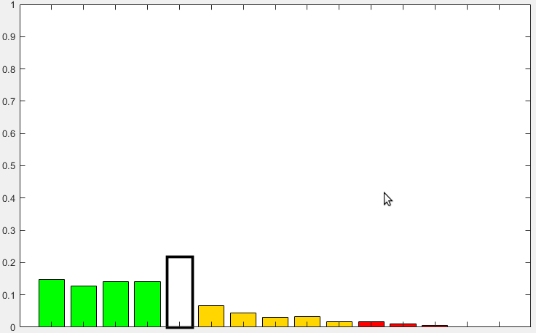
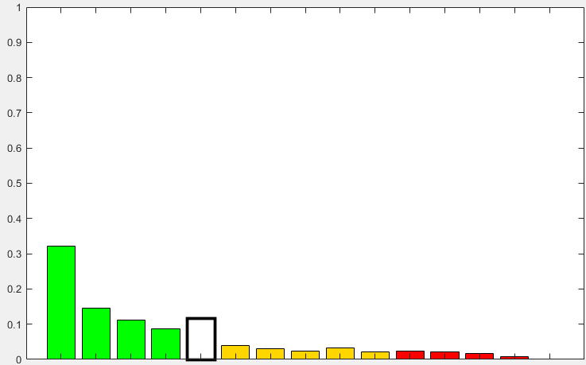





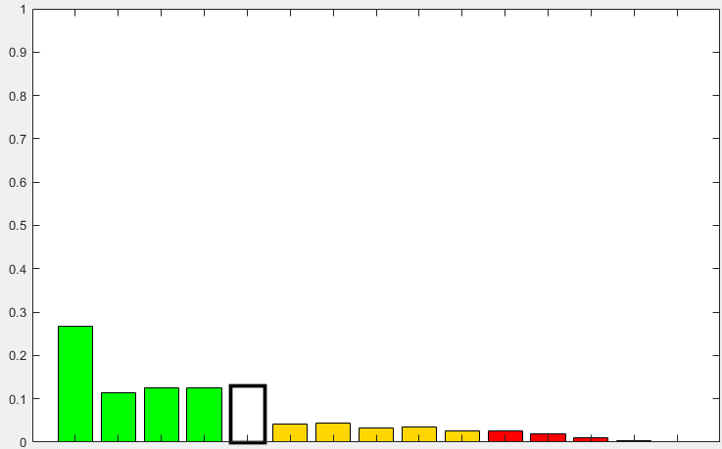
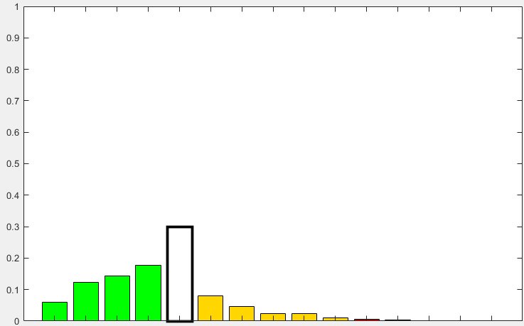
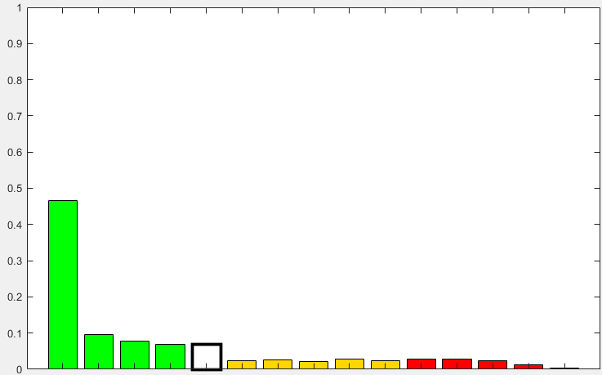
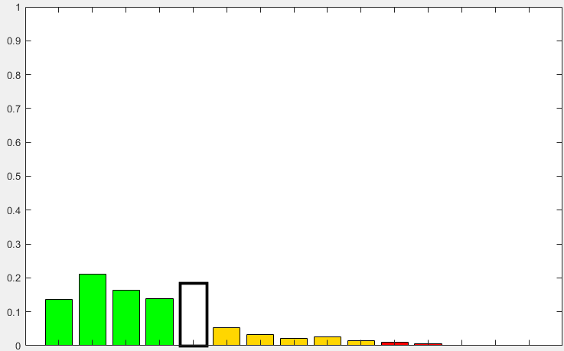
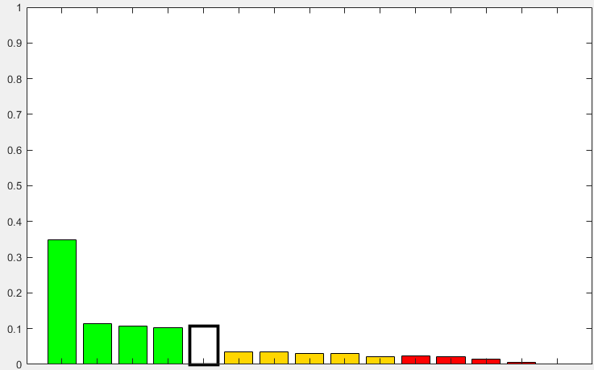
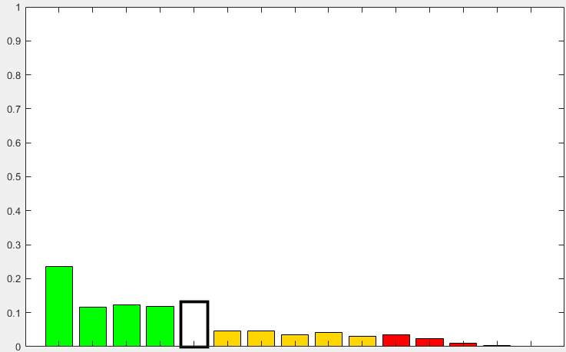
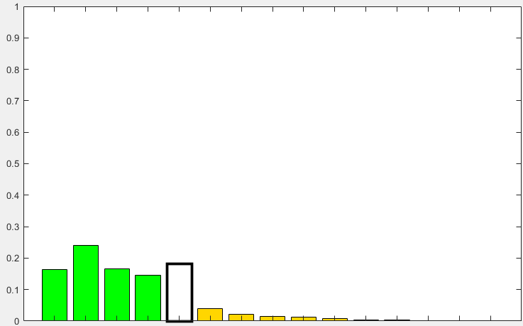
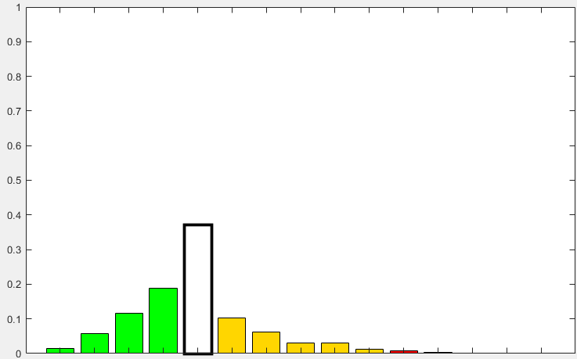
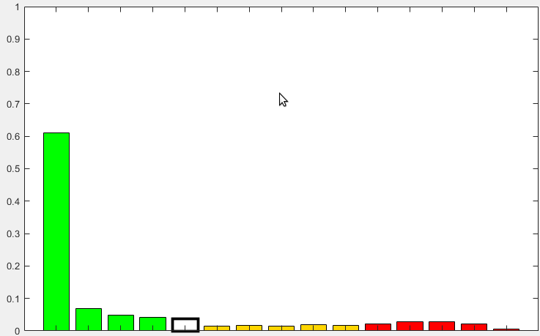
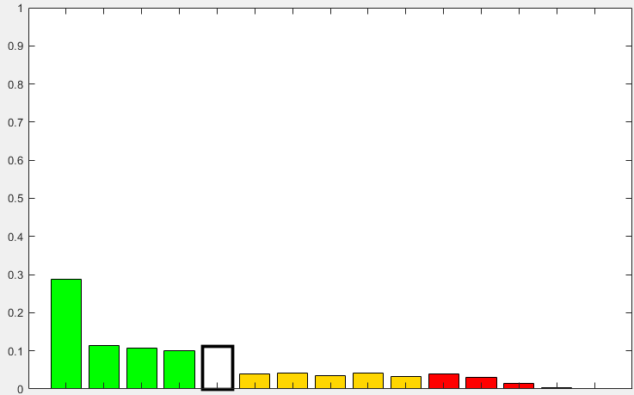
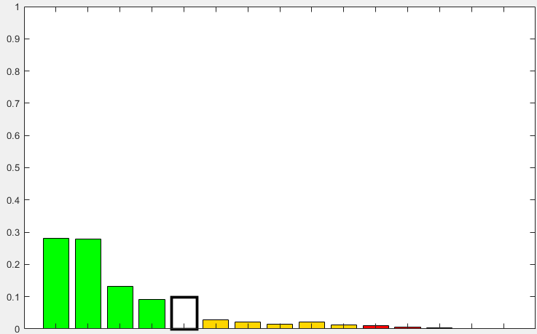
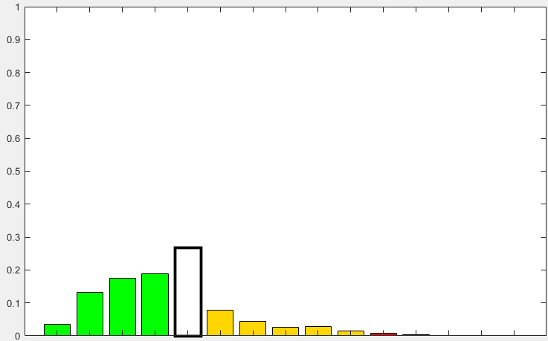

Graphical representation of the ecPoint post-processing technique
Mapping function and decision tree
(a) Error formulation for accumulated variables (Forecast Error Ratio, FER), and errors’ distribution for all cases in the training dataset (Mapping Function, MF)
1
Forecast Error Ratio (FER)
0.9
O_{point} within 25% of F_{gridCAL}
FER = $\frac{\text{O}\text{point}\text{ – }\text{FgridCAL}}{\text{F}\text{gridCAL}}$
0.8
0.7
O_{point} drier than F_{gridCAL}
model overestimates O_{point}
O_{point} wetter than F_{gridCAL}
model underestimates O_{point}
O_{point} =
point-rainfall observations
(e.g., synop)
F_{gridCAL} =
calibration rainfall forecasts
(short-range, >= 1 mm/acc)
0.6
Relative Frequencies [-]
0.5
O_{point} = 0
when F_{gridCAL} >= 1mm
0.4
O_{point} 3 or more times wetter than F_{gridCAL}
higher risk of flash floods, depending on the prediction of rainfall values
0.3
0.2
0.1
0
-1
-1 to -0.75
-0.75 to -0.5
-0.5 to -0.25
-0.25 to 0.25
0.25 to 0.5
0.5 to 0.75
0.75 to 1
1 to 2
2 to 3
3 to 5
5 to 10
10 to 25
25 to 50
>50
FER [-]
(b) Univariate and multivariate ecPoint represented, respectively, as a “single-leaf” and “multiple-leaf” decision tree (DT)
All cases
Univariate ecPoint
Mainly large-scale rainfall
Mainly convective rainfall
Multivariate ecPoint
Low rainfall totals
High rainfall totals
Low rainfall totals
High rainfall totals
Low steering wind speed
High steering wind speed
Low steering wind speed
High steering wind speed
Low steering wind speed
High steering wind speed
Low steering wind speed
High steering wind speed
A
B
CAPE &
Daily solar radiation
CAPE &
Daily solar radiation
CAPE &
Daily solar radiation
CAPE &
Daily solar radiation
CAPE &
Daily solar radiation
CAPE &
Daily solar radiation
CAPE &
Daily solar radiation
CAPE &
Daily solar radiation

