Slide 1
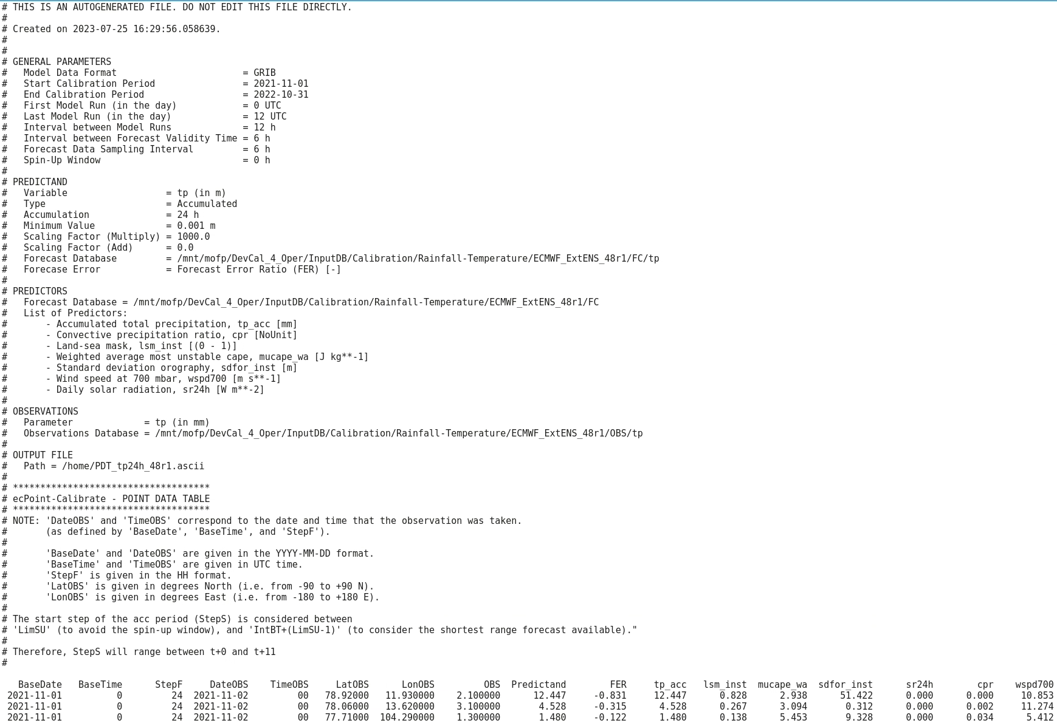
Information about the calibration period, considered model runs, step intervals, and spin-up window.
General information about the considered predictand.
General information about the considered predictors.
General information about the considered observations.
Location of PDT.
PDT metadata.
Fixed number of columns in the PDT providing the values for:
the base date (BaseDate) and base time (BaseTime) for the considered forecasts;
the final step (StepF) for the considered accumulation period;
the date (DateOBS), time (TimeOBS), geographical coordinates (LatOBS, LonOBS), and value (OBS) for the correspondent observations;
the value for the predictand (Predictand);
the value for the Forecast Error Ratio (FER) or Forecasts Error (FE);
Variable number of columns in the PDT providing the values for the considered predictors.
.
.
.
.
.
.
.
.
.
.
.
.
.
.
.
.
.
.
.
.
.
.
.
.
.
.
.
.
.
.
.
.
.
.
.
.
.
.
.
.
.
.
.
.
.
.
.
.
.
.
.
Total number of data points contained in the input database for the calibration period, and the number of data points considered in the PDT. If FER is computed, these two values are generally different. For FE, the two numbers are identical.

