Slide 1
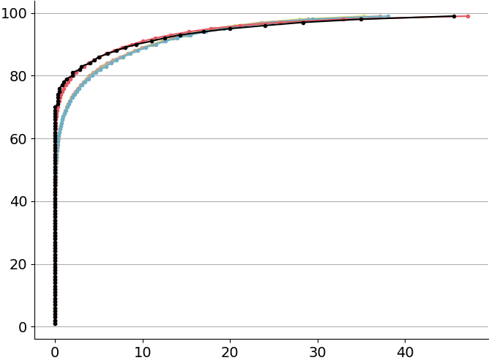
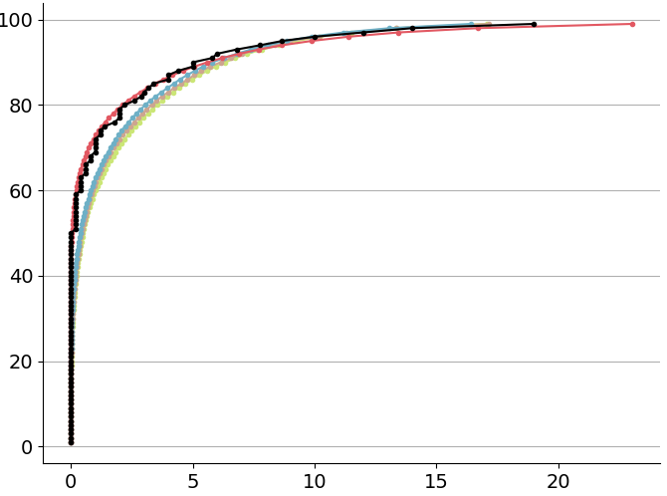
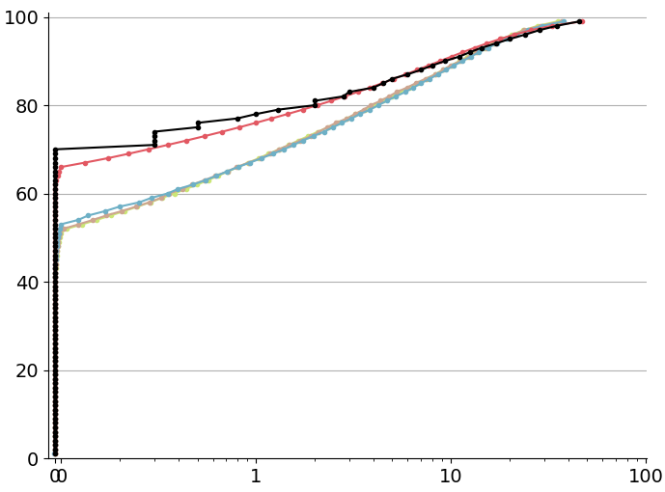
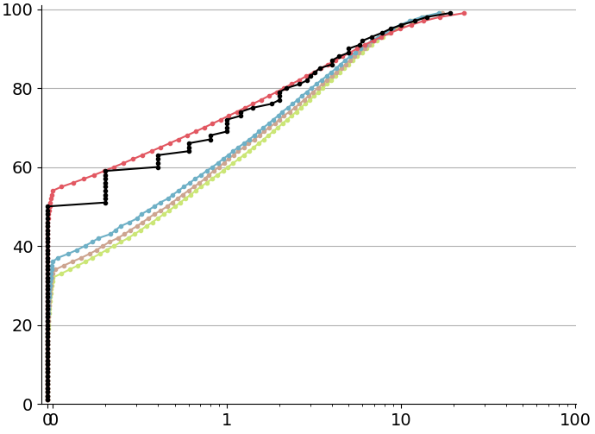
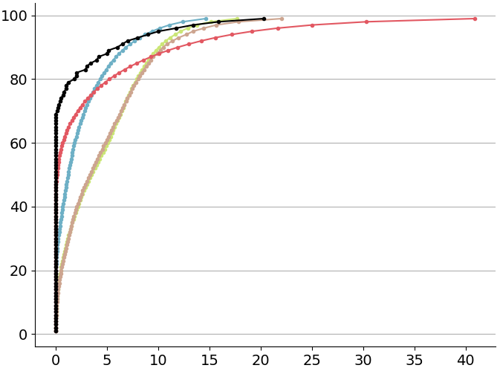
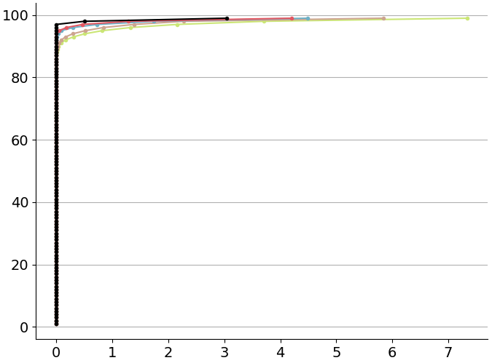
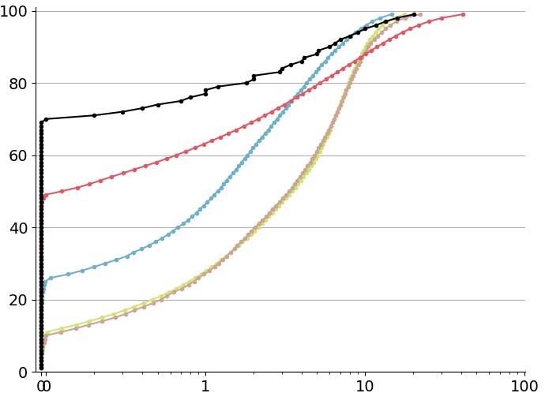
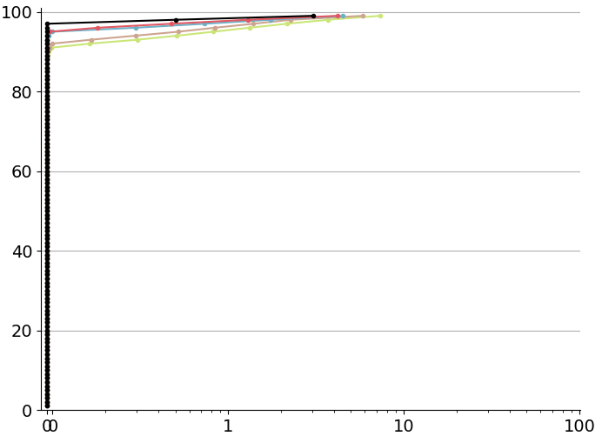
Empirical Cumulative Distribution Functions (ECDFs) for 24-hourly total precipitation (tp)
OBS
ERA5-EDA
ERA5
ECMWF Reforecast - 46r1
ERA5 - ecPoint
(a) Real ECDF, Flat areas
[lat = 38.05, lot = -87.53]
(b) Real ECDF, Hilly/Mountainous areas
[lat = 53.03, lot = -0.5]
Percentiles [%]
Percentiles [%]
Percentiles [%]
Percentiles [%]
tp [mm/24h]
tp [mm/24h]
tp [mm/24h]
tp [mm/24h]
(c) Real ECDF, Very mountainous areas
[lat = -16.52, lot = -68.18]
(d) Real ECDF, Deserts
[lat = 25.30, lot = 49.48]
Percentiles [%]
Percentiles [%]
Percentiles [%]
Percentiles [%]
tp [mm/24h]
tp [mm/24h]
tp [mm/24h]
tp [mm/24h]

