Slide 1
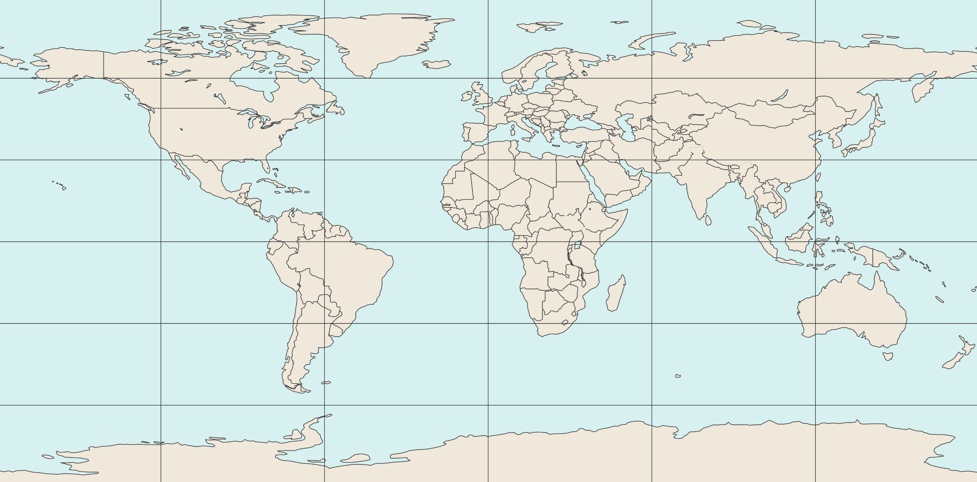
Europe + Mediterranean
[90 °N, 30 °W, 30 °N, 60 °E]
Asia
[90 °N, 60 °E, 5 °N, 180 °E]
60 °N
30 °N
0 °N
North-America
[90 °N, 170 °W, 15 °N, 50 °W]
30 °S
South-America
[15 °N, 100 °W, 60 °S, 30 °W]
Africa + Arabian Peninsula
[30 °N, 30 °W, 40 °S, 60 °E]
Oceania
[5 °N, 60 °E, 60 °S, 180 °W]
60 °S
120 °W
60 °W
0 °E
60 °E
120 °E

