Slide 1
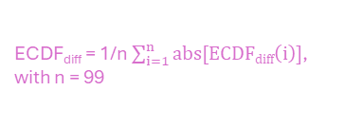
Average areal difference (ECDF_{diff}) between two ECDFs
Schematic representation
ECDF₁
ECDF₂
100
x^{th}
75
ECDF_{diff} = 1/n $\sum_{i=1}^{n}{abs[ECDFdiff\left(i\right)]}$,
with n = 99
50
Percentiles [%]
25
ECDF_{diff} (x^{th}) = ECDF₂(x^{th}) - ECDF₁(x^{th})
0
Rainfall [mm]

