Slide 1
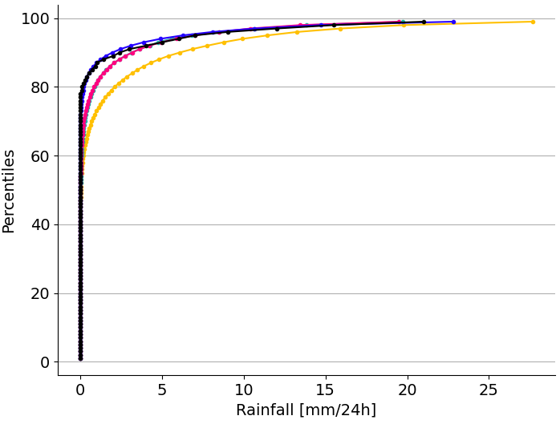
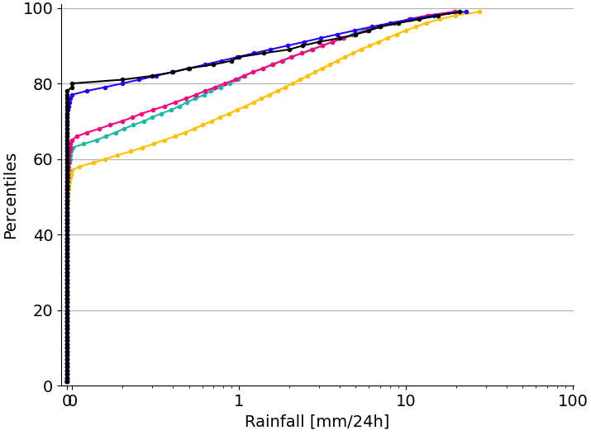
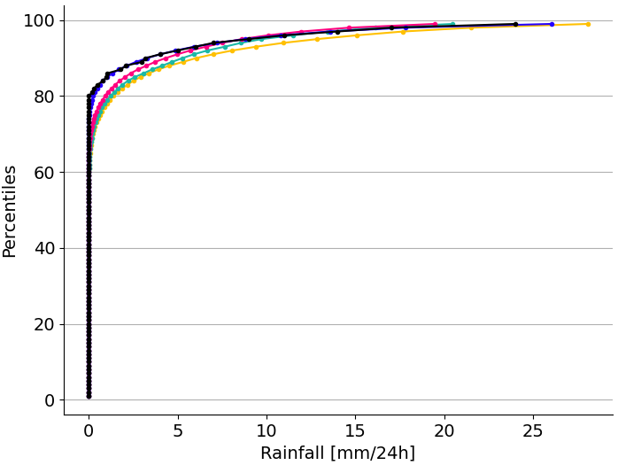
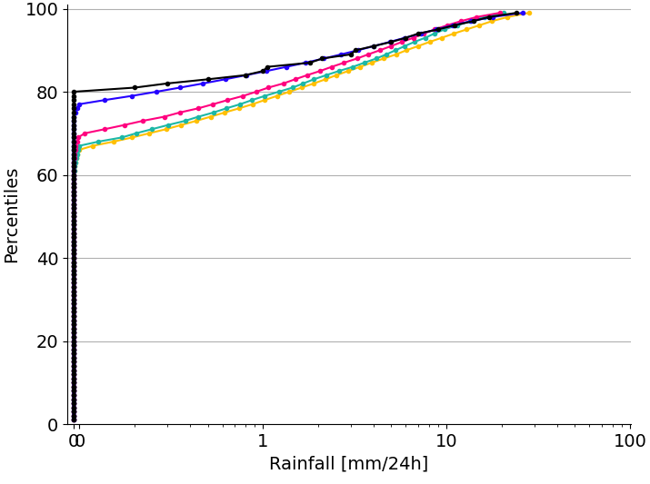
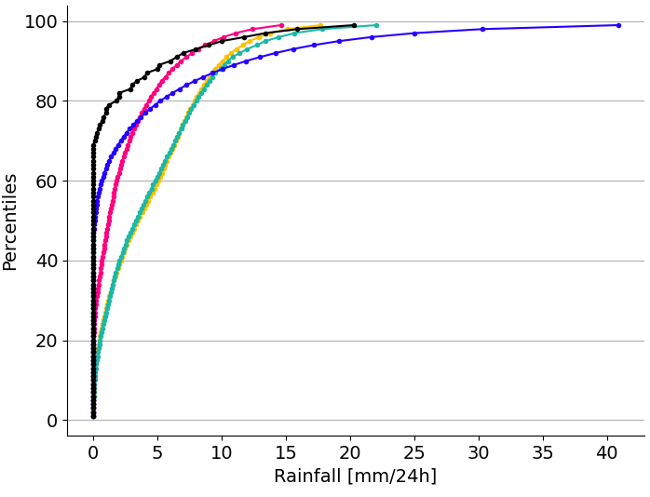
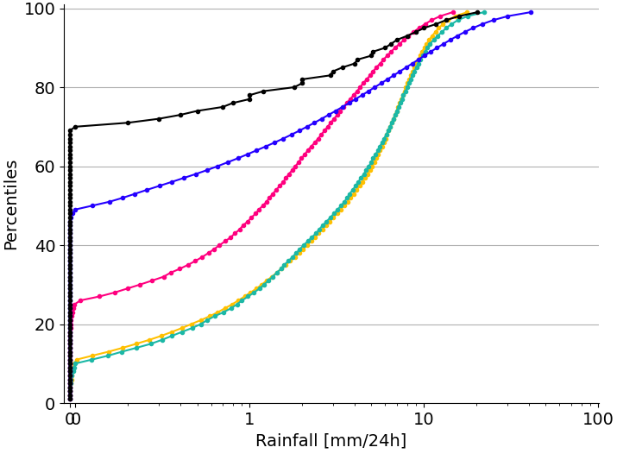
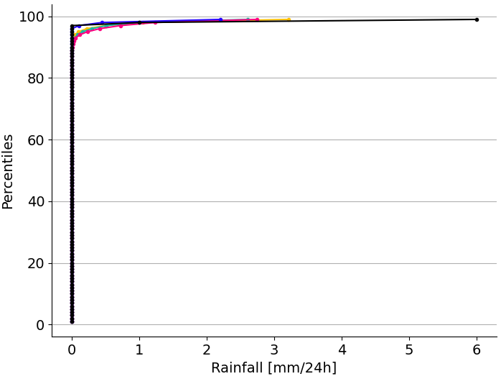
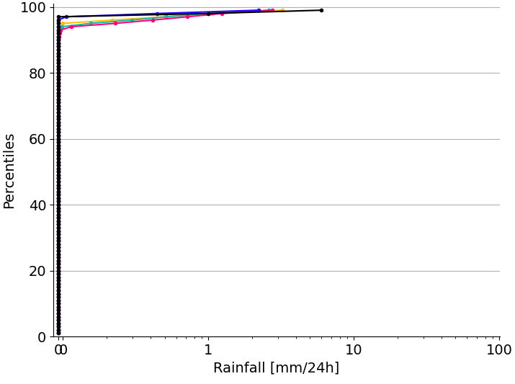
Empirical Cumulative Distribution Functions (ECDFs) for 24-hourly rainfall
OBS
ERA5-EDA
ERA5
Reforecast_46r1
ERA5 - ecPoint
(a) Real ECDF, Flat areas
[lat = 39.83, lot = 114.57]
(e) Log ECDF, Flat areas
[lat = 39.83, lot = 114.57]
(b) Real ECDF, Orographic areas
[lat = 39.47, lot = -6.33]
(f) Log ECDF, Orographic areas
[lat = 39.47, lot = -6.33]
(c) Real ECDF, Complex orographic areas
[lat = -16.52, lot = -68.18]
(g) Log ECDF, Complex orographic areas
[lat = -16.52, lot = -68.18]
(d) Real ECDF, Desertic areas
[lat = 23.62, lot = 58.27]
(h) Log ECDF, Desertic areas
[lat = 23.62, lot = 58.27]

