Slide 1
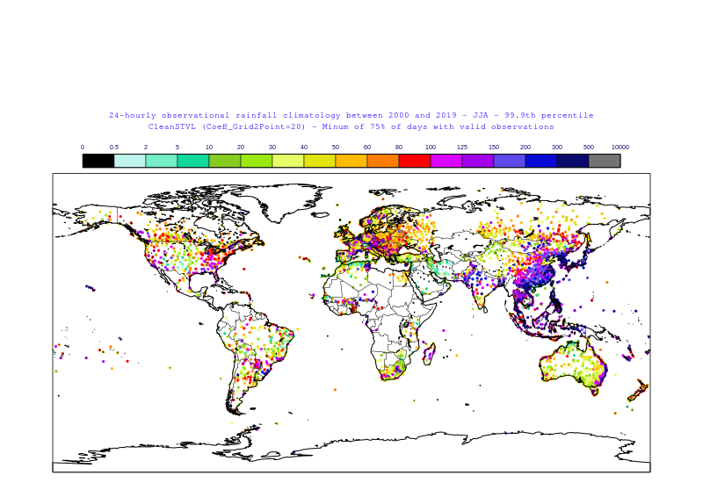
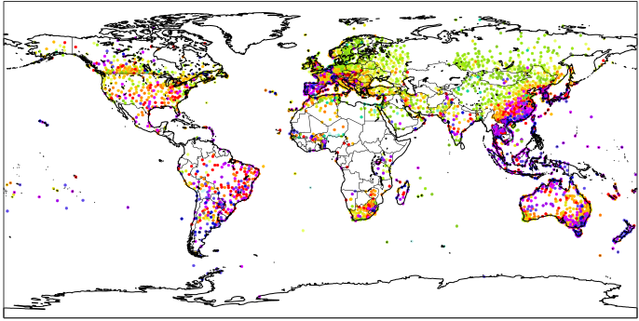
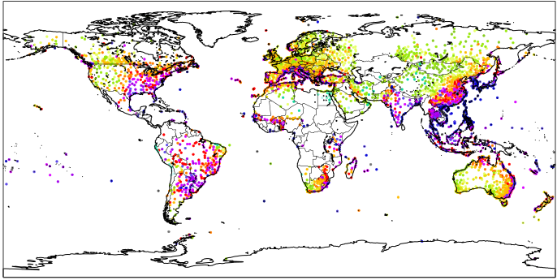
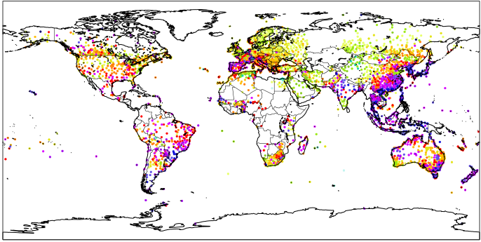
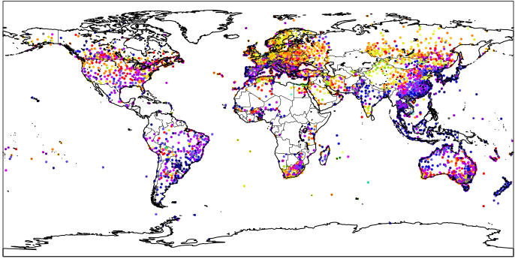
24-hourly rainfall climatologies
mm/24h
DJF, 99.9th
MAM, 99.9th
JJA, 99.9th
SON, 99.9th
YEAR, 99.9th
YEAR, 99.98th

