Slide 1
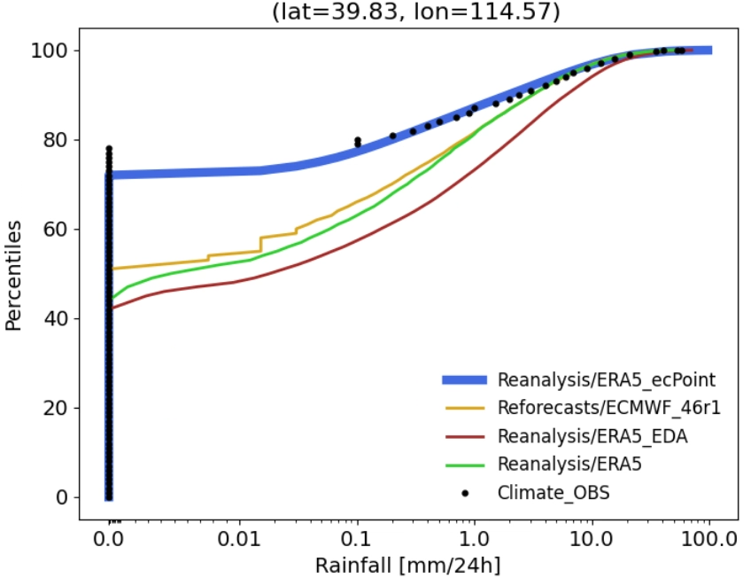
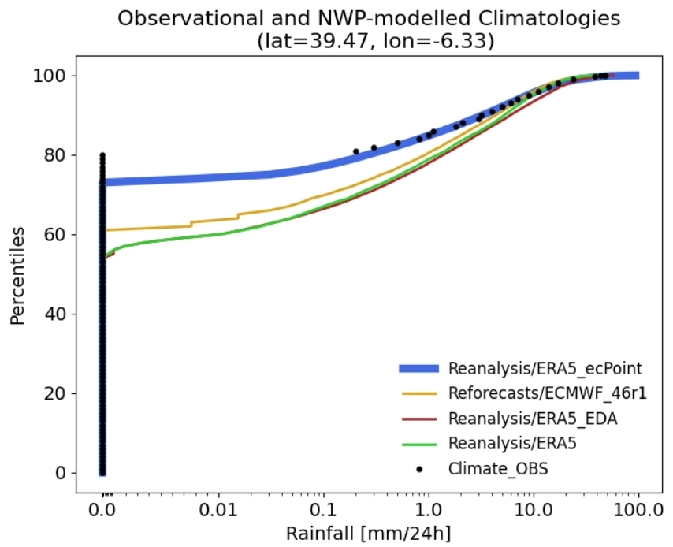
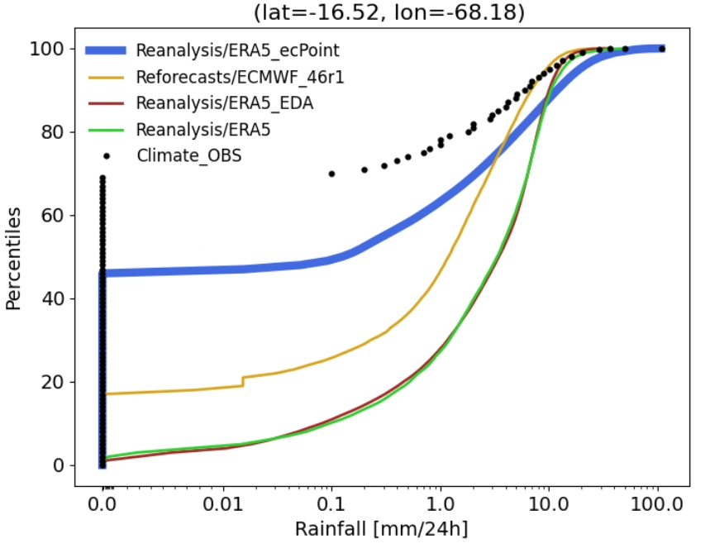
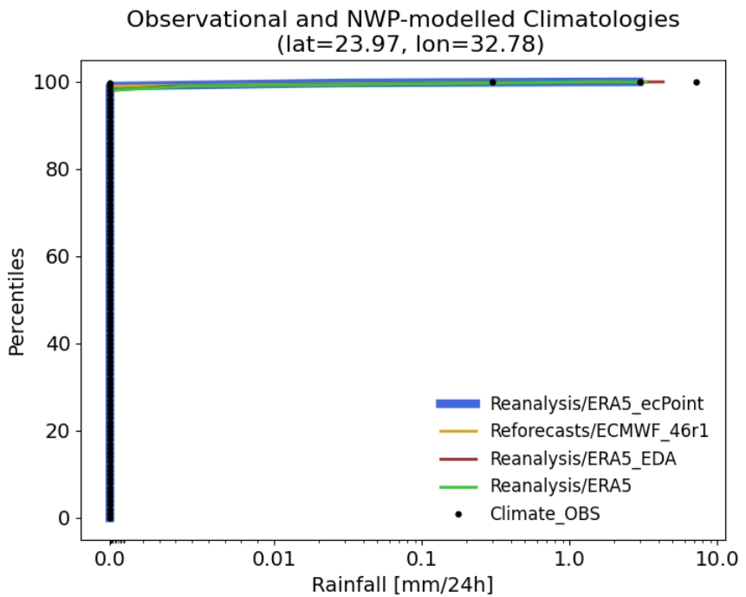
Empirical Cumulative Distribution functions (ECDFs) for observational and NWP climatologies
ERA5-EDA
ERA5
Reforecast_46r1
ERA5 - ecPoint
ERA5 - ecPoint
(a) Flat areas (lat = 39.83, lon = 114.57)
(b) Orographic areas (lat = 39.47, lon = -6.33)
(c) Very complex orographic areas (lat = -16.52, lon = -68.18)
(d) Desert (lat = 23.97, lon = 32.78)

