Slide 1
PAPER SKELETON

Slide 2
ABSTRACT
S1) Context and purpose of the study
S2,3) Basic design of the study? What did you do, what model, what data?
S4,5,6) What are your key messages? This must align to your key findings.
S7,8) Why is what you’ve found important? What does it mean for the community you are talking to or how it will change the think?

Slide 3
INTRODUCTION
First paragraph – General background
What is the reader’s problem, or why should they care?
Forecasts and climatologies are produced as averages over grid boxes but have always been used to produce forecasts at points. The same is valid for modelled gridded climatologies.
Rainfall is arguably one of the most important parameters to evaluate due to its importance in different downstream applications (e.g., hydrology). Detailed point-verification analysis has been carried out to understand how state-of-the-art global point-scale rainfall forecasts compare to modelled gridded NWP predictions in the prediction of rainfall at points, in particular extremes.
It is also important to run the same comparison for the climatologies to understand whether we might be over- or under-estimating point rainfall climatologies. This is especially important if point-scale rainfall forecasts are used because the resolution of the two datasets (forecasts and climatologies) is not the same.
Second paragraph – Definition of the research problem/gap
Research problem/gap
Different modelled gridded climatologies are available for users (e.g., reforecasts, ERA5, ERA5_ecPoint). Still, they have never been compared against point climatologies in order to assess how accurately they can represent such point climatologies and how suitable they might be to assess how extreme point-scale rainfall forecasts might be.
Third paragraph – Definition of research objectives and research question
Research objective
Identify which modelled gridded climatology is better at capturing point rainfall climatologies, including the tails.
Research question

Slide 4
DATA
Tabel 1 – Description of the observational and modelled precipitation climatologies analysed in this study.
Name of climatology | Type of climatology | Dataset description | Spatial coverage & resolution (real and at equator) | Time coverage | Independent realizations | Max percentile that can be computed (for 75% of the days)
Observational (OBS) | Observational, for points | SYNOP observations + higher resolution national databases | Global (patchy), Point-scale | From 01/01/2000 to 31/12/2019 | 1 | 99.98th (1 in 10-year event)
ERA5 - Ensemble Data Assimilation (ERA5-EDA) | Modelled, gridded | Analysis, probabilistic (10 ensemble members) | Global, 62 km | From 01/01/2000 to 31/12/2019 | 10 | 99.998th (1 in 100-year event)
ERA5 | Modelled, gridded | Analysis, deterministic | Global, 31 km | From 01/01/2000 to 31/12/2019 | 1 | 99.98th (1 in 10-year event)
ECMWF Reforecasts for 46r1 (Reforecasts_46r1) | Modelled, gridded | Forecasts, probabilistic (10 ensemble members, up to day 10). Used only control run. | Global, 18 km | Past 20 years for period between 01/07/2019 and 30/06/2020 | 10 | 99.98th (1 in 100-year event)
ERA5-ecPoint | Modelled, gridded | Analysis, probabilistic (99 ensemble members) | Global, point-scale but provided on an 18 km grid | From 01/01/2000 to 31/12/2019 | 99 | 99.98th (1 in 1000-year event)

Slide 5
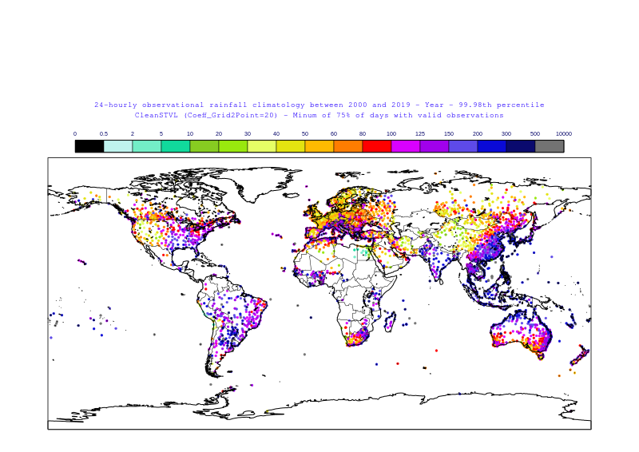
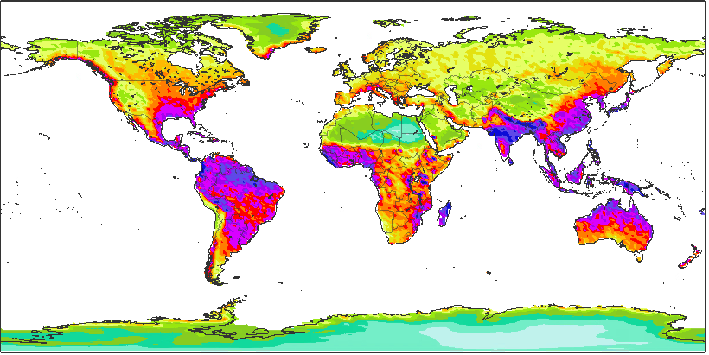
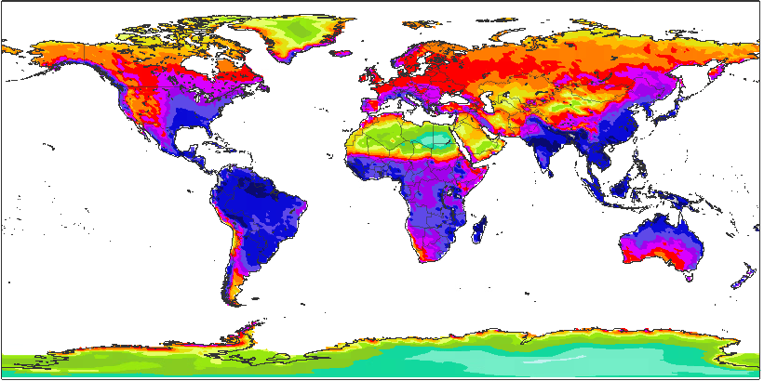
DATA
Climatology for 24-hourly rainfall [mm], 1 in 10 years event (99.98th percentile) mask the ocean
0
0.5
2
5
10
20
30
40
50
60
80
100
125
150
200
300
500
10000
OBS
ERA5
Reforecasts
ERA5-ecPoint

Slide 6
METHODS
Computation of modelled gridded climatologies

Slide 7
METHODS
Statistical test to compare the observational point-scale rainfall climatology and the modelled-gridded climatologies: 2-sample Anderson-Darling test statistic
The 2-sample Anderson-Darling test statistic is a non-parametric method used to compare the empirical distribution functions of two independent samples to assess whether they originate from the same distribution (Scholz & Stephens, 1987). Unlike traditional methods such as the Kolmogorov-Smirnov test, the Anderson-Darling test places more weight on the tails of the distributions, making it more sensitive to differences in the extreme values of the sample sets. This feature is particularly advantageous when assessing data sets where the tail behavior is of interest, for example, in the analysis of rainfall climatology of rainfall. The test statistic is calculated by integrating the squared difference between the two empirical distribution functions, weighted by the variance function of the combined sample. A higher value of the Anderson-Darling statistic indicates a greater discrepancy between the two samples, suggesting that they may come from different distributions. Critical values approximations, allowing to make inferential judgments about the homogeneity of the populations under for the test statistic are determined through simulation studies or asymptotic study. This method's robustness and sensitivity to differences in distribution tails make it a valuable tool in statistical analysis, providing a rigorous approach to testing the assumption of common distribution across samples (Pettitt, 1976).

Slide 8
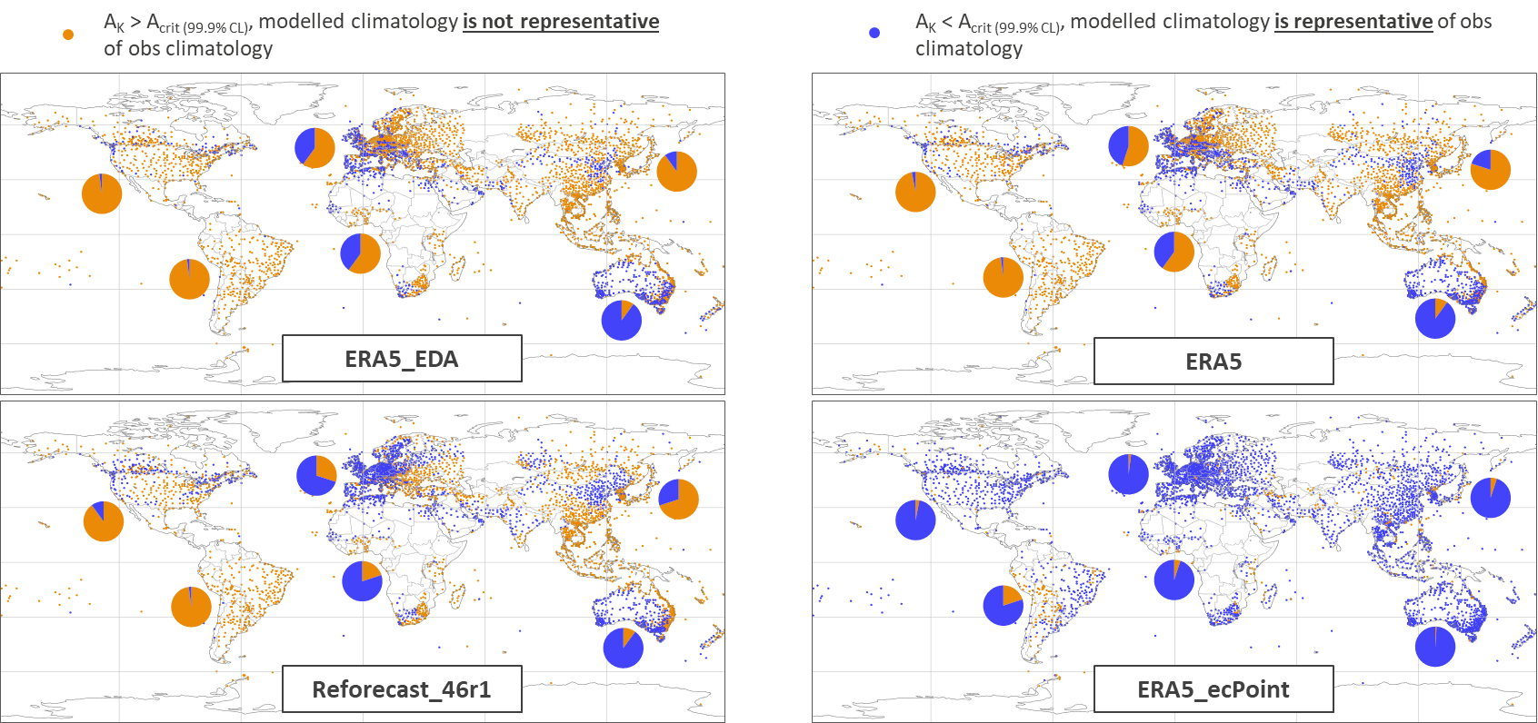
RESULTS
Figure’s main points:
ERA5-ecPoint provides the best representation of point rainfall climatologies than ERA5-EDA, ERA5, and Reforecasts_46r1. Only in South America, the representation of point observational climatologies does not exceed the 95% of the cases.
As the resolution of the modelled climatologies increases, their representation of the point observational climatologies improves, but they are not the same everywhere.
Australia stands out as the continent with the best representation of point observational climatologies by the modelled climatologies. ERA5-ecPoint does not add much value in this region.
a
b
c
d

Slide 9
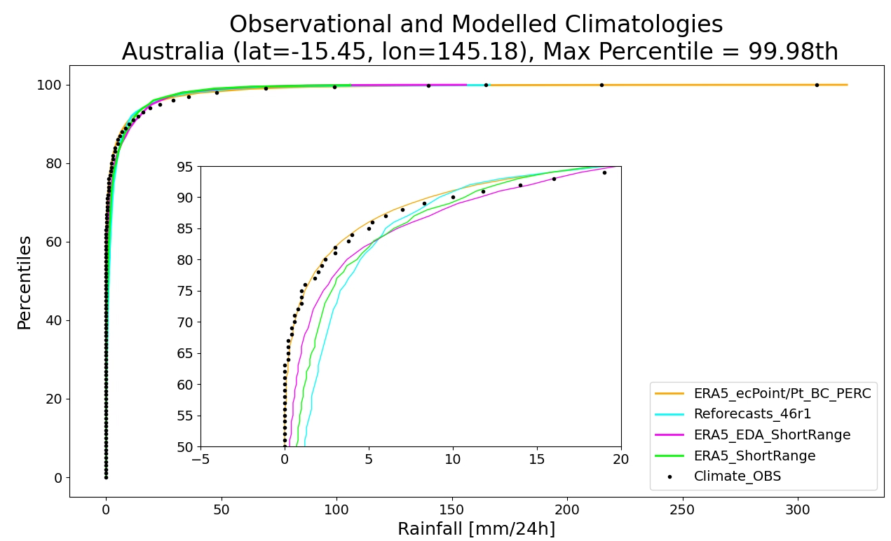
DATA

Slide 10
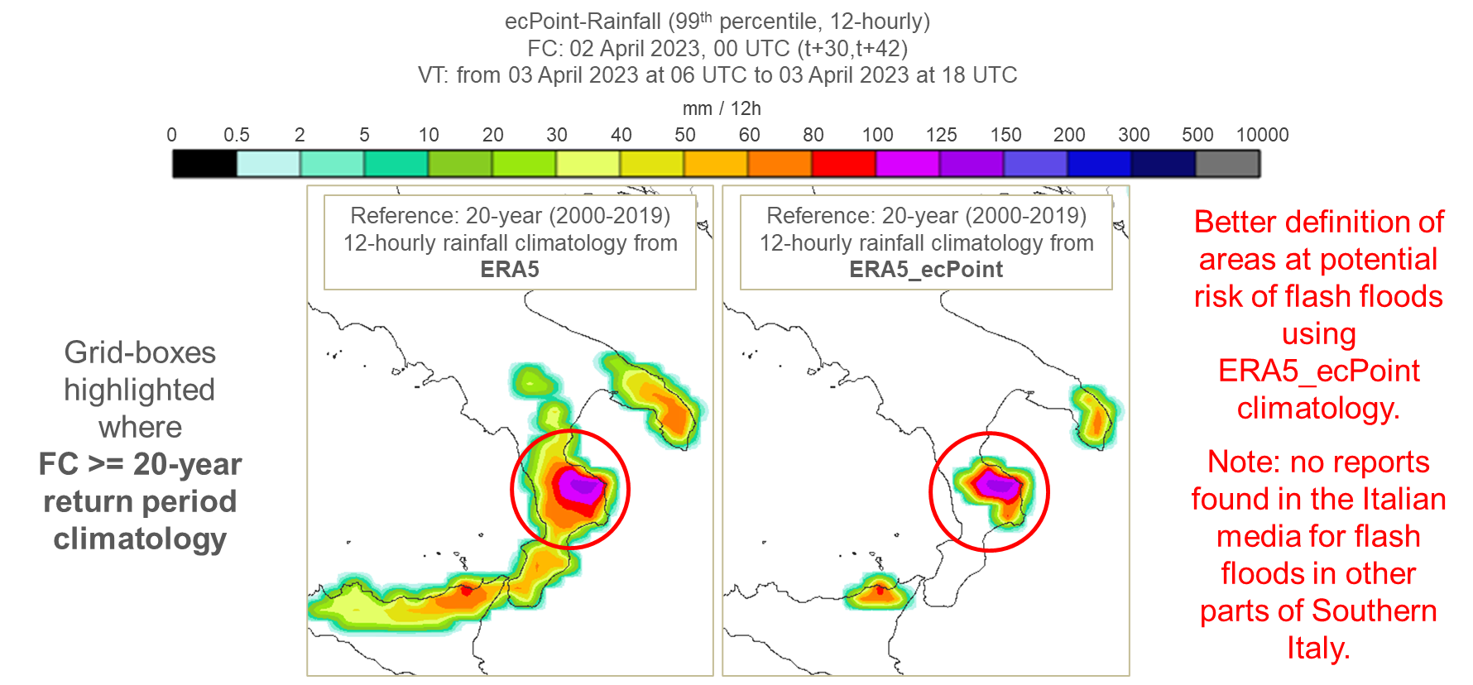
CASE STUDY
What is the goal of including a case study? To show an example of an application for the new ERA5-ecPoint data, e.g., to define rainfall thresholds to define better areas at risk of flash floods.
How can this goal be achieved? The case study compares the definition of areas affected by flash floods by different climatologies, and ERA5-ecPoint hopefully should be able to pinpoint better the areas affected.

Slide 11
DISCUSSION
Why is this important?
We can create climatologies that represent better the observational one, meaning we can issue warnings for extreme localized events.
Now we can create this threshold everywhere, without the need of observations, so we can issue warnings for ungauged areas, so the whole globe can have access to warning for extreme rainfall.
Around the world we have a better representation overall, including extremes.
If we use ecPoint ERA5 we need to be carefull we might create thresholds too high and we might miss events in Europe.
We need to test this with forecasts to understand whether this would make any change in the predictions.

Slide 12
CONCLUSION

