Slide 1
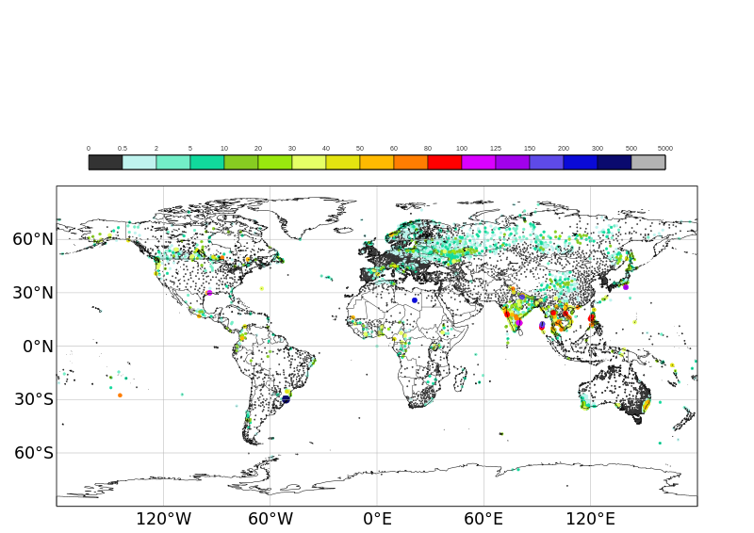
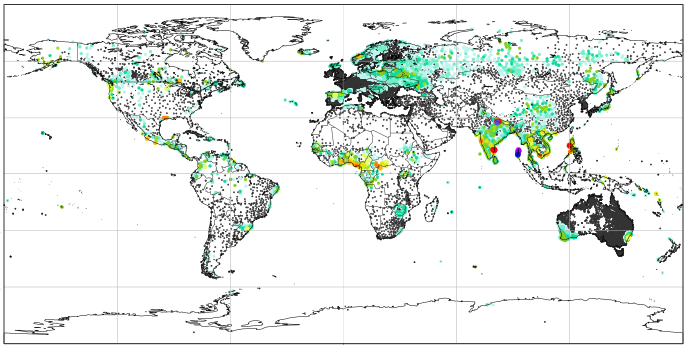
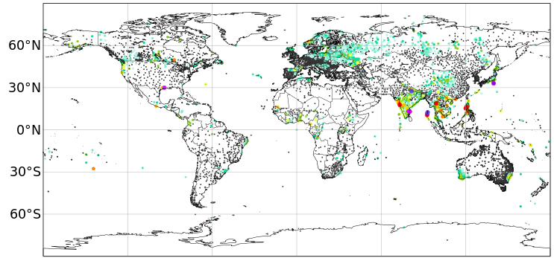





Example of 24-hourly rainfall observations for 2019-09-19
mm/24h
RawSTVL
GridCPC
CleanSTVL, Coeff_Grid2Pt = 2
CleanSTVL, Coeff_Grid2Pt = 2
CleanSTVL, Coeff_Grid2Pt = 2
CleanSTVL, Coeff_Grid2Pt = 2
CleanSTVL, Coeff_Grid2Pt = 2
CleanSTVL, Coeff_Grid2Pt = 2

