Slide 1
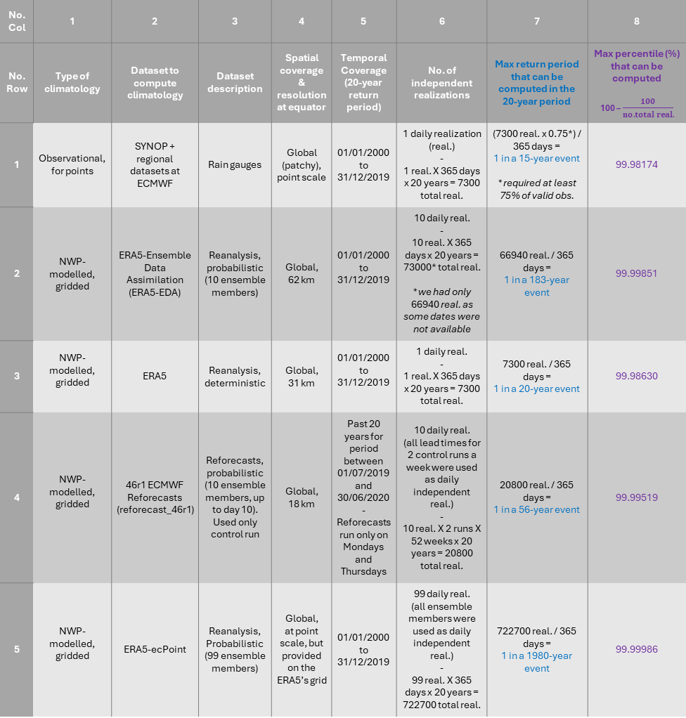
No. Col | 1 | 2 | 3 | 4 | 5 | 6 | 7 | 8
No. Row | Type of climatology | Dataset to compute climatology | Dataset description | Spatial coverage & resolution at equator | Temporal Coverage (20-year return period) | No. of independent realizations | Max return period that can be computed in the 20-year period | Max percentile (%) that can be computed 100 – $\frac{100}{no. total real.}$
1 | Observational, for points | SYNOP + regional datasets at ECMWF | Rain gauges | Global (patchy), point scale | 01/01/2000 to 31/12/2019 | 1 daily realization (real.) - 1 real. X 365 days x 20 years = 7300 total real. | (7300 real. x 0.75*) / 365 days = 1 in a 15-year event * required at least 75% of valid obs. | 99.98174
2 | NWP-modelled, gridded | ERA5-Ensemble Data Assimilation (ERA5-EDA) | Reanalysis, probabilistic (10 ensemble members) | Global, 62 km | 01/01/2000 to 31/12/2019 | 10 daily real. - 10 real. X 365 days x 20 years = 73000* total real. * we had only 66940 real. as some dates were not available | 66940 real. / 365 days = 1 in a 183-year event | 99.99851
3 | NWP-modelled, gridded | ERA5 | Reanalysis, deterministic | Global, 31 km | 01/01/2000 to 31/12/2019 | 1 daily real. - 1 real. X 365 days x 20 years = 7300 total real. | 7300 real. / 365 days = 1 in a 20-year event | 99.98630
4 | NWP-modelled, gridded | 46r1 ECMWF Reforecasts (reforecast_46r1) | Reforecasts, probabilistic (10 ensemble members, up to day 10). Used only control run | Global, 18 km | Past 20 years for period between 01/07/2019 and 30/06/2020-Reforecasts run only on Mondays and Thursdays | 10 daily real. (all lead times for 2 control runs a week were used as daily independent real.) - 10 real. X 2 runs X 52 weeks x 20 years = 20800 total real. | 20800 real. / 365 days = 1 in a 56-year event | 99.99519
5 | NWP-modelled, gridded | ERA5-ecPoint | Reanalysis, Probabilistic (99 ensemble members) | Global, at point scale, but provided on the ERA5’s grid | 01/01/2000 to 31/12/2019 | 99 daily real. (all ensemble members were used as daily independent real.) - 99 real. X 365 days x 20 years = 722700 total real. | 722700 real. / 365 days = 1 in a 1980-year event | 99.99986

