Slide 1
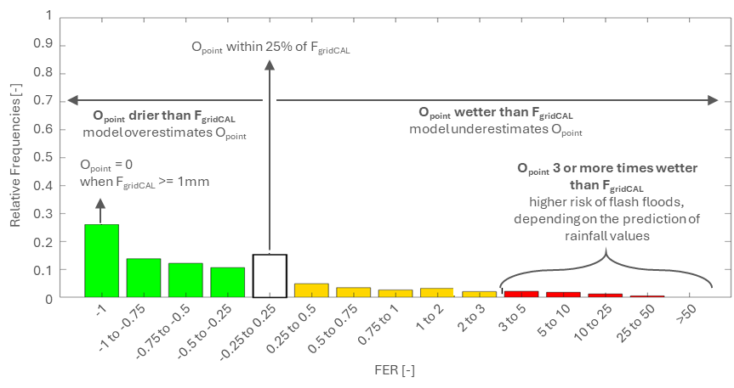
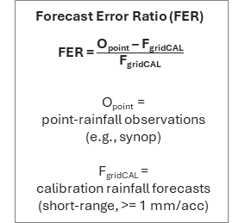
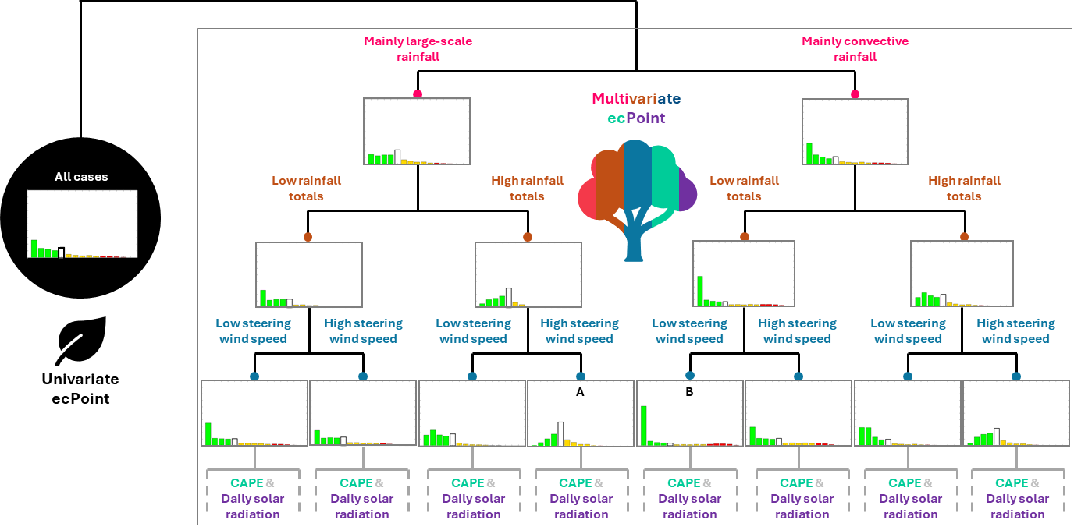
Graphical representation of the ecPoint post-processing technique
Mapping function and decision tree
(a) Error formulation for accumulated variables (Forecast Error Ratio, FER), and errors’ distribution for all cases in the training dataset (Mapping Function, MF)
(b) Univariate and multivariate ecPoint represented, respectively, as a “single-leaf” and “multiple-leaf” decision tree (DT)

Slide 2
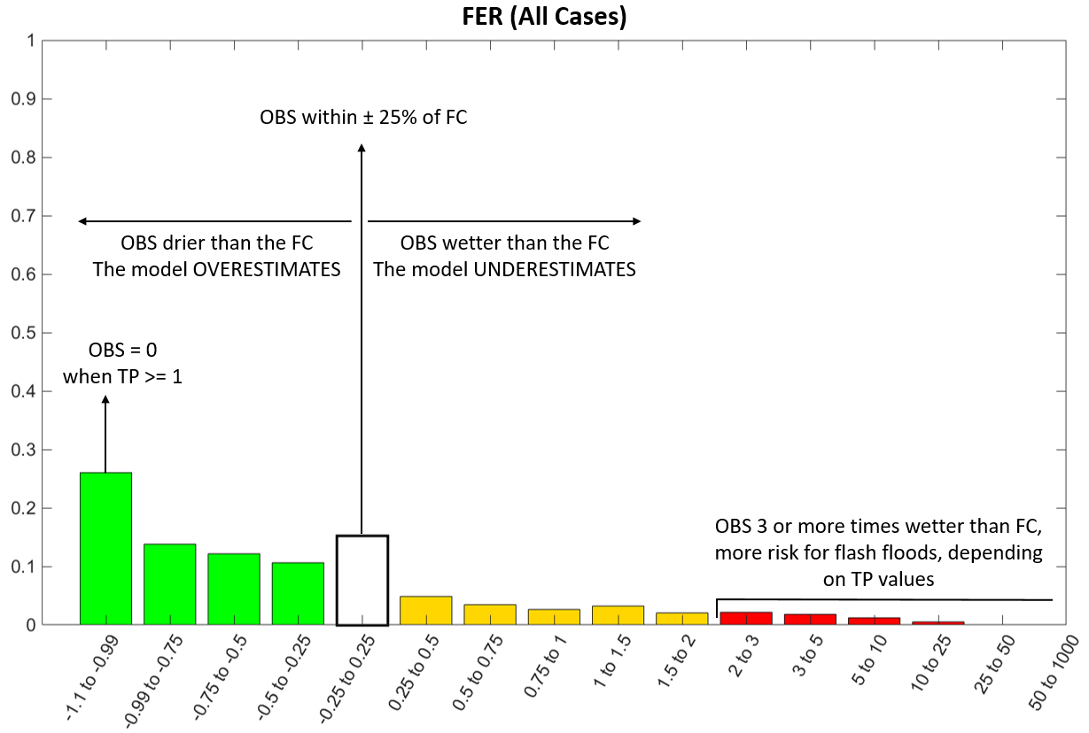

Forecast Error Ratio (FER)
FER = $\frac{\text{O}\text{point}\text{ – }\text{FgridCA}\text{L}}{\text{F}\text{gridCAL}}$
O_{point} =
point-rainfall observations
(e.g., synop)
F_{gridCAL} =
calibration rainfall forecasts
(short-range, >= 1 mm/acc)
1
0.9
O_{point} within 25% of F_{gridCAL}
0.8
0.7
O_{point} drier than F_{gridCAL}
model overestimates O_{point}
O_{point} wetter than F_{gridCAL}
model underestimates O_{point}
0.6
Relative Frequencies [-]
0.5
O_{point} = 0
when F_{gridCAL} >= 1mm
O_{point} 3 or more times wetter than F_{gridCAL}
higher risk of flash floods, depending on the prediction of rainfall values
0.4
0.3
0.2
0.1
0
-1
-1 to -0.75
-0.75 to -0.5
-0.5 to -0.25
-0.25 to 0.25
0.25 to 0.5
0.5 to 0.75
0.75 to 1
1 to 2
2 to 3
3 to 5
5 to 10
10 to 25
25 to 50
>50
FER [-]

Slide 3
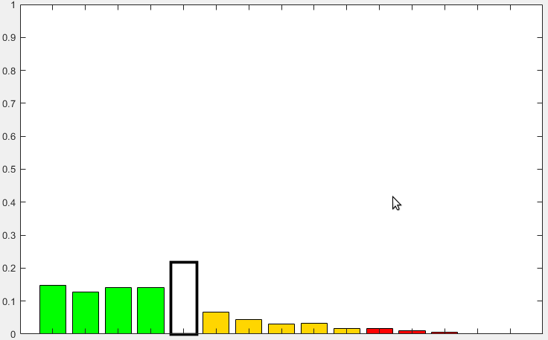
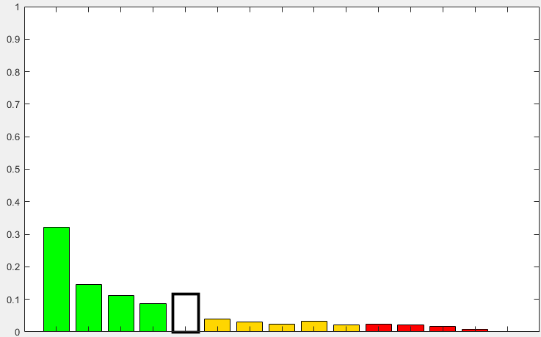





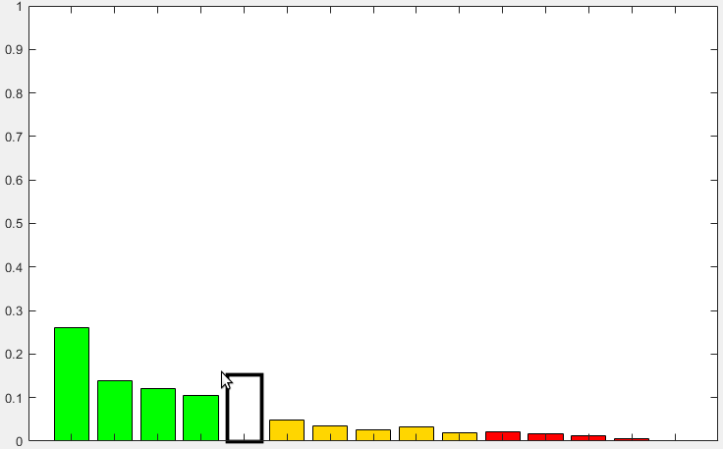
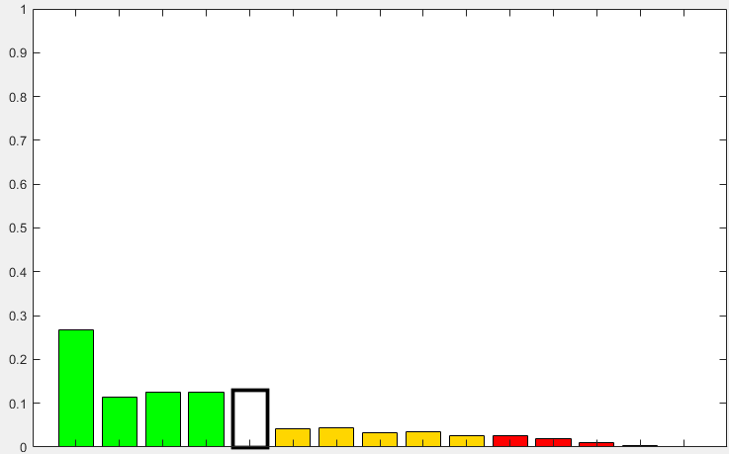
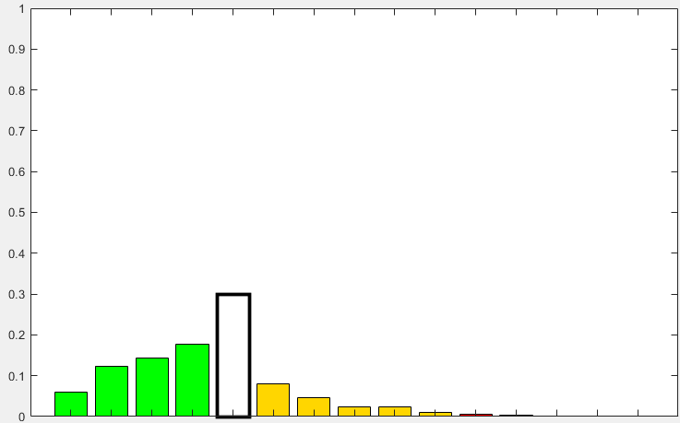
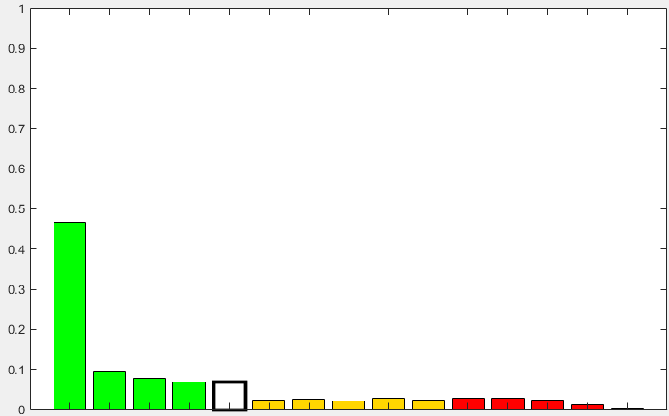
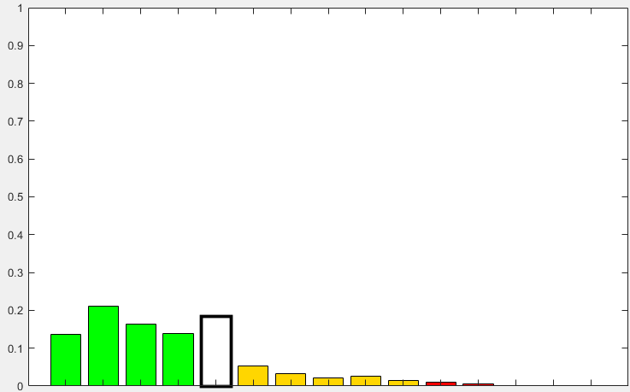

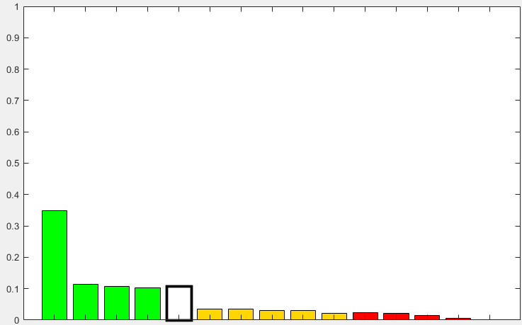
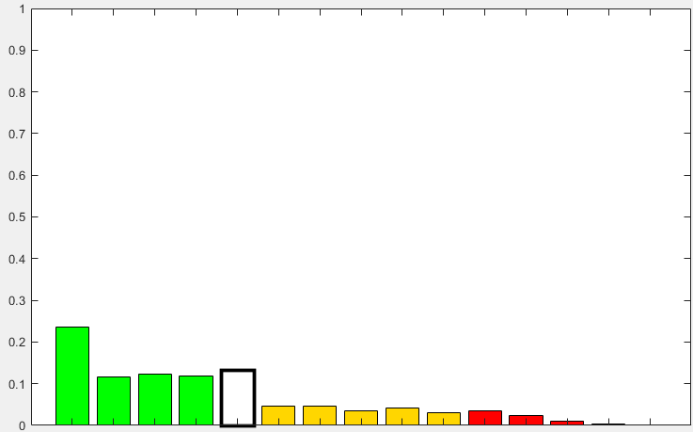
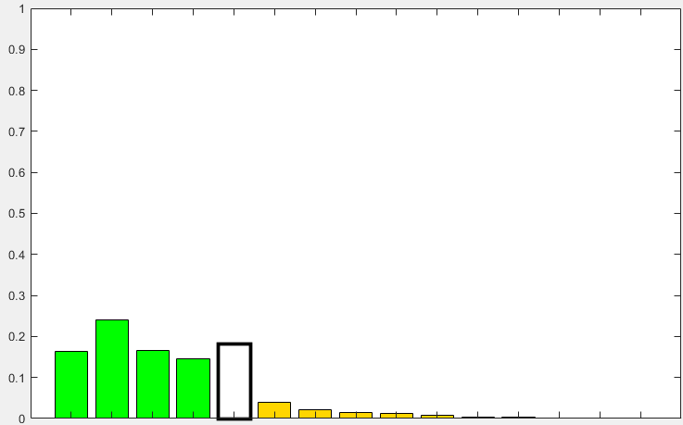
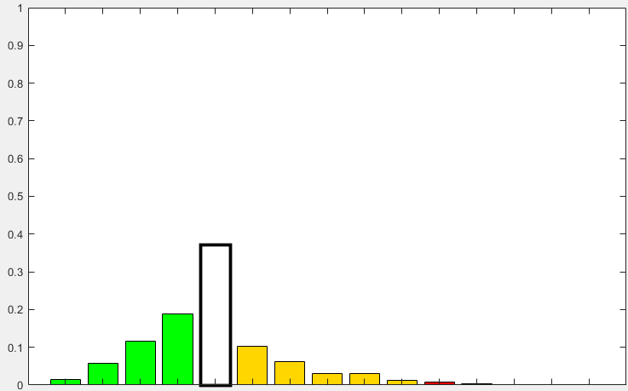
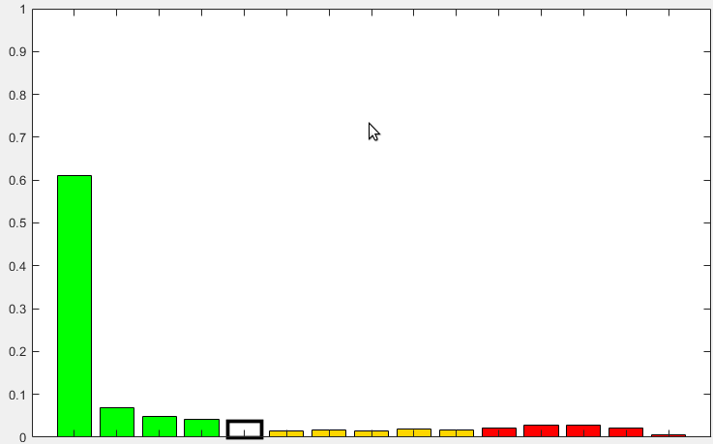
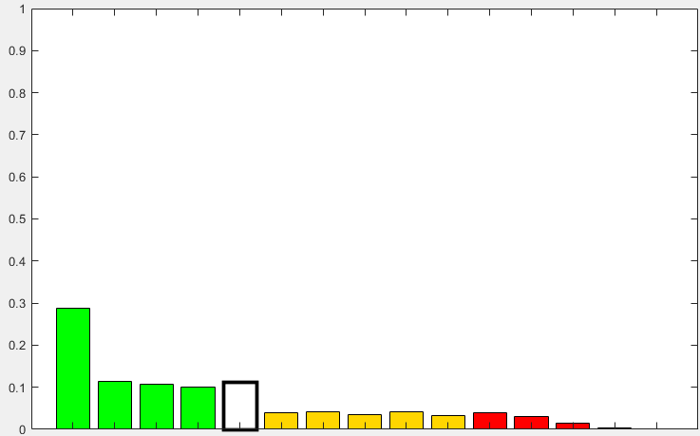
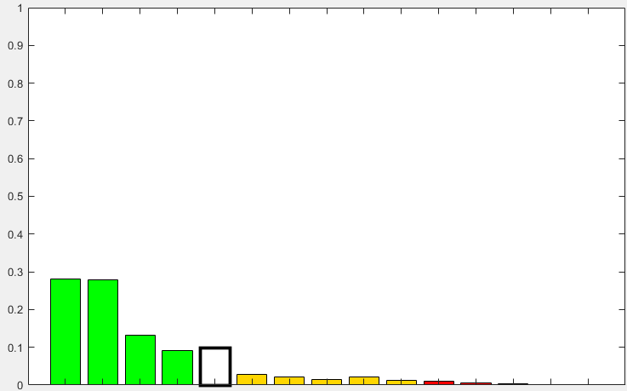
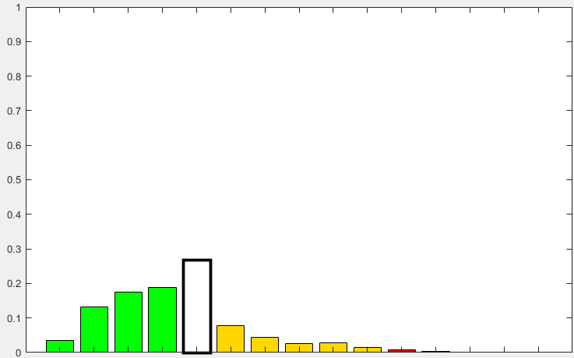
Mainly large-scale rainfall
Mainly convective rainfall
Multivariate ecPoint
All cases
Low rainfall totals
High rainfall totals
Low rainfall totals
High rainfall totals
Low steering wind speed
High steering wind speed
Low steering wind speed
High steering wind speed
Low steering wind speed
High steering wind speed
Low steering wind speed
High steering wind speed
Univariate ecPoint
A
B
CAPE &
Daily solar radiation
CAPE &
Daily solar radiation
CAPE &
Daily solar radiation
CAPE &
Daily solar radiation
CAPE &
Daily solar radiation
CAPE &
Daily solar radiation
CAPE &
Daily solar radiation
CAPE &
Daily solar radiation

