Slide 1
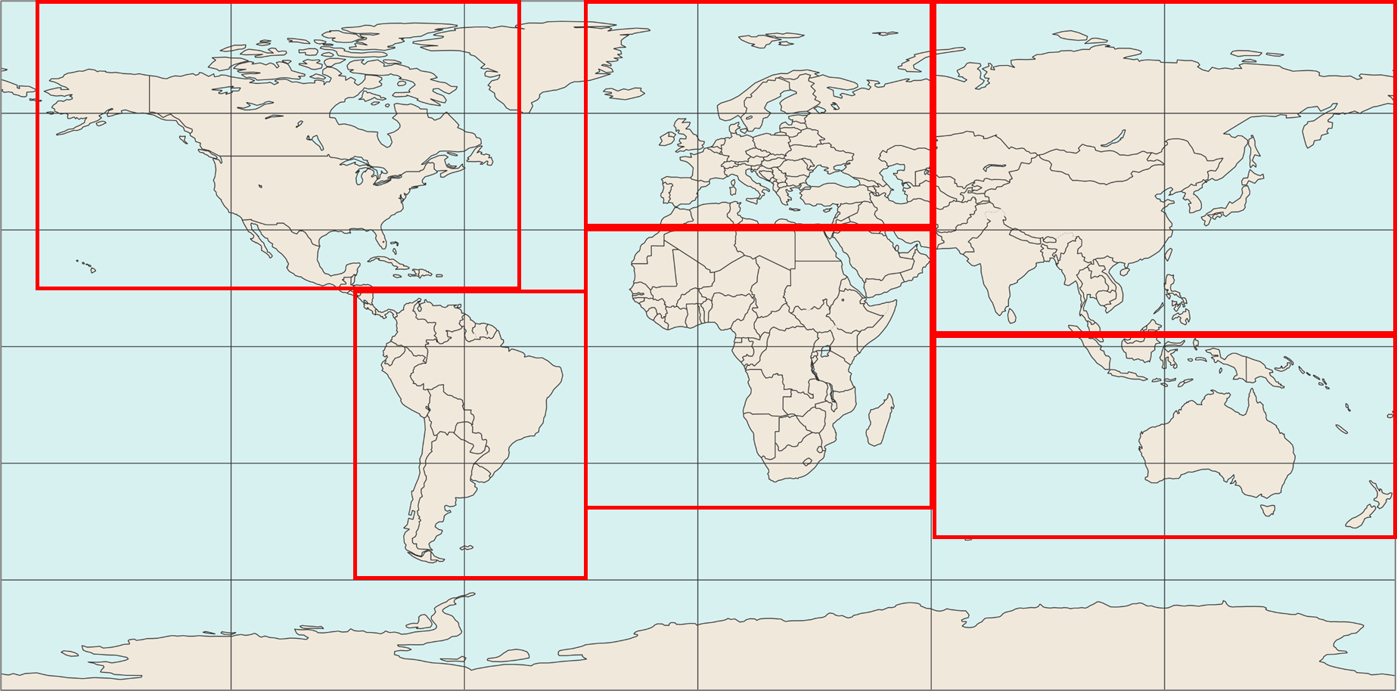
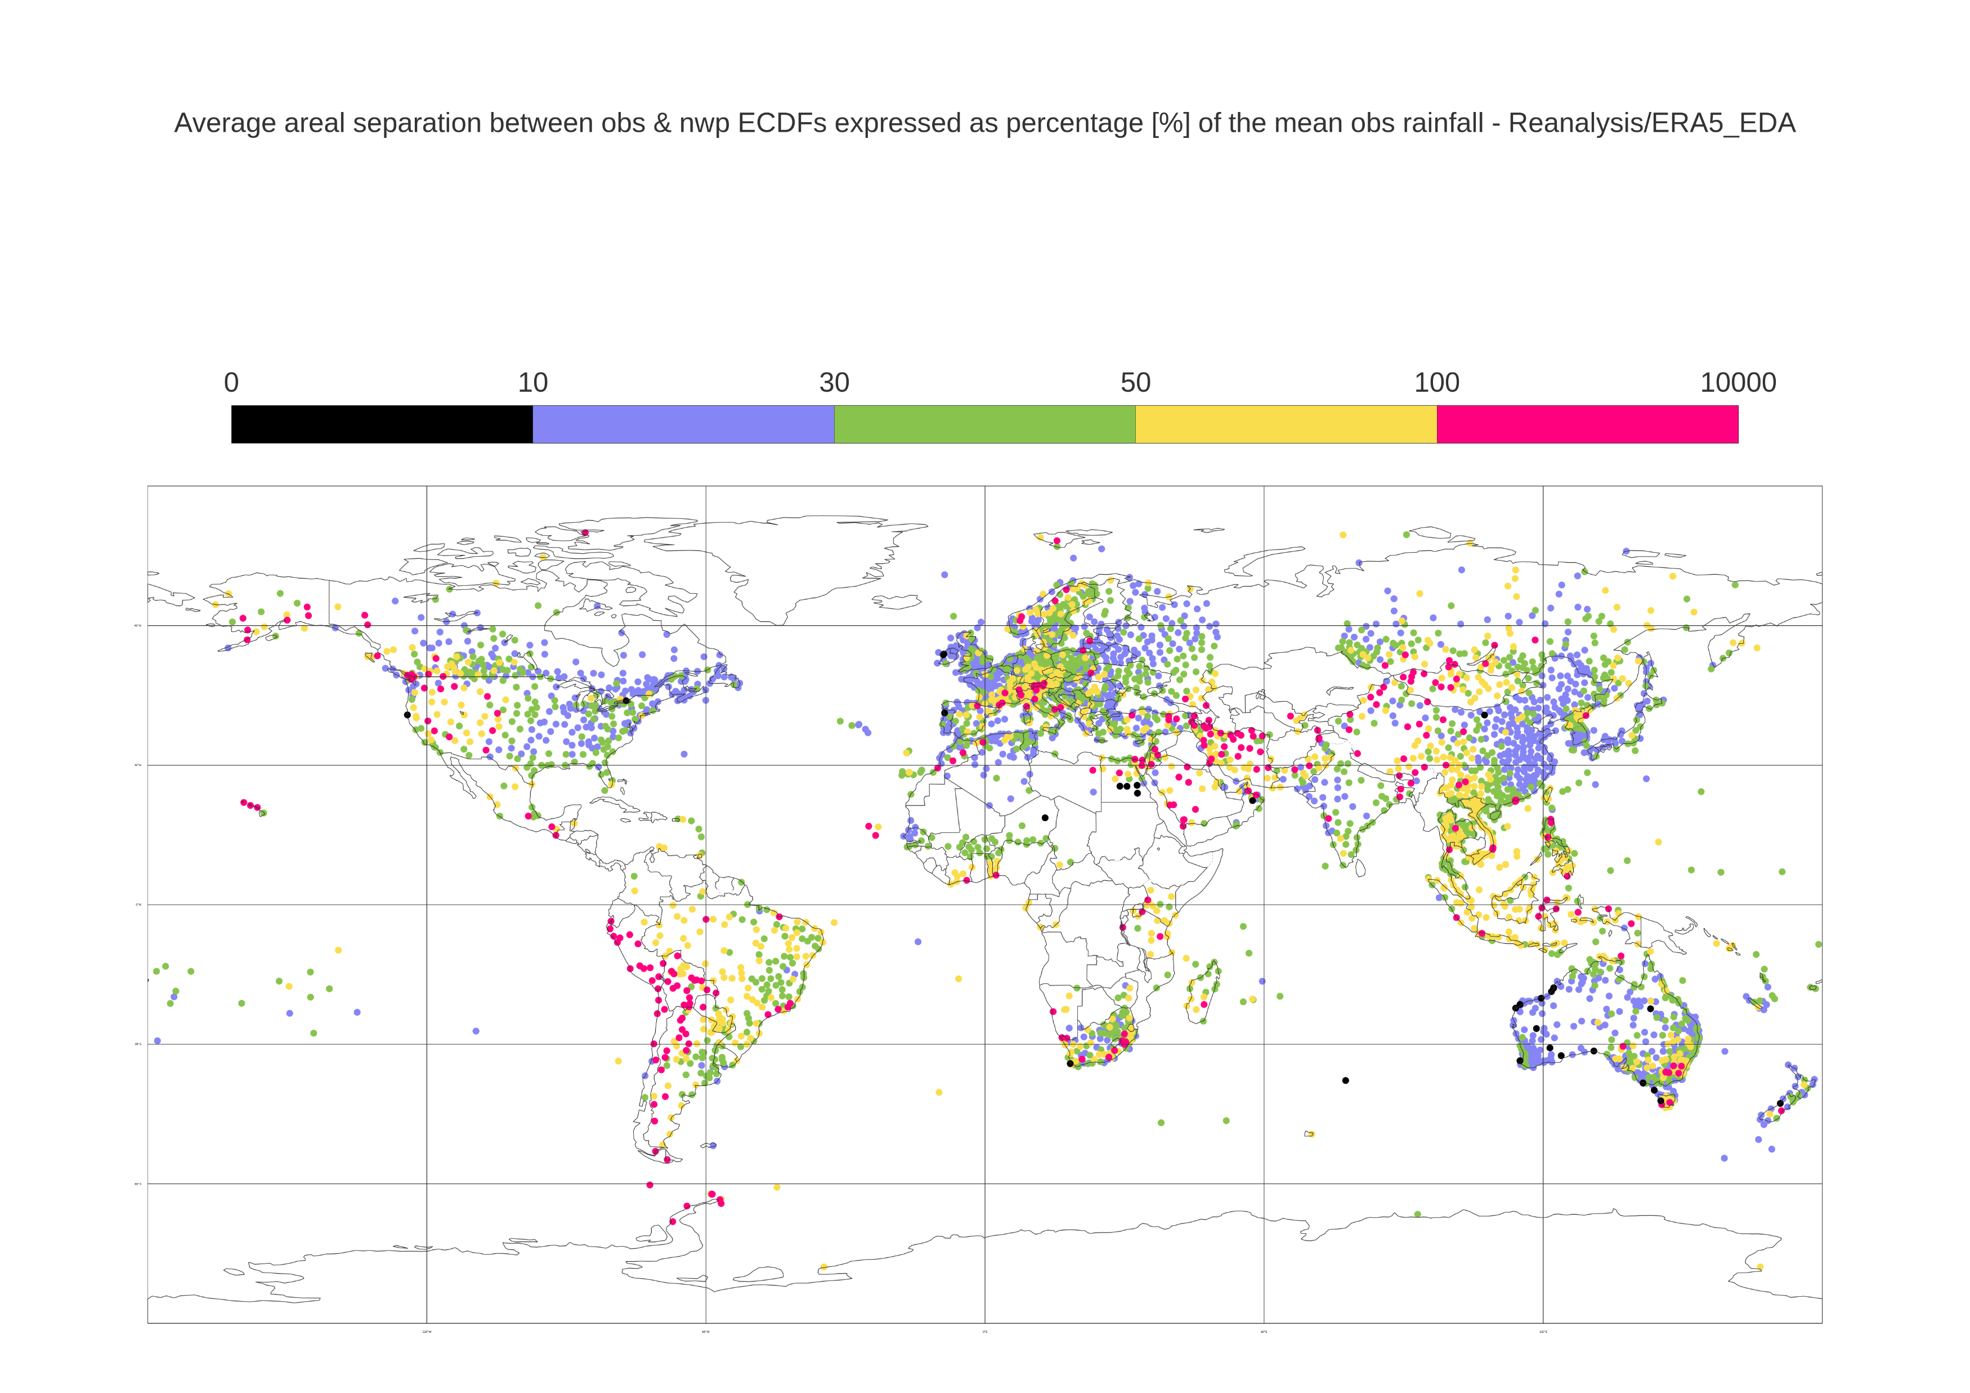
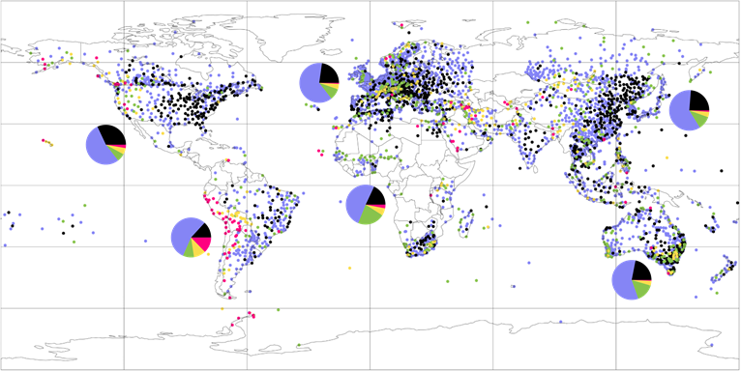
Normalized Mean Absolute Error (MAE_{NORM}) for 24-hourly total precipitation
ECMWF ecPoint (point-scale in 31 km)
a) Domains to create the piecharts
60 °N
North America [90 °N, 170 °W, 15 °N, 50 °W]
South America [15 °N, 100 °W, 60 °S, 30 °W]
Europe & Mediterranean [90 °N, 30 °W, 30 °N, 60 °E]
Africa & Arabian Peninsula [30 °N, 30 °W, 40 °S, 60 °E]
Asia [90 °N, 60 °E, 5 °N, 180 °E]
Oceania [5 °N, 60 °E, 60 °S, 180 °E]
30 °N
0 °N
30 °S
60 °S
120 °W
60 °W
0 °E
60 °E
120 °E
(b) MAE_{NORM} values at each rain gauge station (map plot), aggregated per domain (piecharts), and piecharts’ numerical values (table)
MAE_{NORM}
0
0.1
0.3
0.5
1
100 [-]
120 °W
60 °W
0 °E
60 °E
120 °E
60 °N
30 °N
0 °N
30 °S
60 °S

