Slide 1
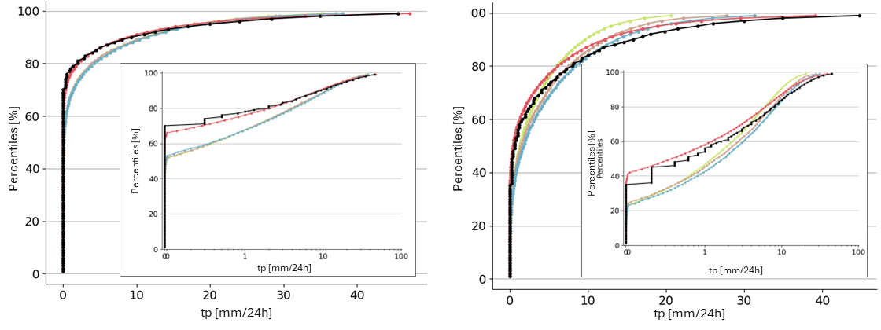
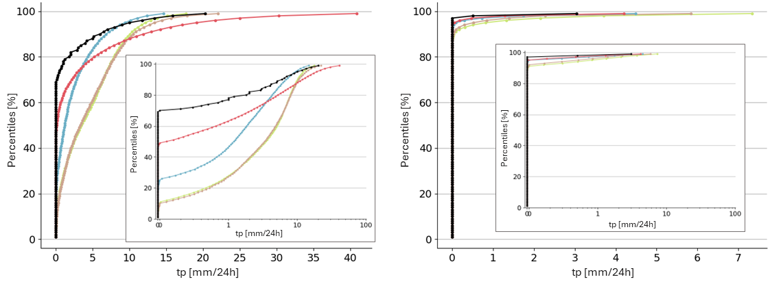
Empirical Cumulative Distribution Functions (ECDFs) for 24-hourly total precipitation (tp)
OBS
ERA5-EDA
ERA5
ECMWF Reforecast - 46r1
ERA5 - ecPoint
(a) Real ECDF, Flat area
Evansville, Indiana, USA [lat = 38.05, lon = -87.53]
(b) Real ECDF, Hilly/Mountainous area
Lake District, UK [lat = 54.05, lon = -2.68]
(c) Real ECDF, Very mountainous area
La Paz, Bolivia [lat = -16.52, lon = -68.18]
(d) Real ECDF, Desert
Al Hofuf, Saudi Arabia [lat = 25.30, lon = 49.48]

