Slide 1
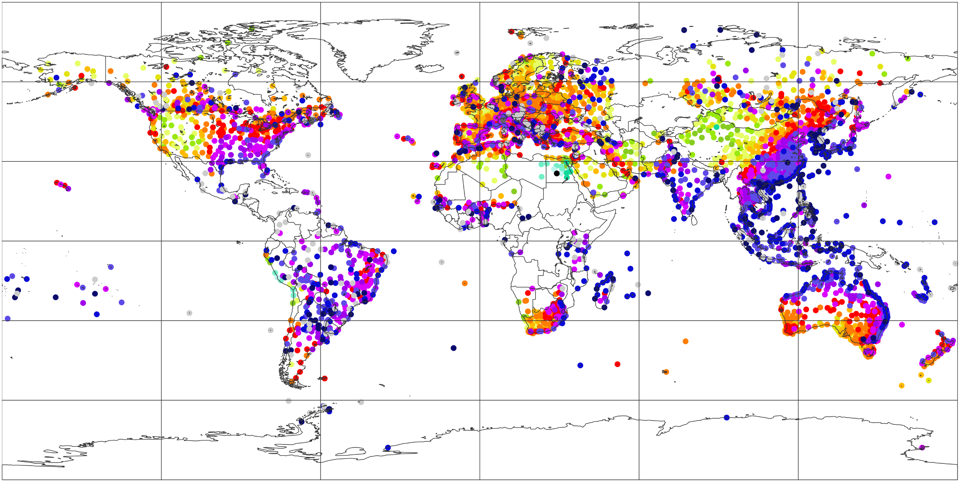
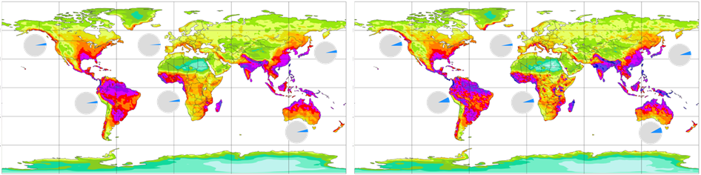
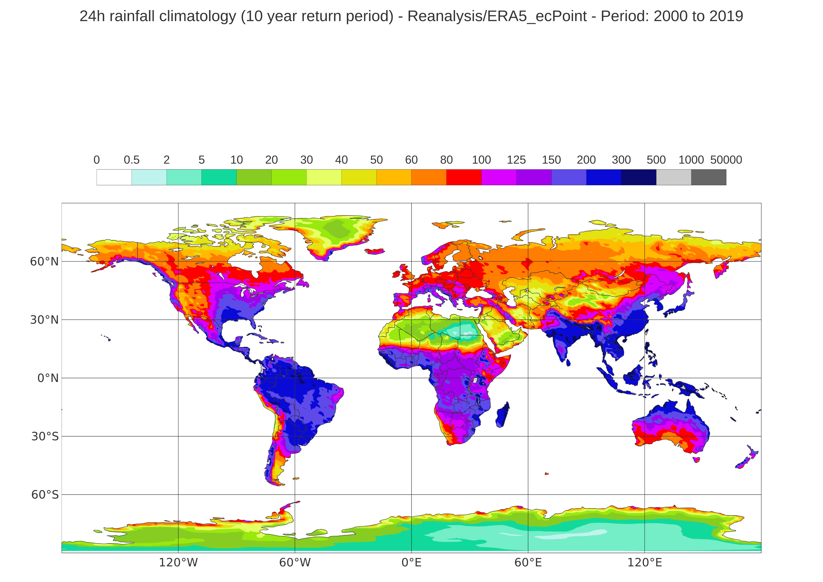
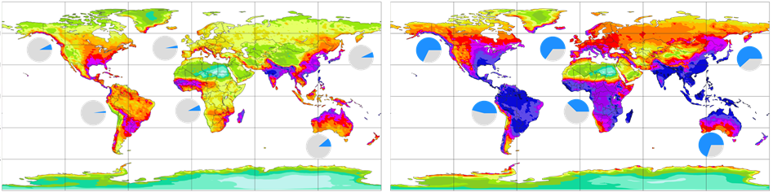
10-year return period (=99.9726th percentile) for 24-hourly total precipitation [mm/24h]
Piecharts: percentage of NWP-modelled estimates exceeding the corresponding observed ones
(a) Rain gauge observations (point scale), only rain gauges with at least 75% of valid record in the 20-year period
mm/24h
inf
60 °N
1000
30 °N
500
300
0 °N
200
30 °S
150
60 °S
125
120 °W
60 °W
0 °E
60 °E
120 °E
100
(b) ERA5 – EDA (62 km)
(c) ERA5 (31 km)
80
60 °N
60
30 °N
3.47%
1.55%
3.94%
5.78%
3.16%
5.61%
0 °N
50
30 °S
3.33%
3.54%
4.27%
7.67%
5.31%
8.13%
40
60 °S
30
(d) ECMWF Reforecasts - 46r1 (18 km)
(e) ERA5 – ecPoint (point-scale in ERA’s 31 km grid)
20
60 °N
30 °N
7.51%
3.55%
65.14%
10
7.01%
67.63%
61.79%
0 °N
46.00%
5
30 °S
2.33%
7.67%
11.29%
37.76%
69.56%
60 °S
2
120 °W
60 °W
0 °E
60 °E
120 °E
120 °W
60 °W
0 °E
60 °E
120 °E
0.5

