Slide 1
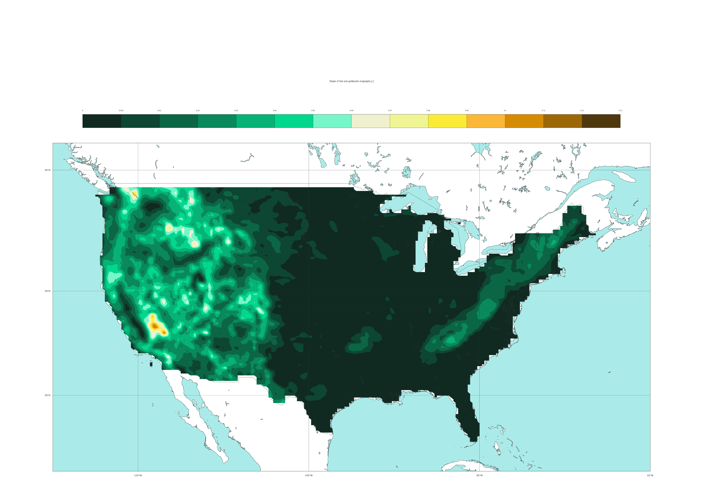
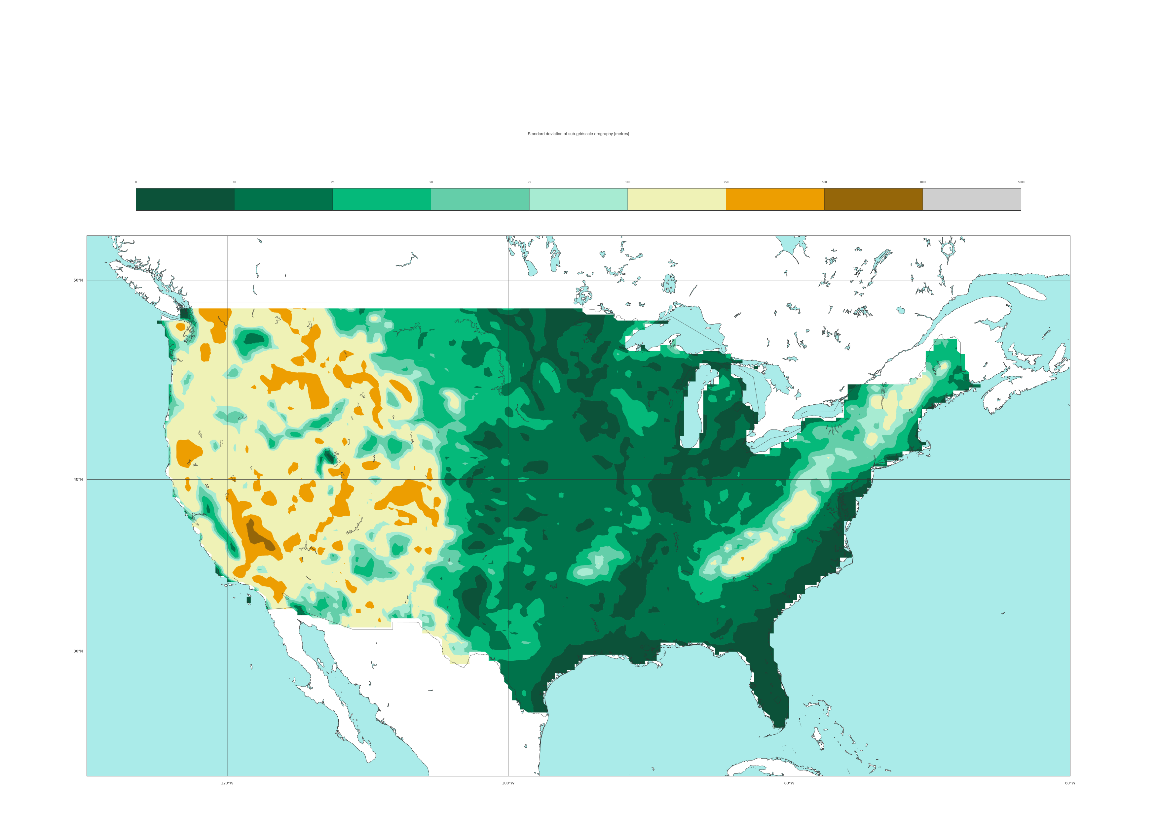

ERA5 variables used in the data-driven model
Variables to represent the orography (static)
a) Slope of sub-grid scale orography
[%]
0
0.5
1
2
3
4
5
6
7
8
9
10
11
12
100
50 °N
40 °N
30 °N
120 °W
100 °W
80 °W
b) Standard deviation of the filtered sub-grid orography
[metres]
0
10
25
50
75
100
250
500
1000
5000
50 °N
40 °N
30 °N
120 °W
100 °W
80 °W

