Slide 1
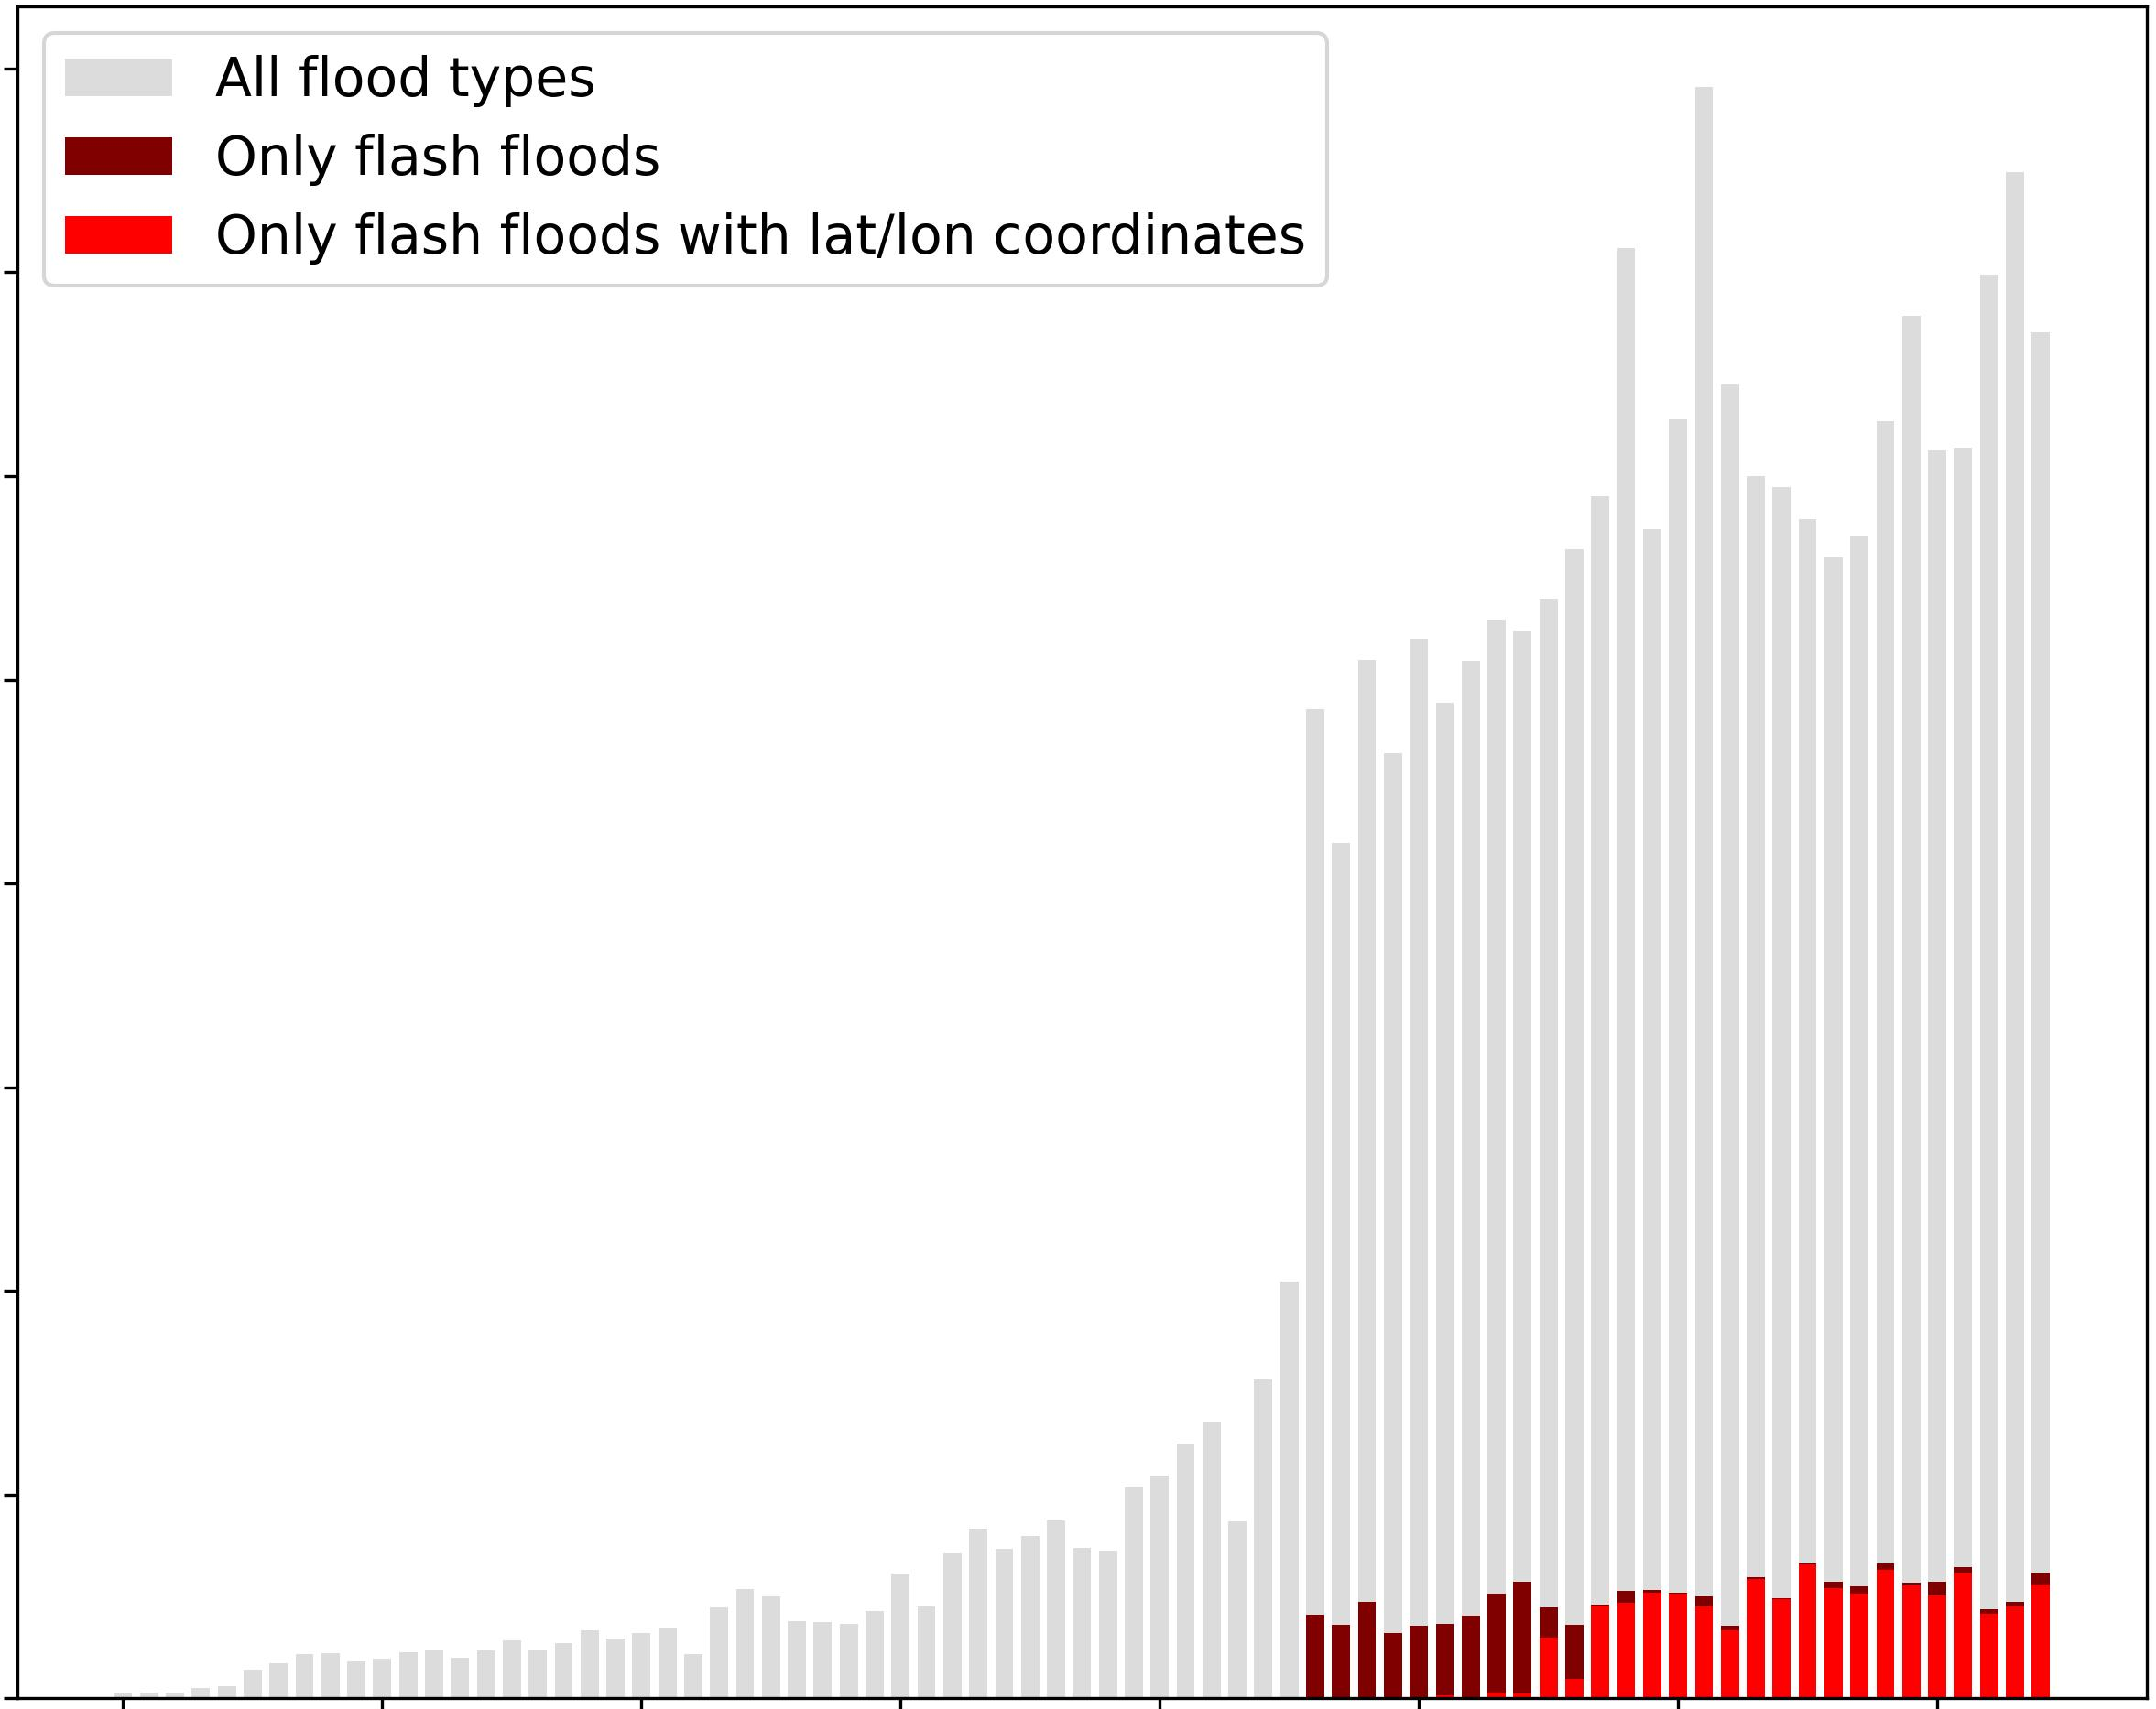

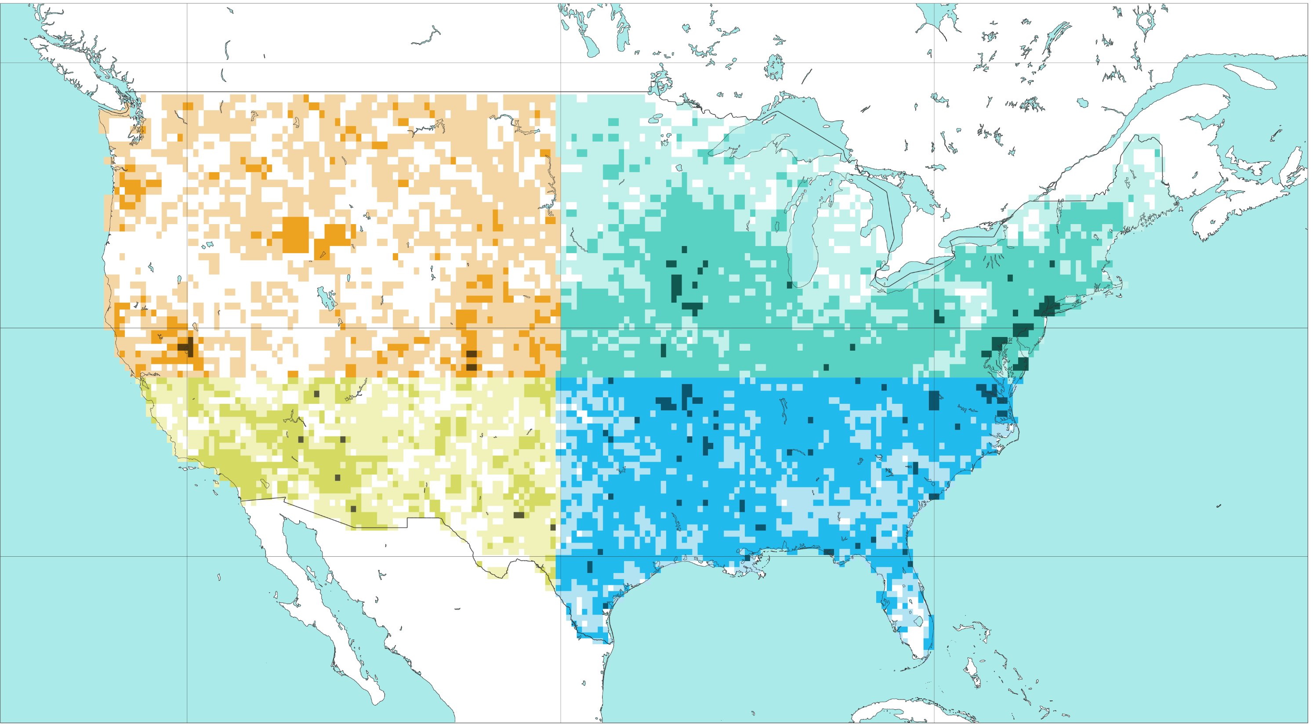
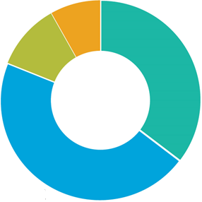
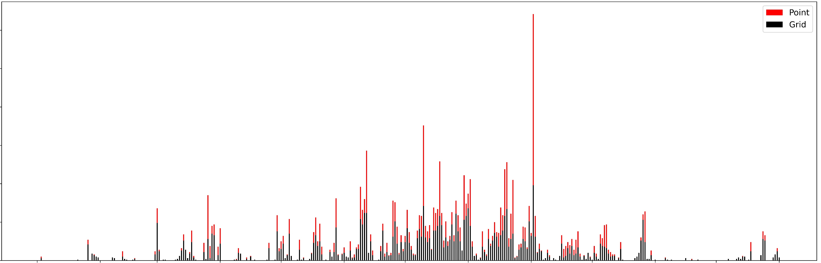
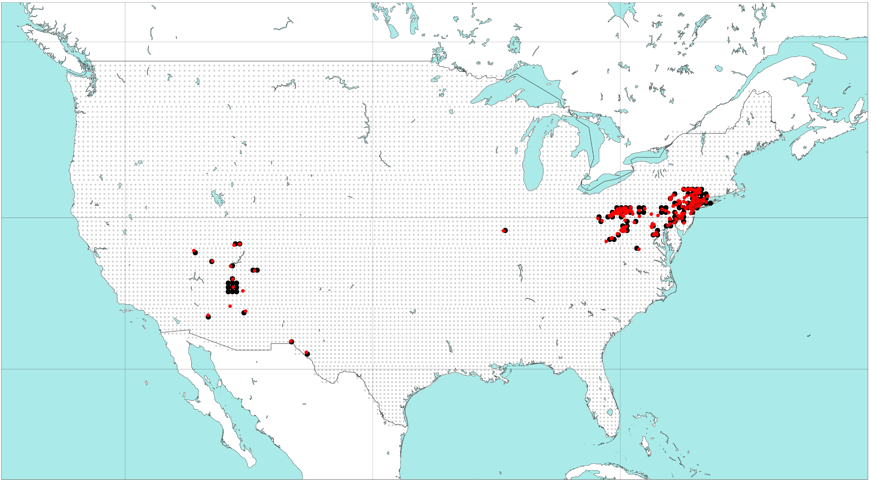
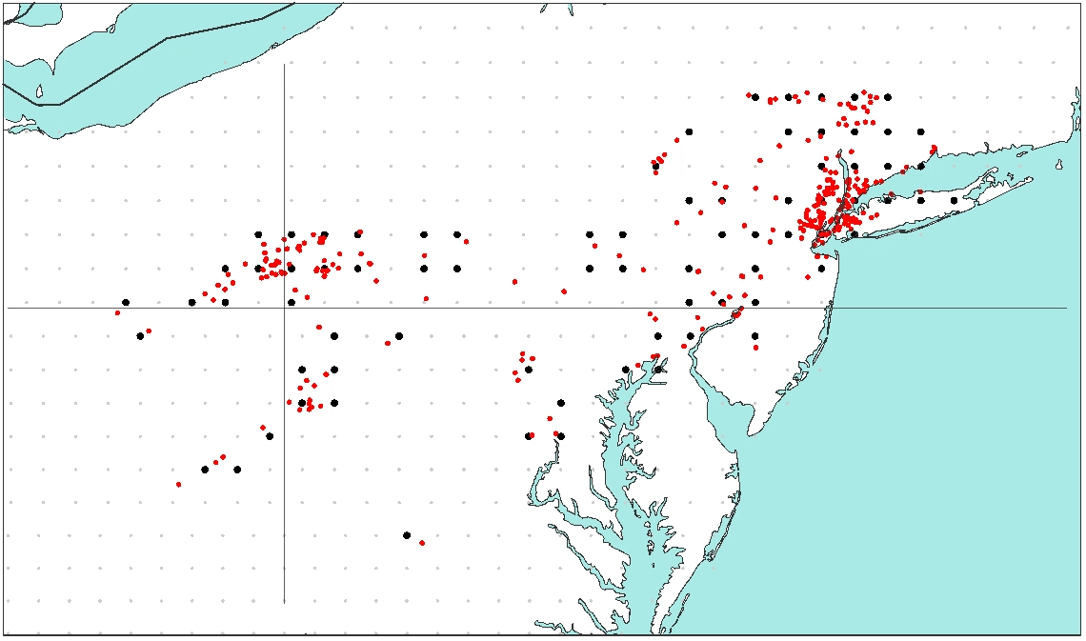
Target variable for data-driven model
Flash flood impact reports from NOAA’s Storm Event Database
a) Spatial distribution for the frequency of point flash flood impact report counts per grid-box, between 2001 and 2024
b) Timeseries of point flood report counts per year, between 1950 and 2024
[%]
[%]
8
All flood types
7
Only flash floods
0
0.1
1
10
0
0.1
1
10
Only flash floods
with lat/lon coord.
NW
NE
6
SW
SE
5
Counts * 10⁴
50 °N
4
3
40 °N
2
1
0
30 °N
10.7%
8.2%
1950
1960
1970
1980
1990
2000
2010
2020
Years
120 °W
100 °W
80 °W
45.7%
35.4%
Total = 108903
2021
c) Timeseries of point and gridded flash flood report counts in 2021, accumulated over 24-hourly periods ending at 00 UTC
300
Point
24-hourly accumulation
period ending on
02-09-2021 at 00 UTC
(Storm Ida)
250
Gridded
200
Counts
150
100
50
0
2021-11
2022-01
2021-01
2021-02
2021-03
2021-04
2021-05
2021-06
2021-07
2021-08
2021-09
2021-10
2021-12
Days
d) Spatial distribution of point and gridded flash flood impact reports, accumulated over the 24-hourly period ending on 2021-09-02 at 00 UTC (Storm Ida)
50 °N
40 °N
30 °N
120 °W
100 °W
80 °W

