Slide 1
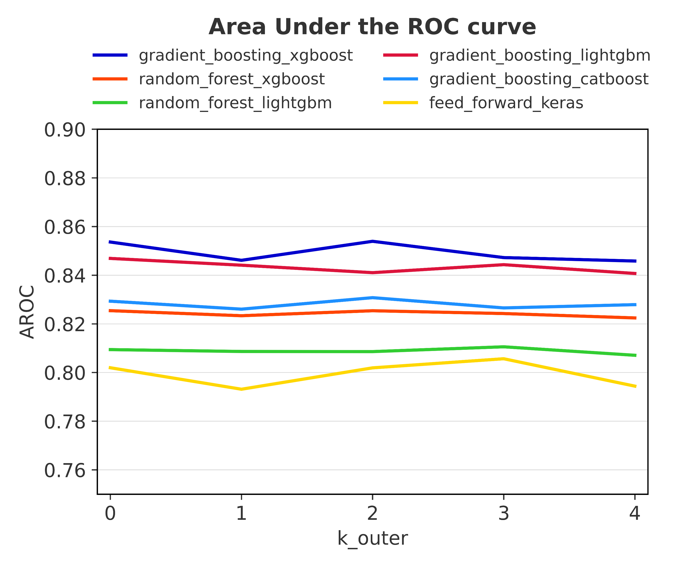
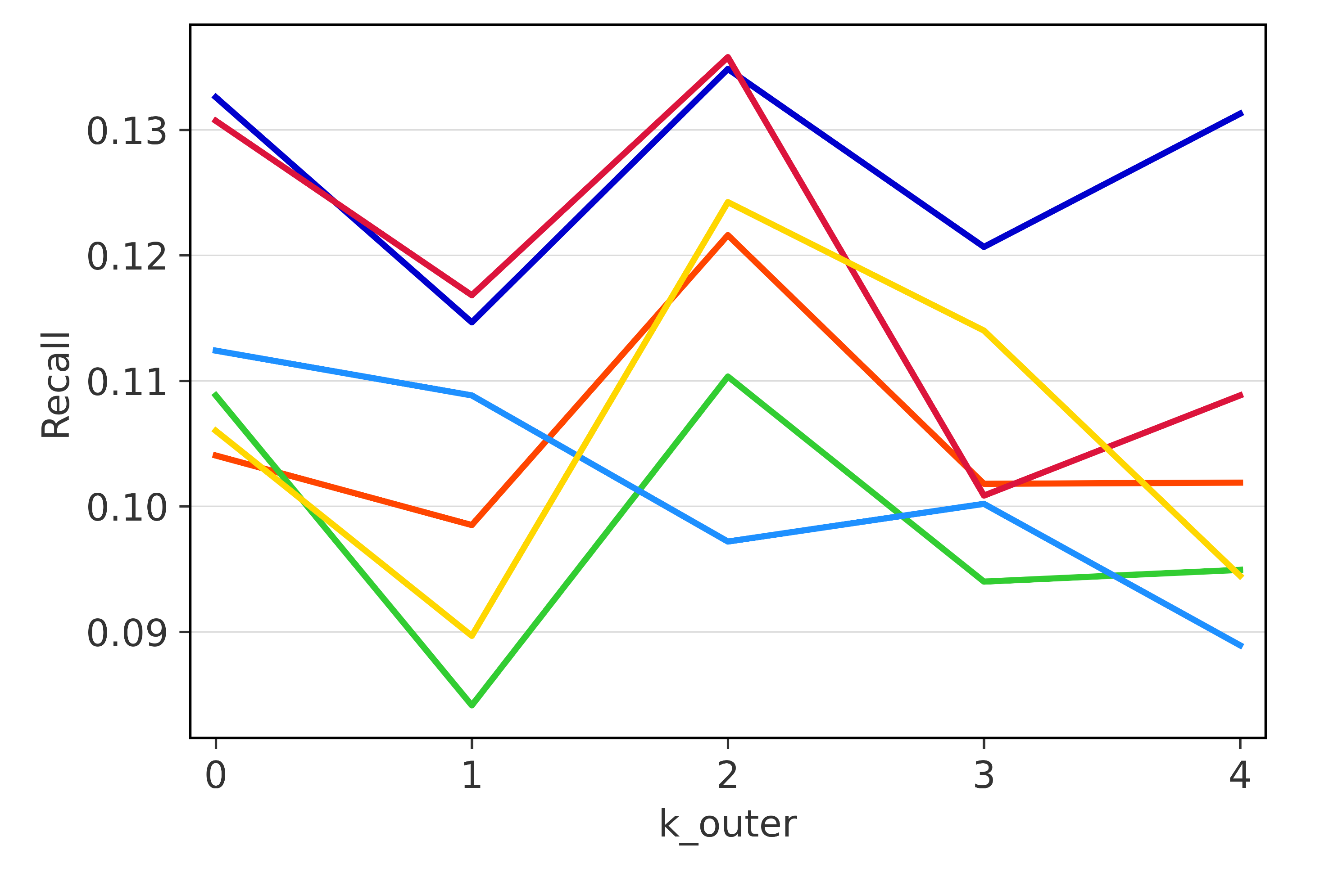
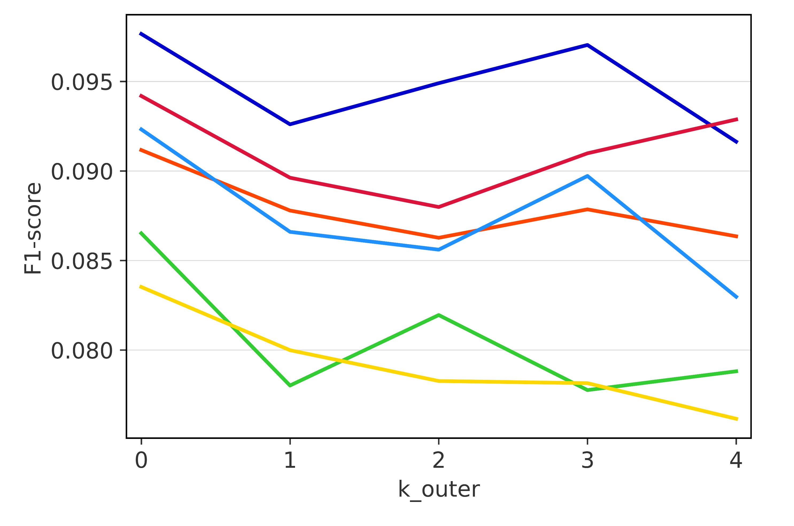
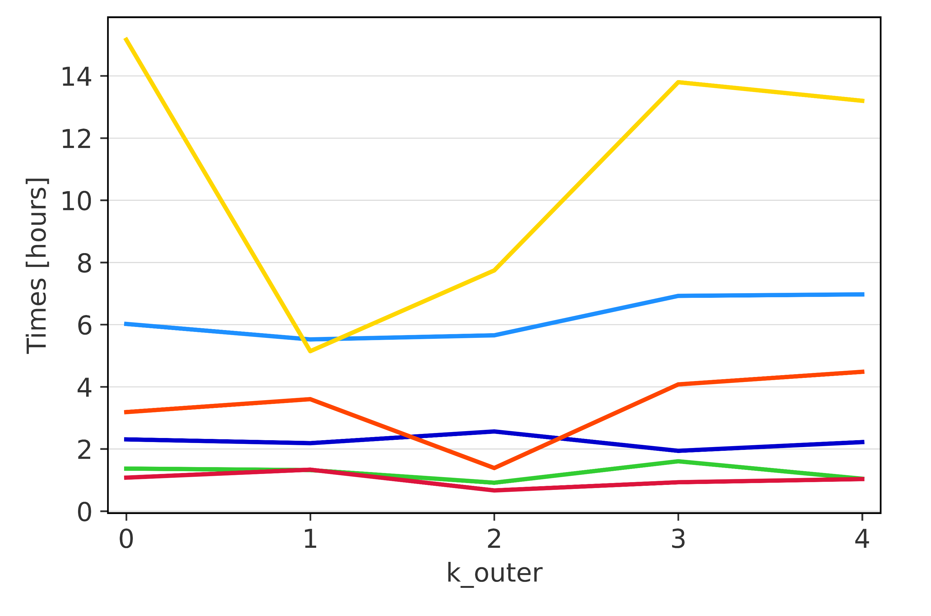
Nested stratified k-fold cross-validation
Overall performance
a) Area under the ROC curve
b) Recall
c) F1-score
d) Computation time per outer fold

