Slide 1
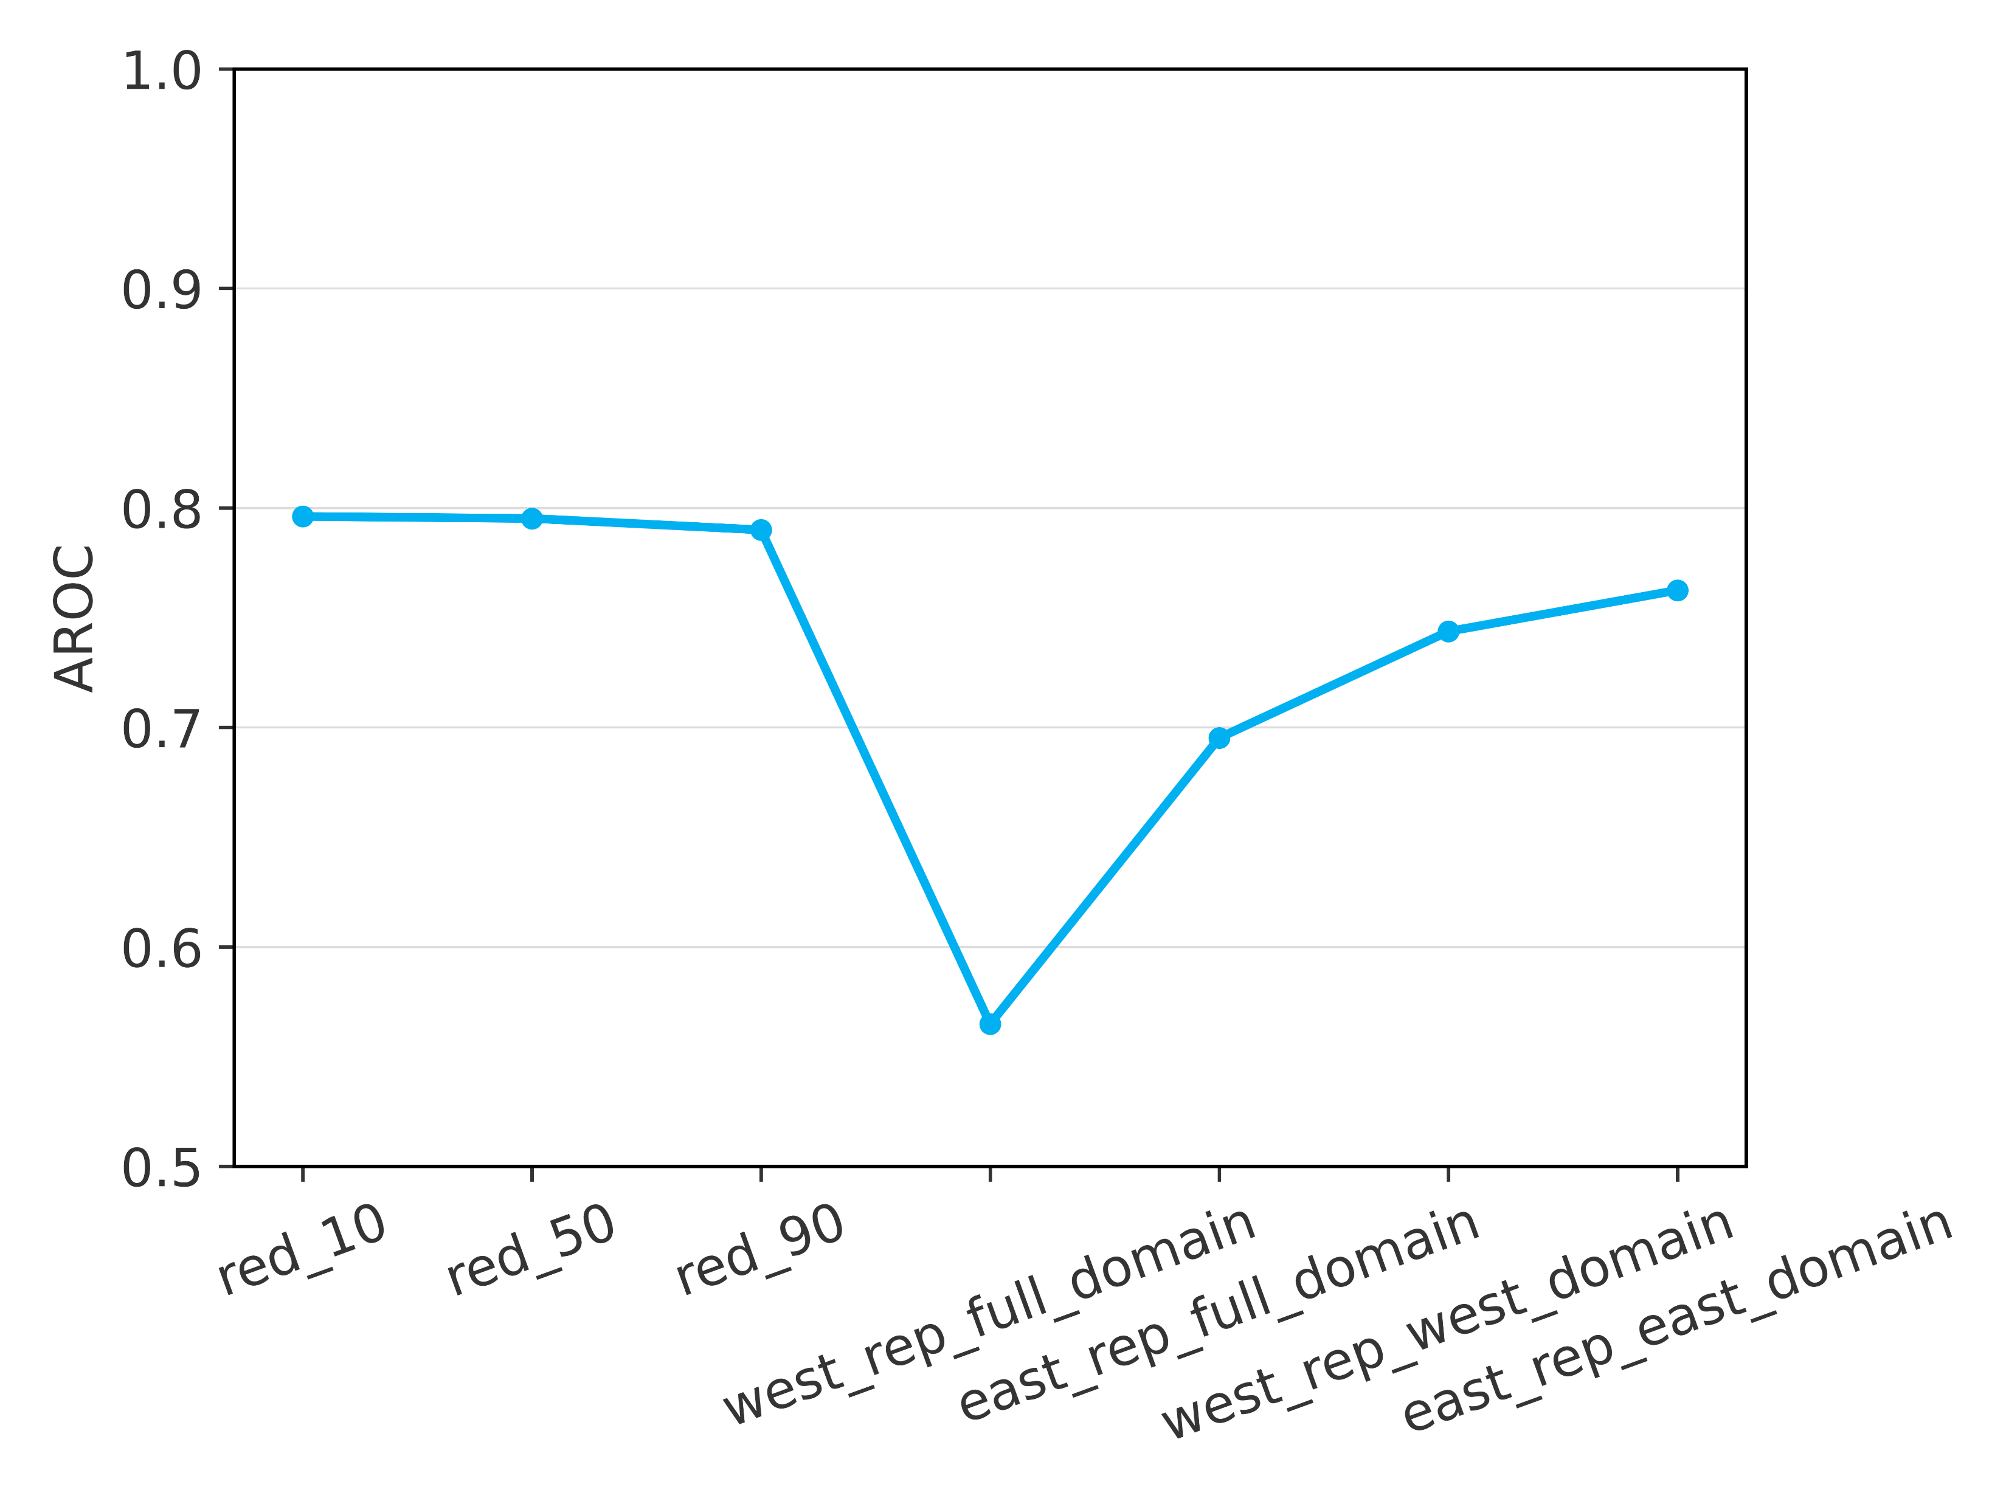
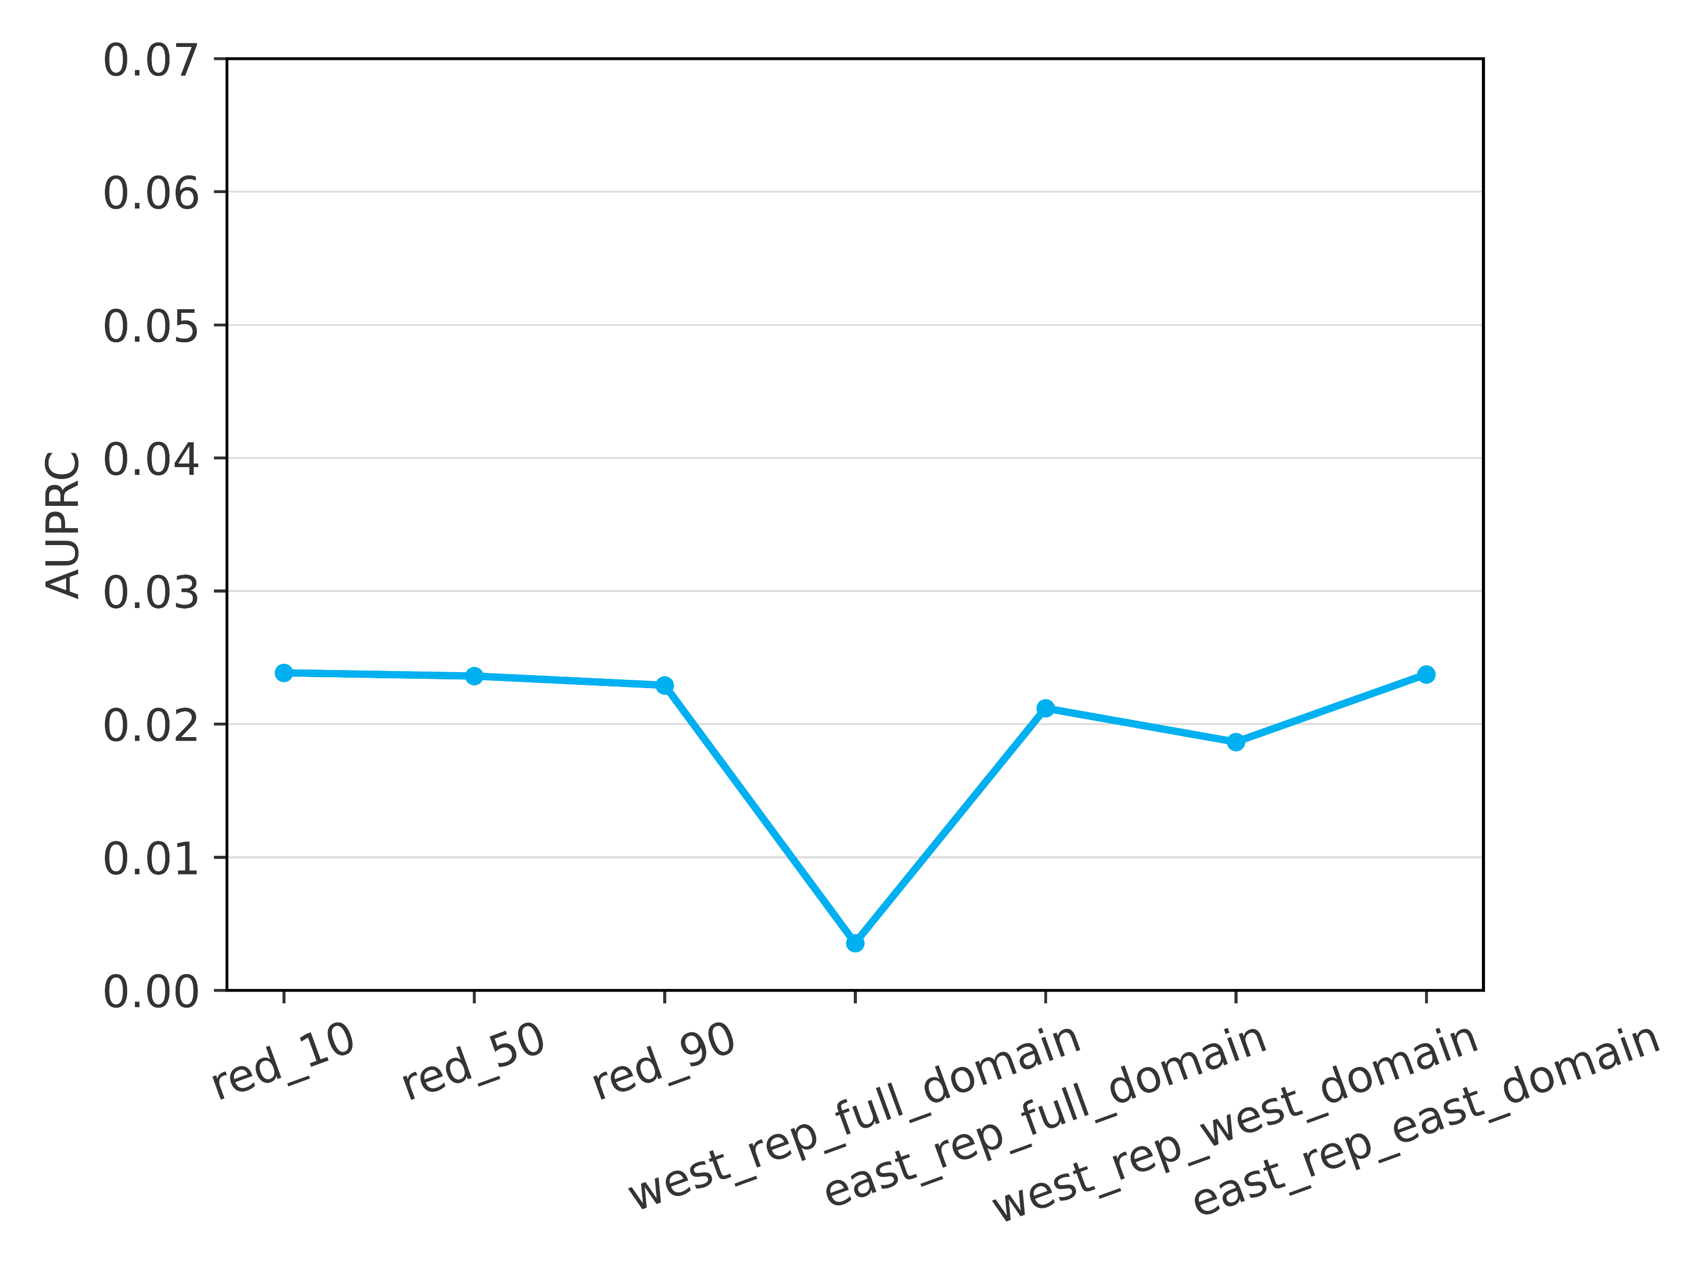
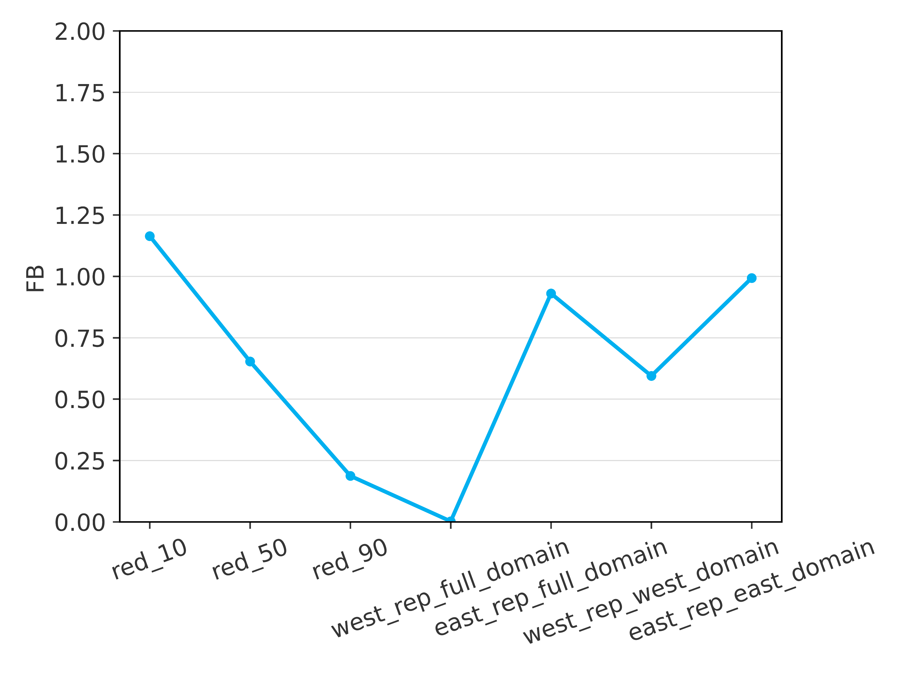







Verification results – Overall scores
Evaluated over the verification dataset, for the XGBoost implementation of gradient boosting
Scores computed with the full training dataset
(in Chapter 6)
Scores computed with the training subsets
AUC-ROC
AUC-PR
FB
Refer to Figure 6.11a
0.07
2
Refer to Figure 6.11i
1
0.06
1.75
a
Refer to Figure 6.11e
b
c
0.9
1.5
0.05
1.25
0.8
0.04
1
0.03
0.7
0.75
0.02
0.5
0.6
0.01
0.25
0.5
0
0
TA1-1
TA1-2
TA1-3
TA2-1
TA2-2
TA3-1
TA3-2
TA1-1
TA1-2
TA1-3
TA2-1
TA2-2
TA3-1
TA3-2
TA1-1
TA1-2
TA1-3
TA2-1
TA2-2
TA3-1
TA3-2

