Slide 1
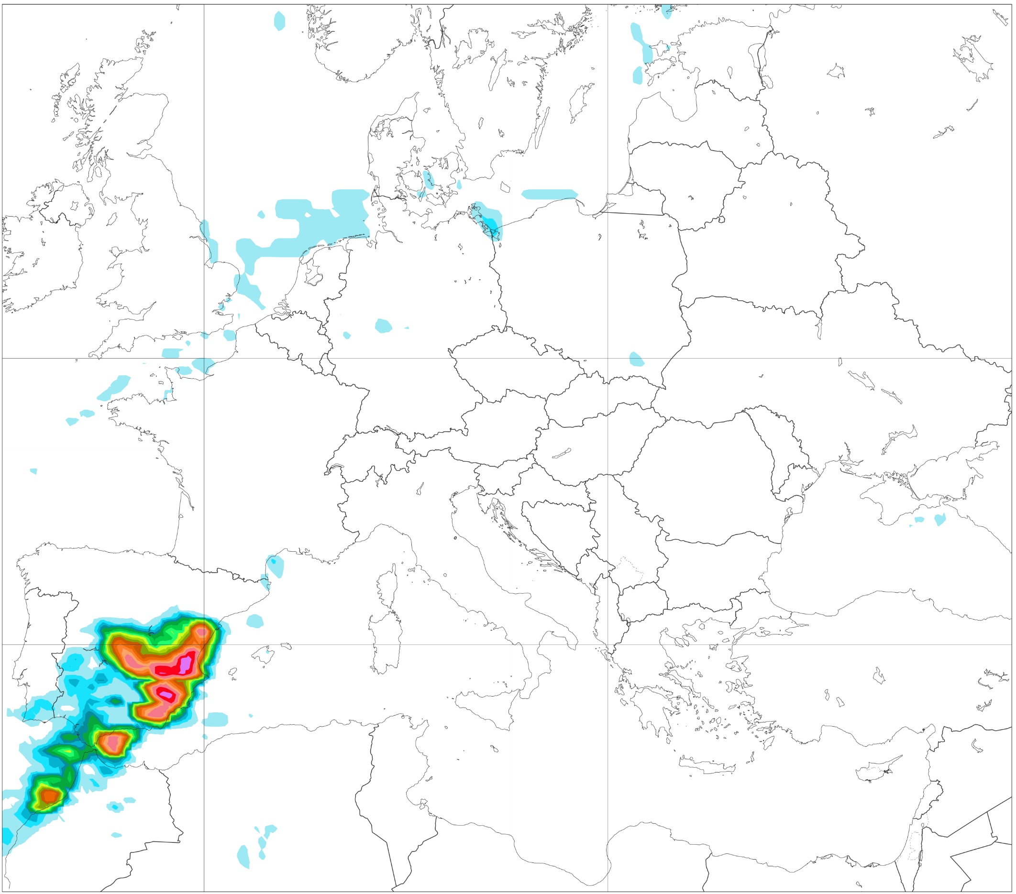
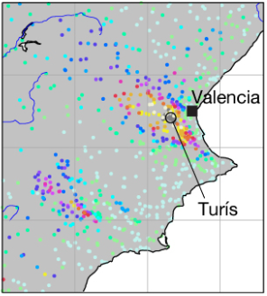
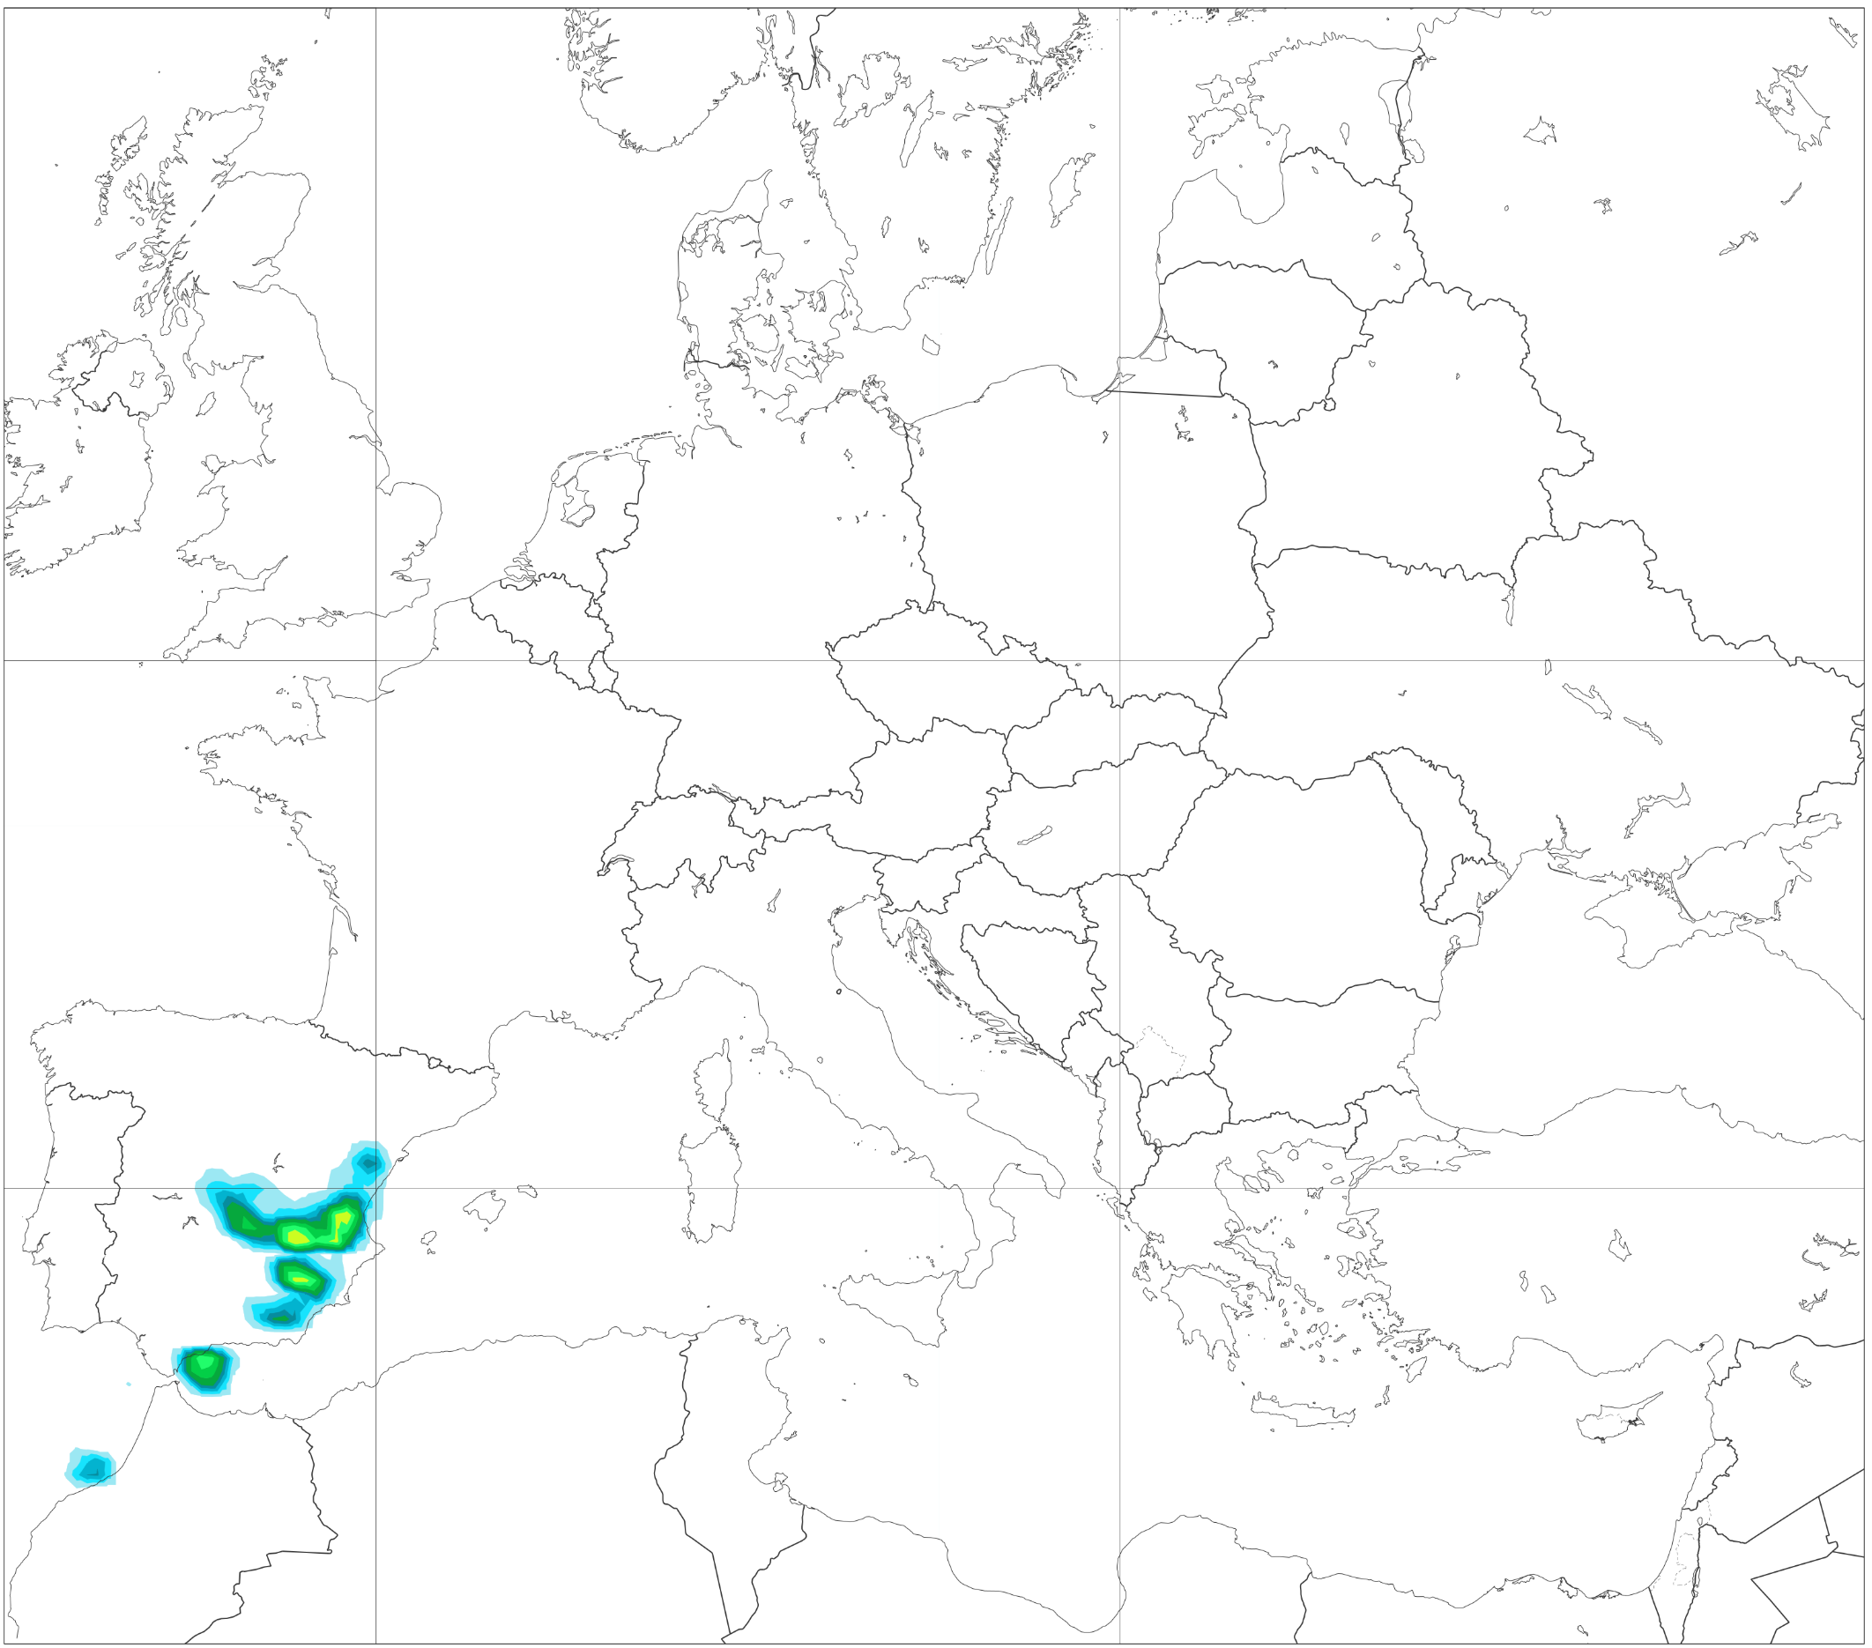
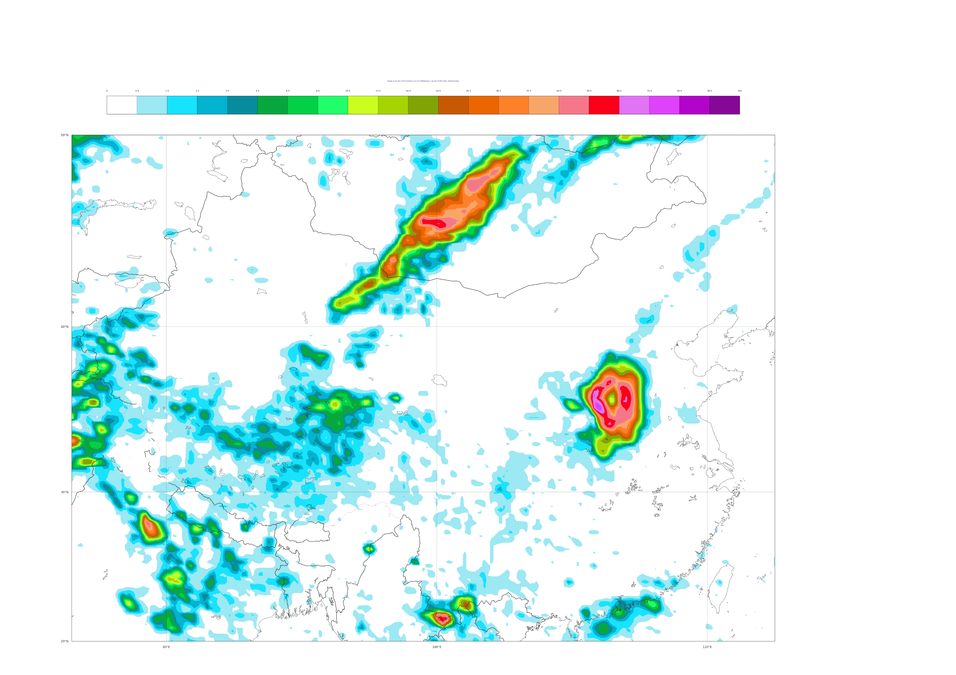
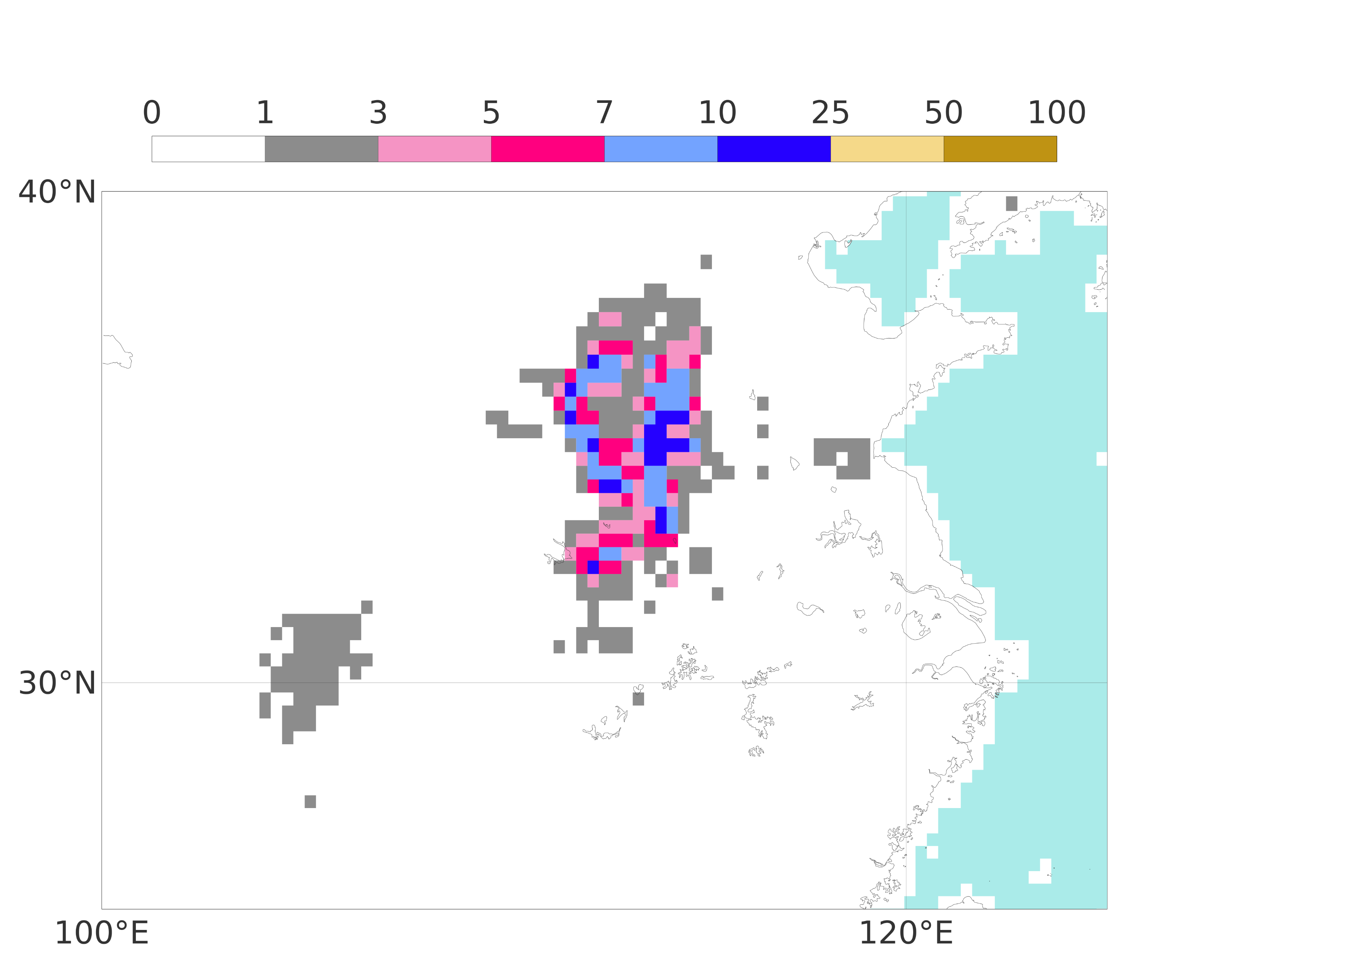
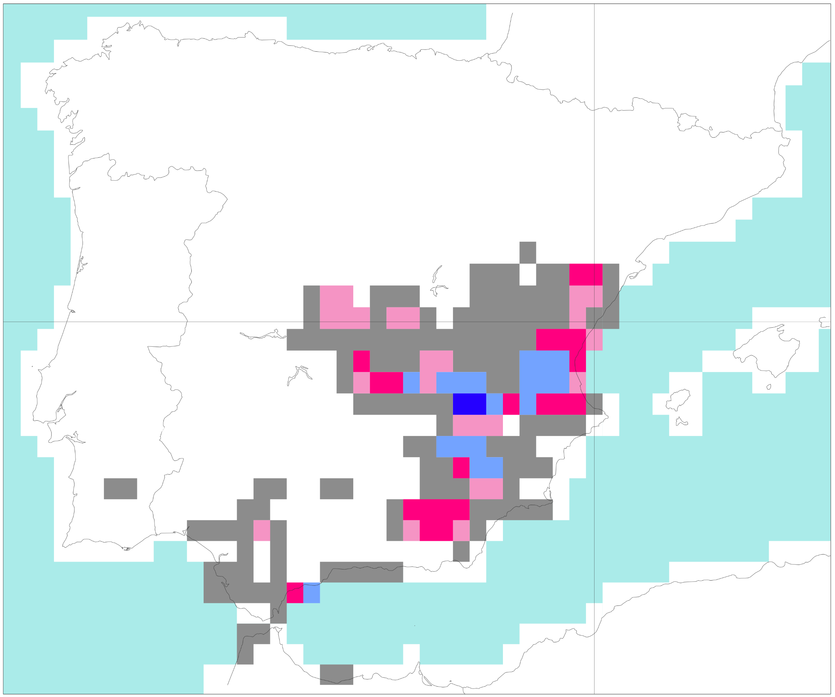
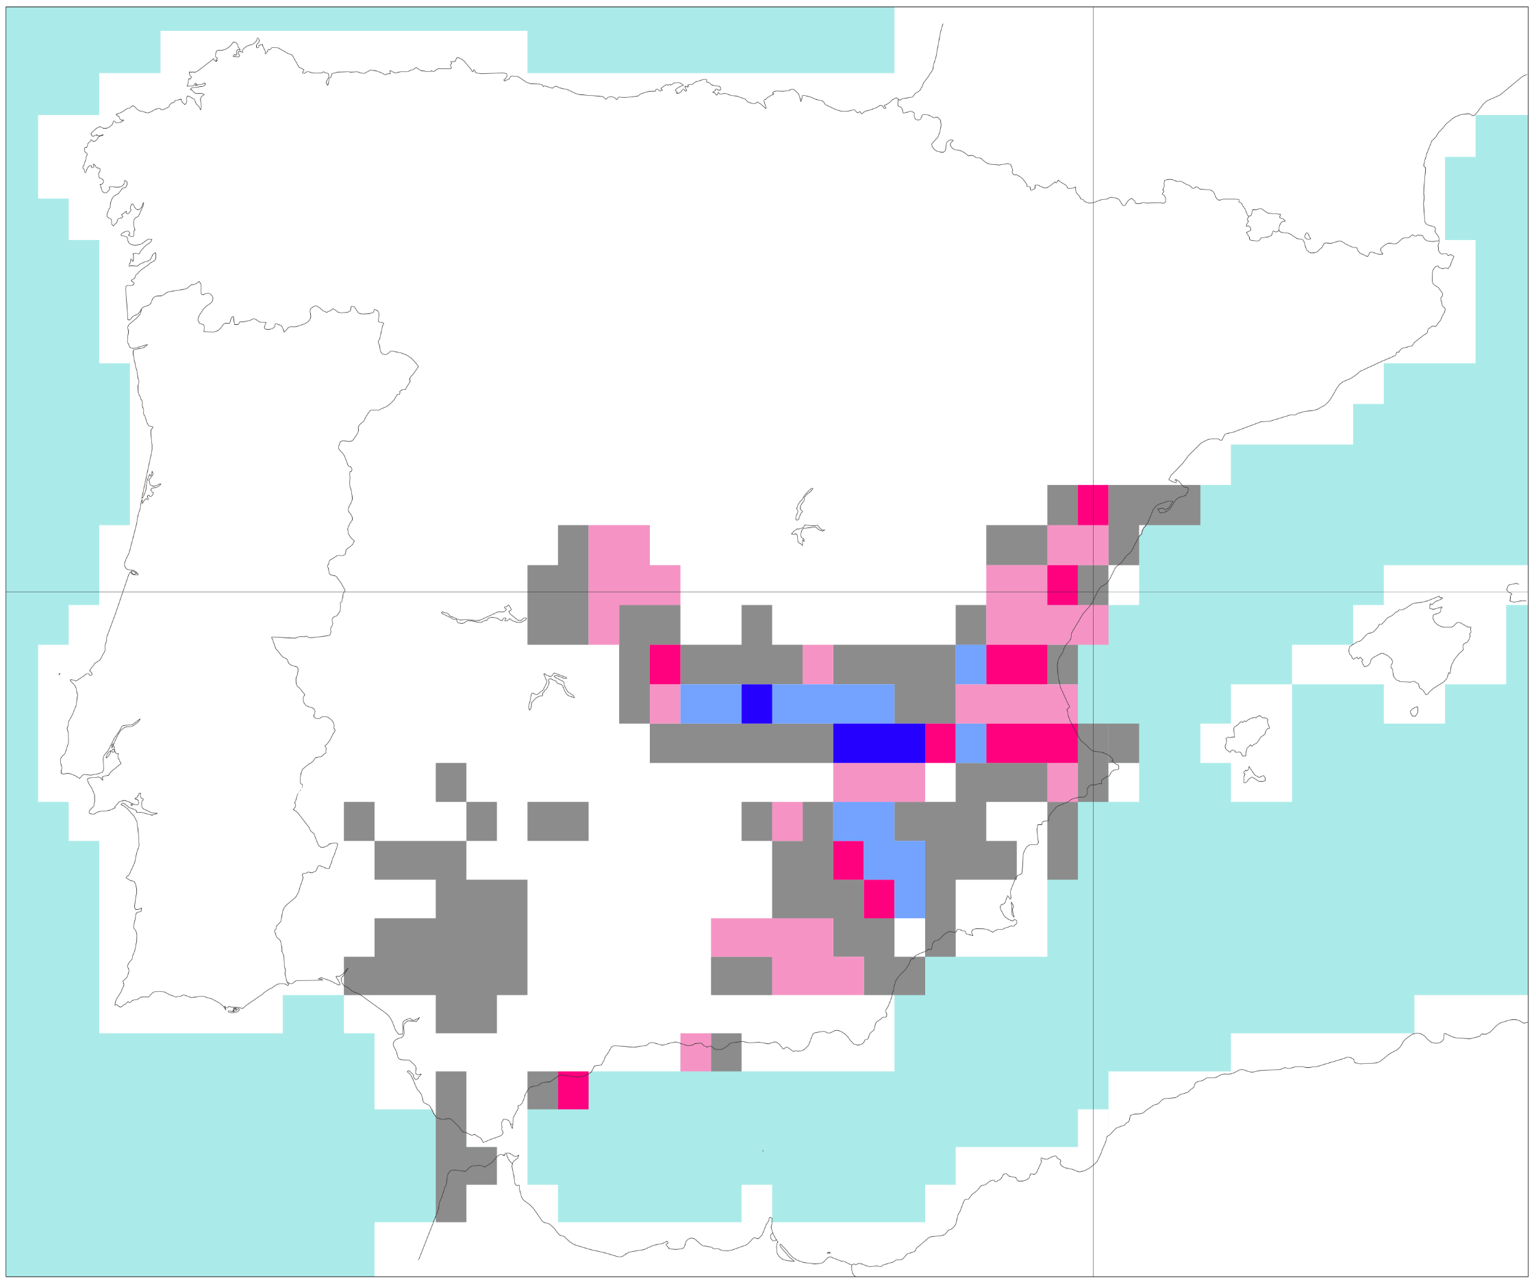
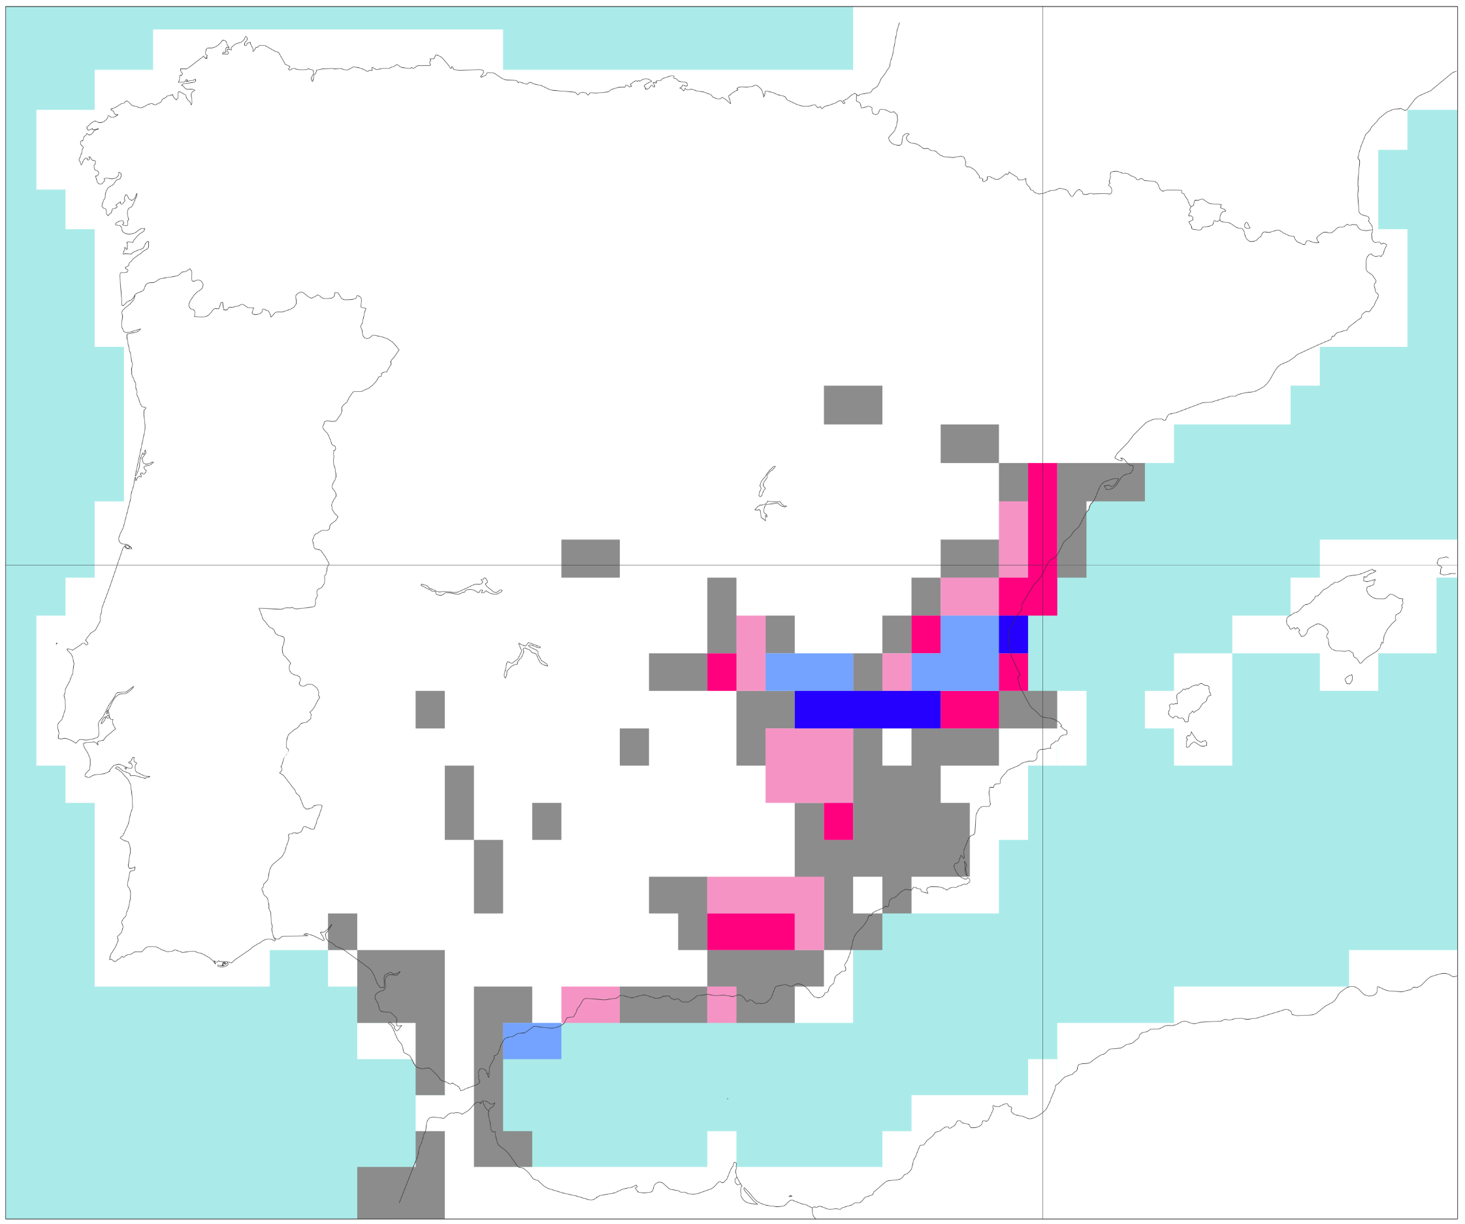
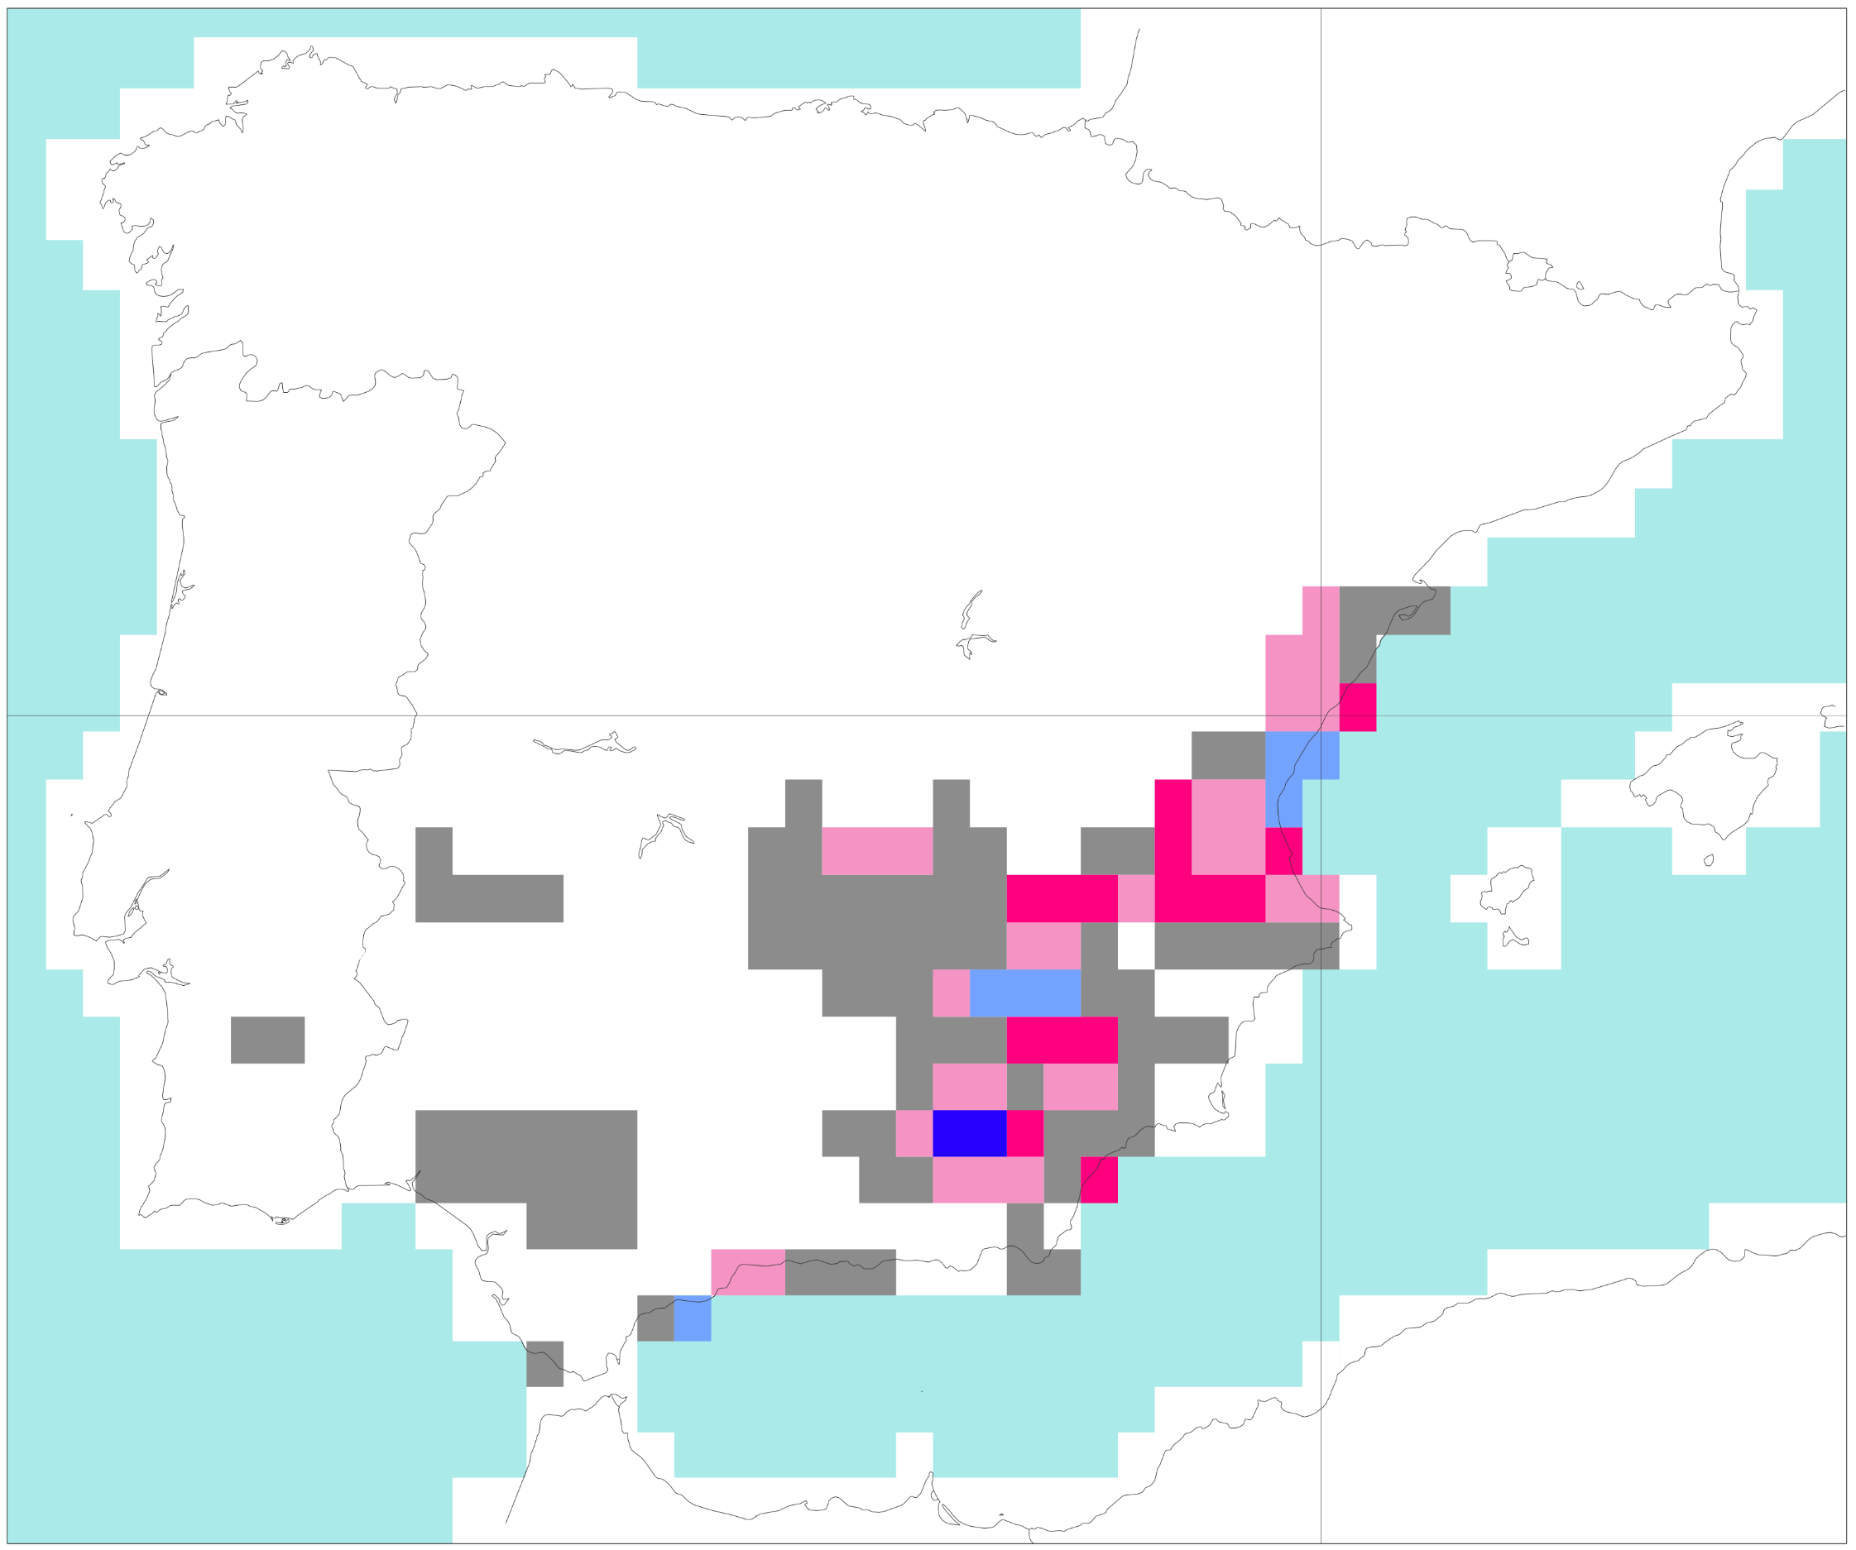
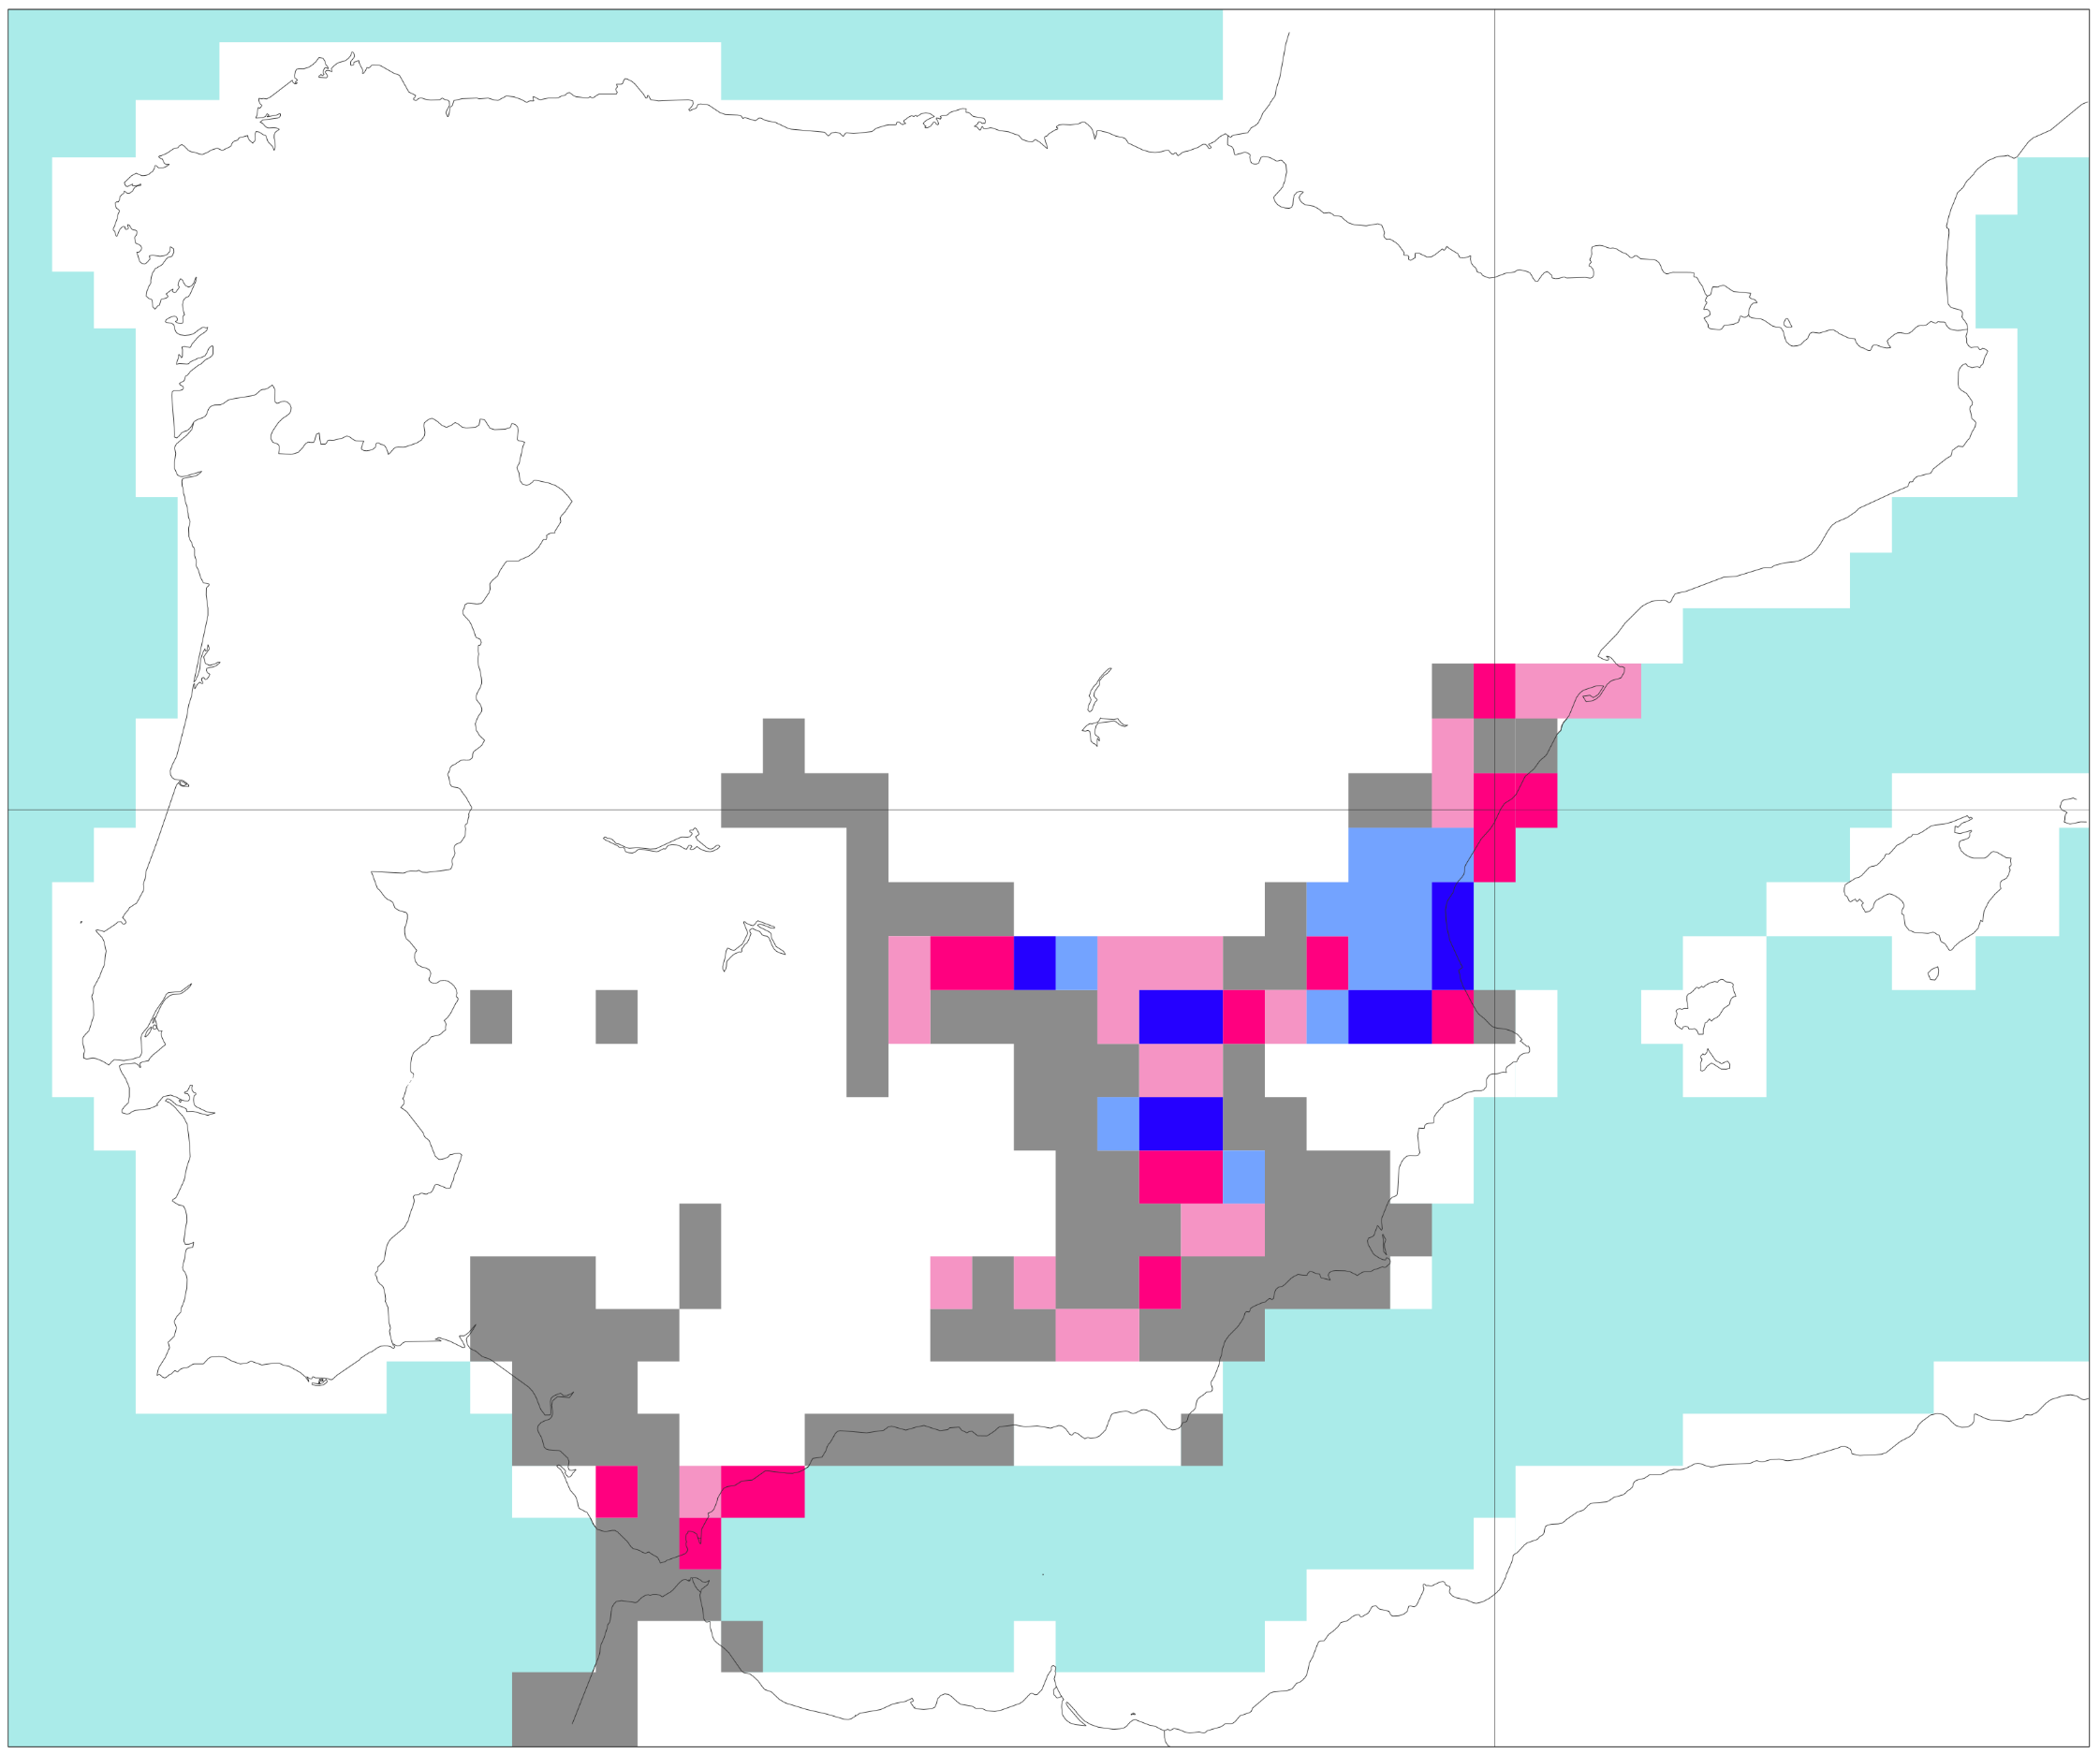
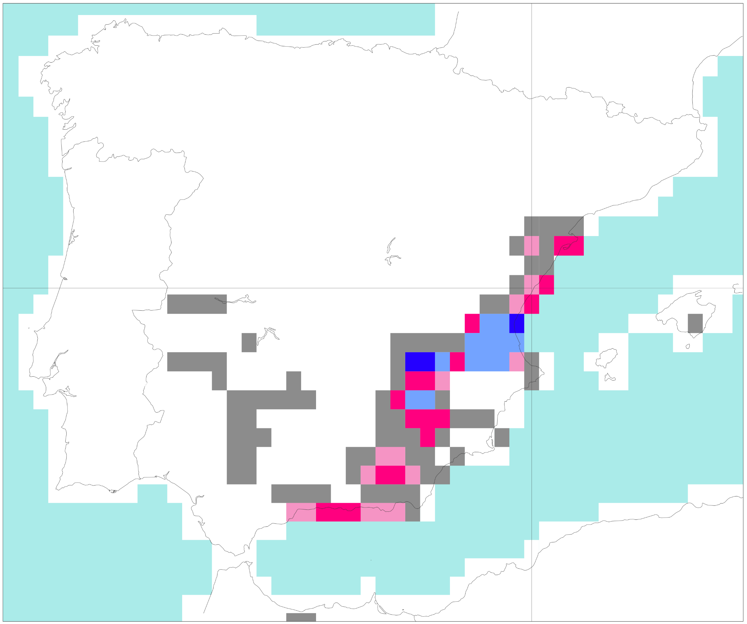
Flash floods in Spain in October 2024
VT: from 2024-10-29 00 UTC to 2024-10-30 00 UTC
100
(a) Rainfall (mm/24h) observations
(b) Probability (%)
of exceeding the
1-year return
Period - Reanalysis
90.5
80.5
1
800
70.5
10
20
30
40
50
60
80
100
125
150
175
200
250
350
500
60.5
41 °N
50.5
40.5
30 °N
35.5
(c) Probability (%)
of exceeding the
50-year return
Period - Reanalysis
30.5
40 °N
20 °N
25.5
20.5
16.5
39 °N
50 °N
13.5
10.5
8.5
6.5
38 °N
40 °N
4.5
3.5
30 °N
2.5
37 °N
0°
20 °E
40 °E
1.5
2 °W
1 °W
0°
0.5
0
Probability (%) of flash flood
0
1
3
5
7
10
25
50
100
d) Reanalysis
e) FC: 2024/10/29 at 00 UTC (t+0,t+24) – Day 1
40 °N
40 °N
f) FC: 2024/10/28 at 00 UTC (t+24,t+48) – Day 2
g) FC: 2024/10/27 at 00 UTC (t+48,t+72) – Day 3
40 °N
40 °N
h) FC: 2024/10/26 at 00 UTC (t72,t+96) – Day 4
i) FC: 2024/10/25 at 00 UTC (t+96,t+120) – Day 5
40 °N
40 °N
0°
0°

