Slide 1
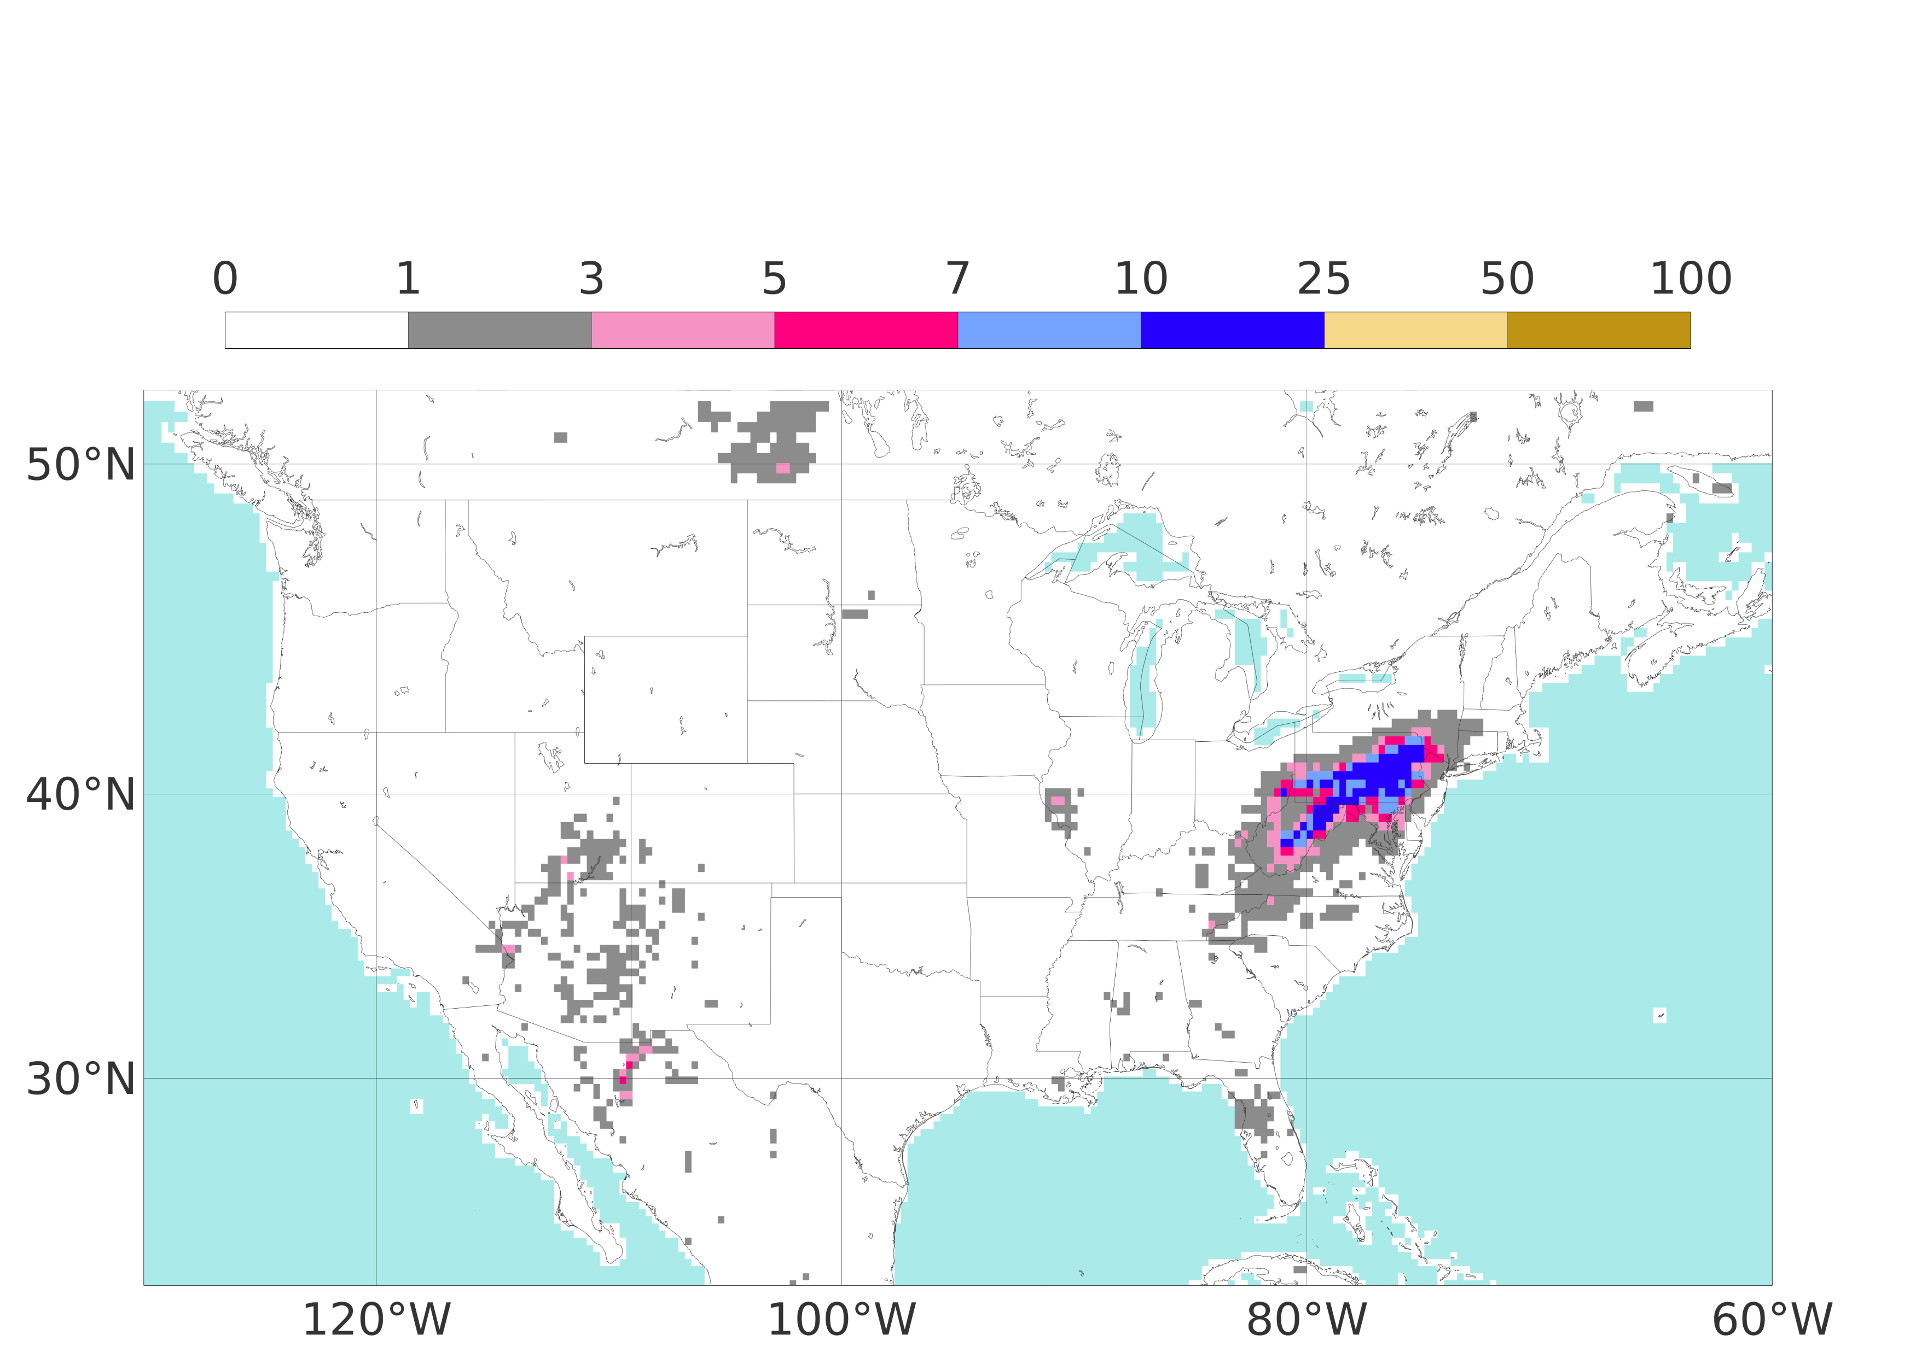
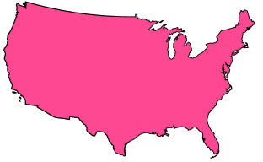


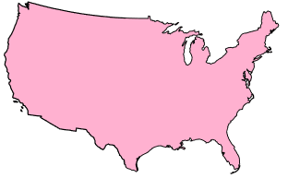
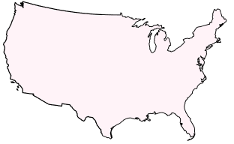
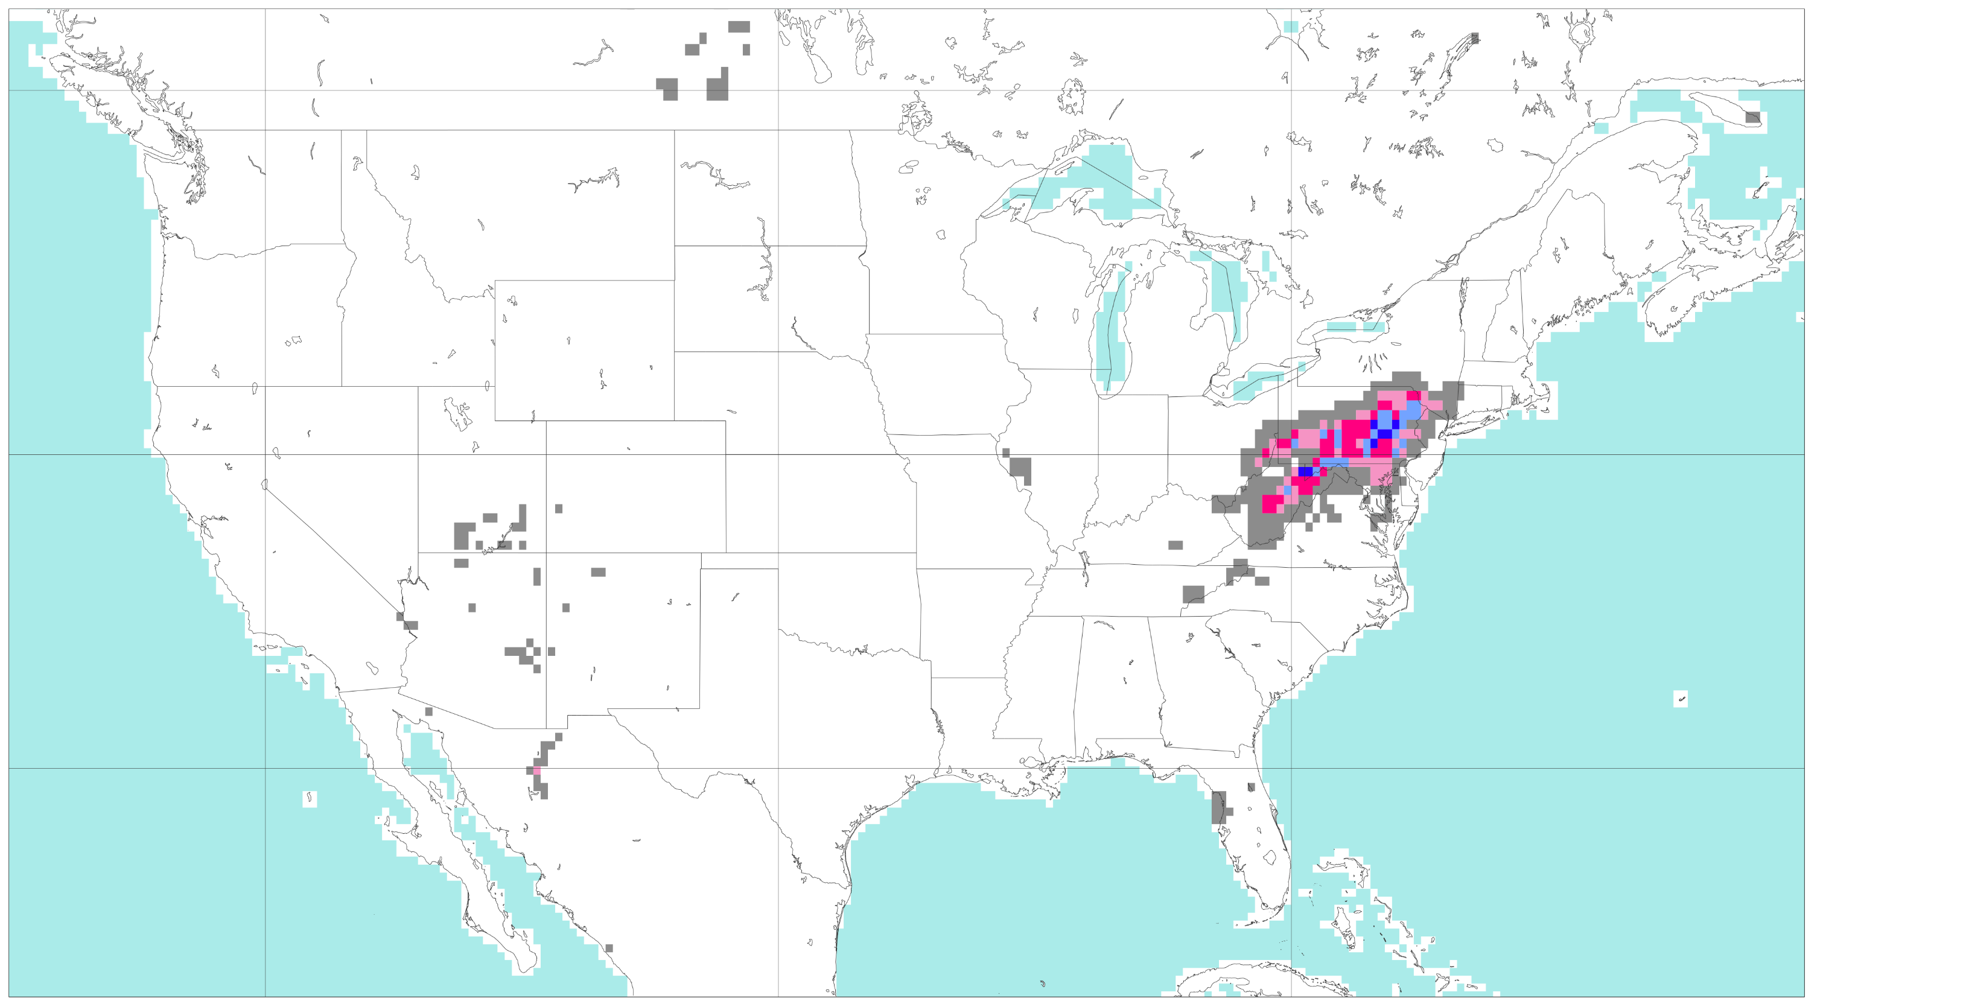
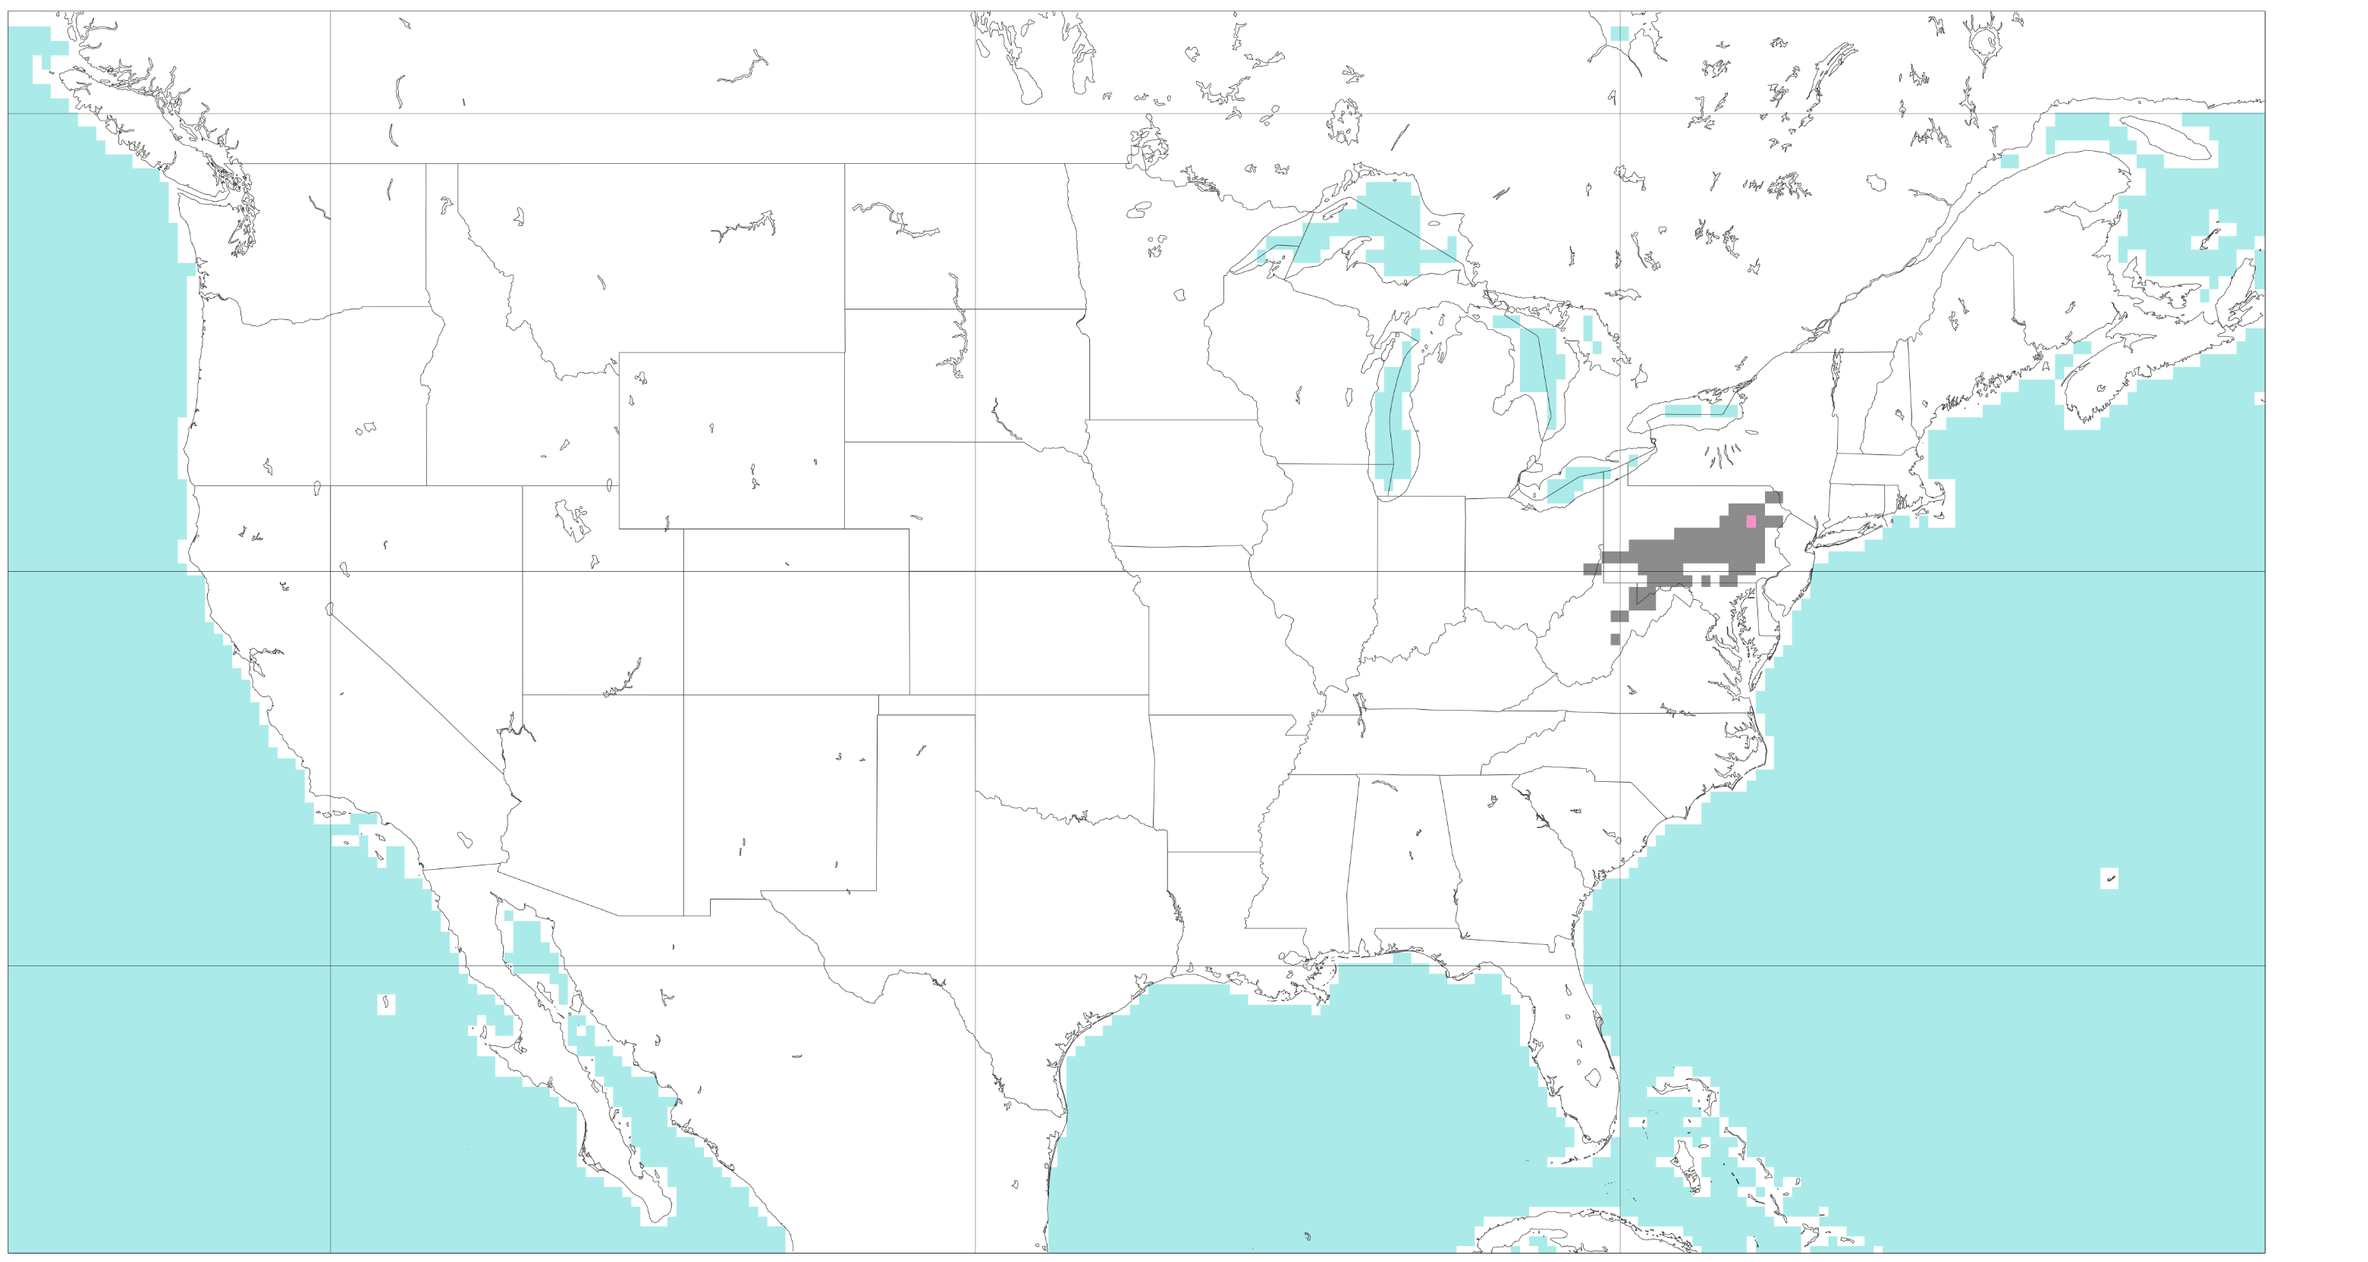
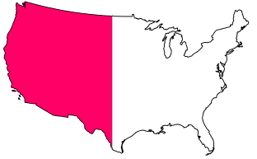

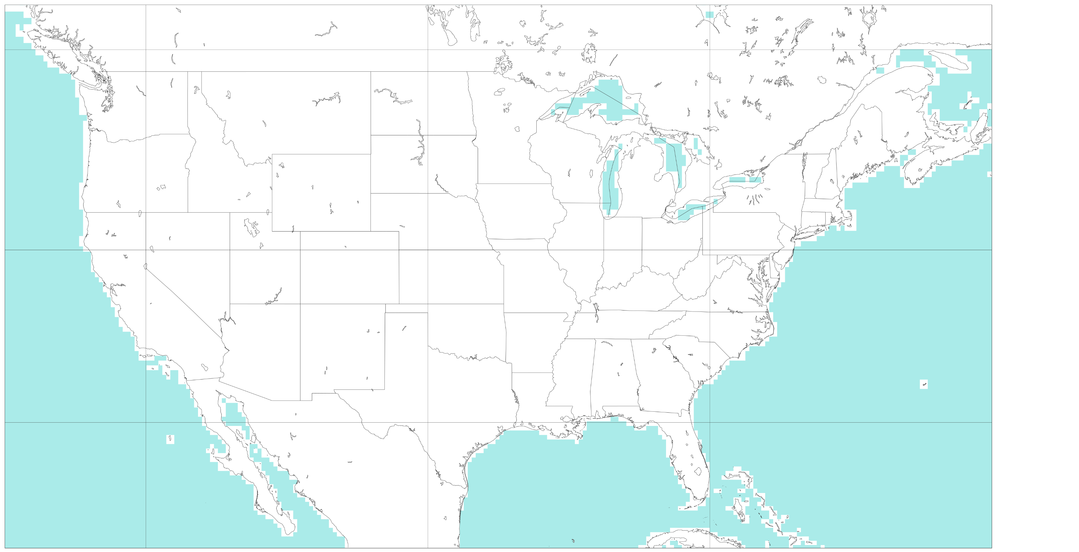
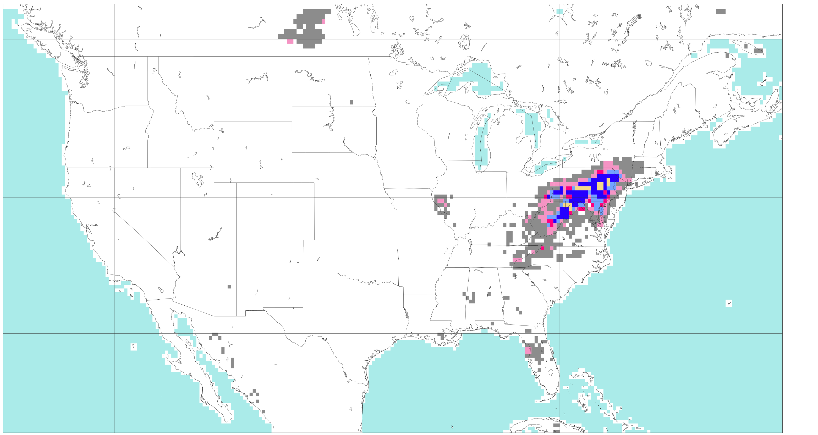


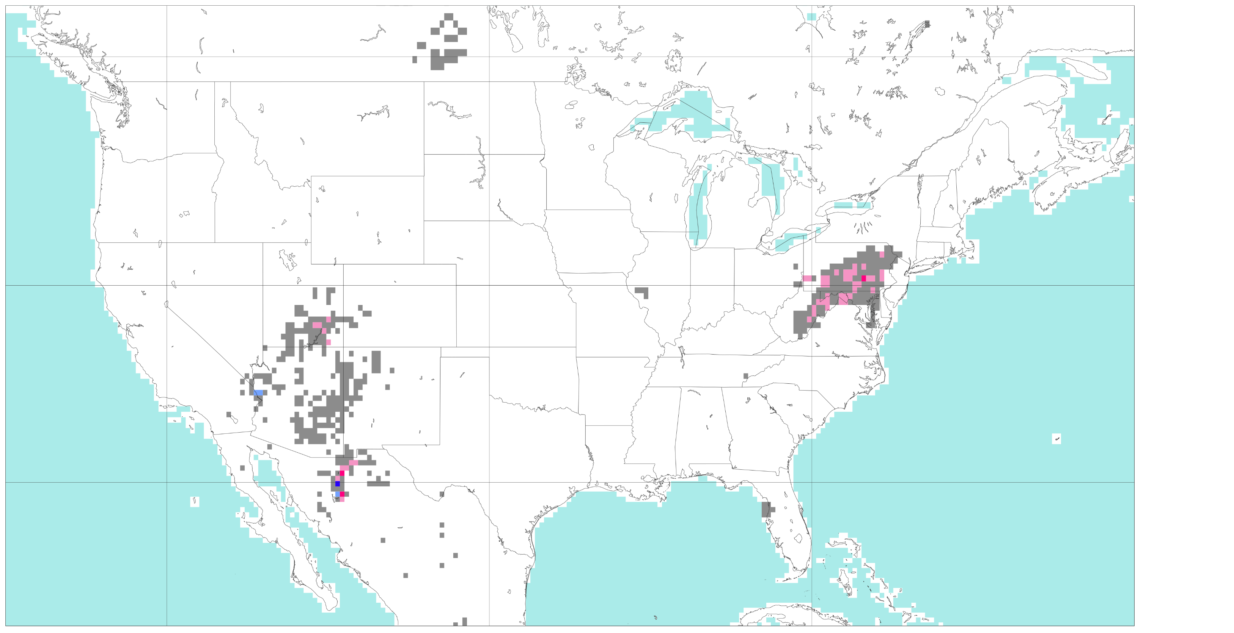

Verification results – Map plots for Storm Ida
VT: from 2021-09-01 00 UTC to 2021-09-02 00 UTC
[%]
0
1
3
5
7
10
25
50
100
a) Full training dataset (from Figure 6.17a)
b) TA1-1
50 °N
40 °N
30 °N
c) TA1-2
d) TA1-3
50 °N
40 °N
30 °N
e) TA2-1
f) TA2-2
50 °N
40 °N
30 °N
g) TA3-1
h) TA3-2
50 °N
40 °N
30 °N
120 °W
100 °W
80 °W
120 °W
100 °W
80 °W

