Slide 1
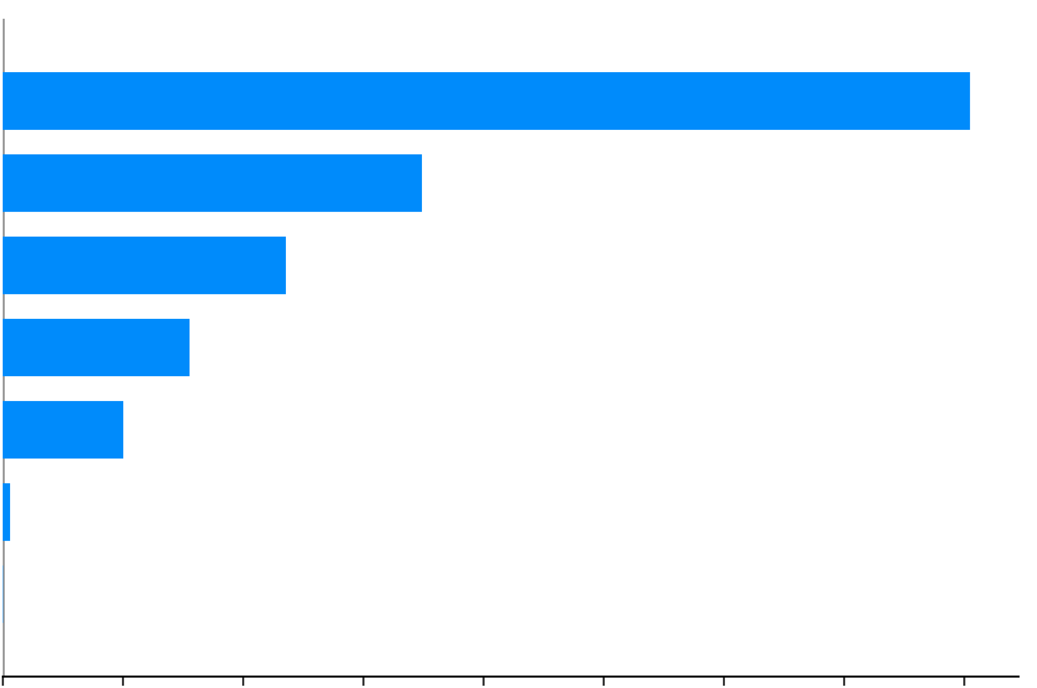
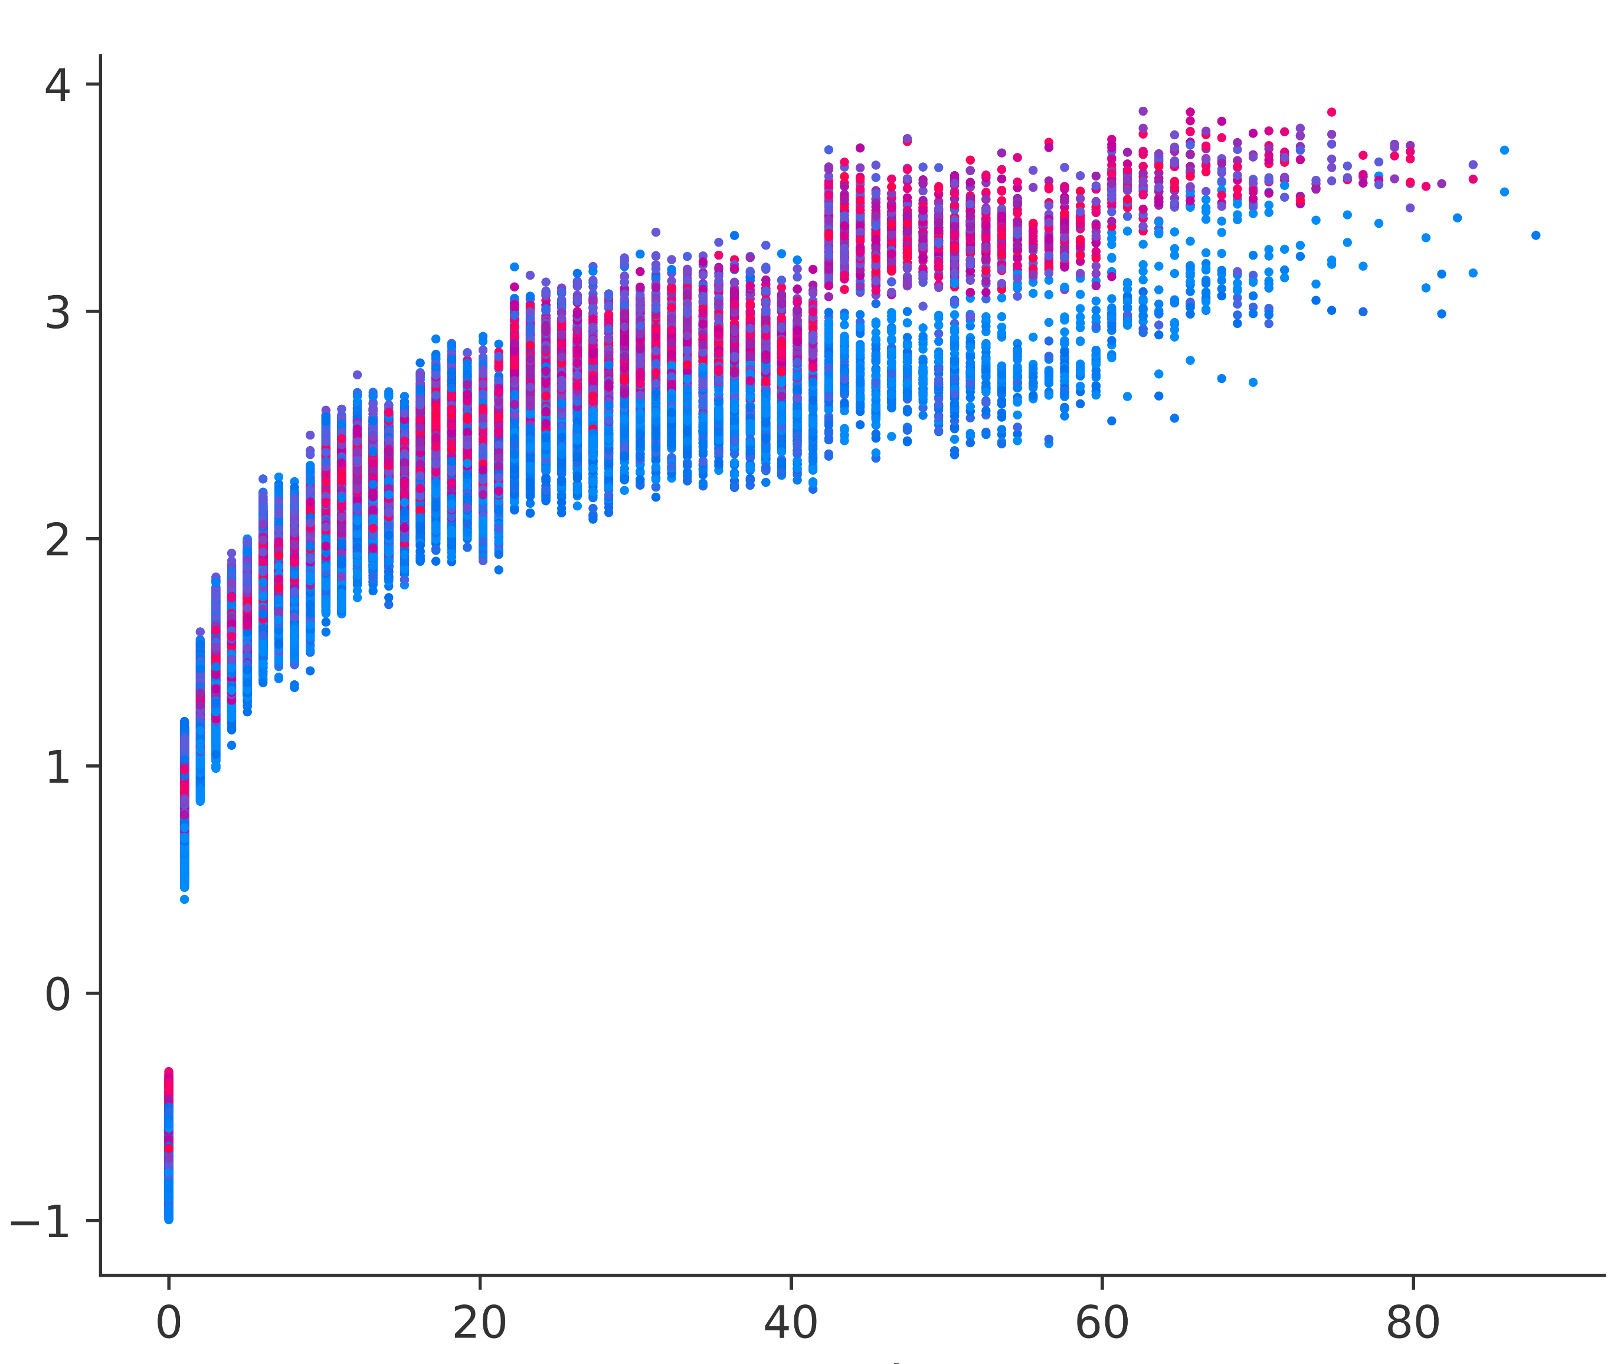
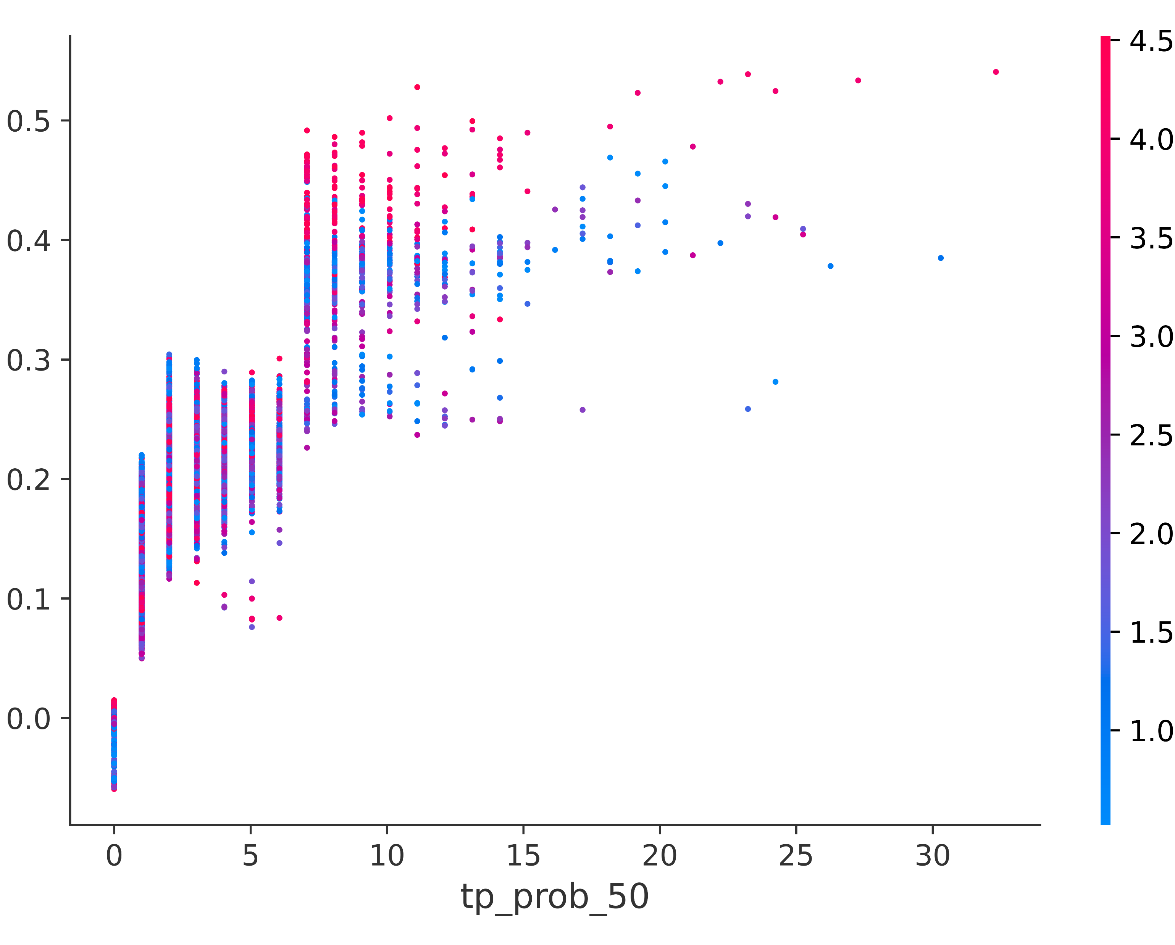
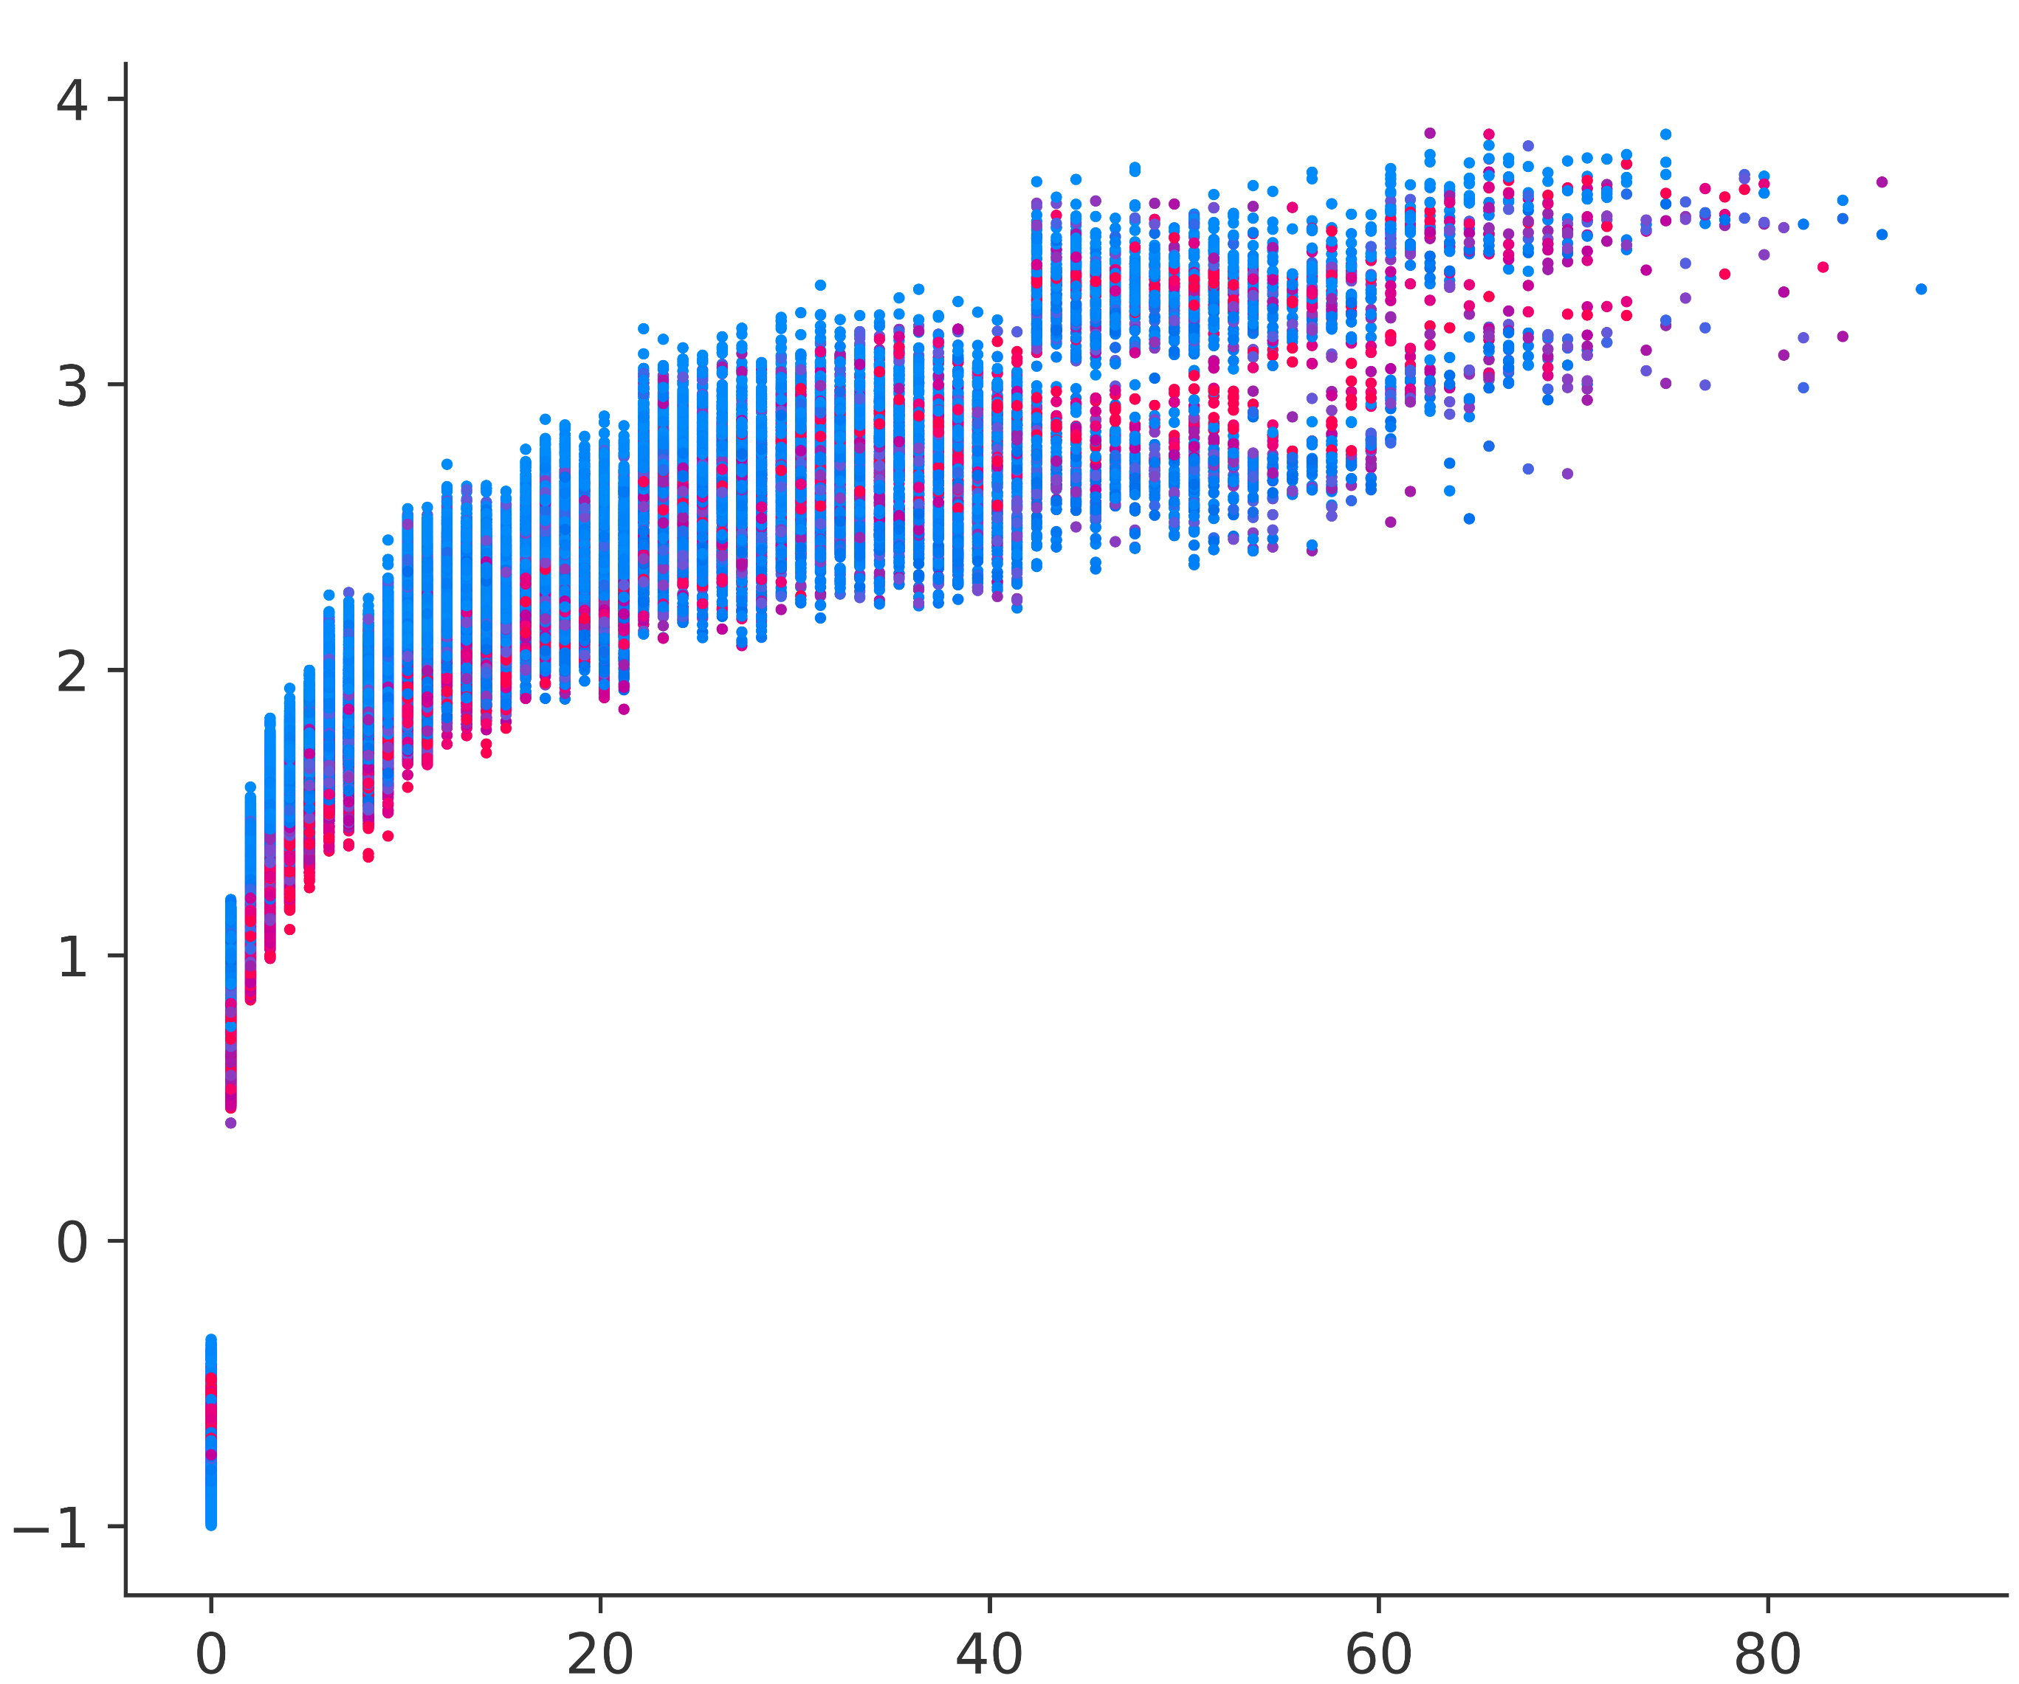
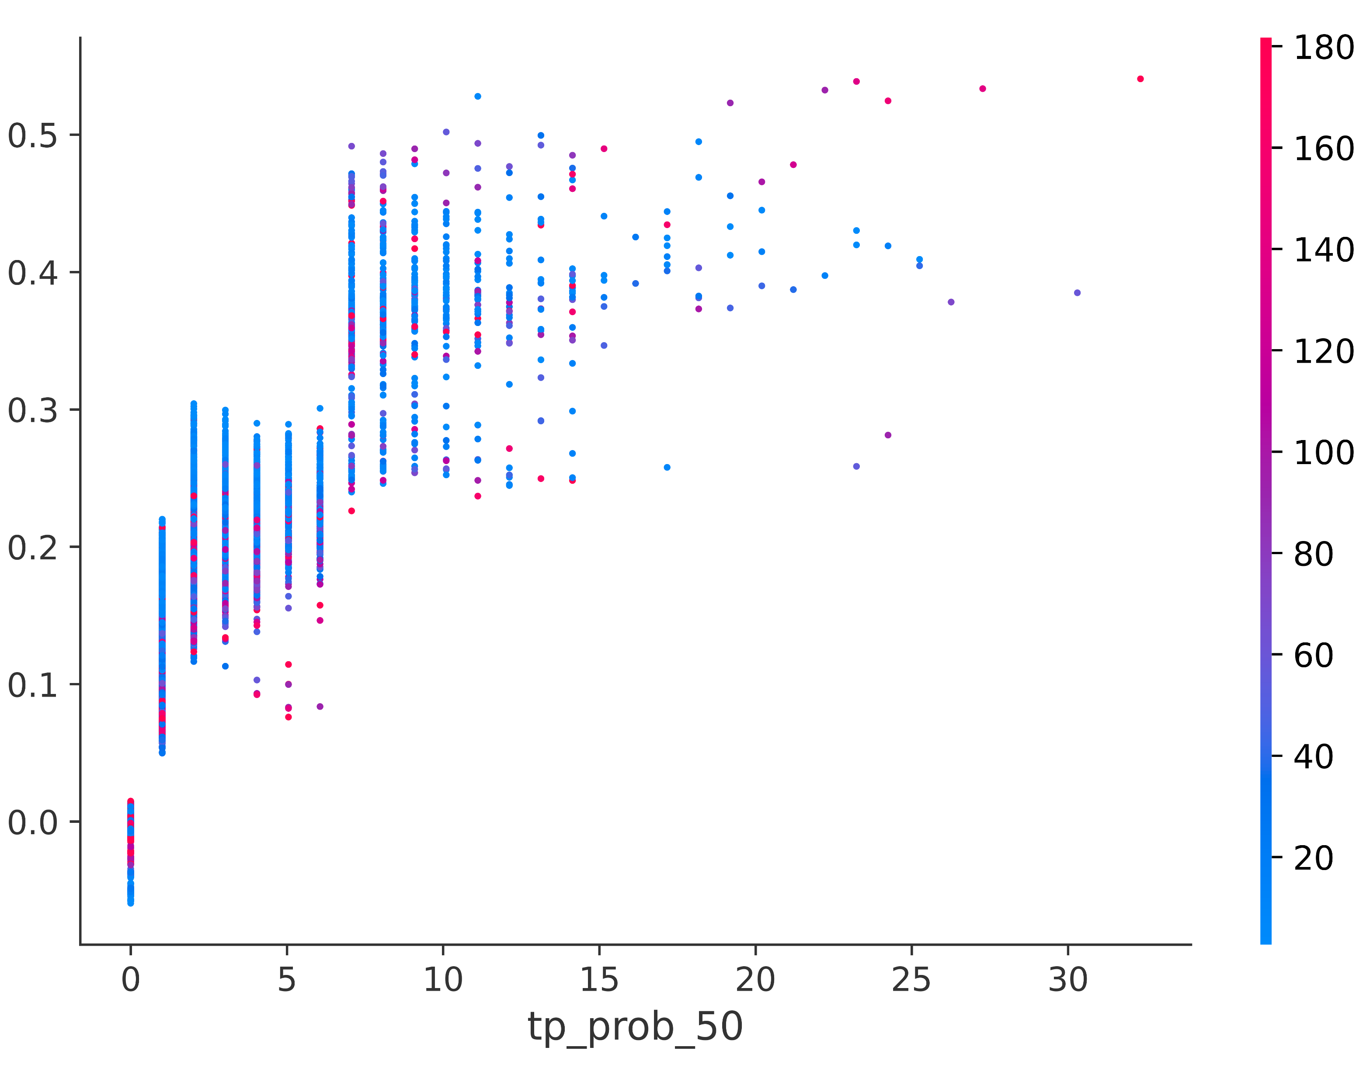
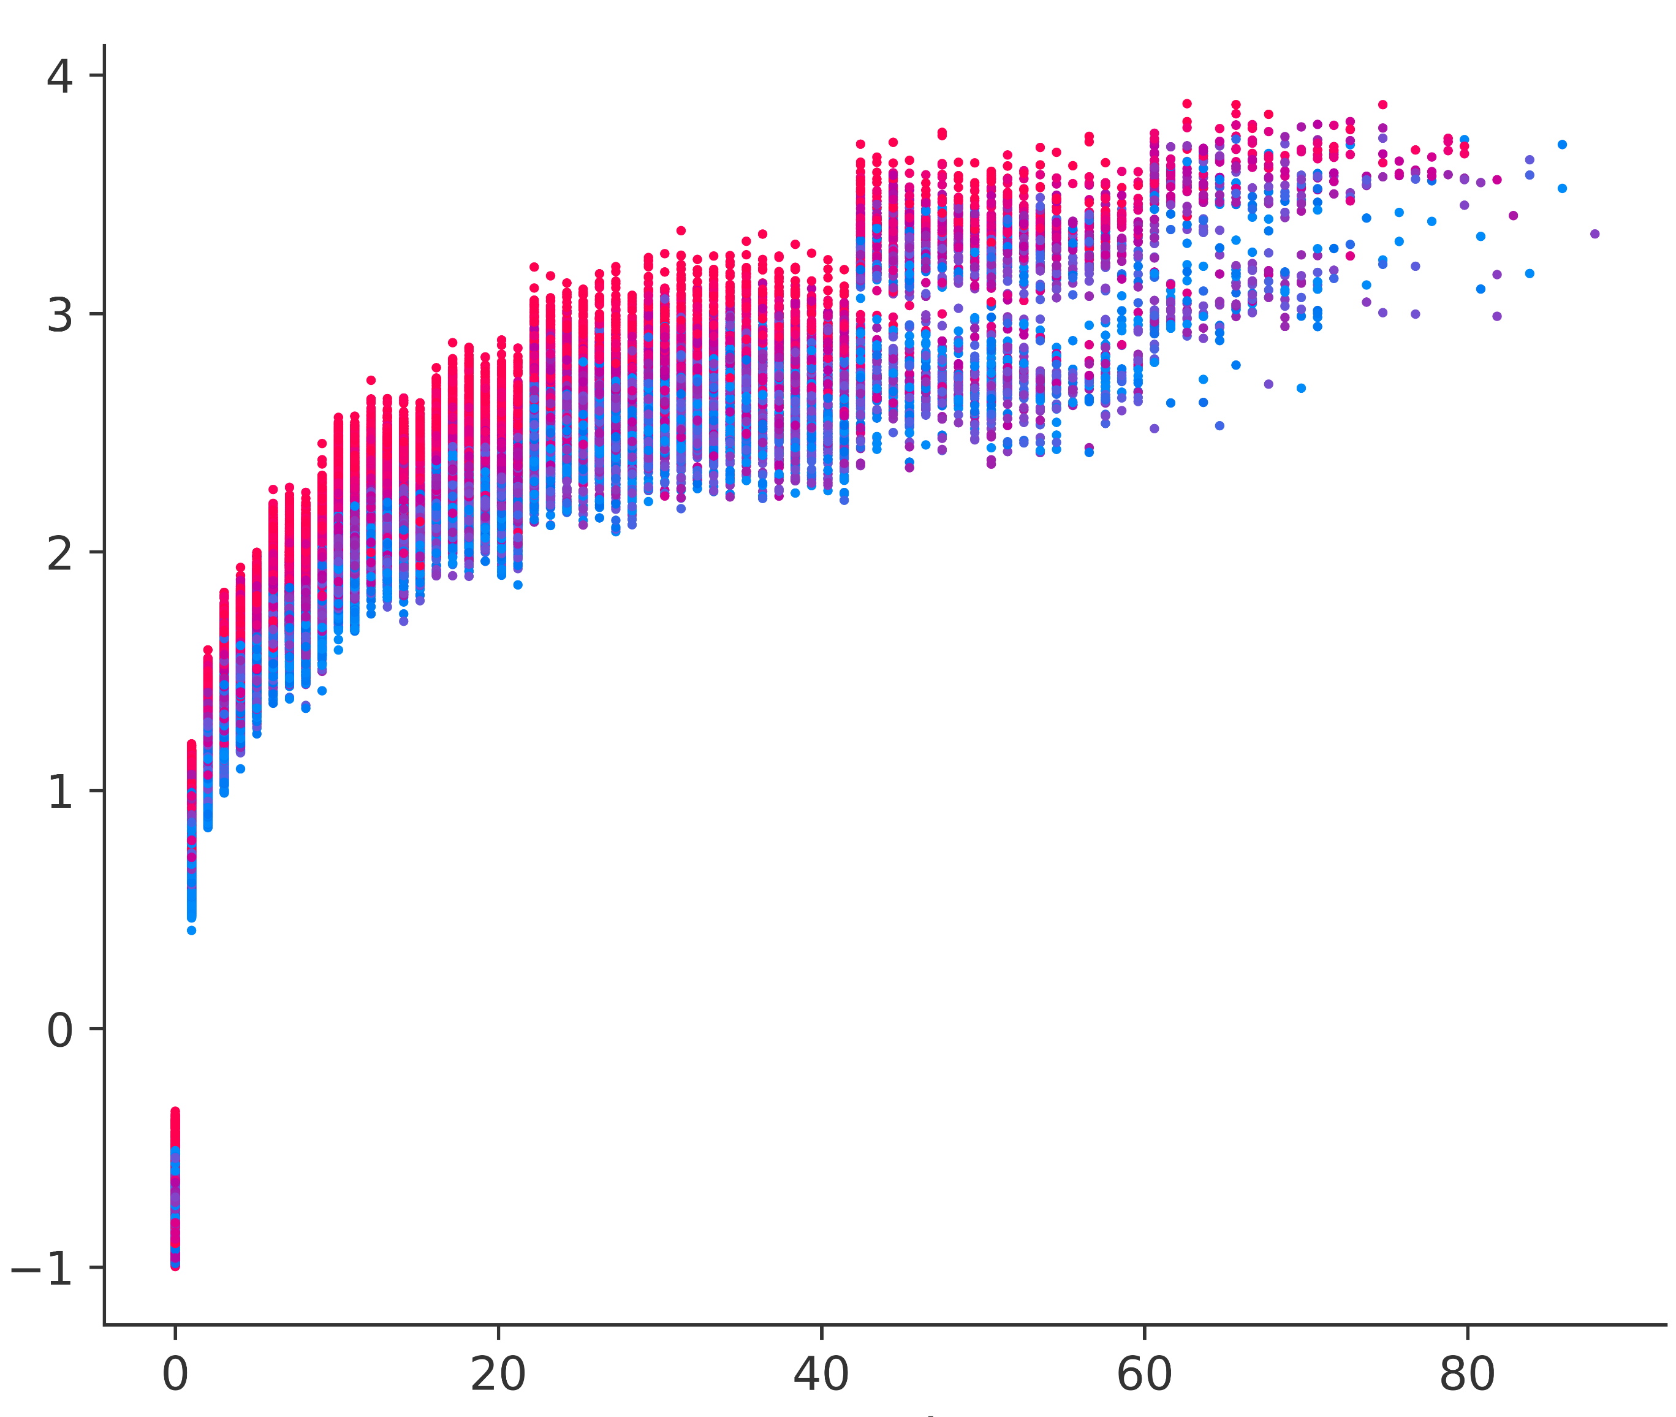
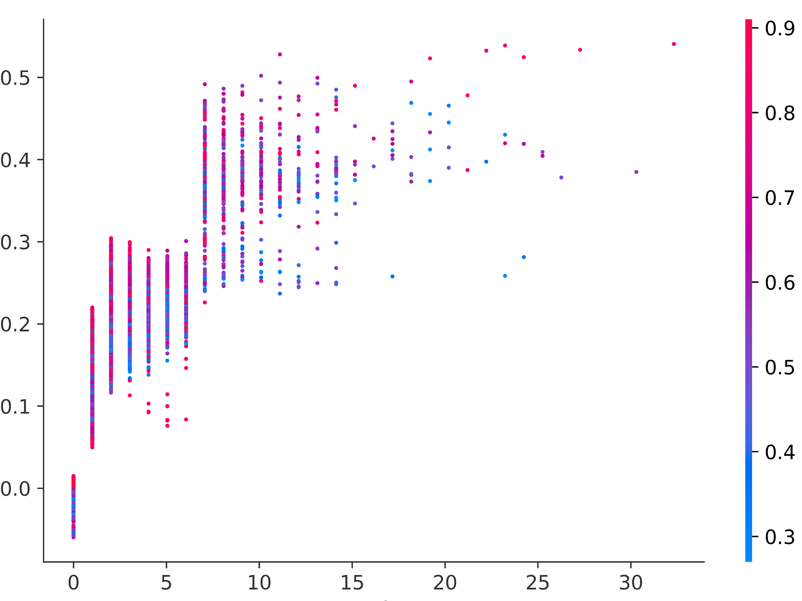
Physical interpretation of data-driven forecasts
SHAP values computed over the test verification dataset
tp_prob_1
lai
sdfor
swvl
Model predictors
tp_prob_1_adj_gb
tp_prob_50
a
tp_prob_50_adj_gb
0
0.1
0.2
0.3
0.4
0.5
0.6
0.7
0.8
Mean SHAP values
SHAP values for
tp_prob_1
SHAP values for
tp_prob_50
lai
b
e
SHAP values for
tp_prob_1
SHAP values for
tp_prob_50
sdfor
c
f
SHAP values for
tp_prob_1
SHAP values for
tp_prob_50
swvl
d
g
tp_prob_1
tp_prob_50

