Slide 1
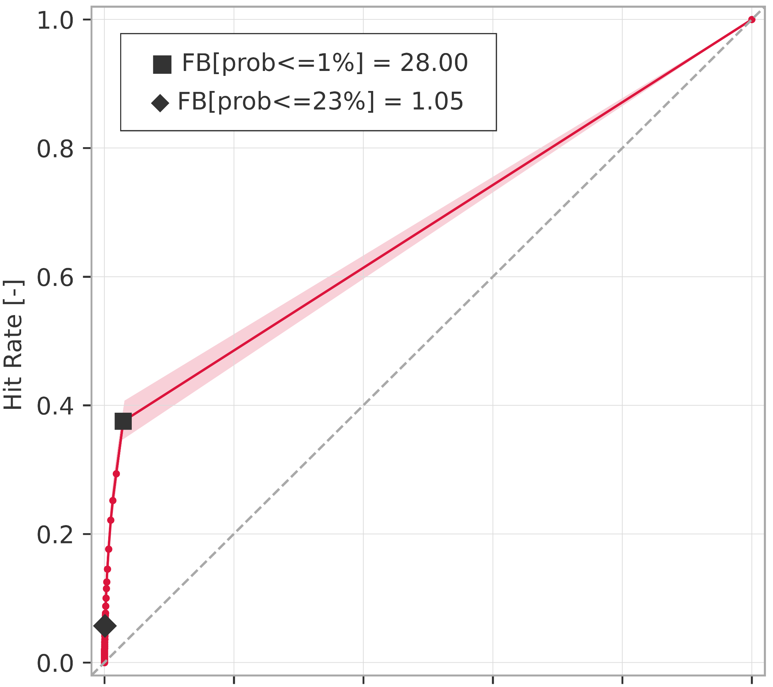
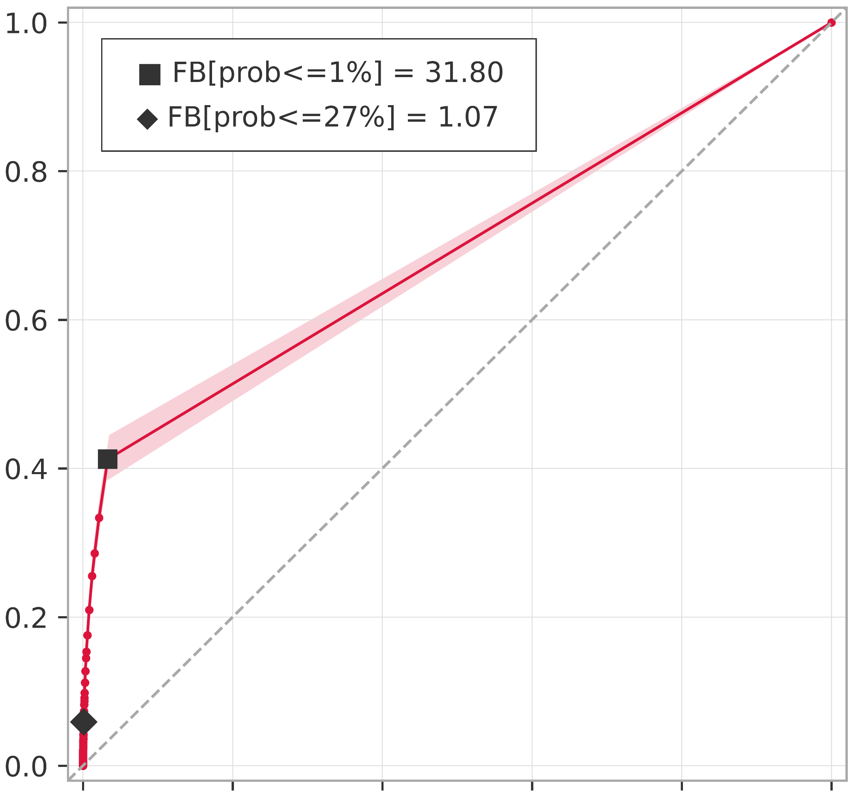
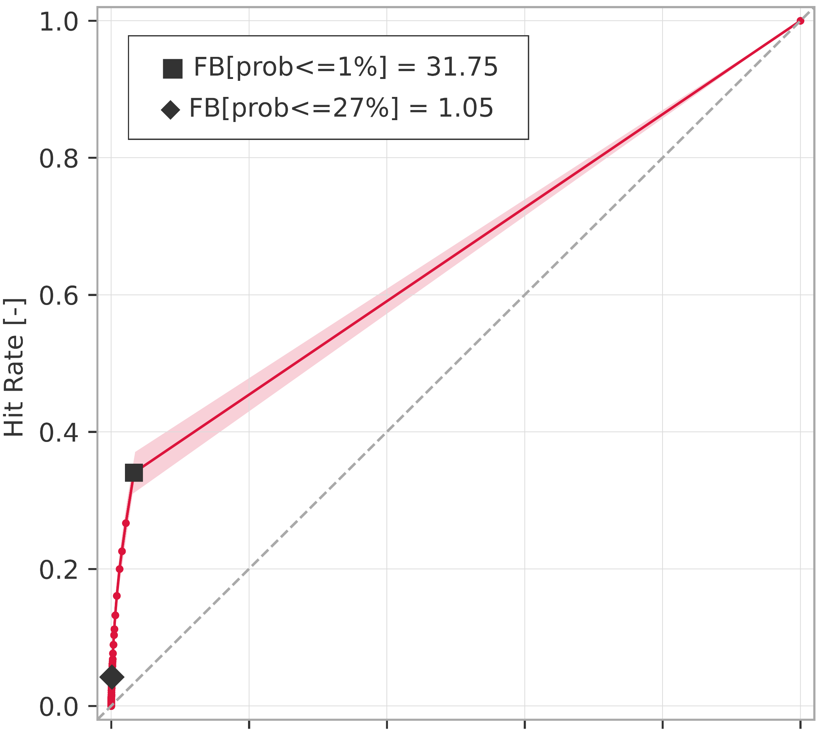
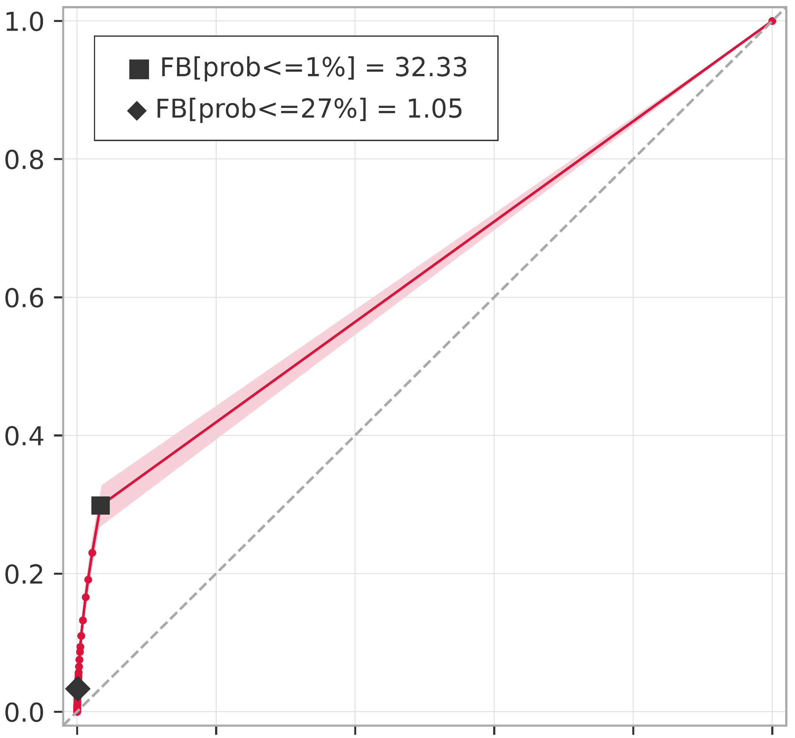
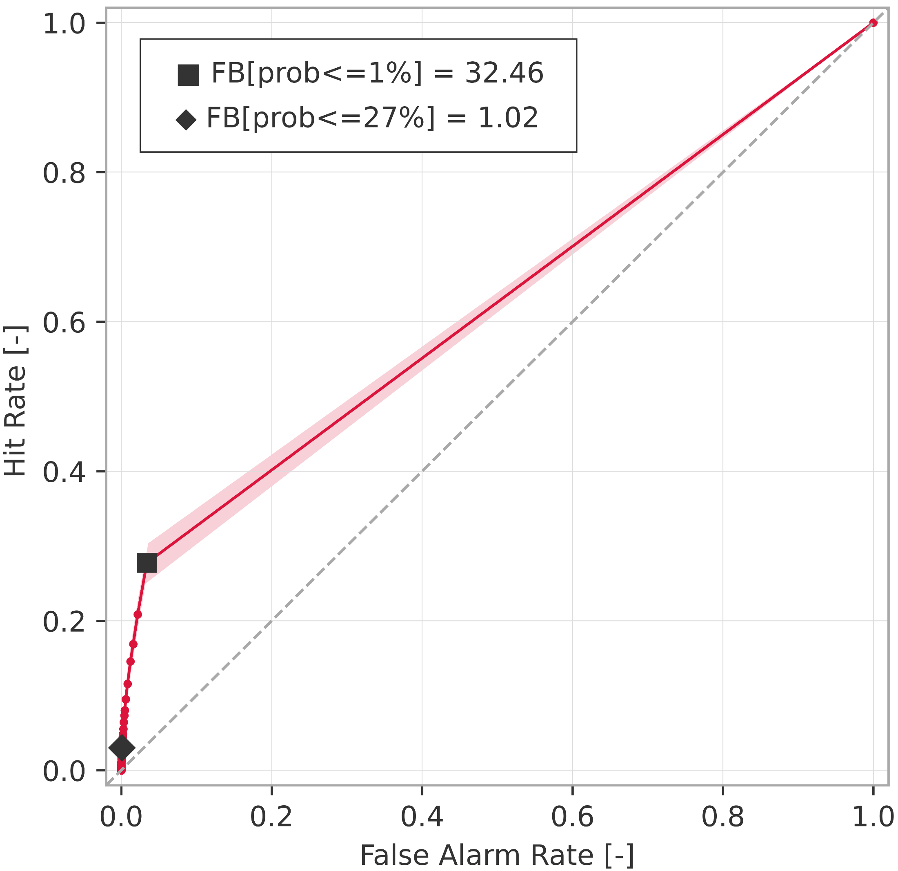
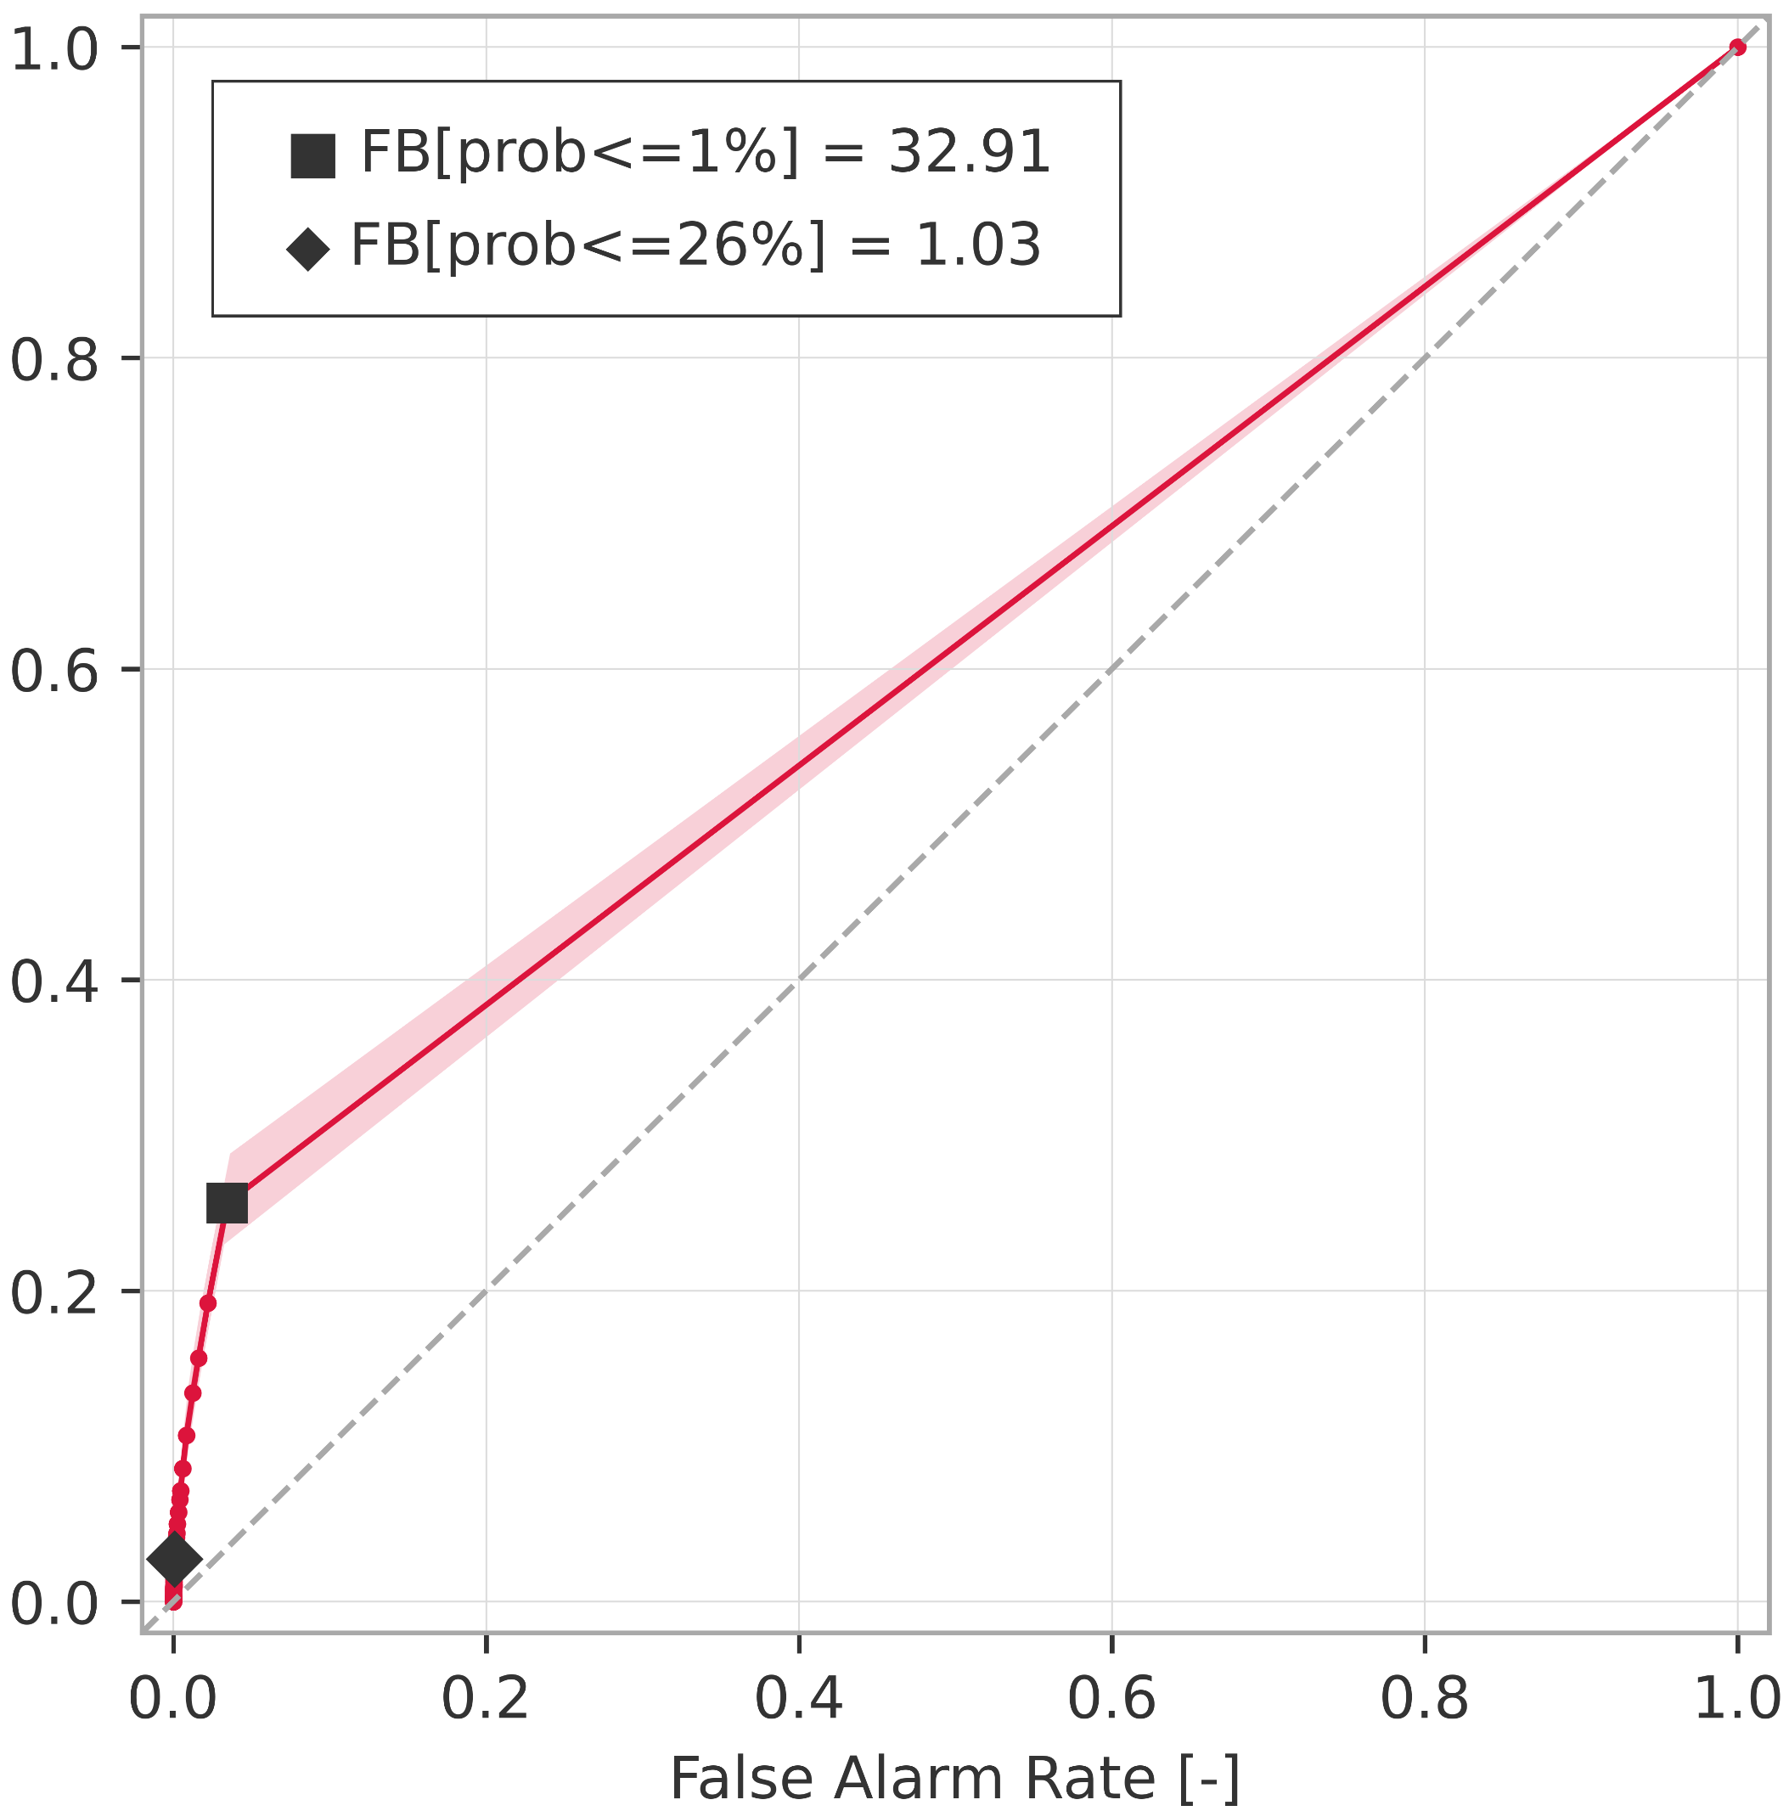
Breakdown verification scores (rainfall-based forecasts)
ROC curves for rainfall events exceeding the 1-year return period
ROC curve
99% confidence interval
a) short-range forecast (reanalysis)
.
b) long-range forecast (t+0,t+24)
AROC = 0.675
(0.660 ; 0.691)
AROC = 0.692
(0.677 ; 0.708)
c) long-range forecast (t+24,t+48)
d) long-range forecast (t+48,t+72)
AROC = 0.655
(0.640 ; 0.670)
AROC = 0.634
(0.618 ; 0.649)
e) long-range forecast (t+72,t+96)
f) long-range forecast (t+96,t+120)
AROC = 0.623
(0.609 ; 0.636)
AROC = 0.612
(0.598 ; 0.628)

