Slide 1
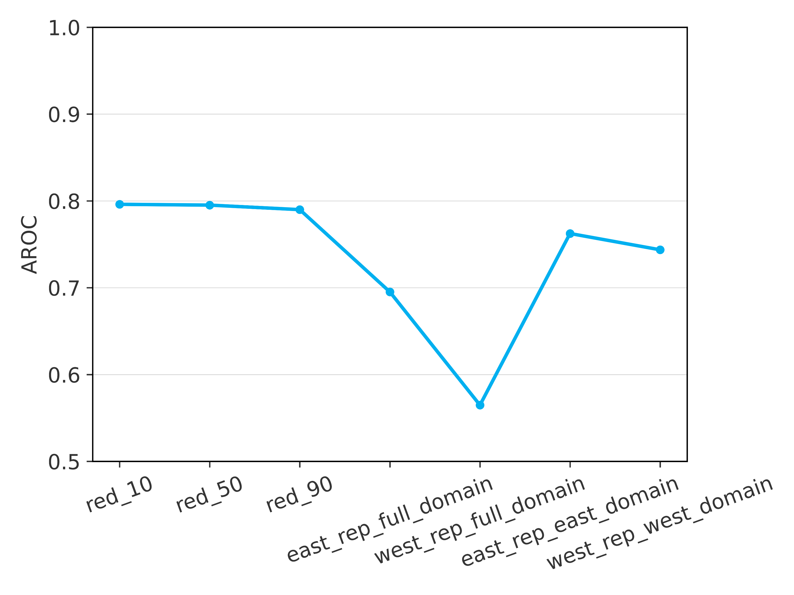
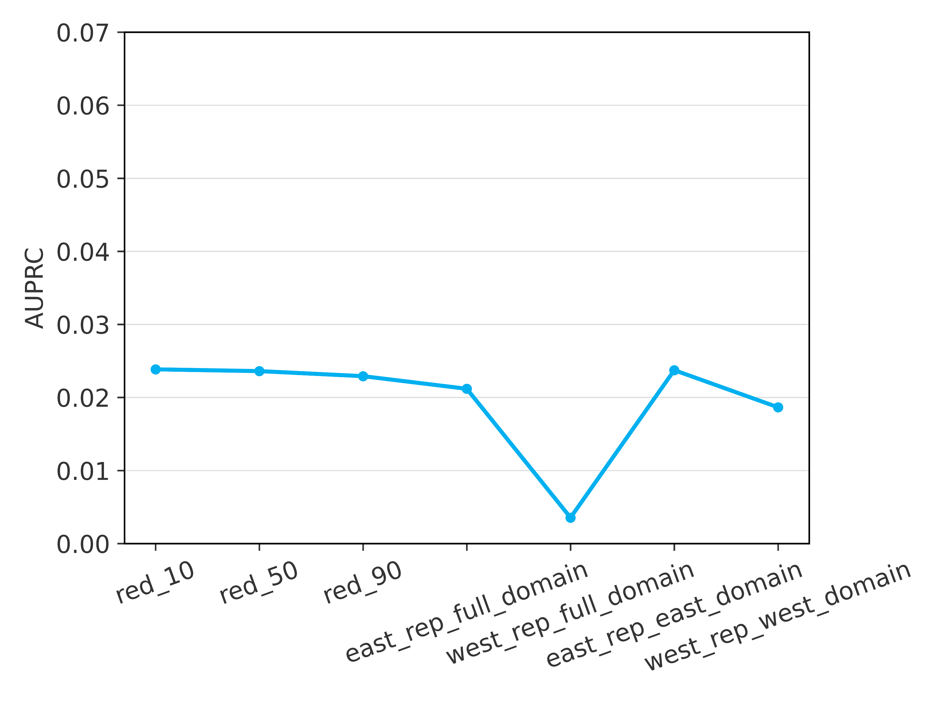
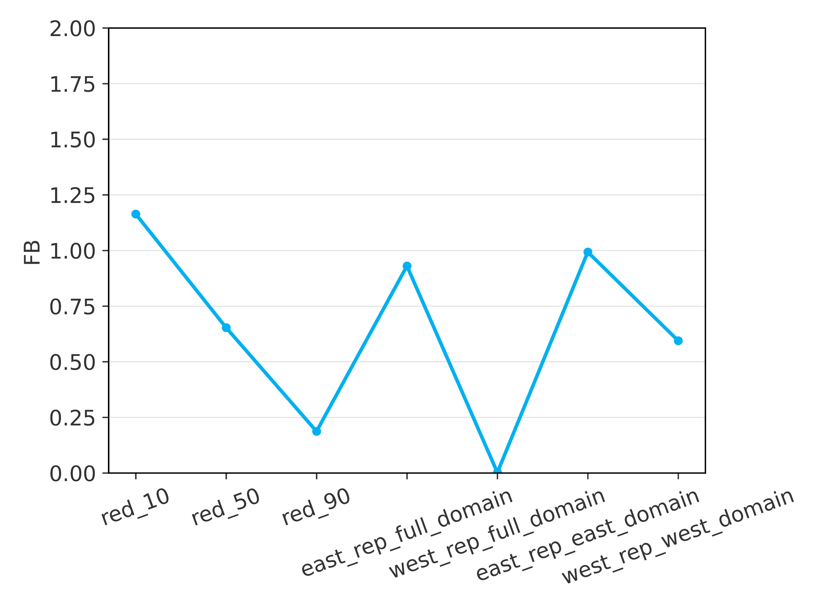







Verification results – Overall scores
Evaluated over the verification dataset, for the XGBoost implementation of gradient boosting
Scores computed with the full training dataset
Scores computed with the training subsets
AUC-ROC
AUC-PR
FB
Refer to Figure 6.11a
Refer to Figure 6.11i
0.07
2
1
0.06
b
1.75
c
a
Refer to Figure 6.11e
0.9
0.05
1.5
0.04
1.25
0.8
1
0.03
0.7
0.75
0.02
0.5
0.6
0.01
0.25
0.5
0
0

