Slide 1
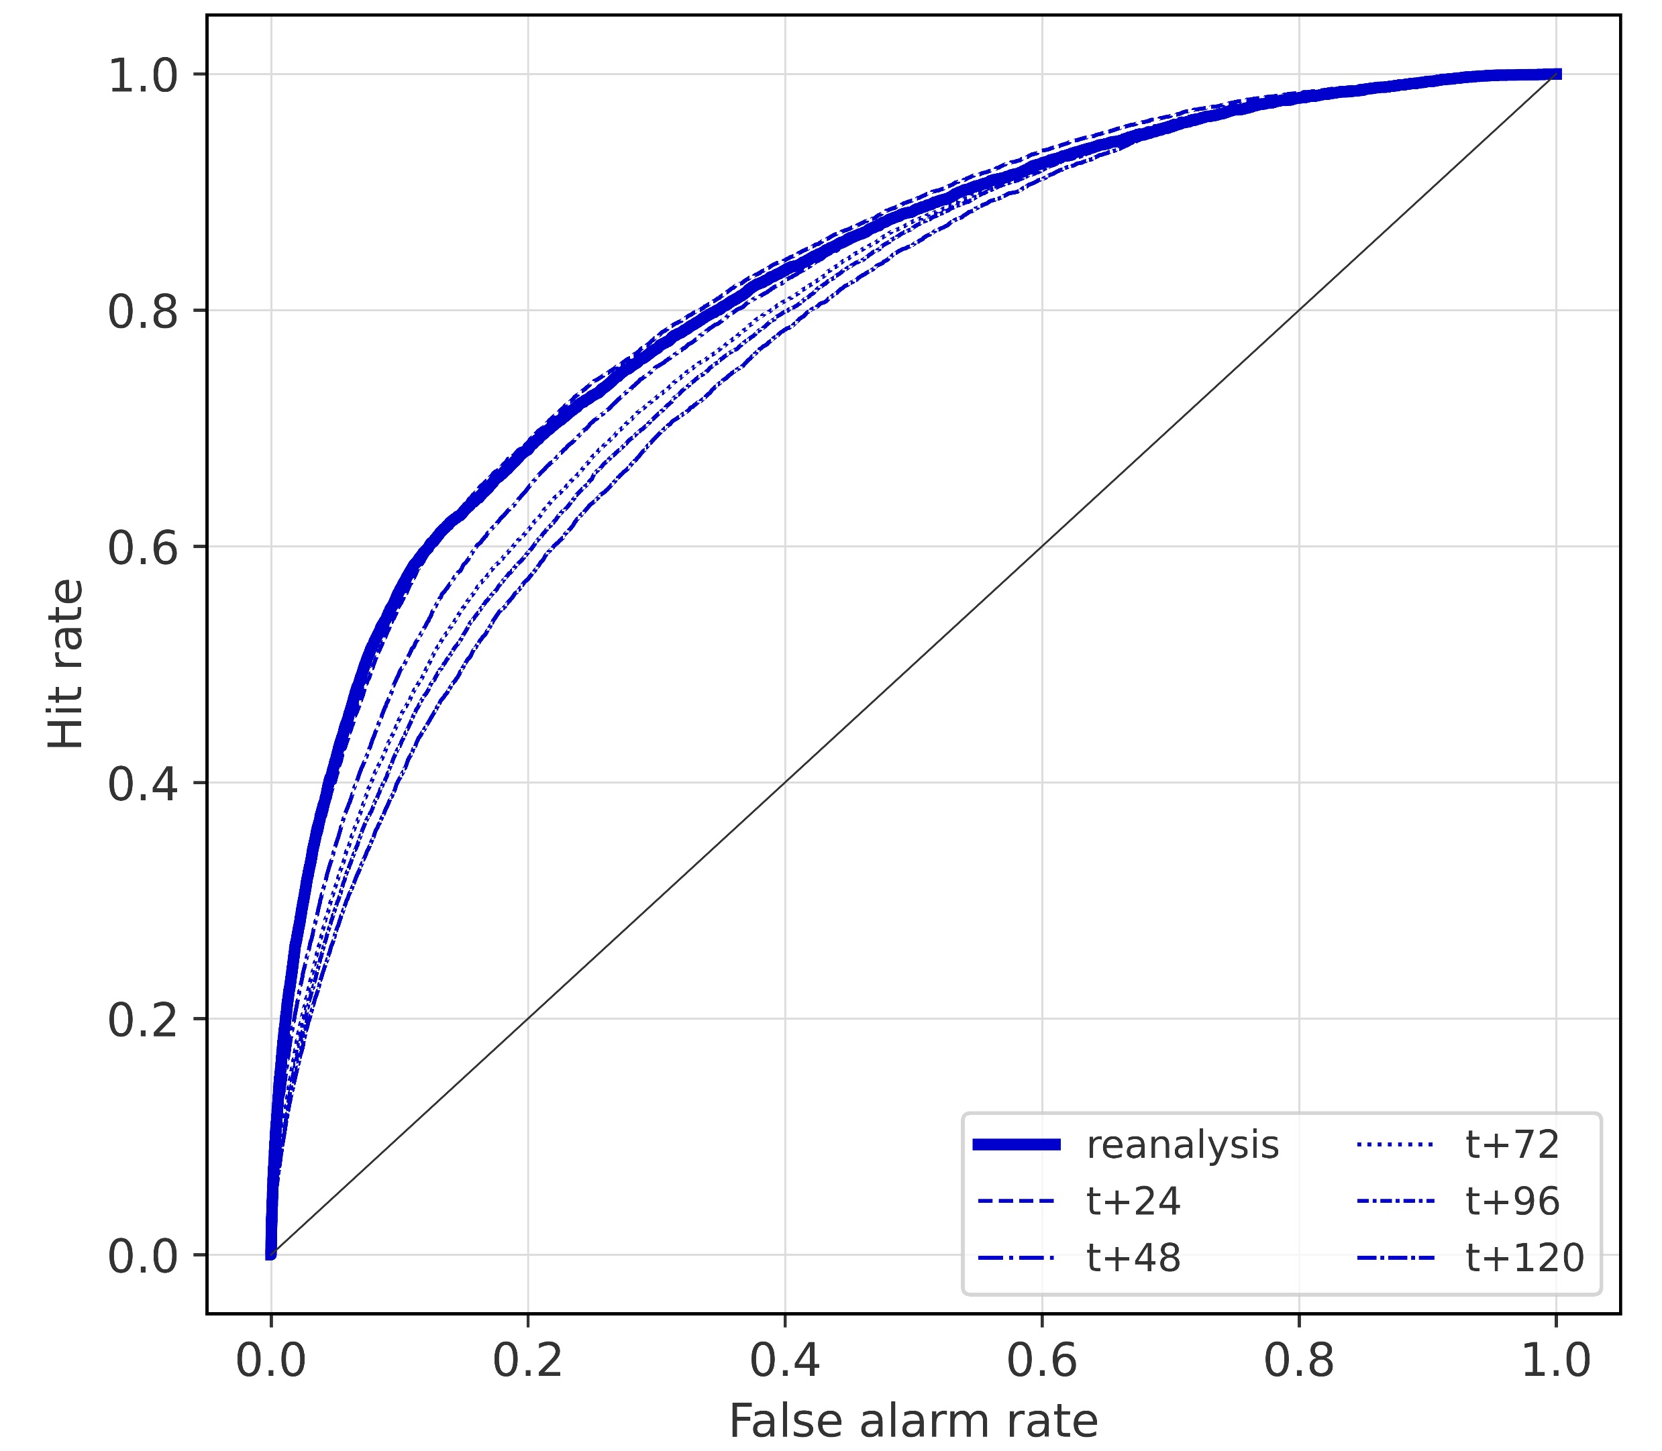
Breakdown verification scores (data-driven forecasts)
Roc curves

