Slide 1
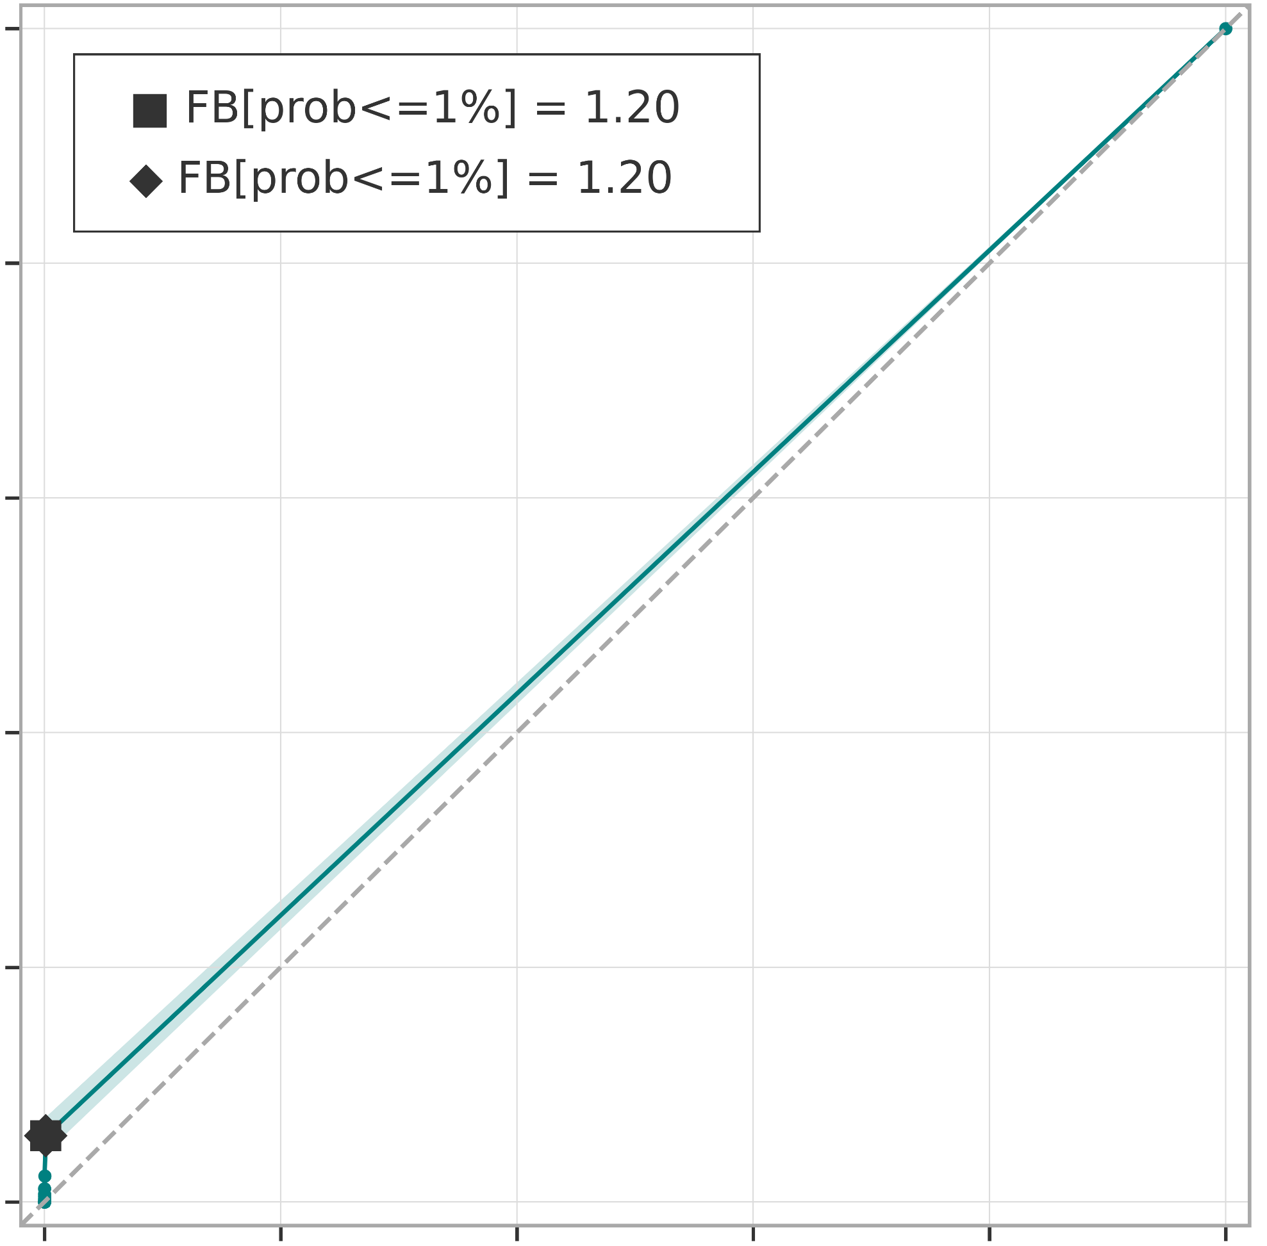
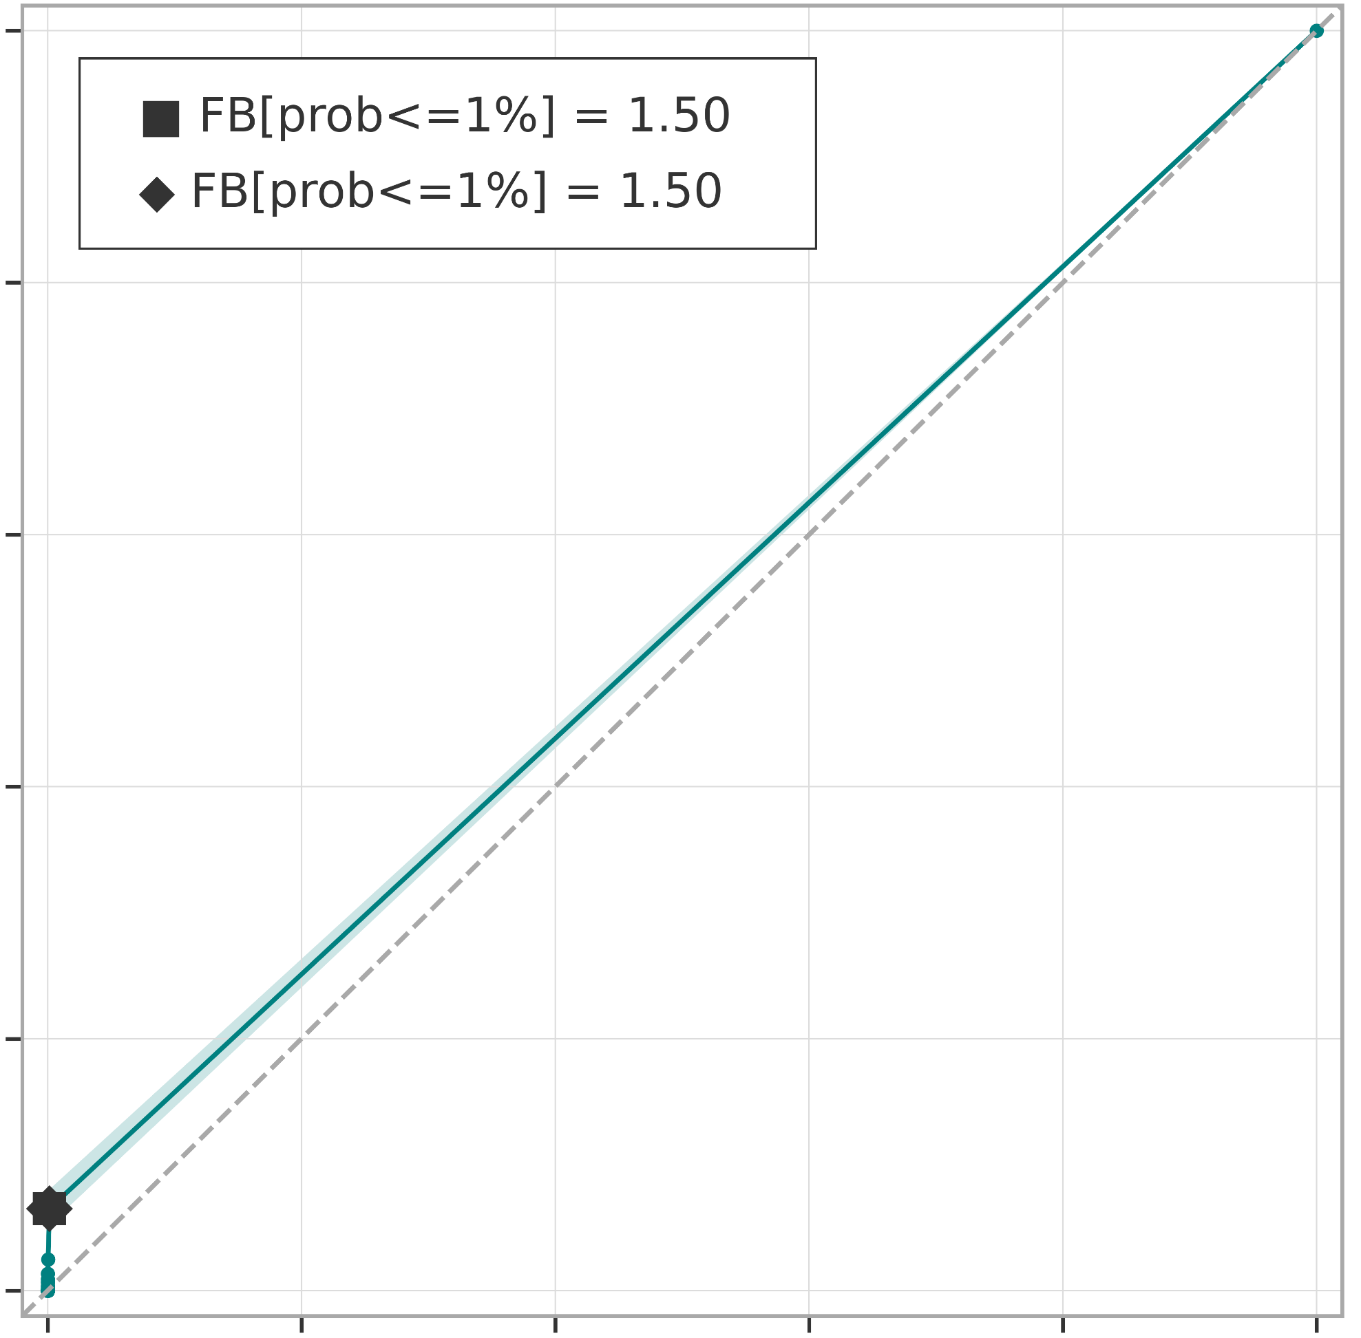



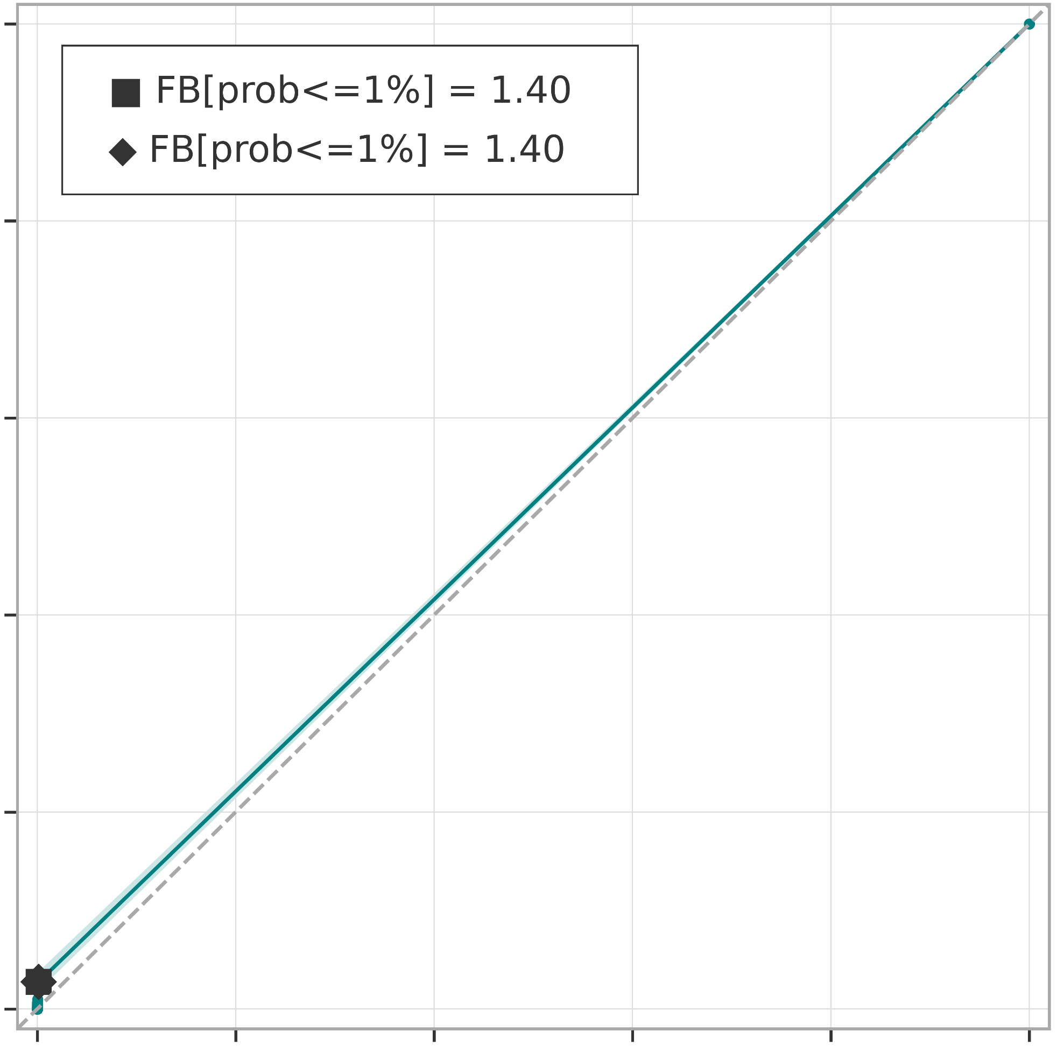
Breakdown verification scores (rainfall-based forecasts)
ROC curves for rainfall events exceeding the 100-year return period
ROC curve
99% confidence interval
a) short-range forecast (reanalysis)
.
b) long-range forecast (t+0,t+24)
AROC = 0.528
(0.520 ; 0.535)
AROC = 0.532
(0.525 ; 0.540)
c) long-range forecast (t+24,t+48)
d) long-range forecast (t+48,t+72)
AROC = 0.523
(0.516 ; 0.530)
AROC = 0.518
(0.513 ; 0.525)
e) long-range forecast (t+72,t+96)
f) long-range forecast (t+96,t+120)
AROC = 0.515
(0.509 ; 0.520)
AROC = 0.513
(0.509 ; 0.518)

