Slide 1
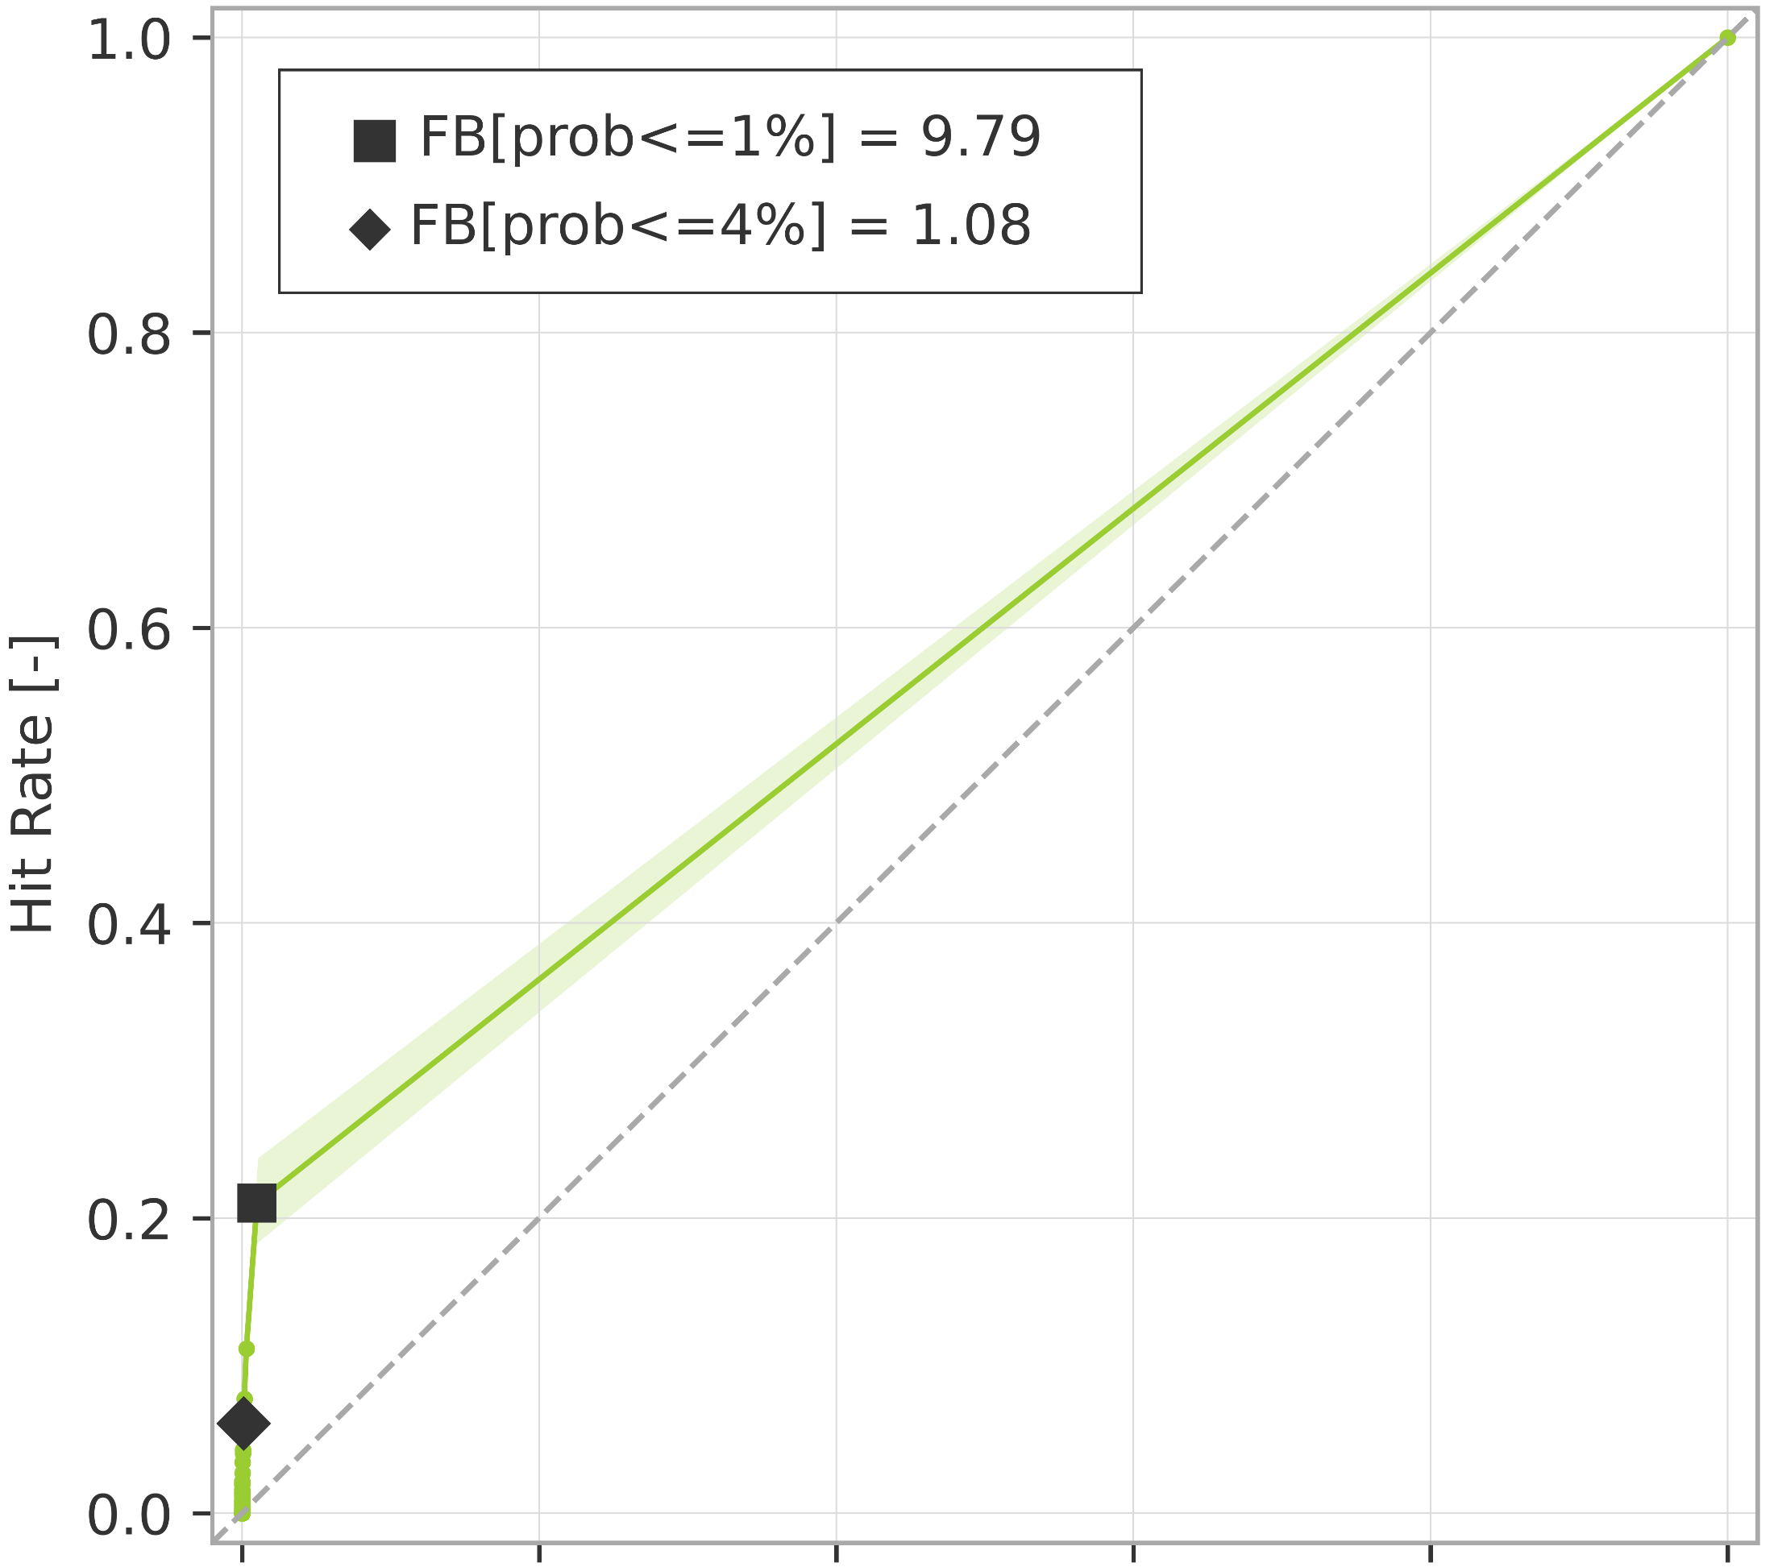
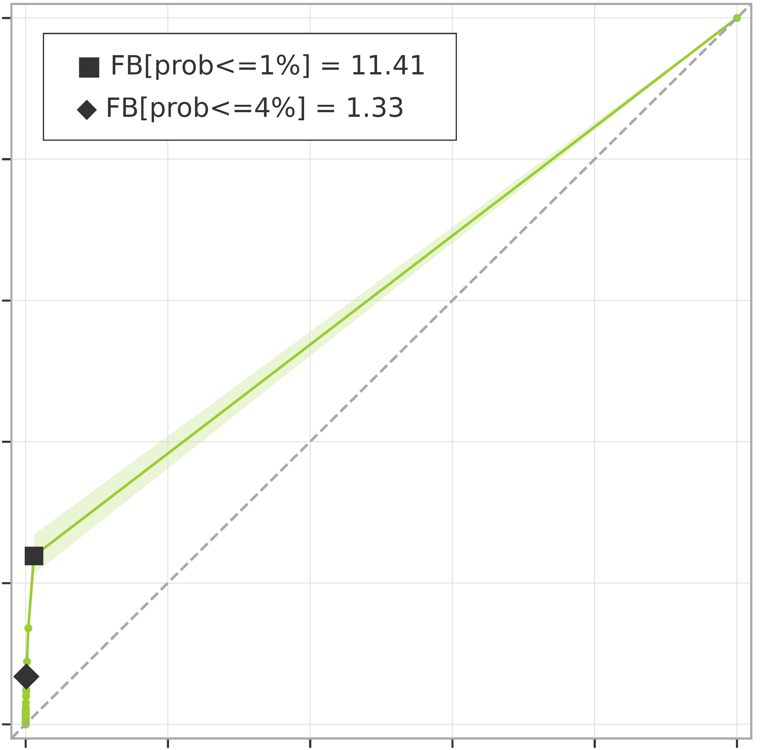
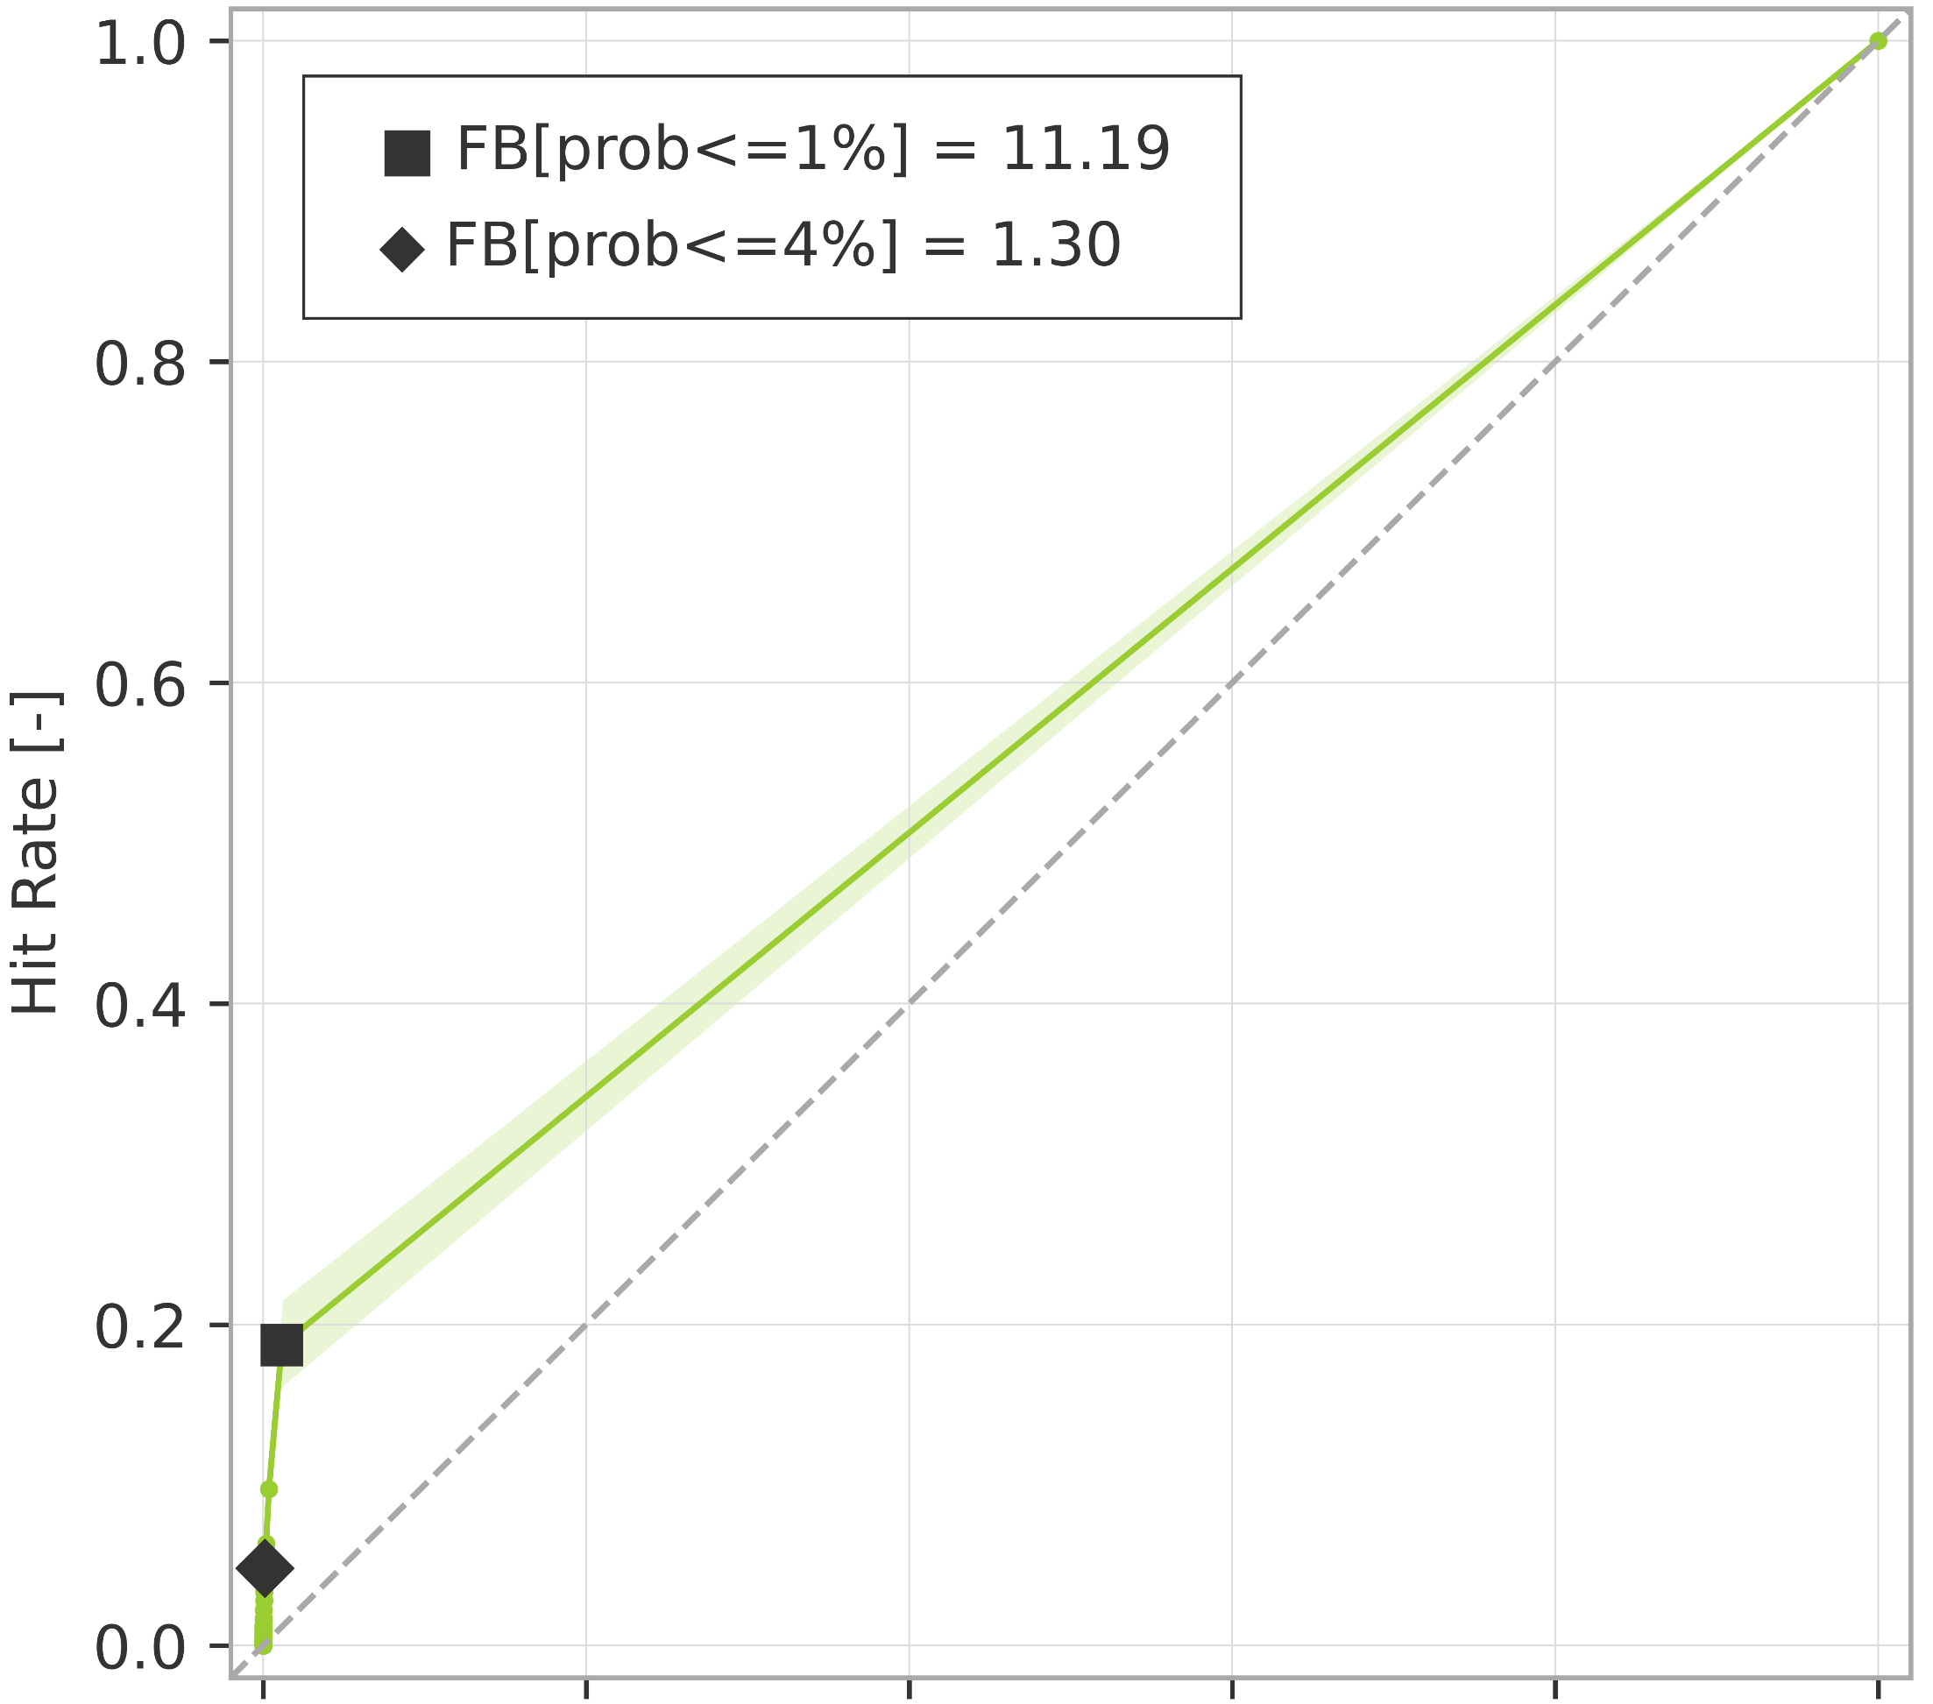



Breakdown verification scores (rainfall-based forecasts)
ROC curves for rainfall events exceeding the 10-year return period
ROC curve
99% confidence interval
a) short-range forecast (reanalysis)
.
b) long-range forecast (t+0,t+24)
AROC = 0.600
(0.586 ; 0.615)
AROC = 0.614
(0.600 ; 0.629)
c) long-range forecast (t+24,t+48)
d) long-range forecast (t+48,t+72)
AROC = 0.588
(0.574 ; 0.602)
AROC = 0.573
(0.560 ; 0.585)
e) long-range forecast (t+72,t+96)
f) long-range forecast (t+96,t+120)
AROC = 0.563
(0.552 ; 0.573)
AROC = 0.557
(0.545 ; 0.571)

