Slide 1
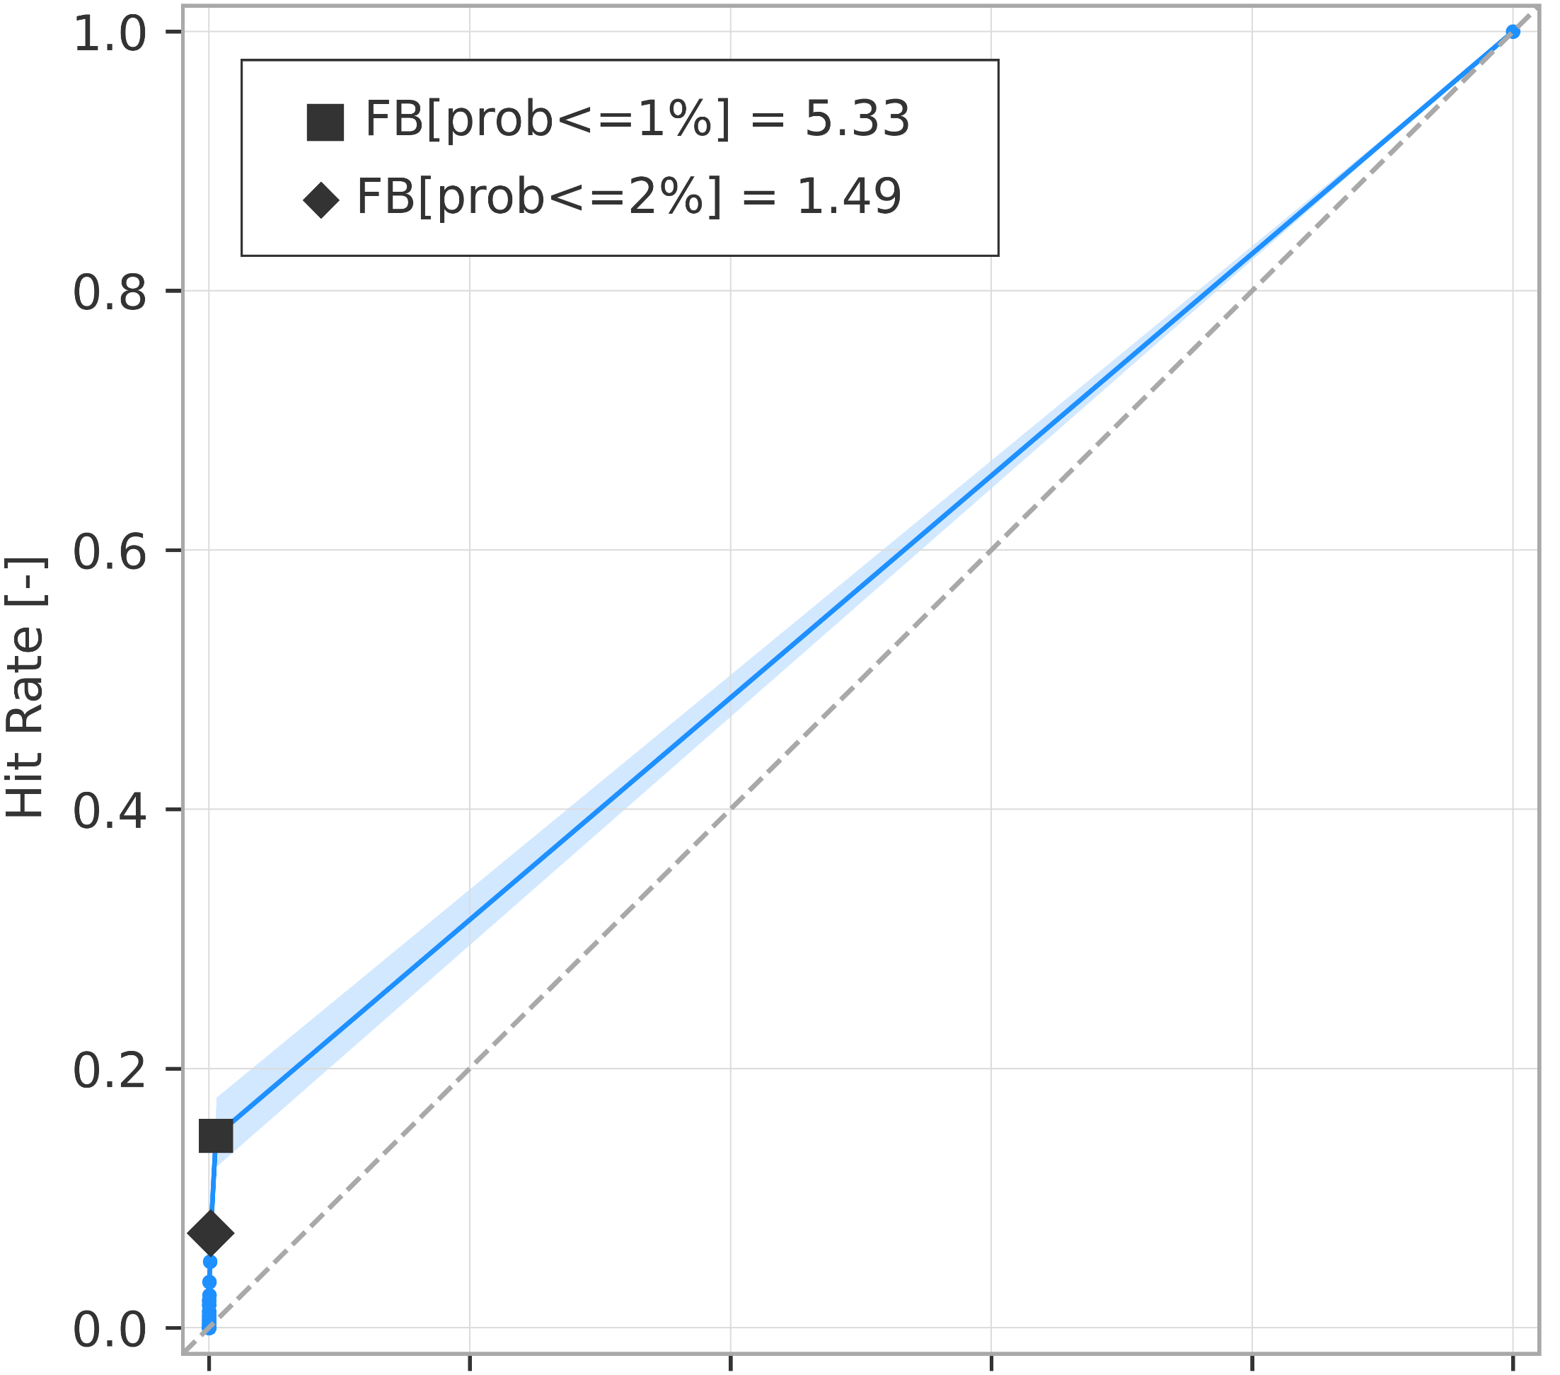


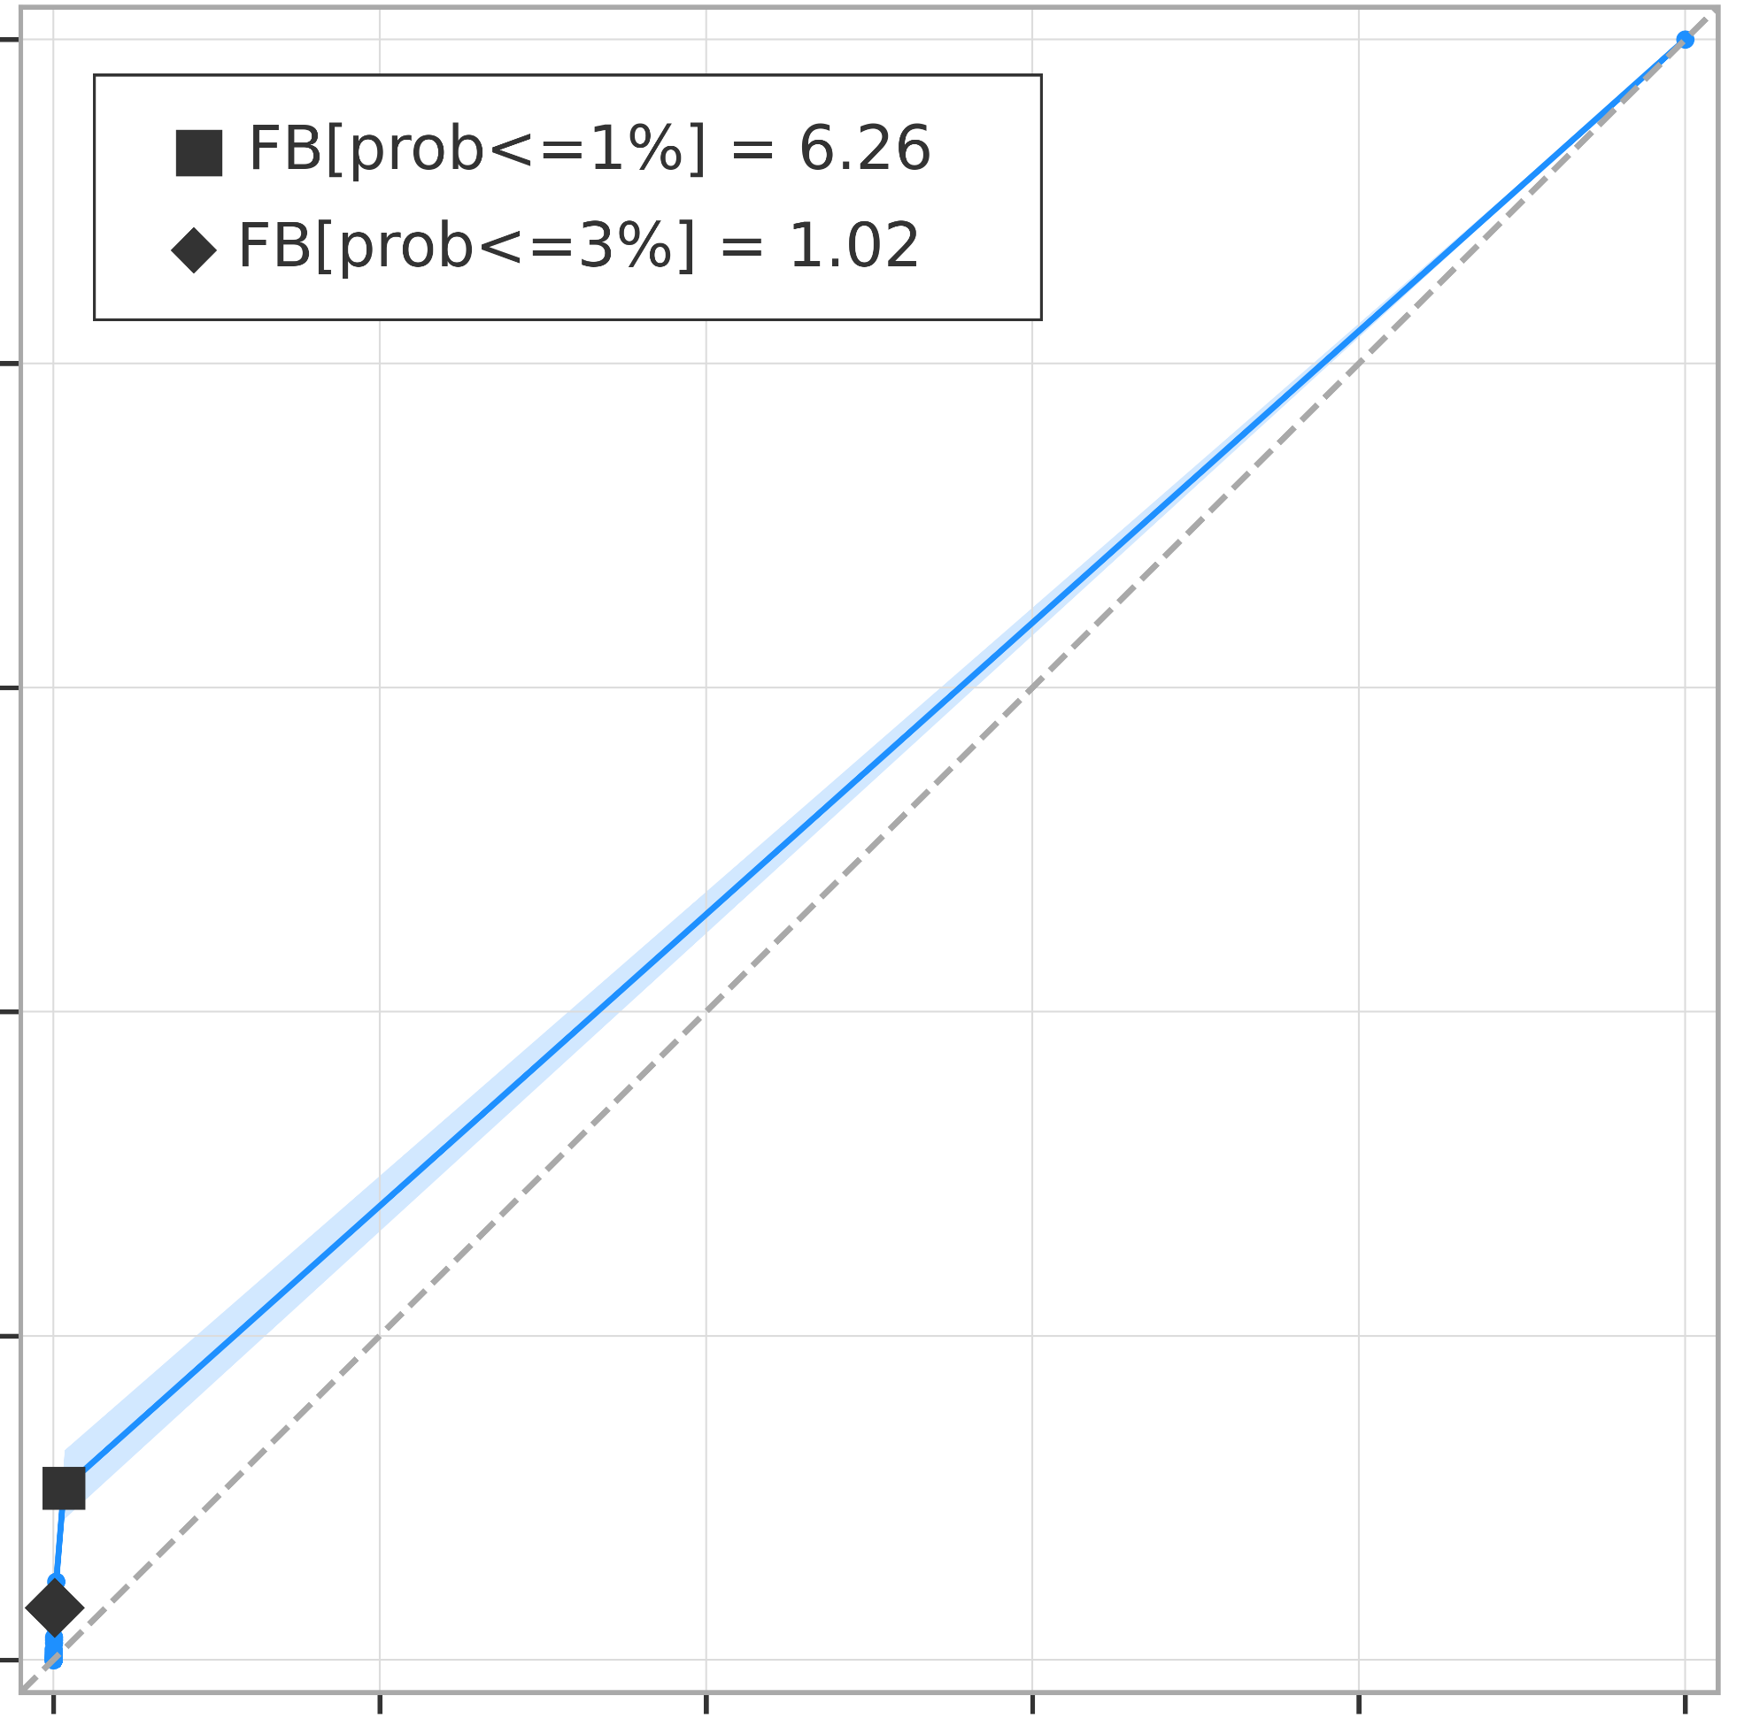
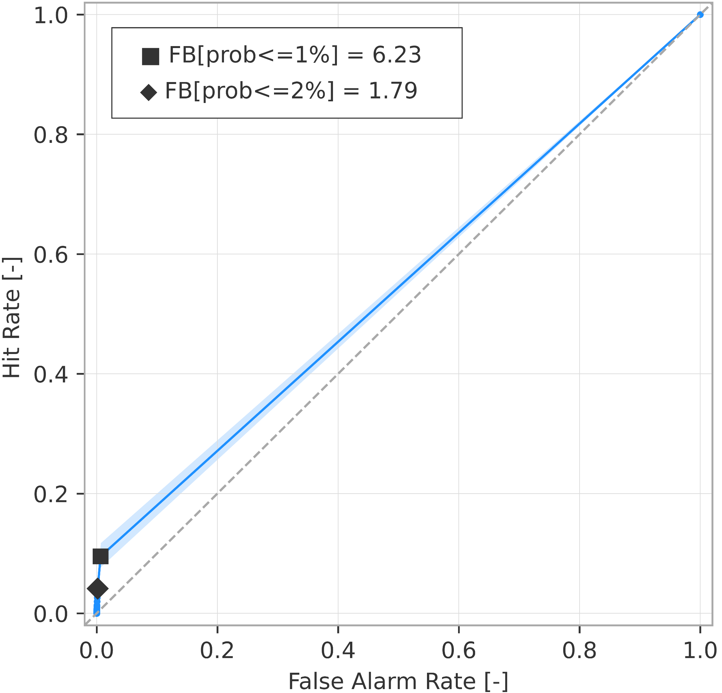
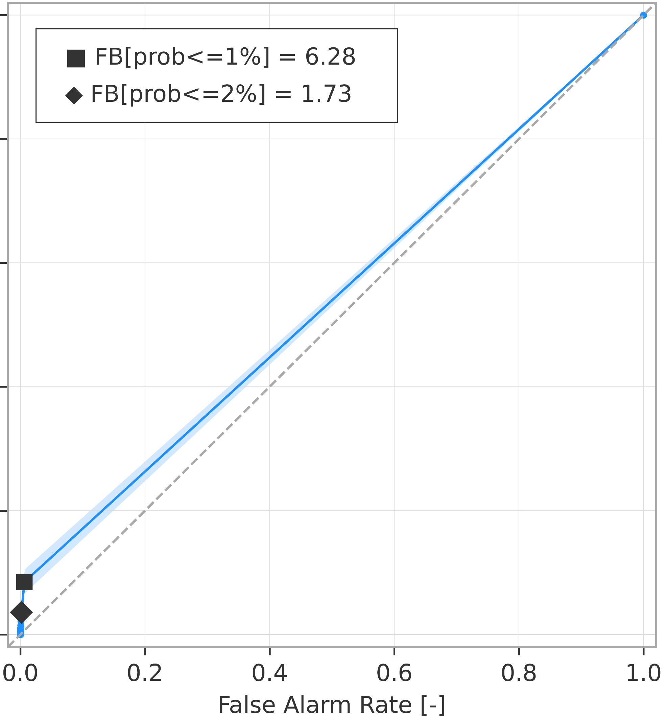
Breakdown verification scores (rainfall-based forecasts)
ROC curves for rainfall events exceeding the 20-year return period
ROC curve
99% confidence interval
a) short-range forecast (reanalysis)
.
b) long-range forecast (t+0,t+24)
AROC = 0.571
(0.559 ; 0.586)
AROC = 0.582
(0.569 ; 0.595)
c) long-range forecast (t+24,t+48)
d) long-range forecast (t+48,t+72)
AROC = 0.562
(0.551 ; 0.574)
AROC = 0.550
(0.540 ; 0.561)
e) long-range forecast (t+72,t+96)
f) long-range forecast (t+96,t+120)
AROC = 0.544
(0.535 ; 0.555)
AROC = 0.539
(0.529 ; 0.549)

