Slide 1
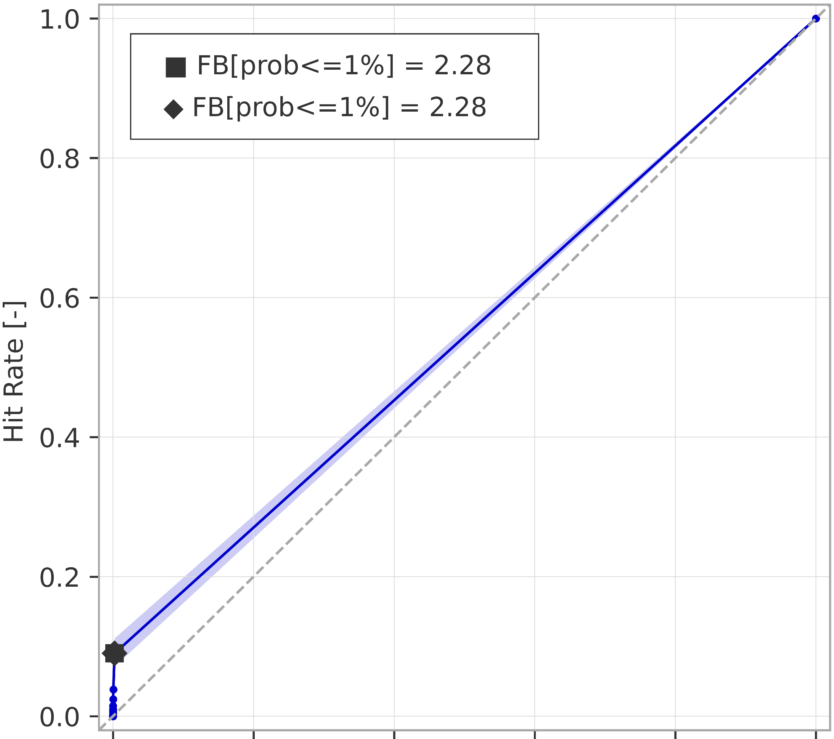

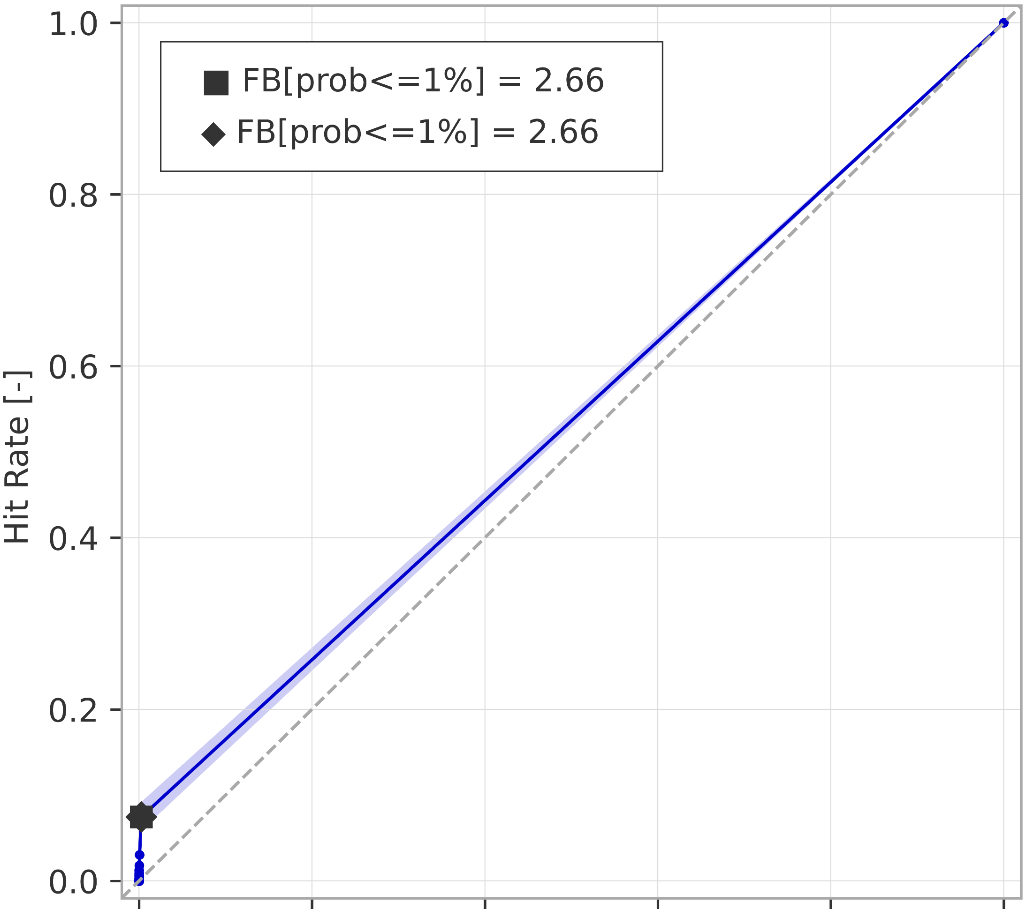
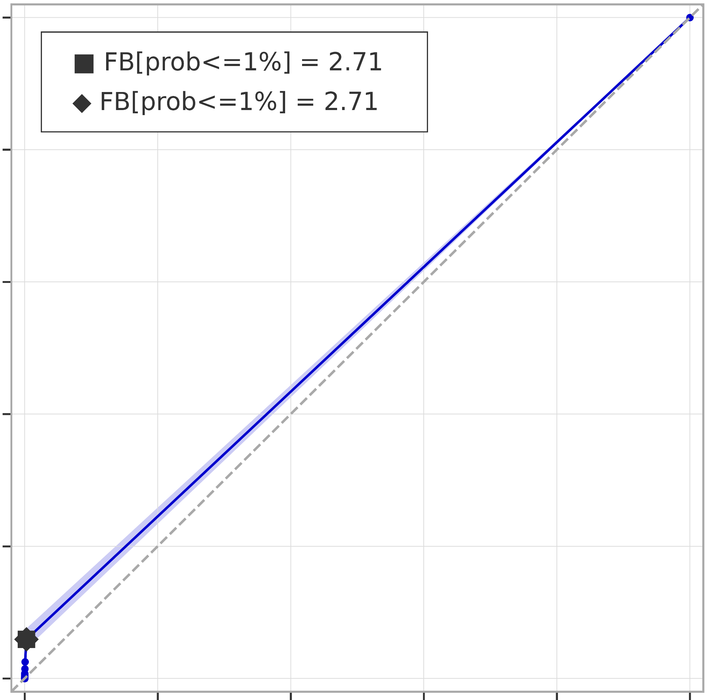
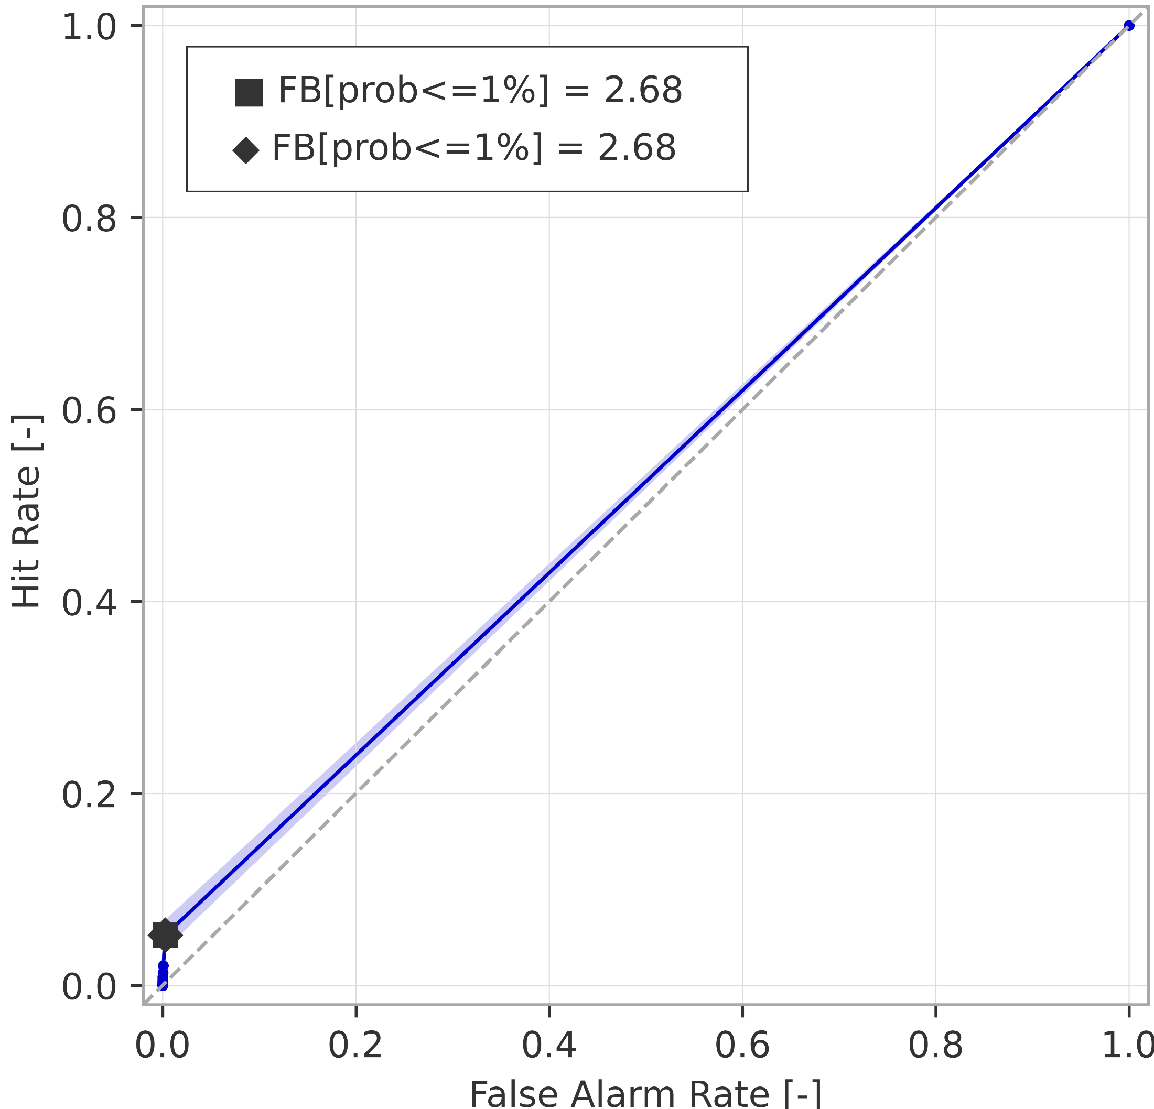
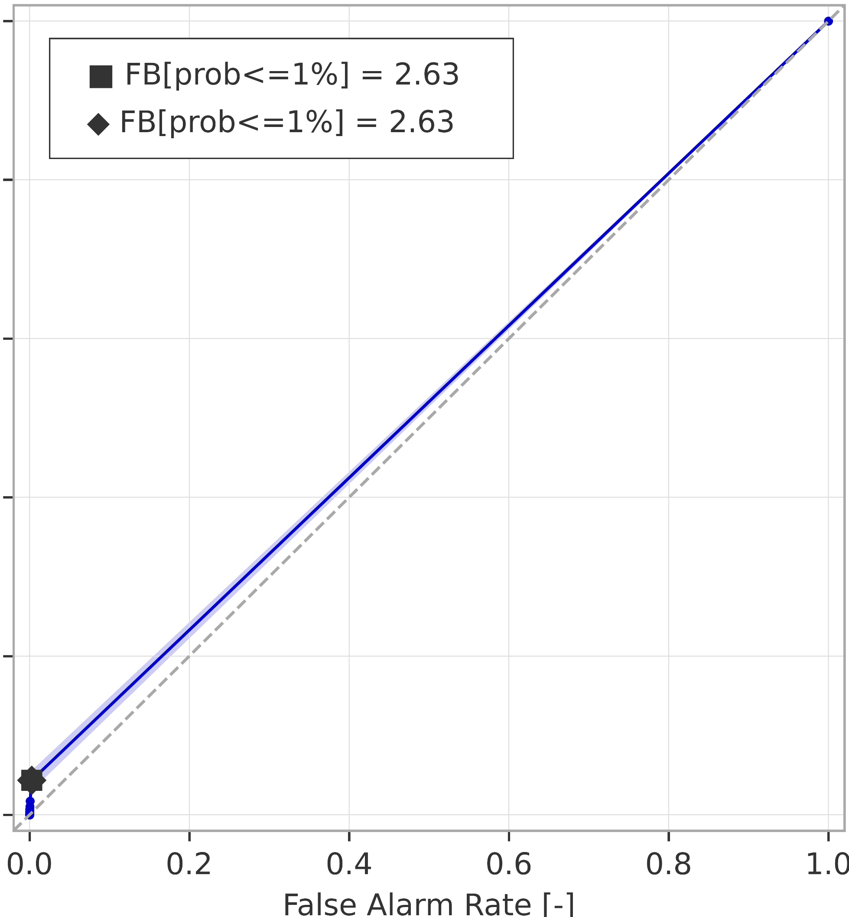
Breakdown verification scores (rainfall-based forecasts)
ROC curves for rainfall events exceeding the 50-year return period
ROC curve
99% confidence interval
a) short-range forecast (reanalysis)
.
b) long-range forecast (t+0,t+24)
AROC = 0.544
(0.534 ; 0.555)
AROC = 0.552
(0.542 ; 0.562)
c) long-range forecast (t+24,t+48)
d) long-range forecast (t+48,t+72)
AROC = 0.536
(0.528 ; 0.545)
AROC = 0.528
(0.521 ; 0.537)
e) long-range forecast (t+72,t+96)
f) long-range forecast (t+96,t+120)
AROC = 0.525
(0.518 ; 0.533)
AROC = 0.520
(0.514 ; 0.527)

