Slide 1
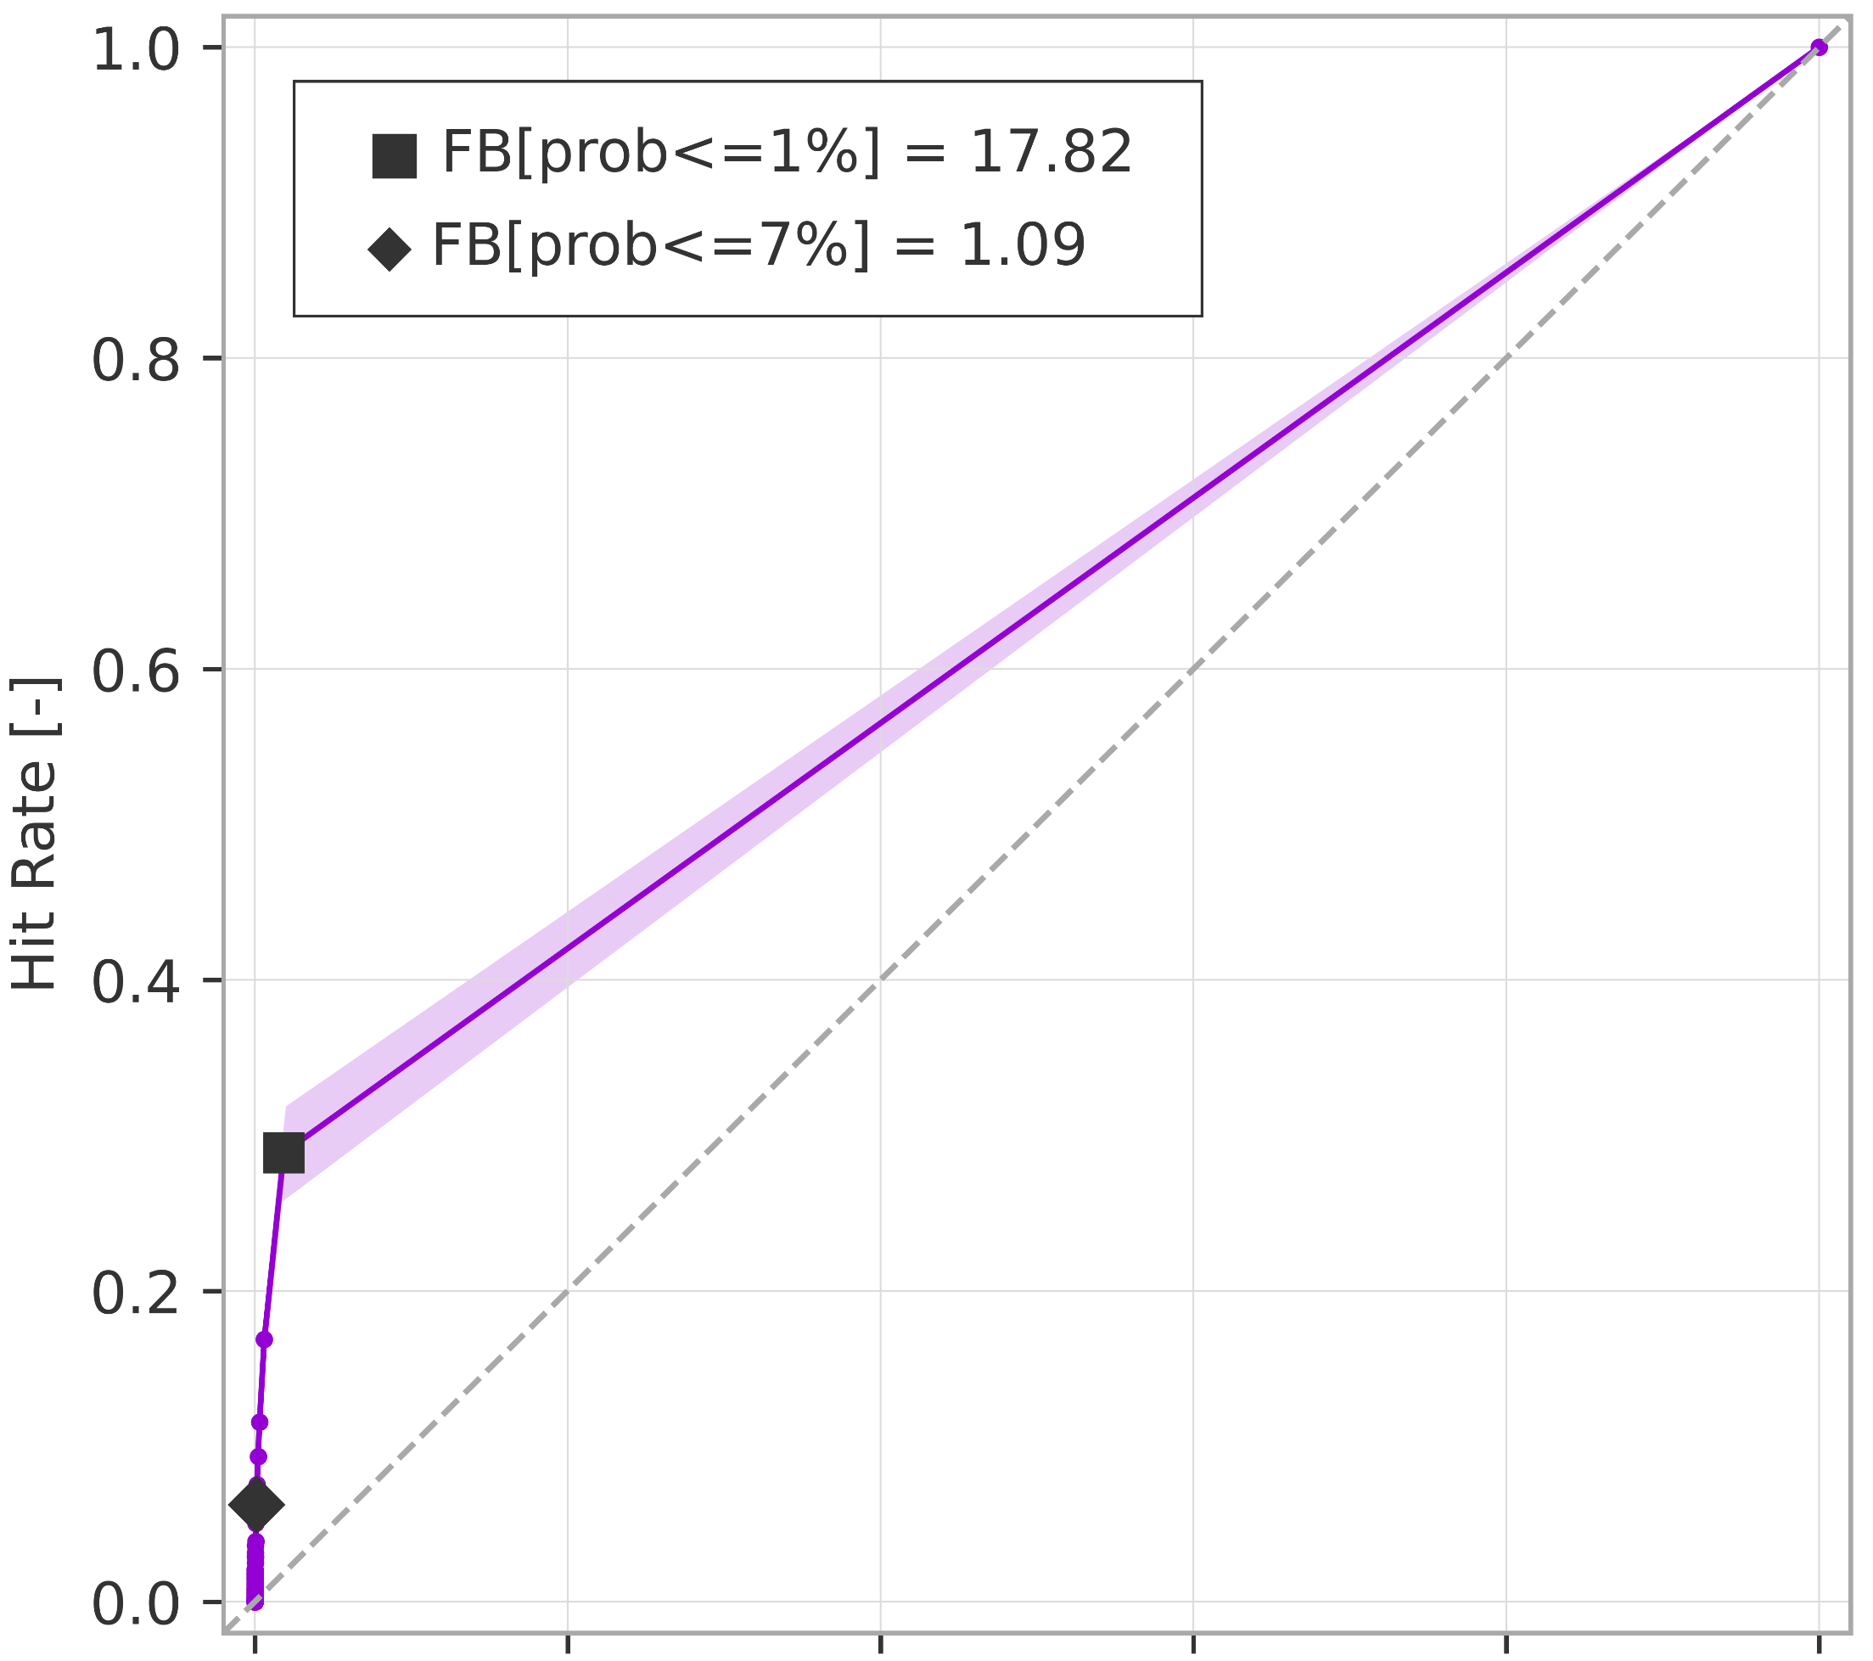

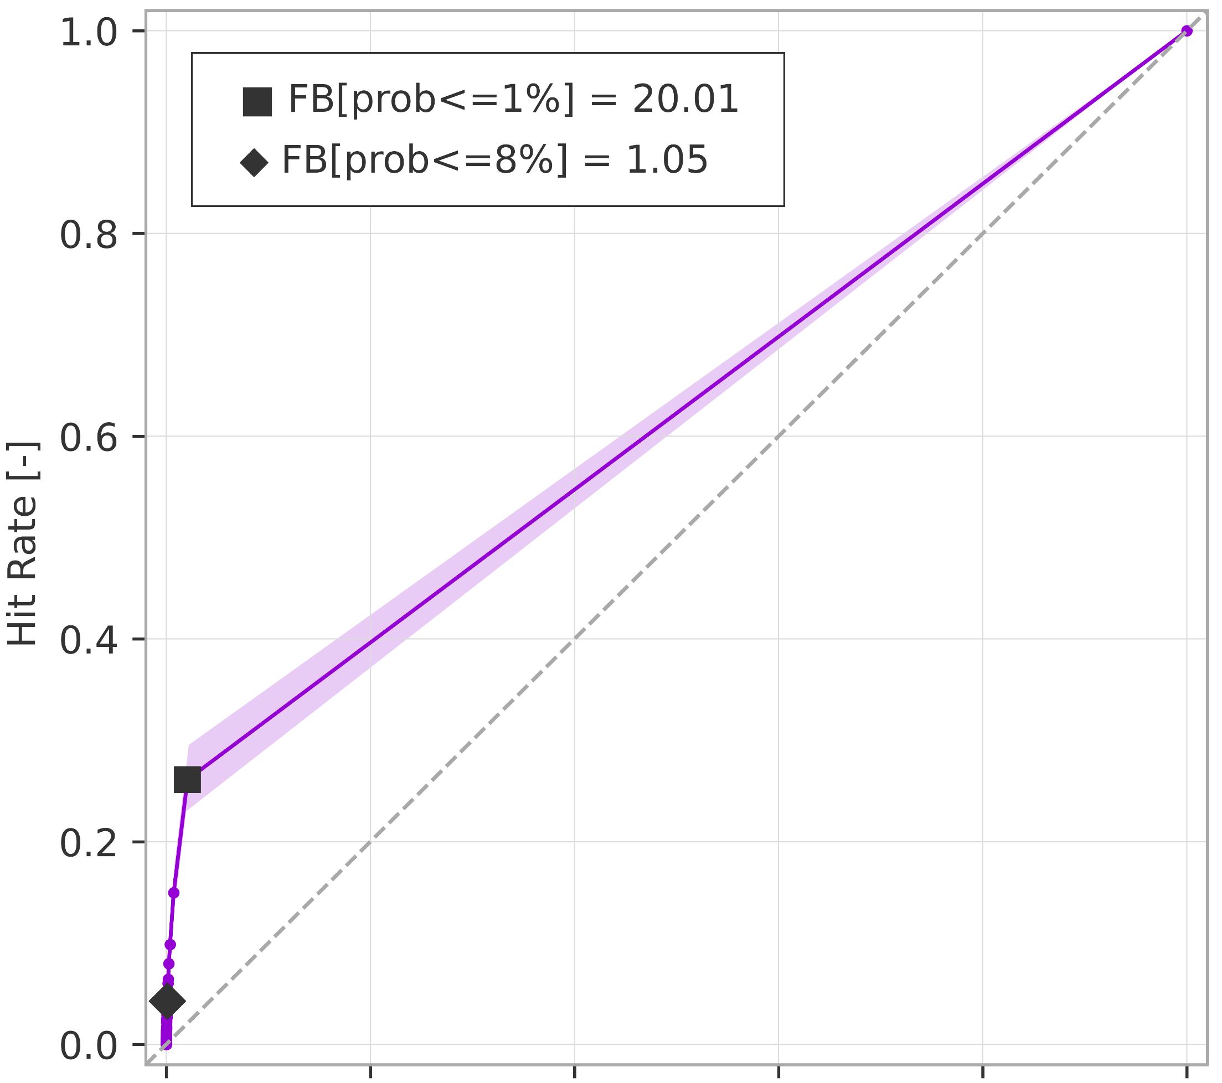
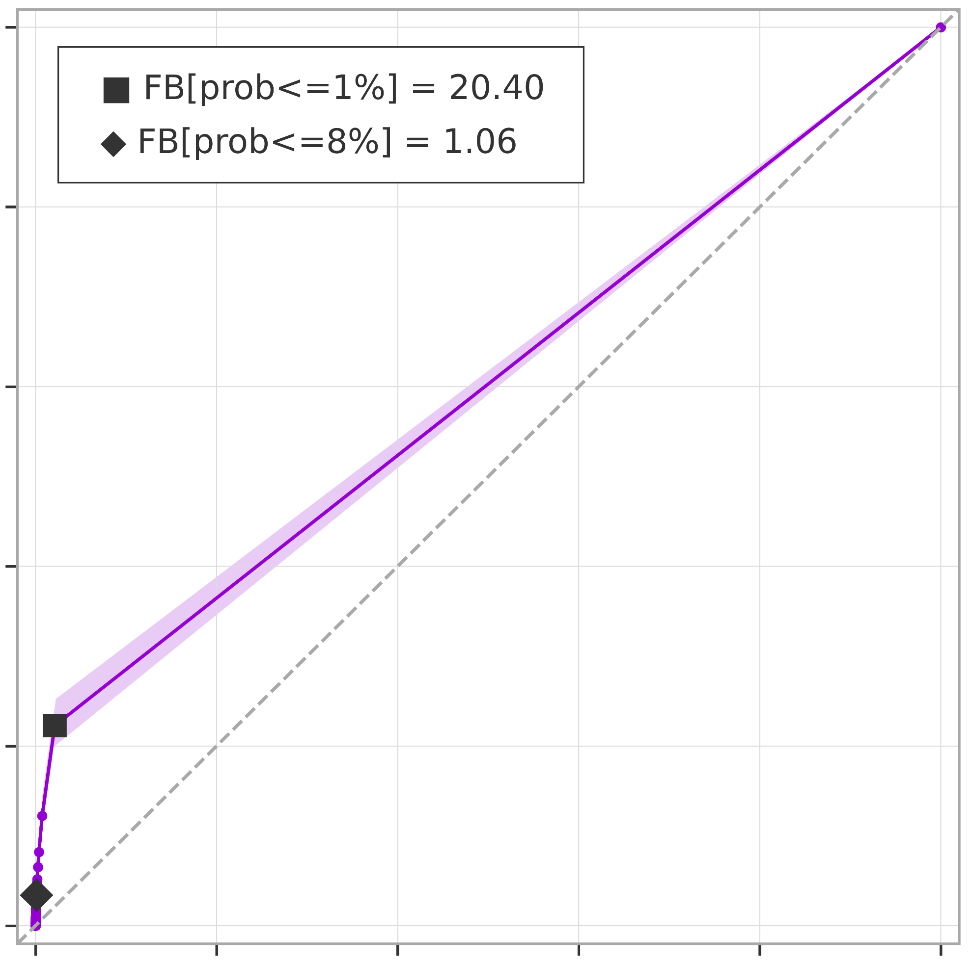
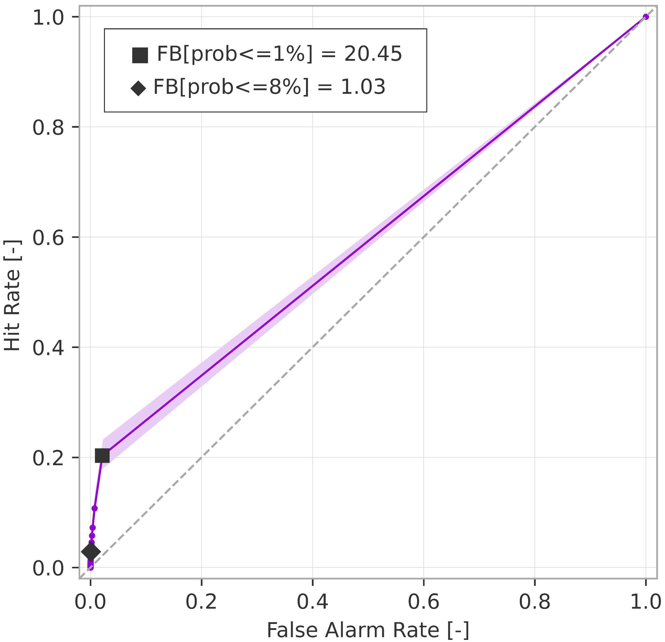
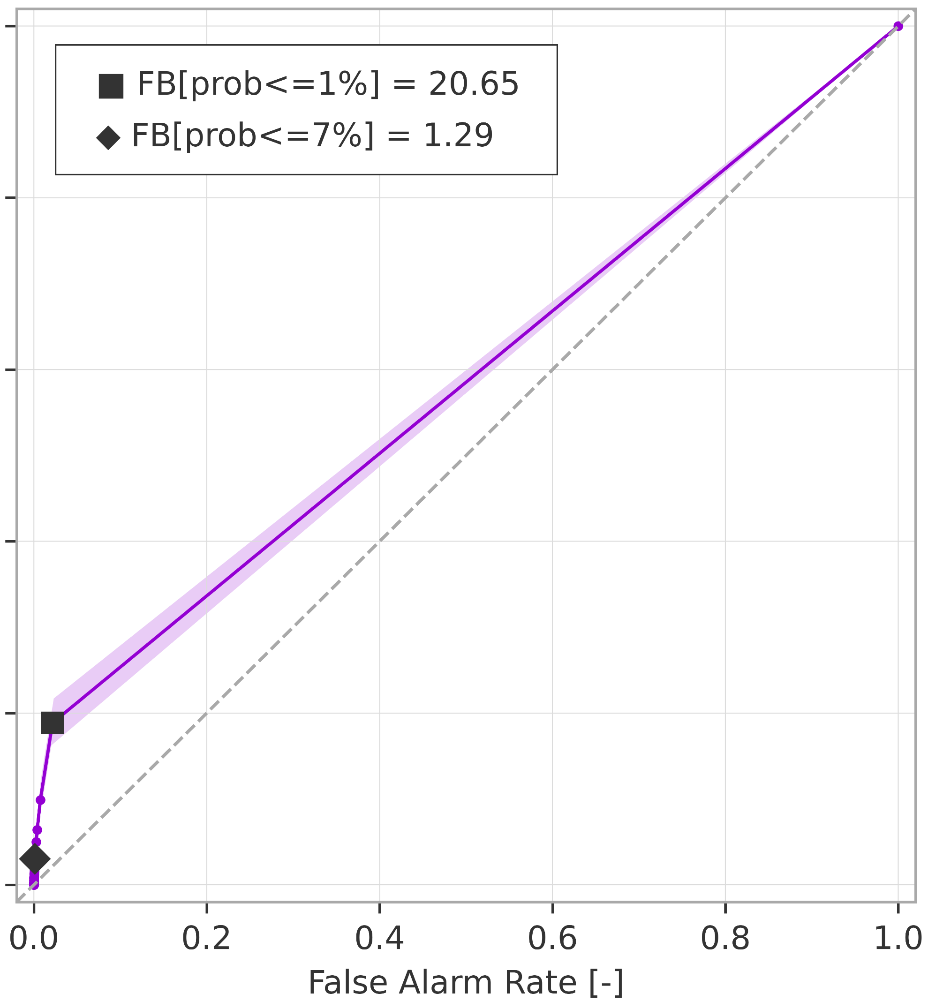
Breakdown verification scores (rainfall-based forecasts)
ROC curves for rainfall events exceeding the 5-year return period
ROC curve
99% confidence interval
a) short-range forecast (reanalysis)
.
b) long-range forecast (t+0,t+24)
AROC = 0.636
(0.620 ; 0.651)
AROC = 0.652
(0.636 ; 0.667)
c) long-range forecast (t+24,t+48)
d) long-range forecast (t+48,t+72)
AROC = 0.621
(0.605 ; 0.637)
AROC = 0.601
(0.589 ; 0.616)
e) long-range forecast (t+72,t+96)
f) long-range forecast (t+96,t+120)
AROC = 0.591
(0.579 ; 0.606)
AROC = 0.584
(0.571 ; 0.598)

