Slide 1
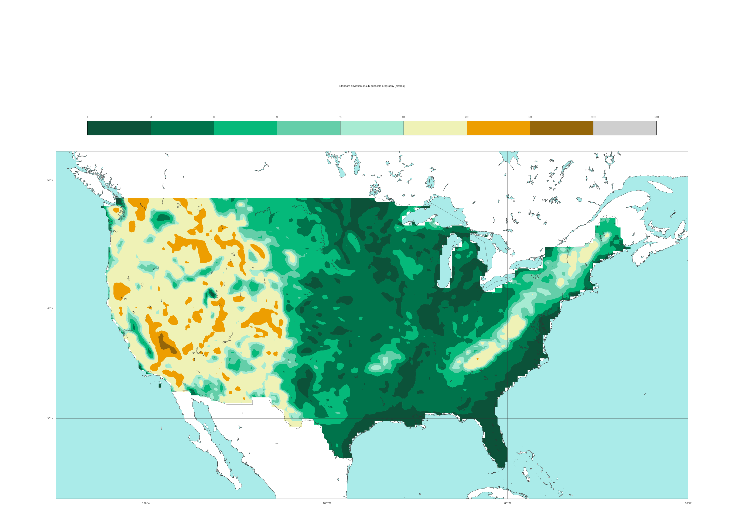

Feature variables for data-driven model
Standard deviation of the filtered sub-grid orography (ERA5) Static field
[metres]
0
10
25
50
75
100
250
500
1000
5000
50 °N
40 °N
30 °N
120 °W
100 °W
80 °W

