Slide 1
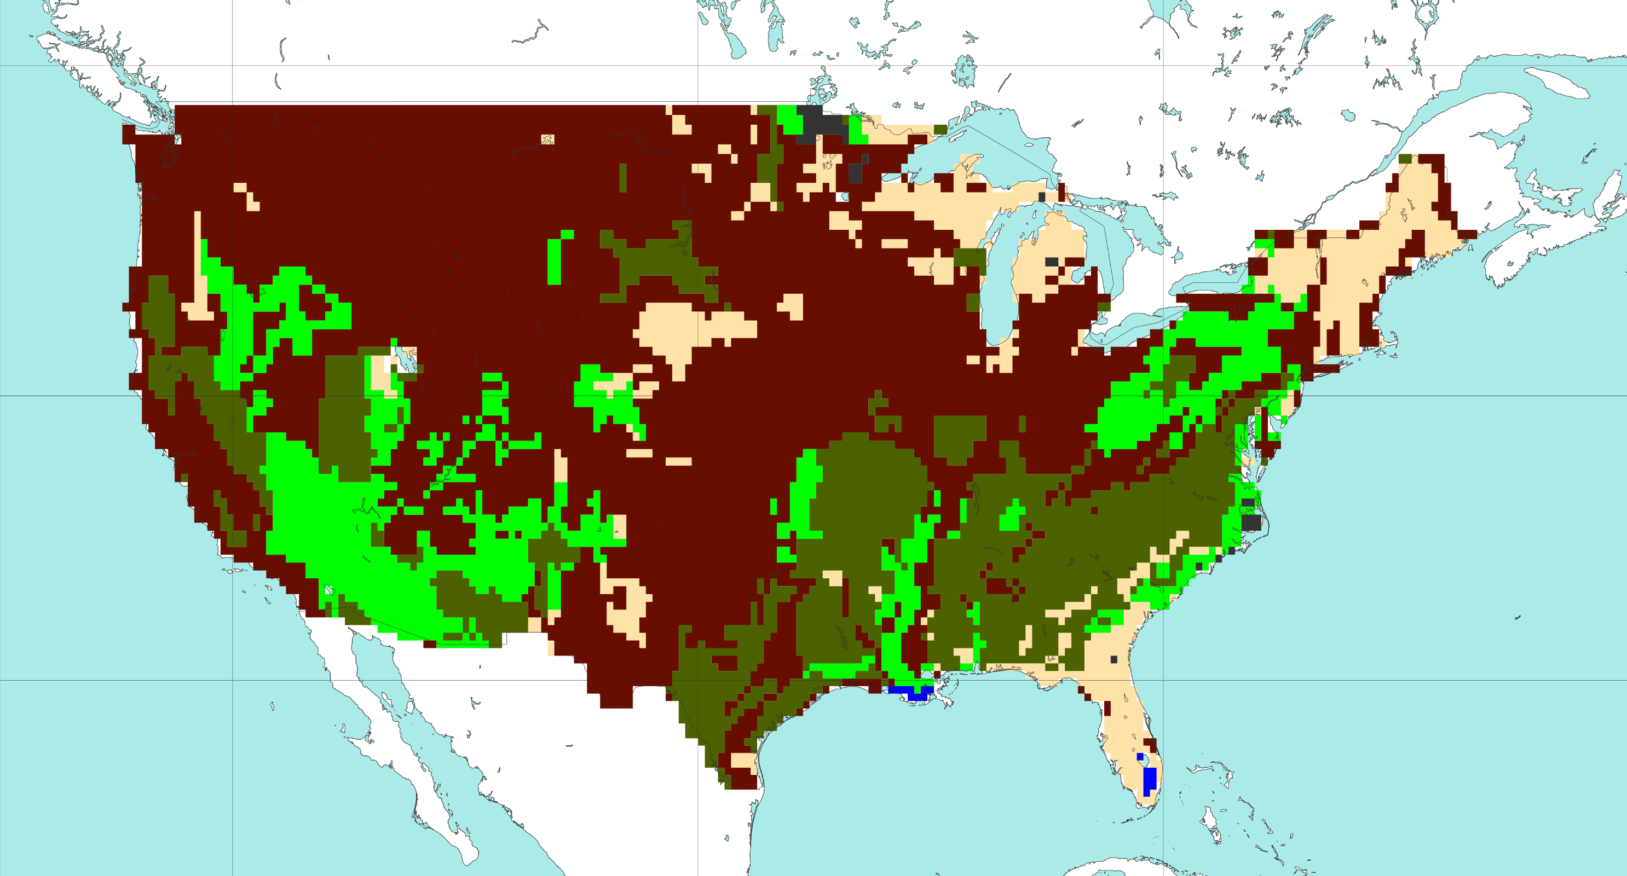
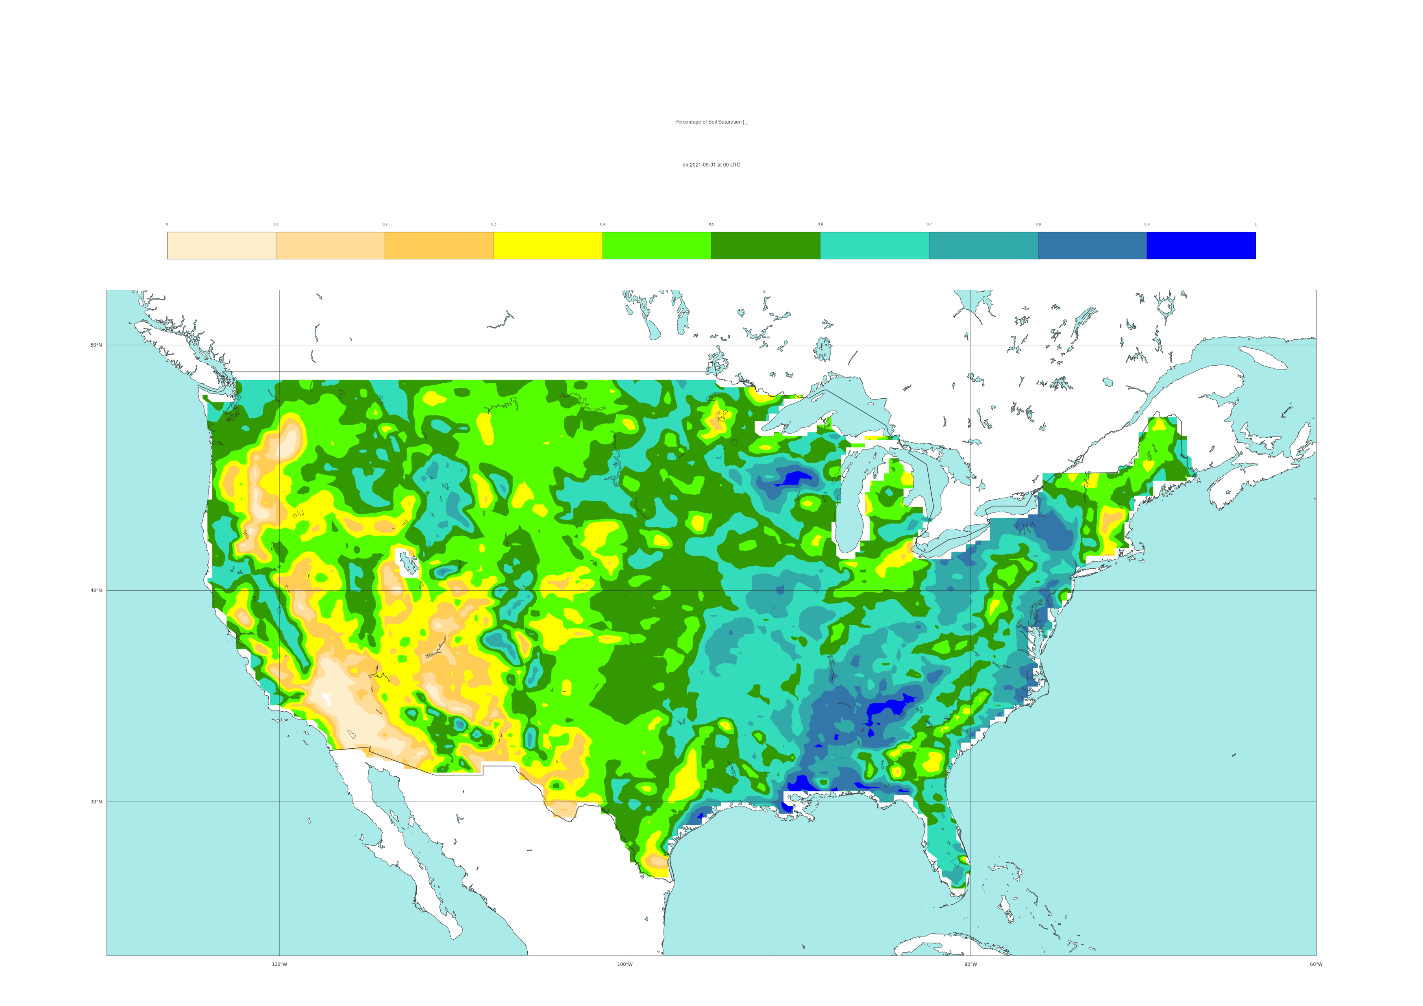

Coarse
Medium
Medium
fine
Fine
Very
fine
Organic
Tropical organic
50 °N
40 °N
30 °N
a
120 °W
100 °W
80 °W
[%]
0
10
20
30
40
50
60
70
80
90
100
50 °N
40 °N
30 °N
b
120 °W
100 °W
80 °W

