Slide 1
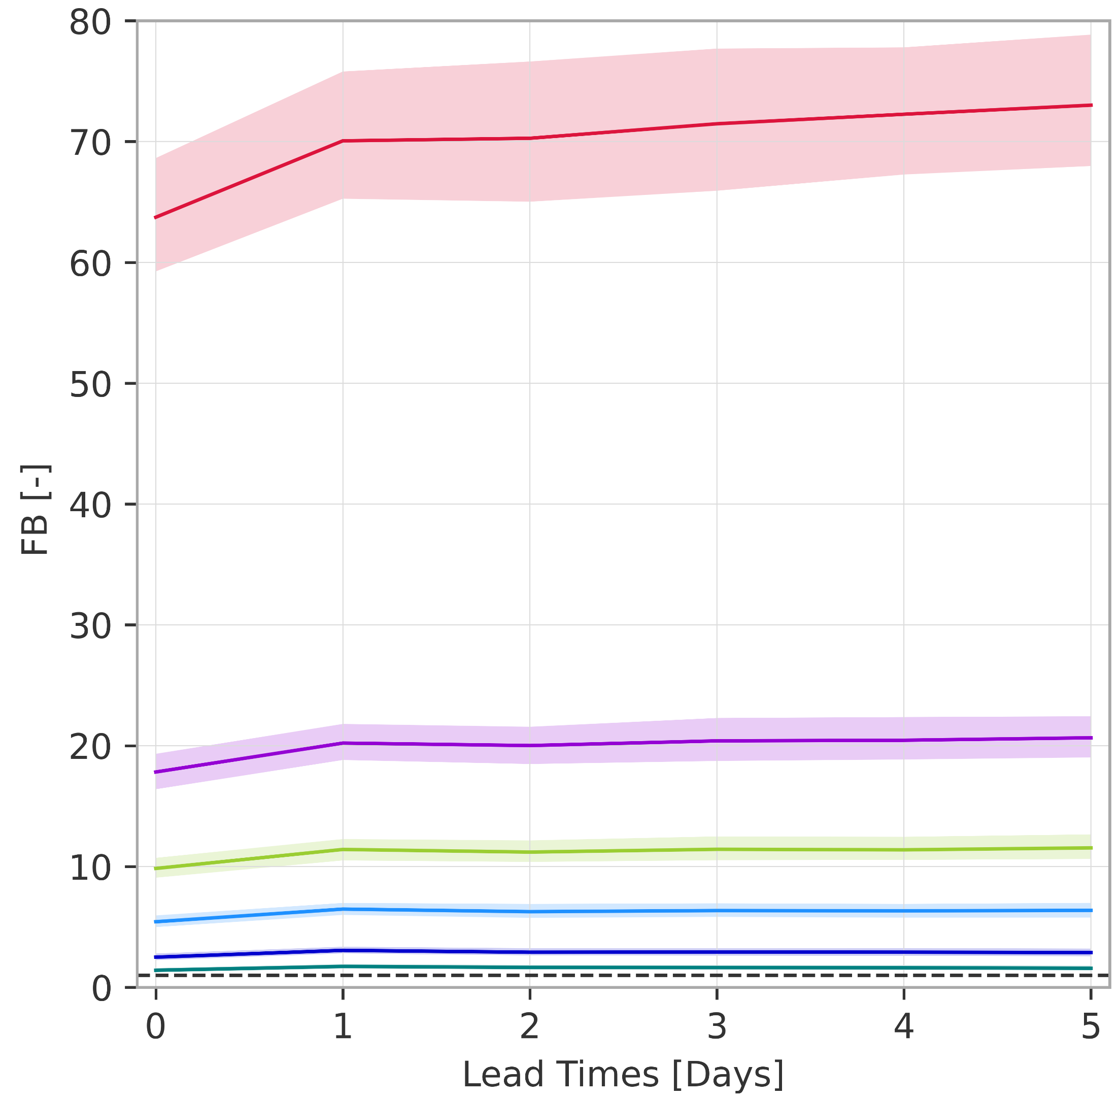
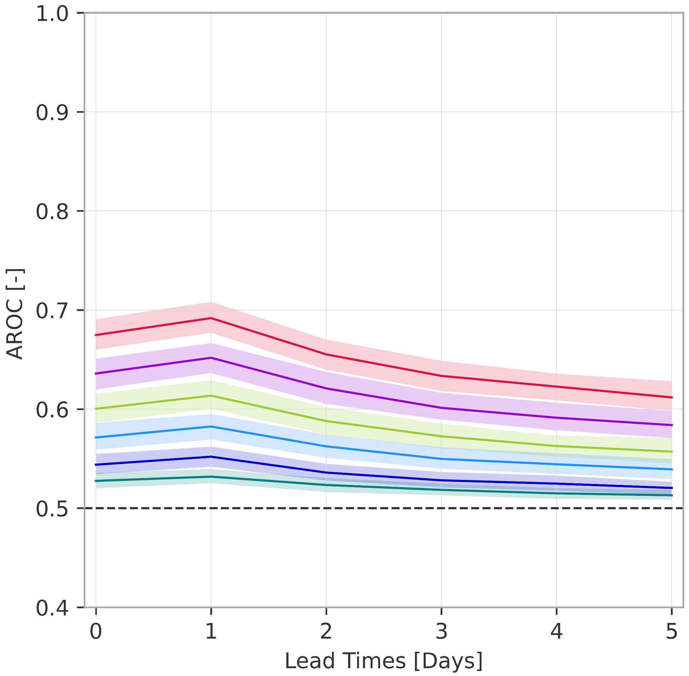
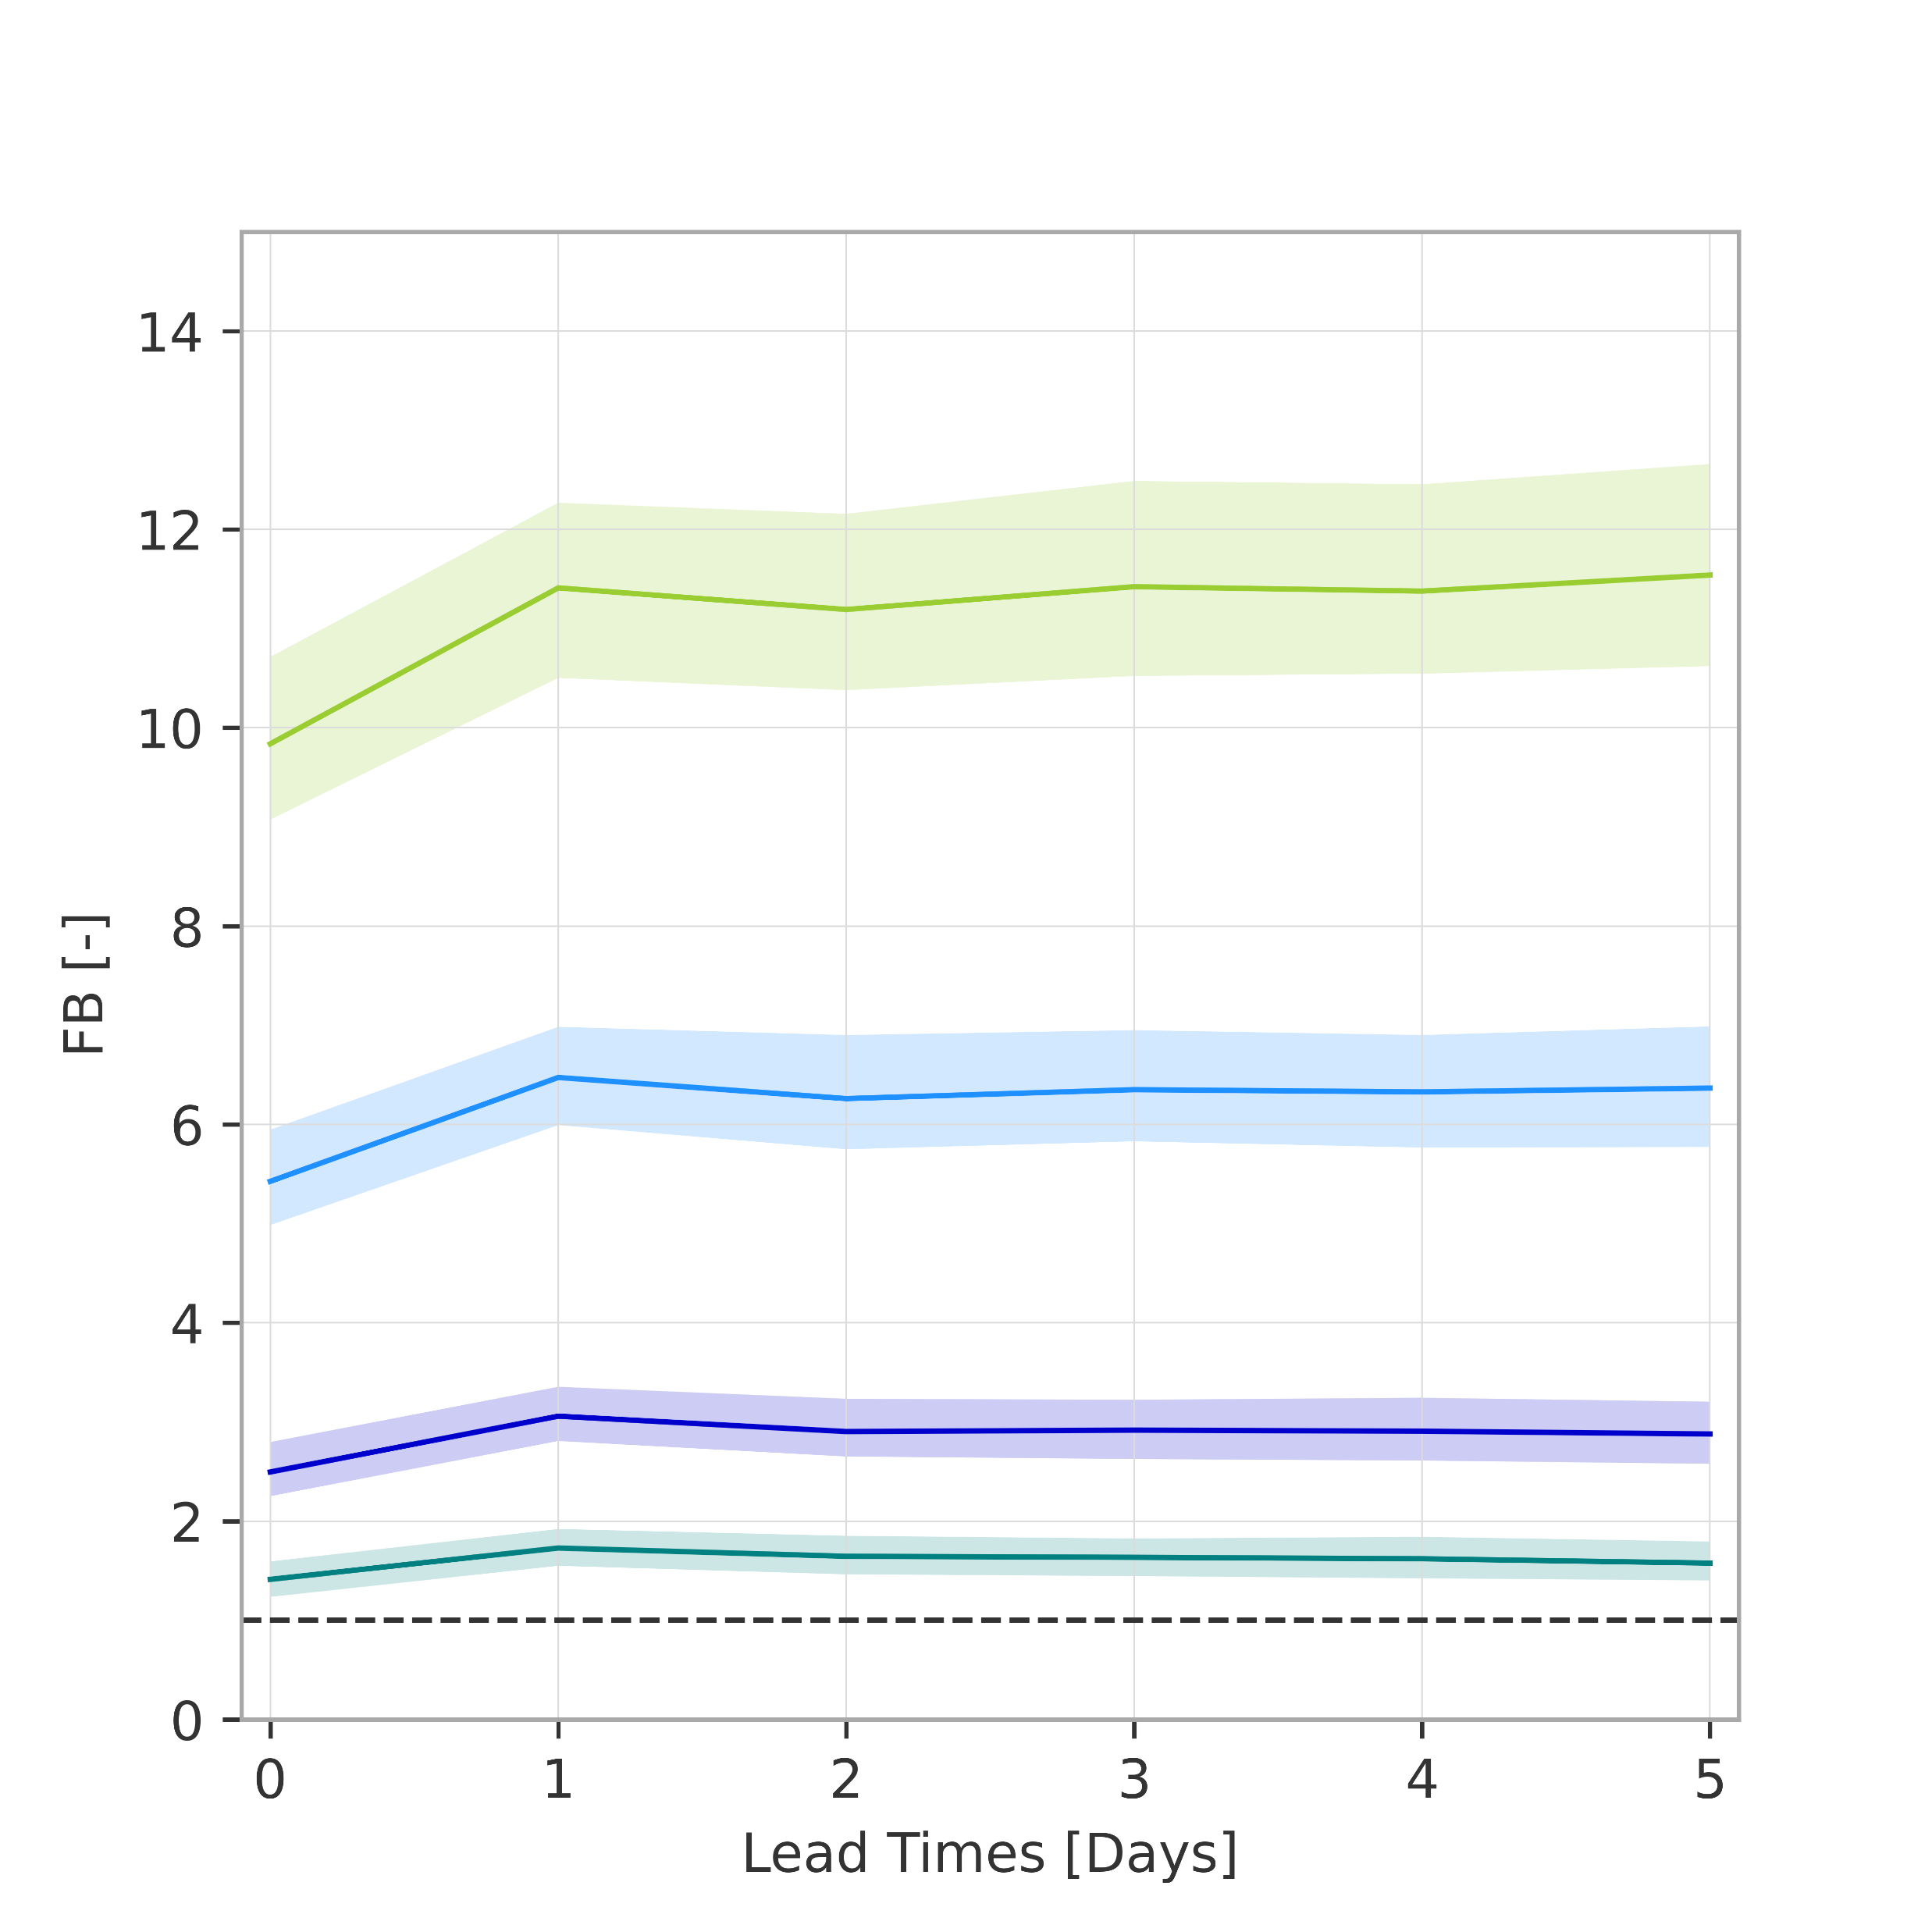
Overall verification scores (rainfall-based forecasts)
(a) Frequency bias and (b) Area under the ROC curve
1-year return period (CI 99%)
20-year return period
.
.
5-year return period
50-year return period
.
.
10-year return period
100-year return period
.
b
14
better
a
10
6
2
FB = 1
(perfect bias)
0
1
2
3
4
5
better
AROC = 0.5 (no skill)

