Slide 1
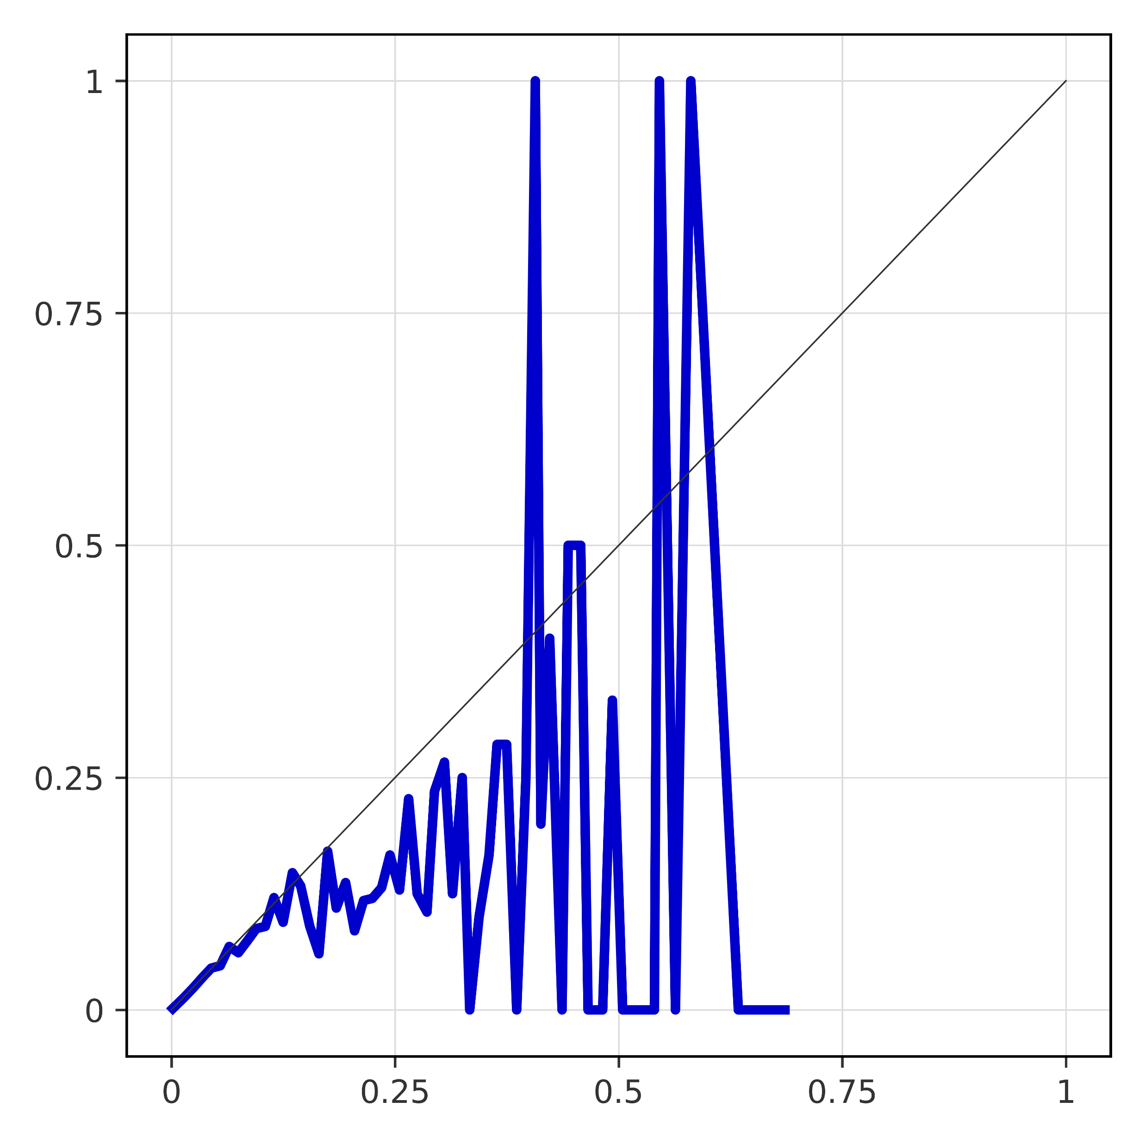
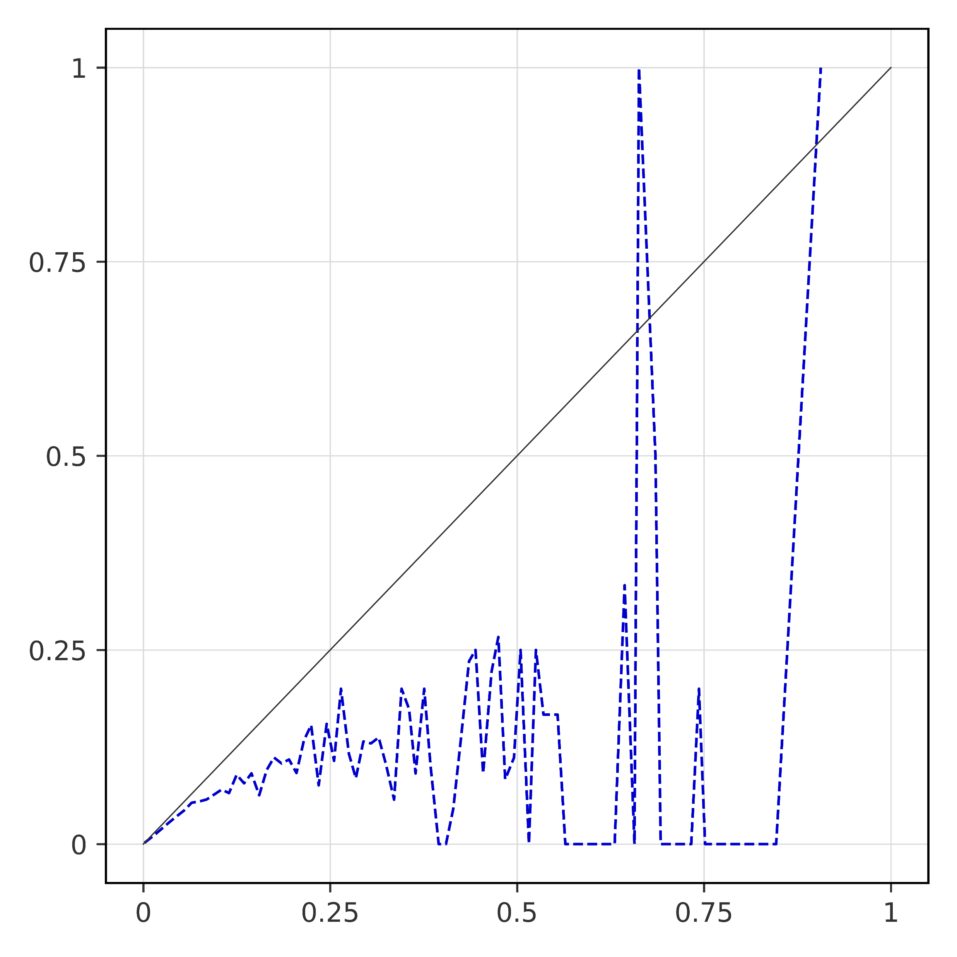
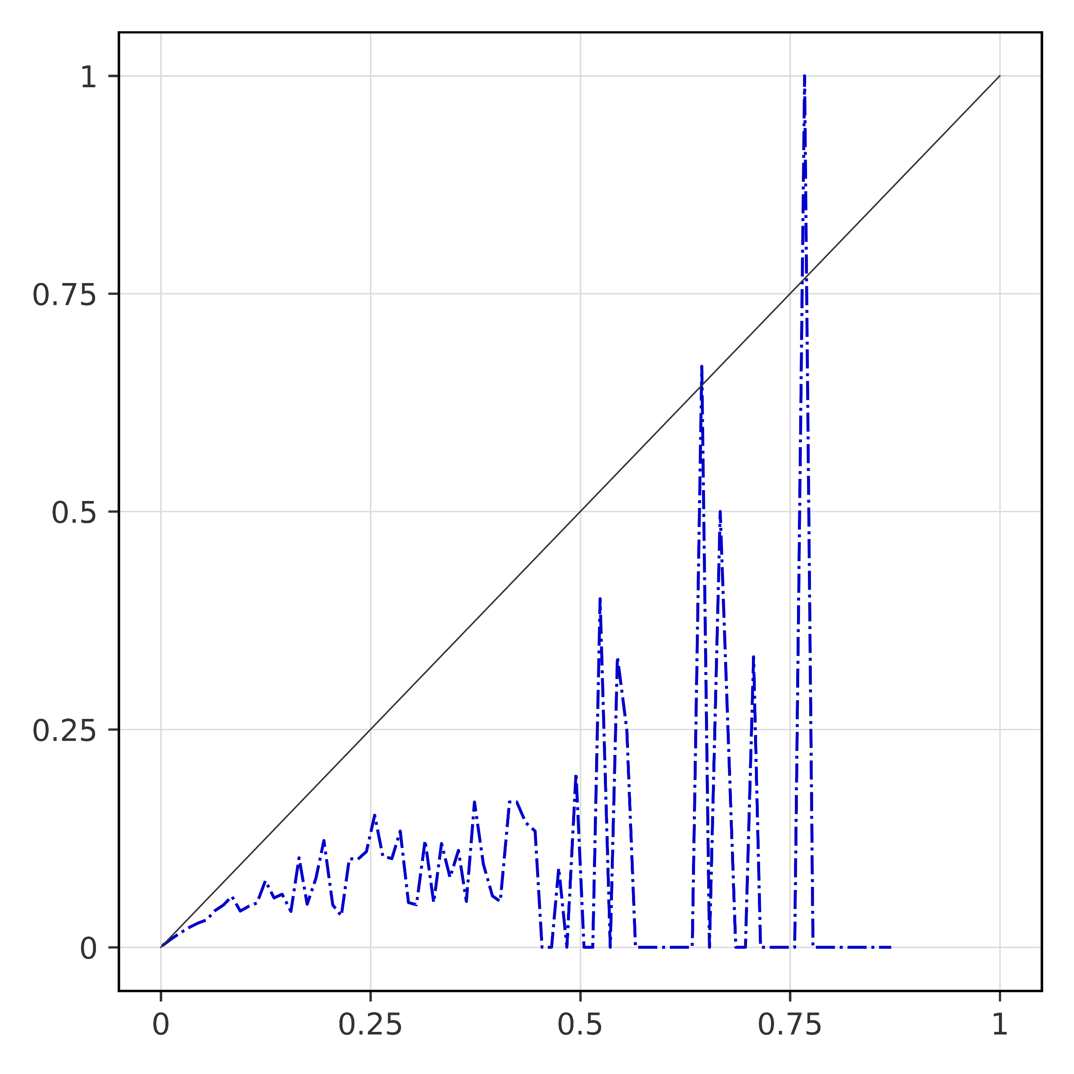
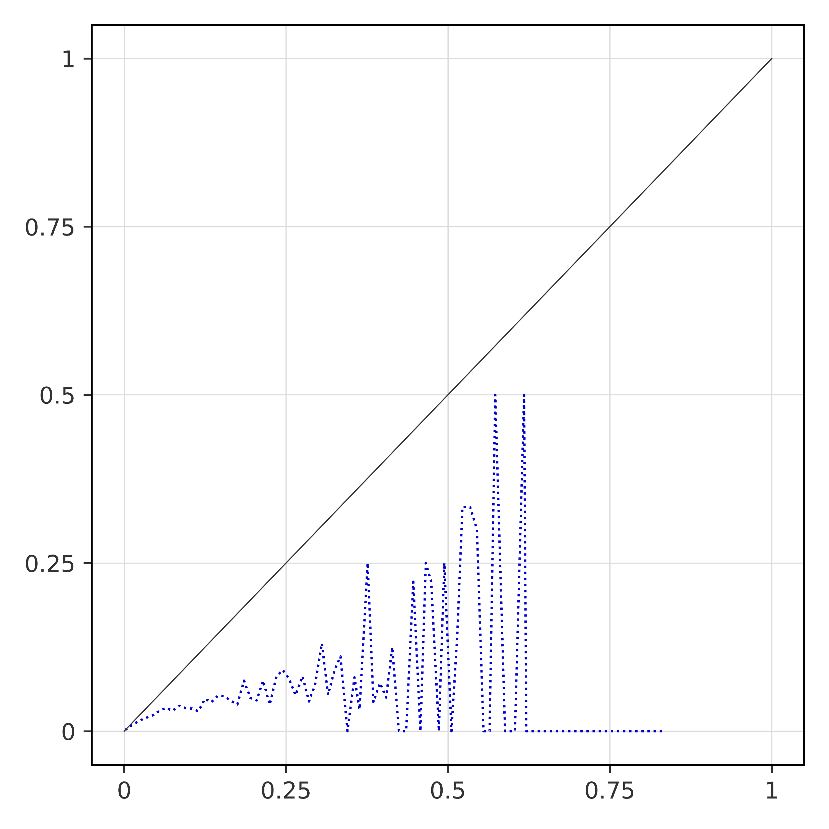
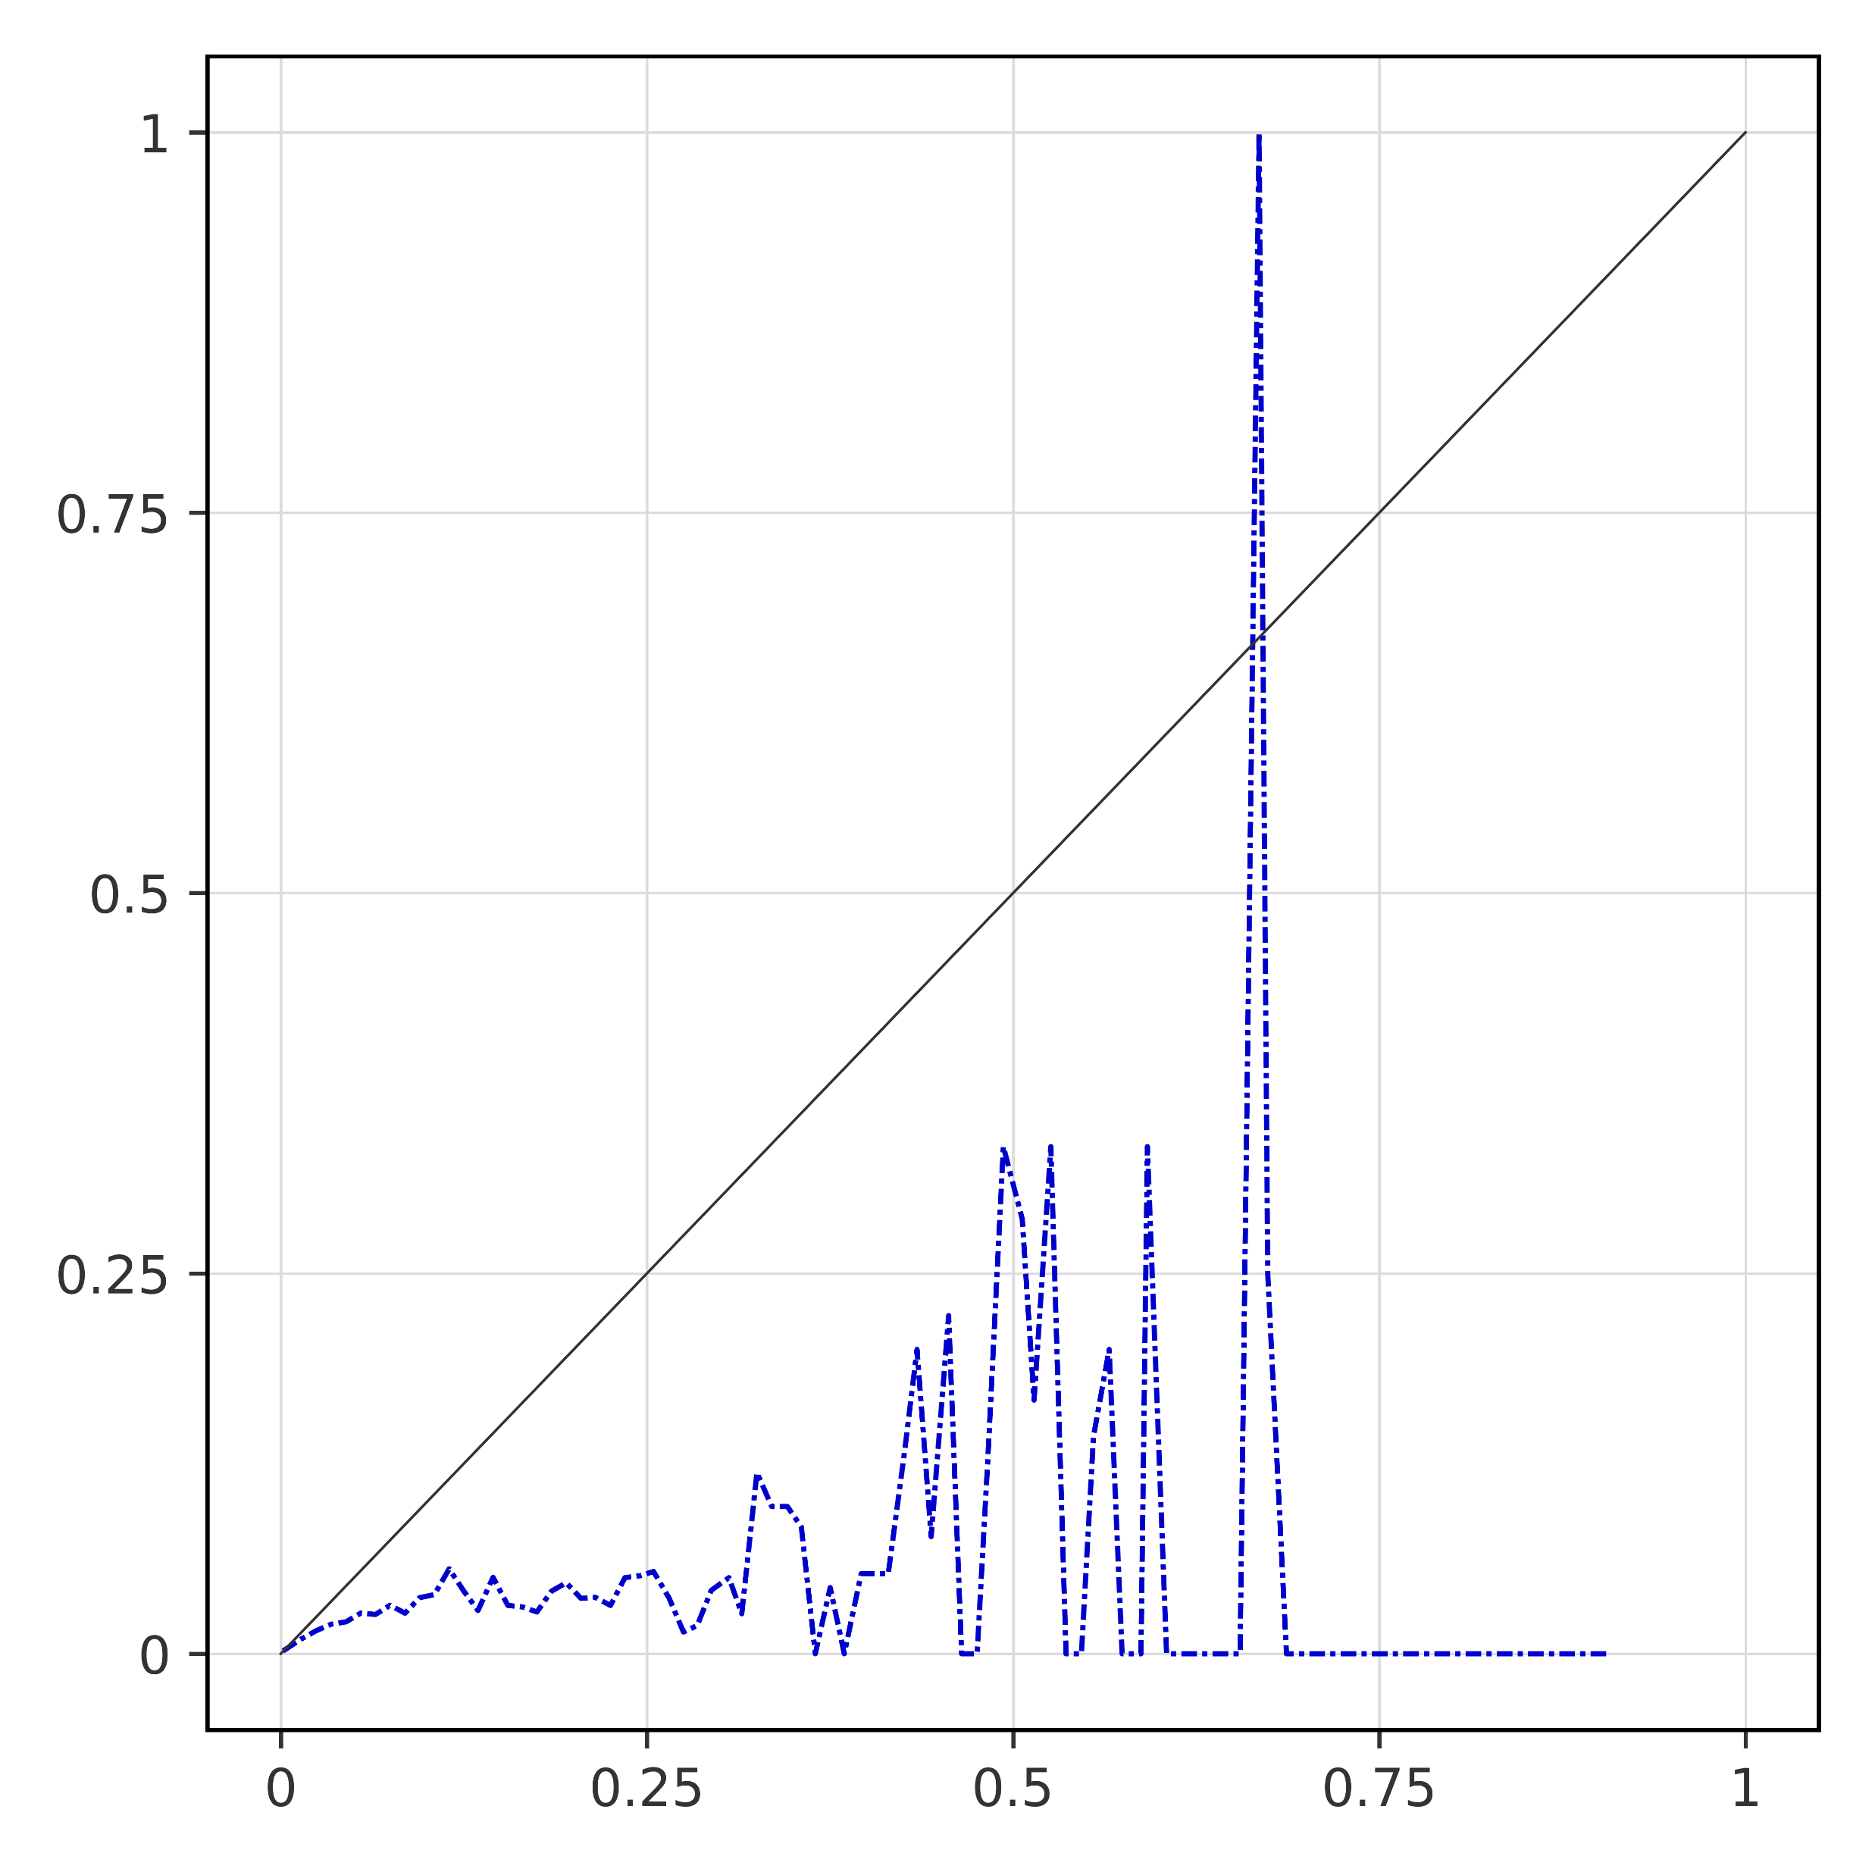
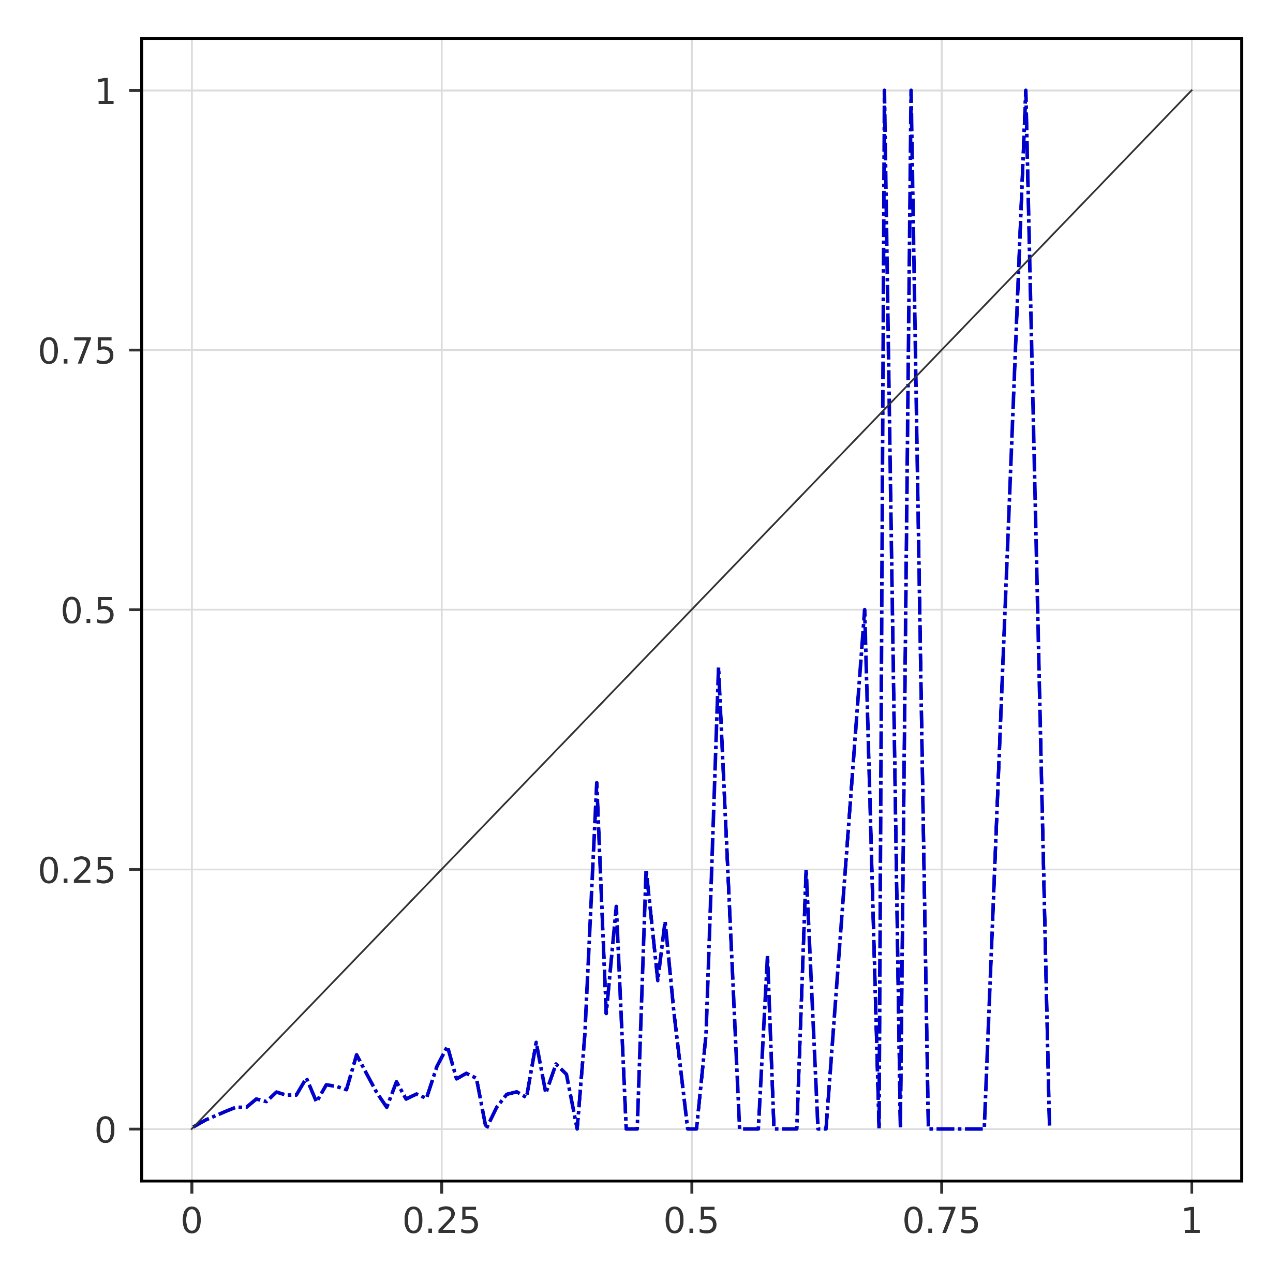
Breakdown verification scores (data-driven forecasts)
Reliability diagrams
a) short-range forecast (reanalysis)
b) long-range forecast (t+0,t+24)
Observed frequencies
c) long-range forecast (t+24,t+48)
d) long-range forecast (t+48,t+72)
Observed frequencies
e) long-range forecast (t+72,t+96)
f) long-range forecast (t+96,t+120)
Observed frequencies
Forecast probabilities
Forecast probabilities

