Slide 1
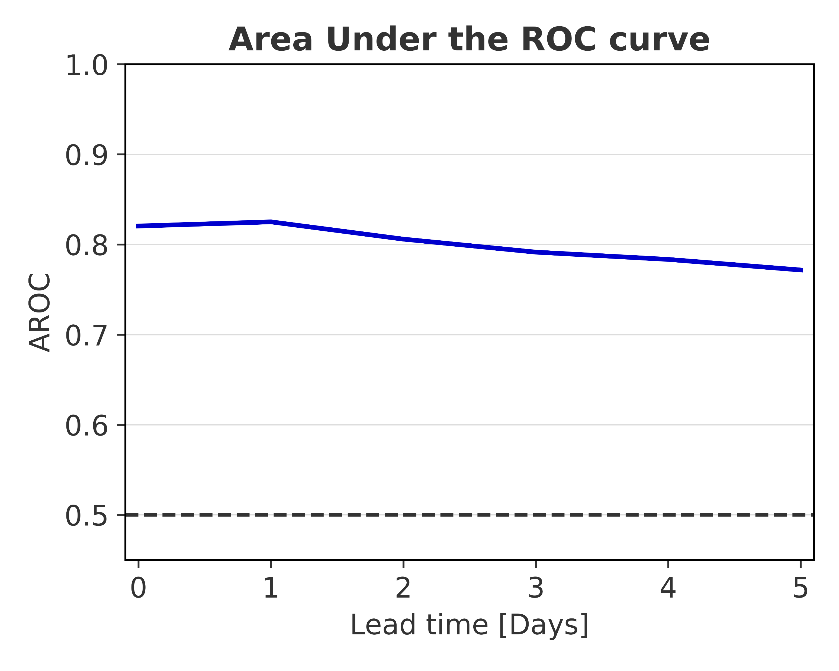
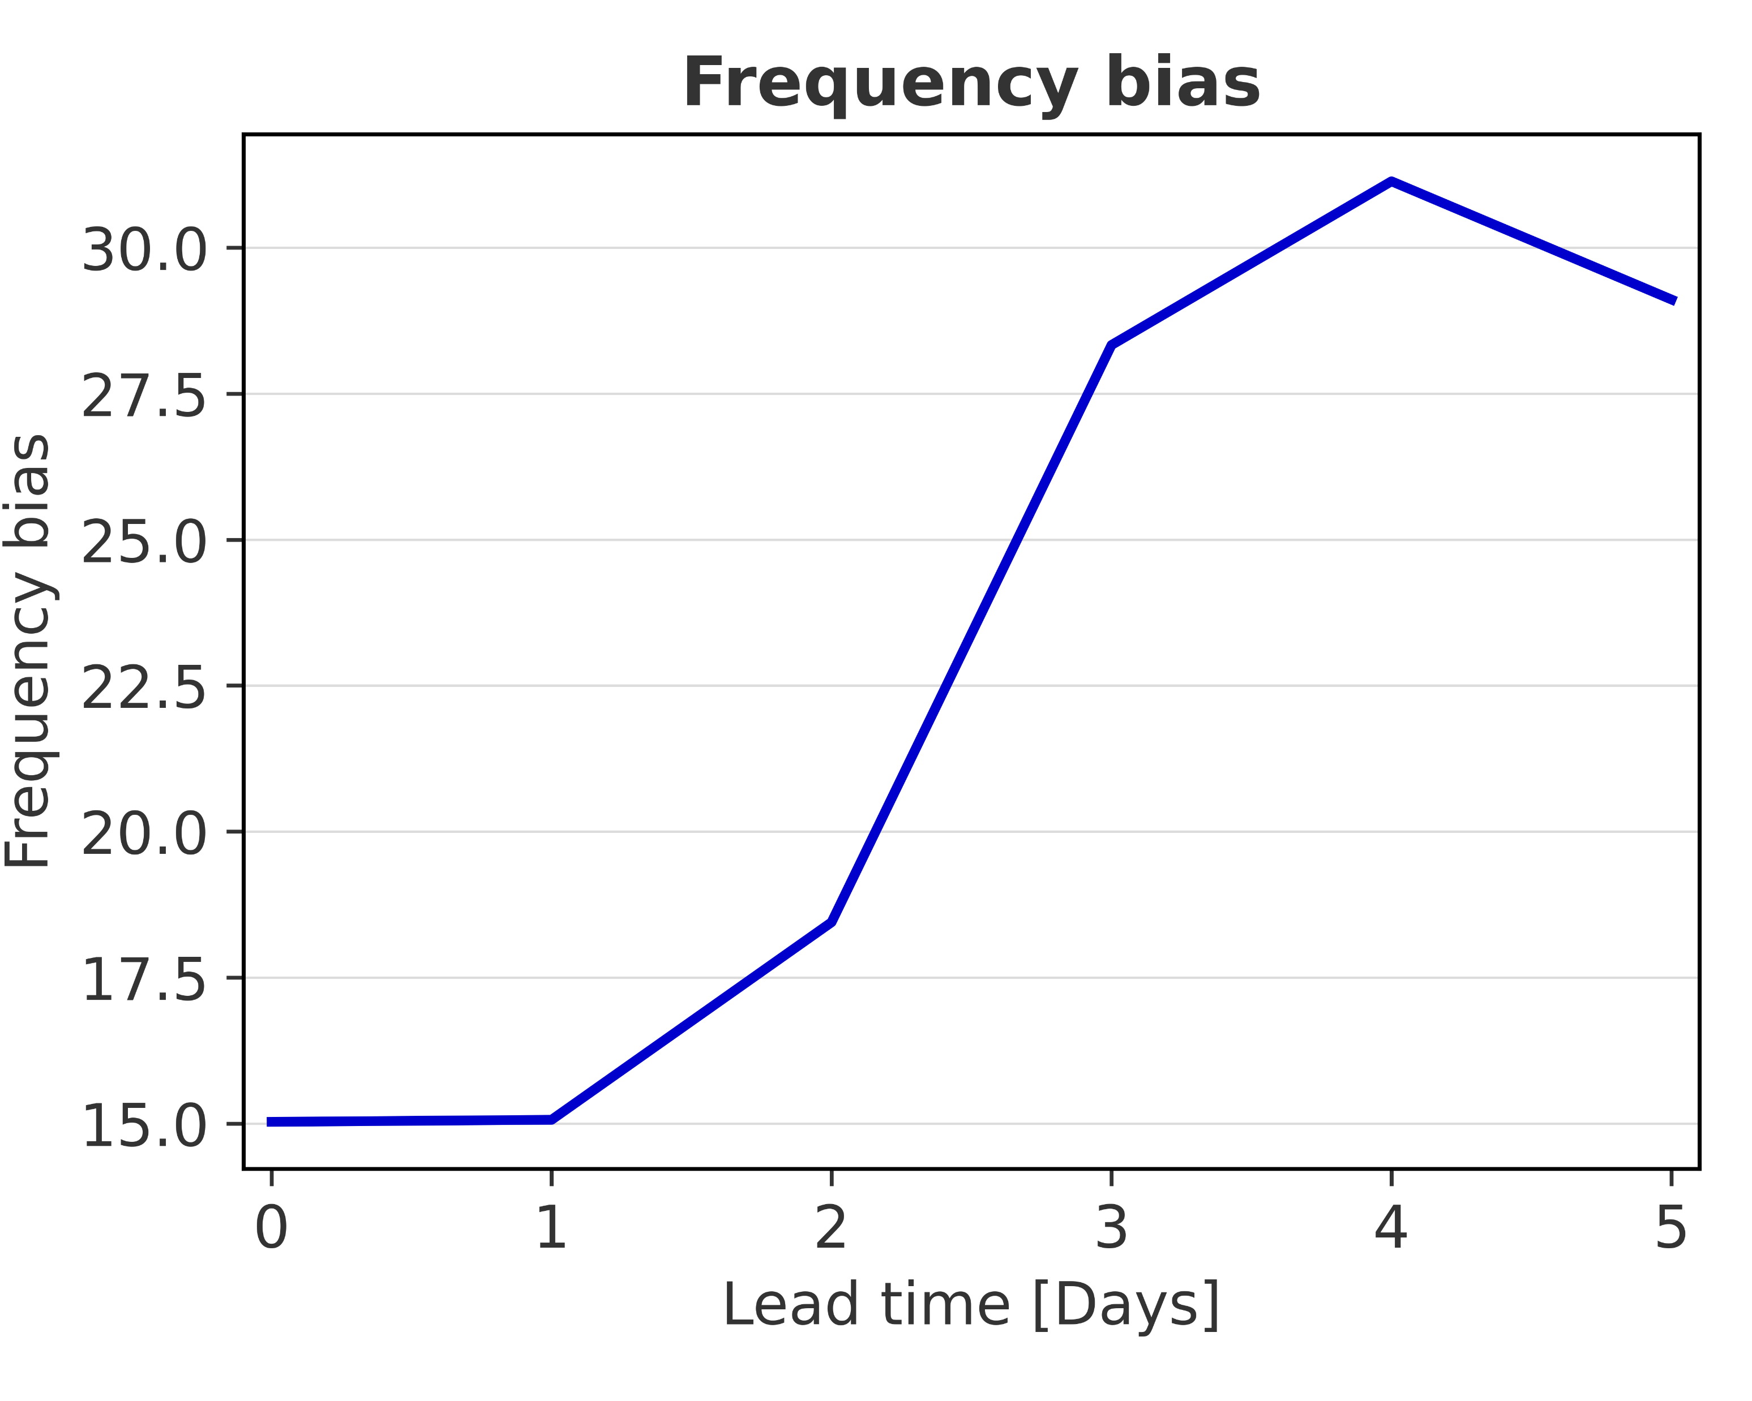
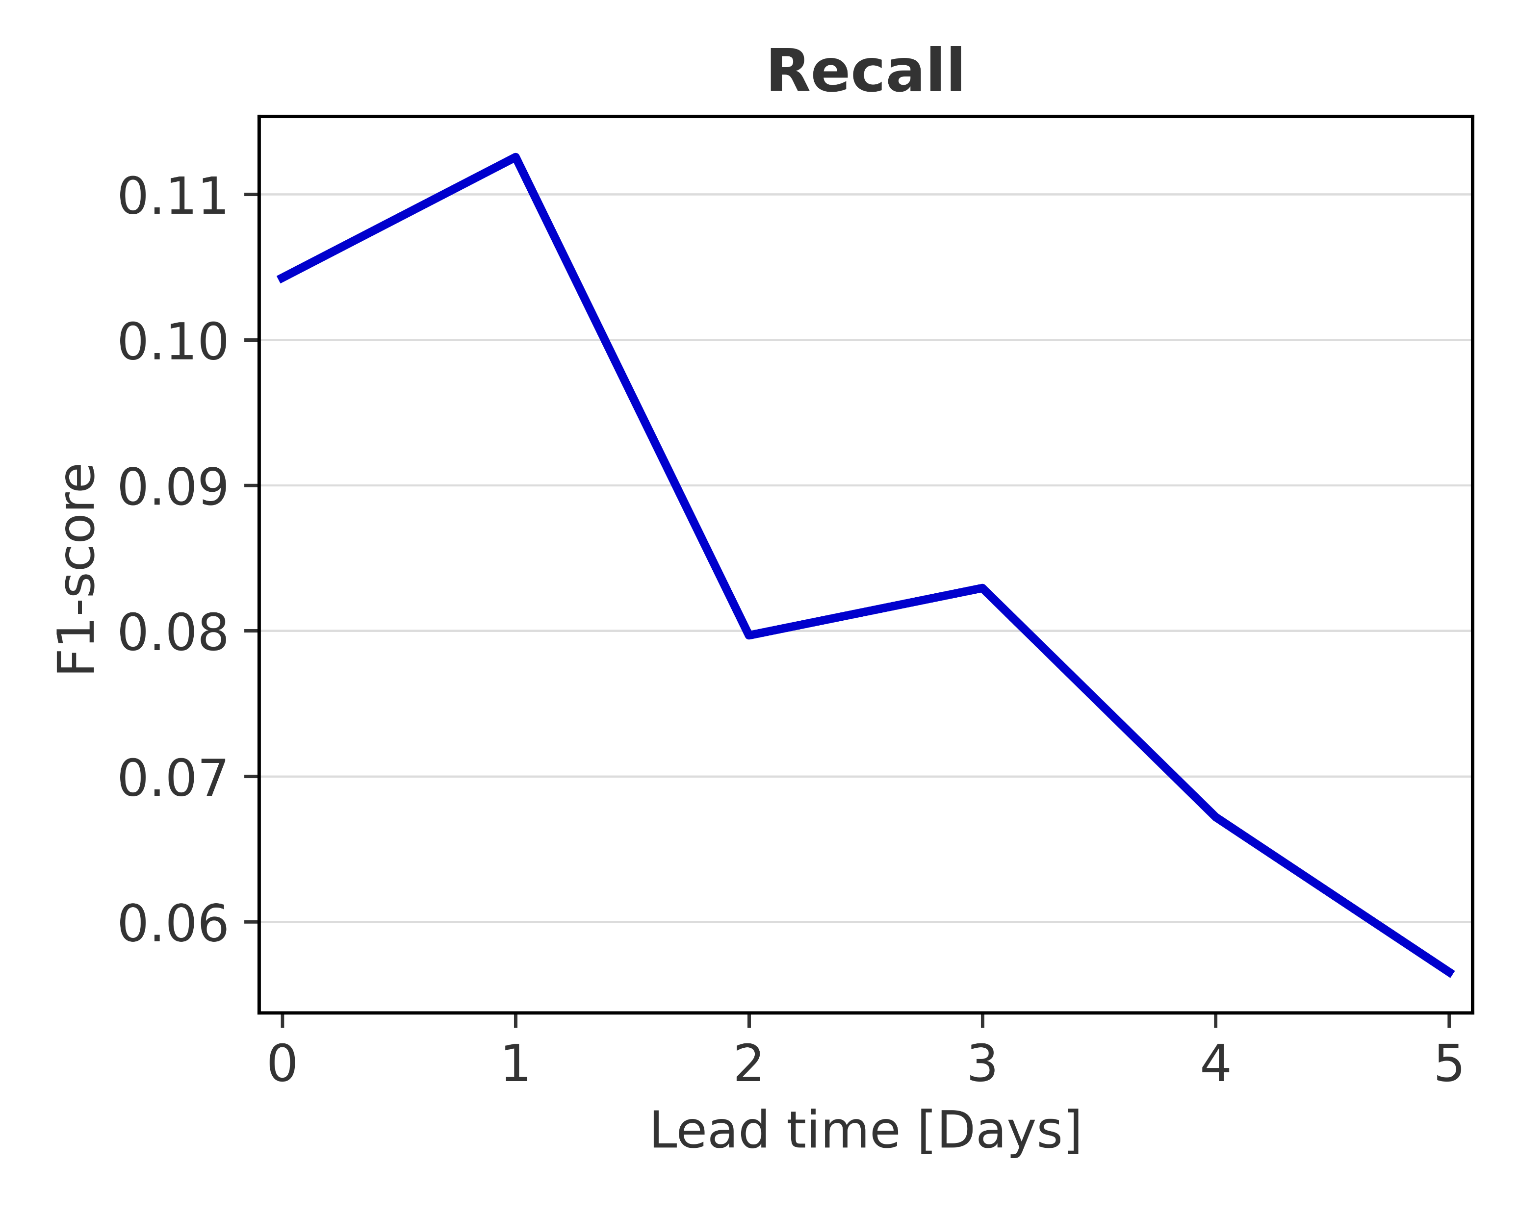
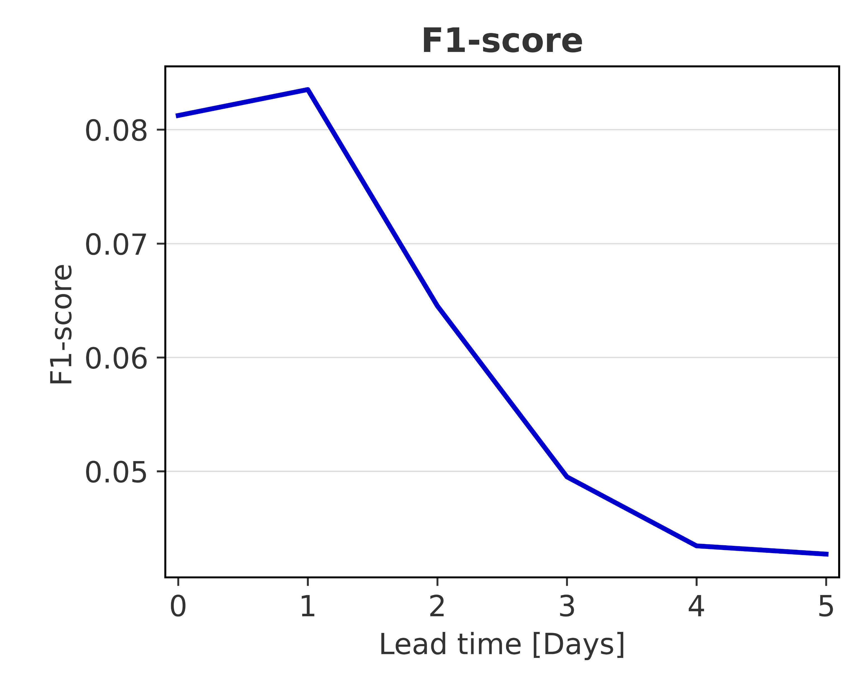
Overall verification scores (data-driven forecasts)
Area under the ROC curves, frequency bias, recall, and F1-score
Lead Time 0 = short-range forecast (reanalysis) Lead Times 1 to 5 = long-range forecasts

