Slide 1

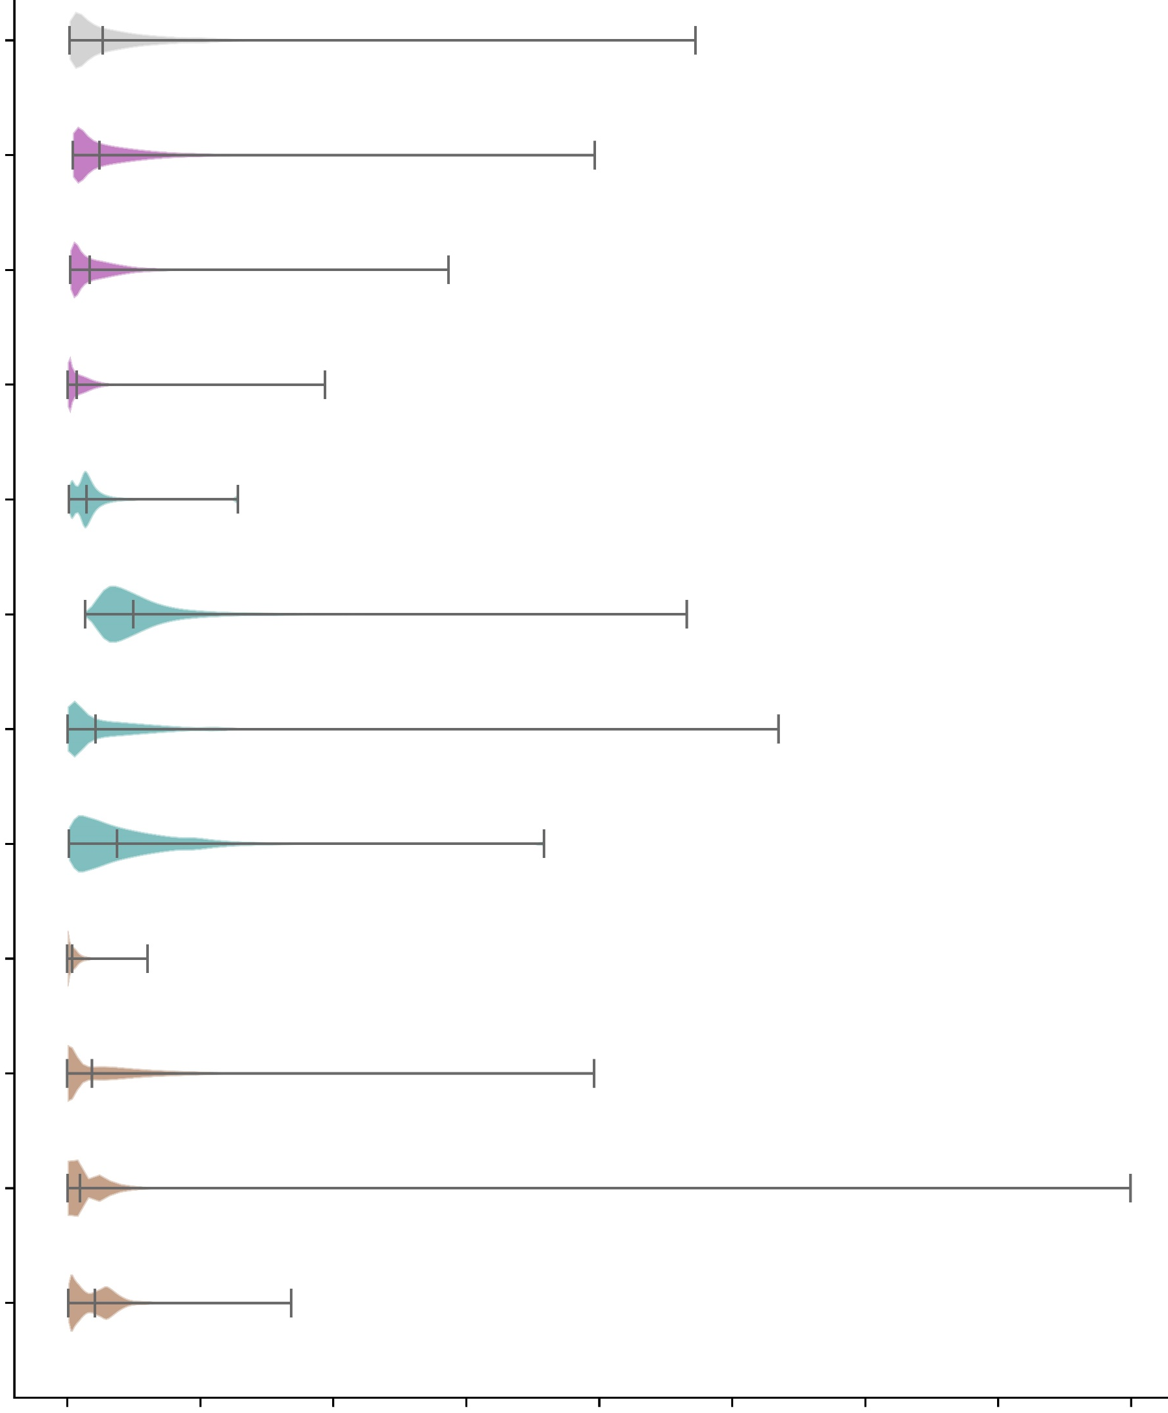

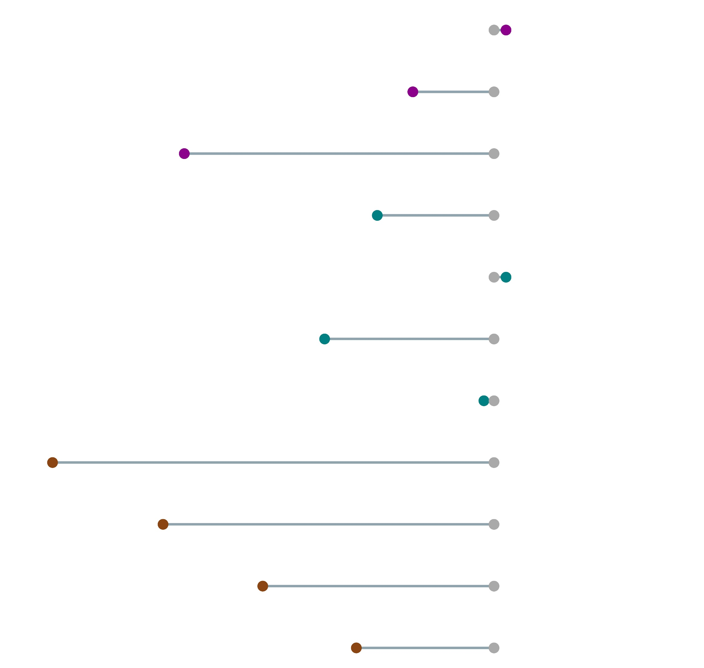










Sensitivity analysis for the global extension of the XGBoost’s US-focused training
Verification period (VP): 01-01-2021 to 31-12-2024
0
100
Distribution of predicted probabilities of having a flash flood in a grid-box
Flash flood signal: percentage difference in no. of grid-boxes exceeding the climatological average probability (=0.08%) of having a flash flood event
% of flash flood reports used for training
All data
247953
APPROACH 1
Training carried out with randomly reduced number of flash flood reports over the full domain
90%
+1.42 %
50%
-9.56 %
10%
-36.50 %
-13.75 %
APPROACH
Training carried out over only over a part of the domain
(+ 1.42 %)
(-19.96 %)
(-1.18 %)
(-52.04 %)
APPROACH 3
Training carried out with flash flood reports over a part of the domain
(-39.00 %)
(-27.25 %)
(-16.22 %)
No. grid-boxes exceeding climatological average probability of having a flash flood
0
2
4
6
8
10
12
14
16
Probabilities [%]

