Slide 1

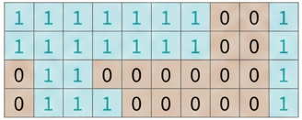
Hydro-meteorological data-driven predictions of areas at risk of flash floods
Defining yes- and non-events
Forecasts of probability of flash flood (%, grid-scale)
NO
Is the forecast
>= probability threshold
(optimised on the F1-score)
YES
Non-event
(no flash flood risk)
0
Yes-event
(flash flood risk)
1
Rainfall-based predictions of areas at risk of flash floods (binary field)

